Slide 1
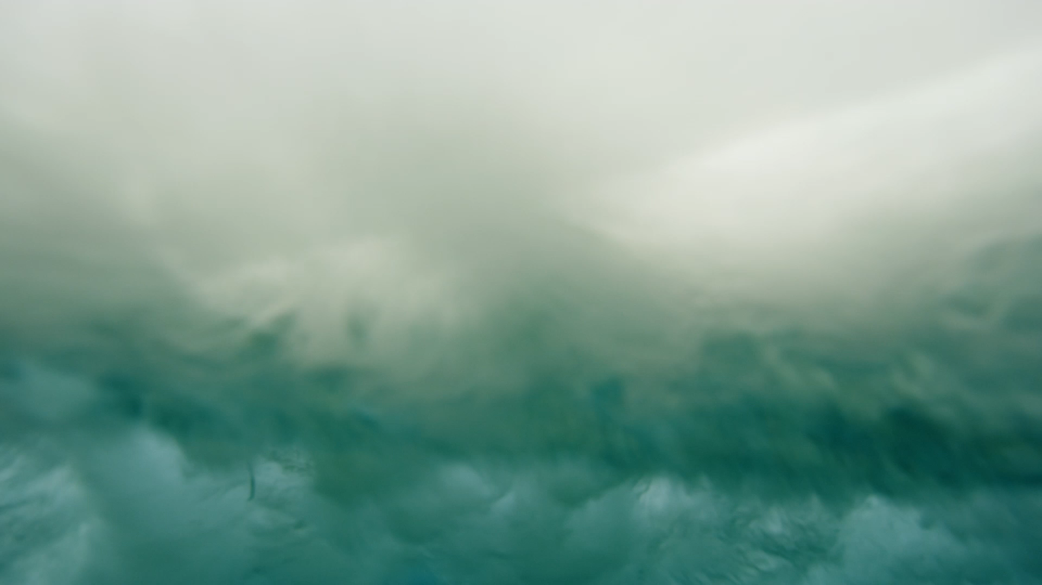

Waves, Currents and Tides
6th Grade Earth Science
with
Ms. Tametria Gadson

Slide 2
AKS 3e
I will analyze and interpret data to create graphic representations of the causes and effects of waves, currents, and tides in Earth’s systems.

Slide 3
Waves
The up and down movement of energy on the surface of water.
Carries or transfers energy
Caused by:
Wind moving across the surface of water.
Volcanoes
Earthquakes
Landslides
Types:
Tsunamis
ripple

Slide 4
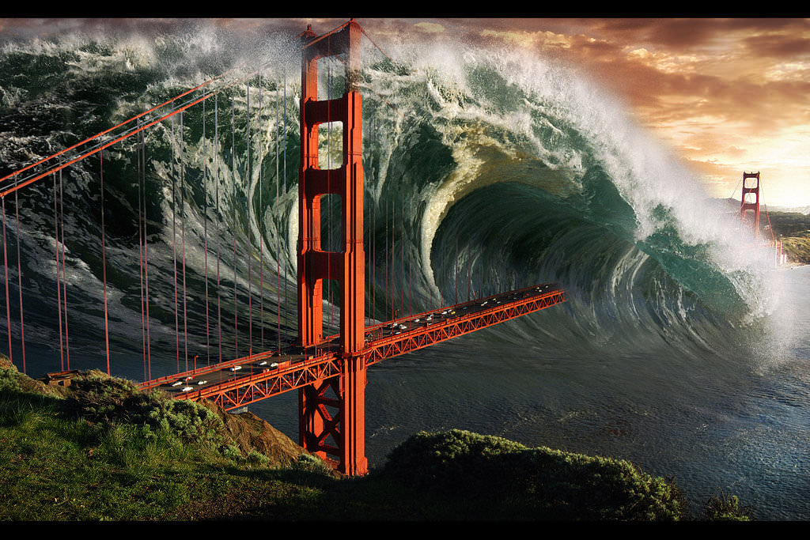
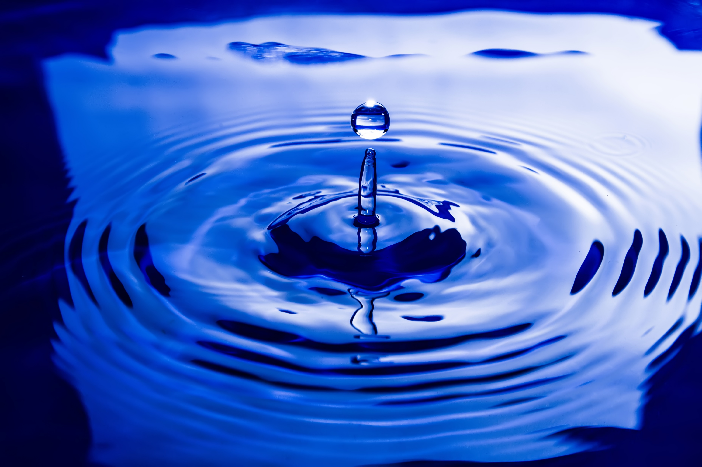
Wave examples
This Photo by Unknown Author is licensed under CC BY
Tsunami
Ripple

Slide 5
Currents
Continuous flow of water in the Ocean. Or, the constant movement of water in a river or ocean.
Move in a circular path
Caused by:
The wind
Changes in temperature and salinity
Coriolis affect--Weather and climate
Types:
Surface currents
Deep ocean currents

Slide 6
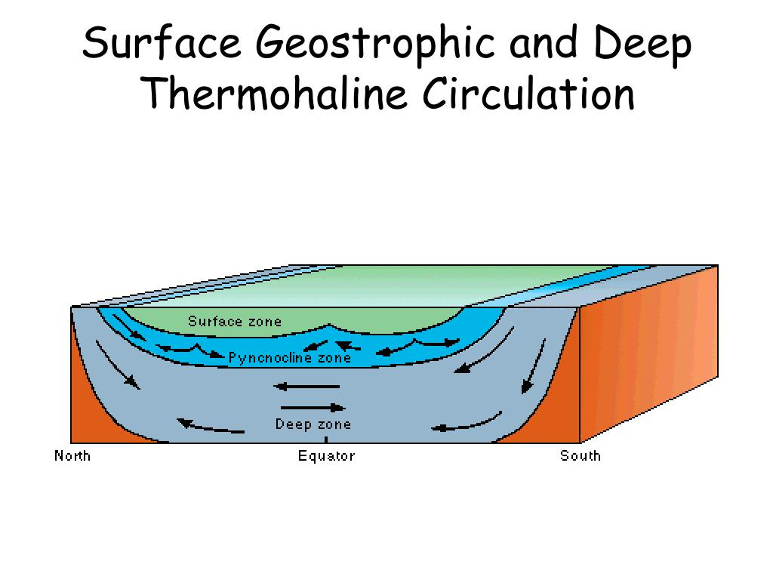
Current examples
Surface
Deep Ocean

Slide 7
Tides
The continuous rise and fall of water in seas and oceans
The moon has the biggest effect on tides.
Caused by:
Gravitational Pull of the sun and moon
Types:
Low tides
High tides
Neap tides
Spring tides
Everyday
Tied to the moon cycle = 2x a month

Slide 8
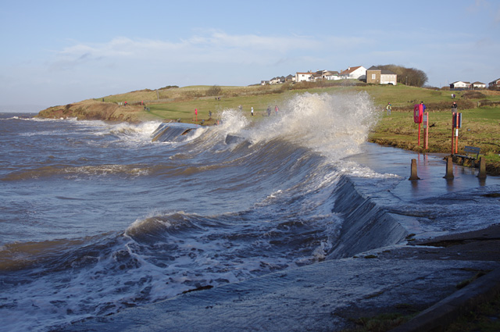
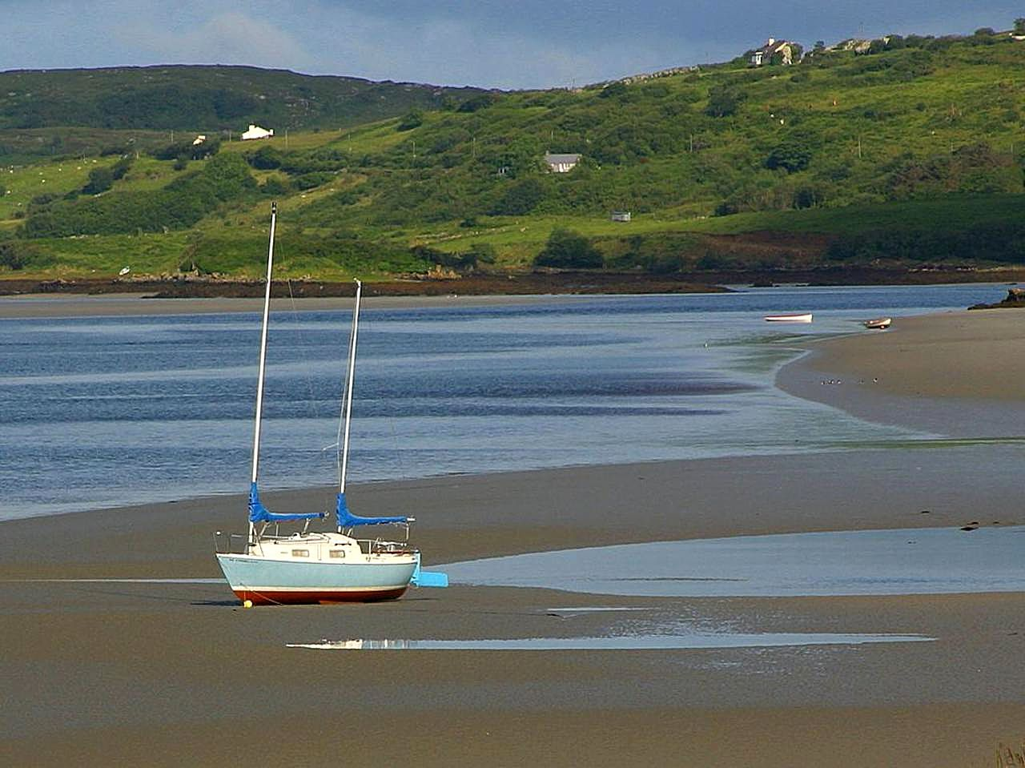
Tide examples
High Tide
Low Tides are 90 degrees away from the moon.

Slide 9
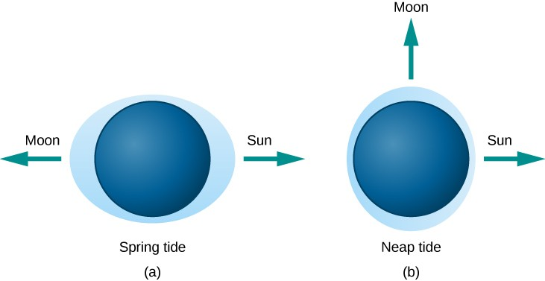
Tide examples

Slide 10
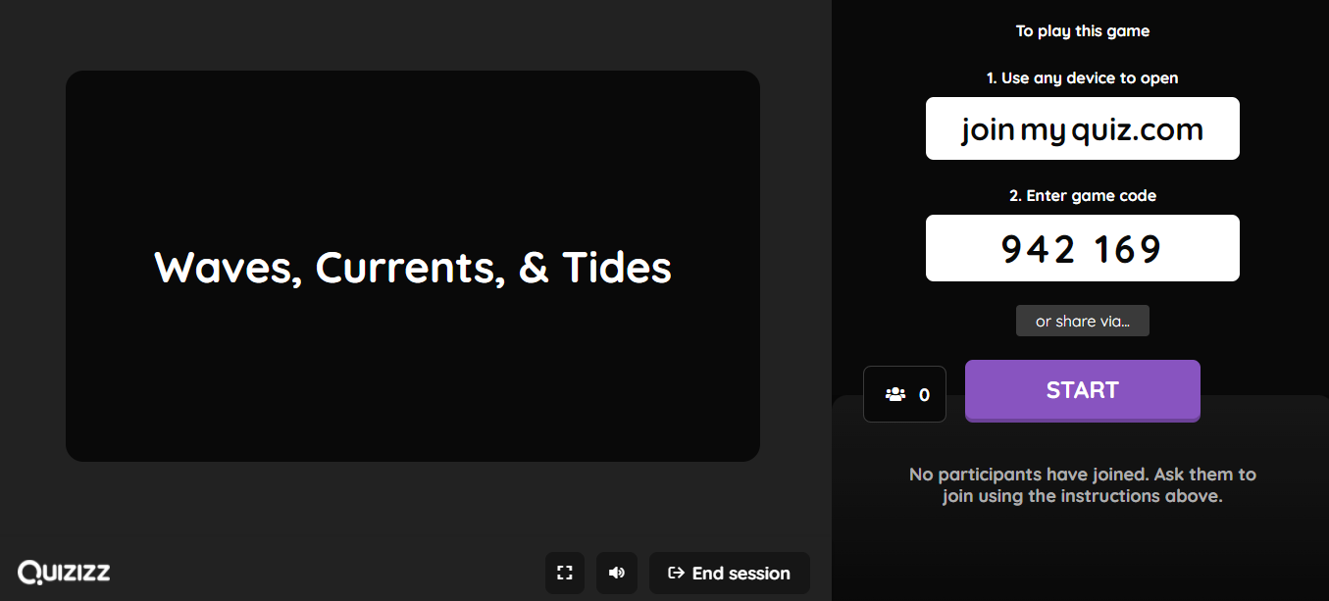
QUIZIZZ (We DO)
This is an instructor lead quizizz. The quiz will start once all students have joined.

Slide 11
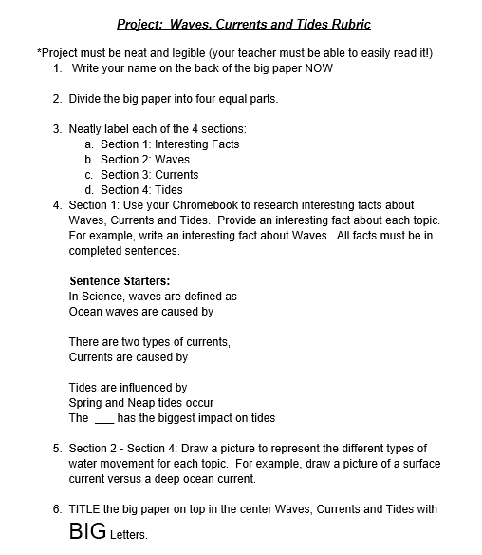
Waves, Currents and Tides Project (You DO)

