Slide 1
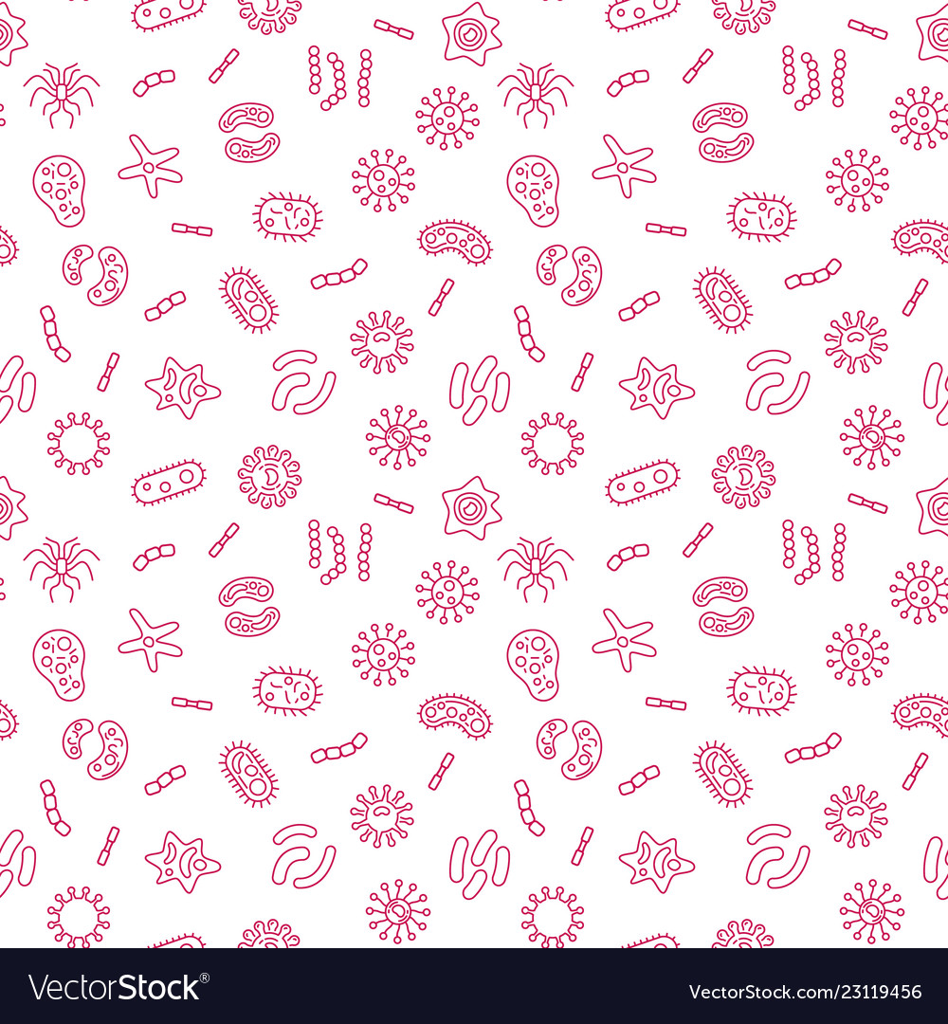
Introduction to Microbiology & Viruses

Slide 2
What are microbes?

Slide 3
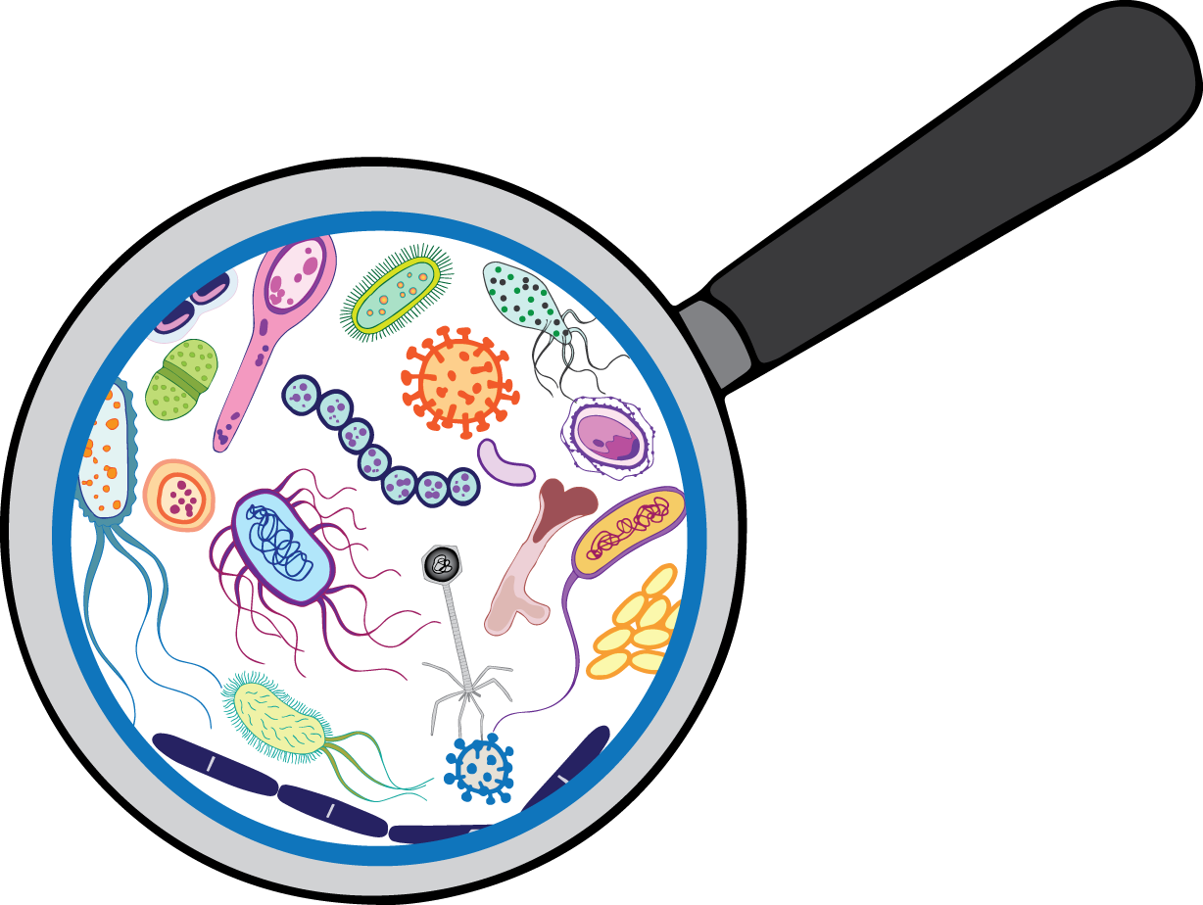
What are microbes?
A microbe is any organism that is too small to be seen by the eyes alone.
This includes helminths, protozoans, fungi, mold, algae, bacteria, and viruses!

Slide 4
What are some microbes that you already know?

Slide 5
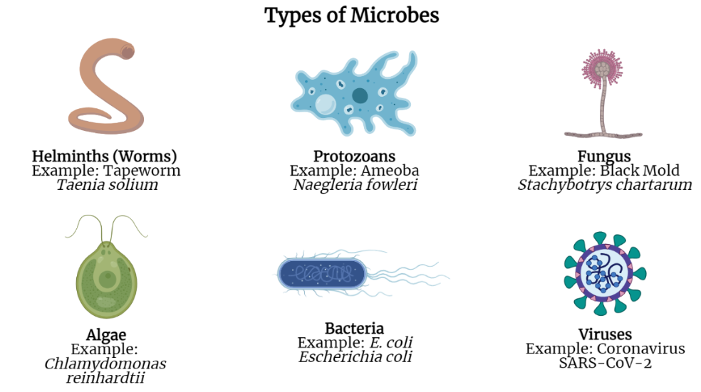

Slide 6
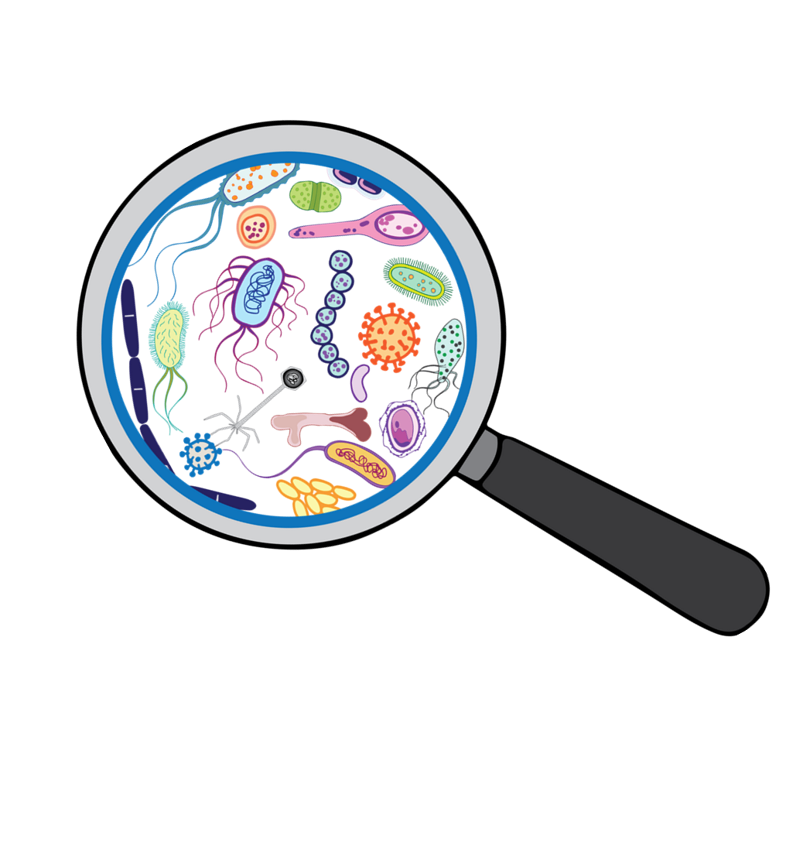
Let’s see how small microbes really are!
Make a prediction. List the following items from largest to smallest:
Coffee Bean
E. coli Bacteria
Skin Cell
Viruses
Grain of Salt

Slide 7
ANSWER
From largest to smallest:
Coffee Bean
Grain of Salt
Skin Cell
E. coli Bacteria
Viruses

Slide 8
Are microbes good or bad?

Slide 9
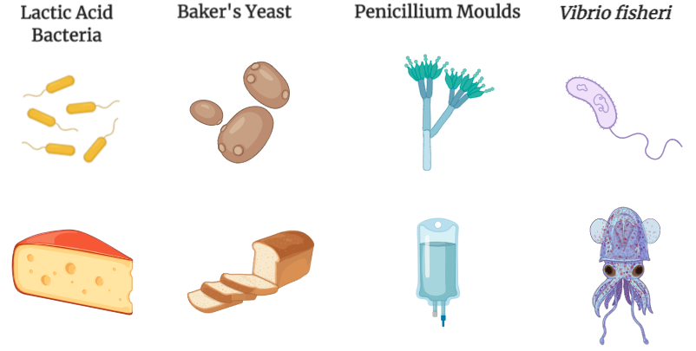

Notes:
Some microbes are beneficial, or useful! (A) For example, lactic acid bacteria is essential for fermenting milk to make cheese! (B) Baker’s yeast are microscopic organisms that are used in baking. They ferment sugar to make bread rise! (C) Many antibiotics come from microbes! Penicillin was the first antibiotic ever discovered! It is an antibiotic that is naturally produced by mold. (Why do you think a mold would produce antibiotics?). (D) Have you all seen an angler fish? Maybe a picture from the deep sea, or from the scene in Finding Nemo? Well, you know what makes the light bulb glow? Microbes! A Vibrio bacteria lives with the angler fish, in a symbiotic relationship. The Vibrio bacteria glows! (Why do you think this is a symbiotic relationship?)

Slide 10
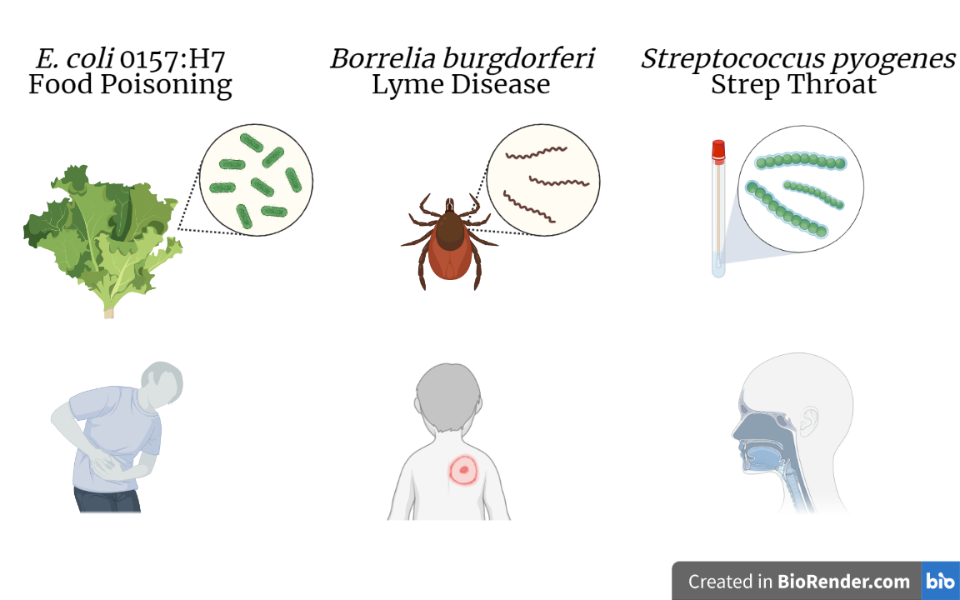
Notes:
Some microbes, however, are dangerous to humans! (A) Perhaps you’ve heard of food poisoning! Food poisoning can be caused by bacteria, like E. coli, and can come from fruit, vegetables, or meat that are not properly washed or cooked. (B) Lyme disease is caused by a type of bacteria, called Borrelia burgdorferi, that is transmitted through tick bites. A tick bite can lead to an infection. The infection is recognized by the distinct bulls-eye rash. (C) Have you ever had a sore throat? Or strep throat? Strep throat is caused by a bacteria called Streptococcus. It is contagious and spread from person to person.

Slide 11
Viruses
Notes:
Some of the most curious microbes are viruses!

Slide 12
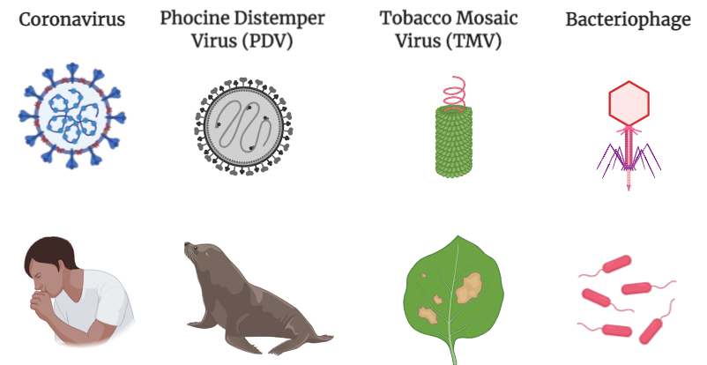
Notes:
Viruses are the smallest microbes and require a host cell to survive. In order to replicate, a virus must infect a host cell. These host cells may be cells from humans, plants, animals, or other microorganisms.
Examples of viruses. (a) The SARS-CoV02 virus infects and replicates inside human and animal cells, (b) Phocine Distemper Virus infects seals and sea lions. (C) The Tobacco Mosaic Virus infects and replicates inside a wide range of plants, especially tobacco, (c) The bacteriophage virus infects and replicates inside bacterial cell hosts.

Slide 13
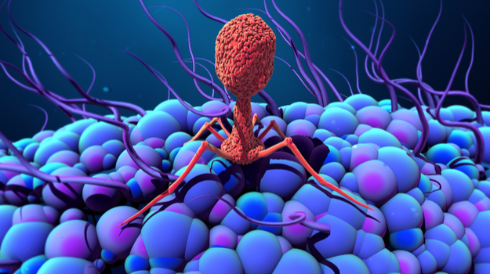
Watch Me!
Notes:
Pause At 1:10 and ask - Can you describe what has happened in this video? What do you think will happen next?

Slide 14
Let’s Build a Virus!

Slide 15
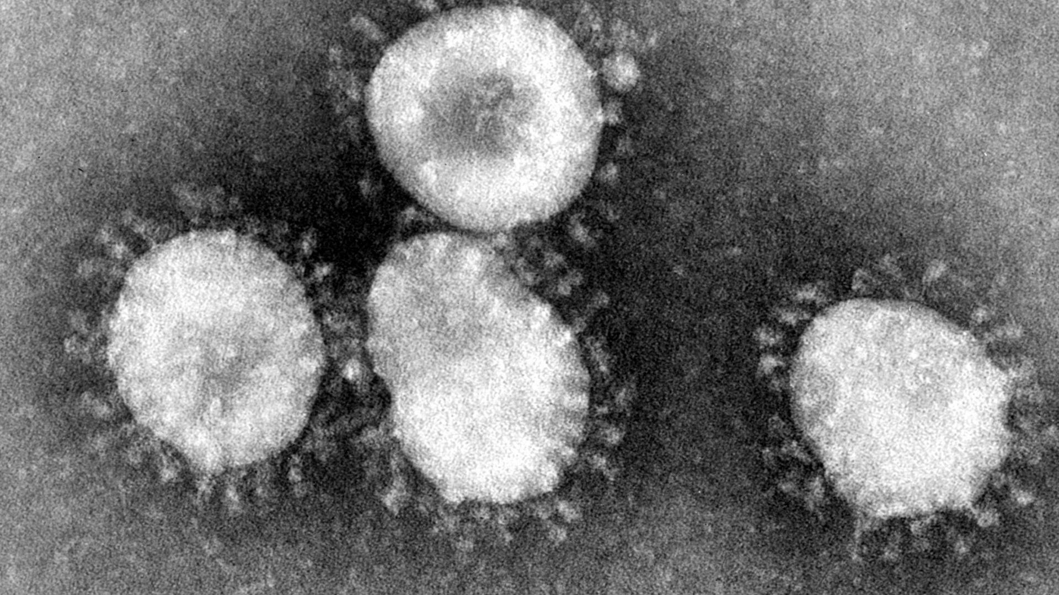
Notes:
This is an image from an electron microscope, the most powerful microscope we can use! Can anyone guess what is in this image?
This is an image of the coronavirus, SARS-CoV-2, the virus that causes COVID-19. What do you see in this image? What parts of the virus can you see? Draw what you see in this image.

Slide 16
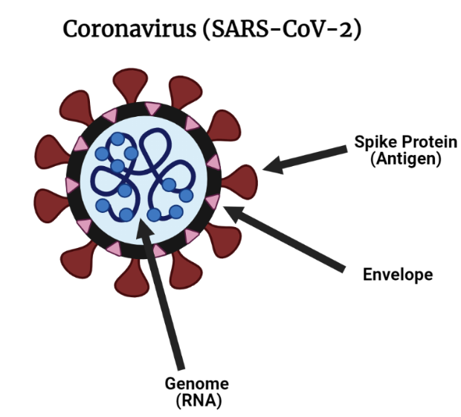
Notes:
Now, add labels to your drawing!
The Spike Protein (outer protein) is the part of the virus that attaches to cells. It is used to infect cells!
The envelope (outer layer) is like a gum wrapper, keeping all of the components together! This is analogous to a cell membrane.
The virus genome is all the genetic material of the Virus (stored as RNA).

Slide 17
Predict: What happens when the SARS-CoV-2 virus enters the body?

Slide 18
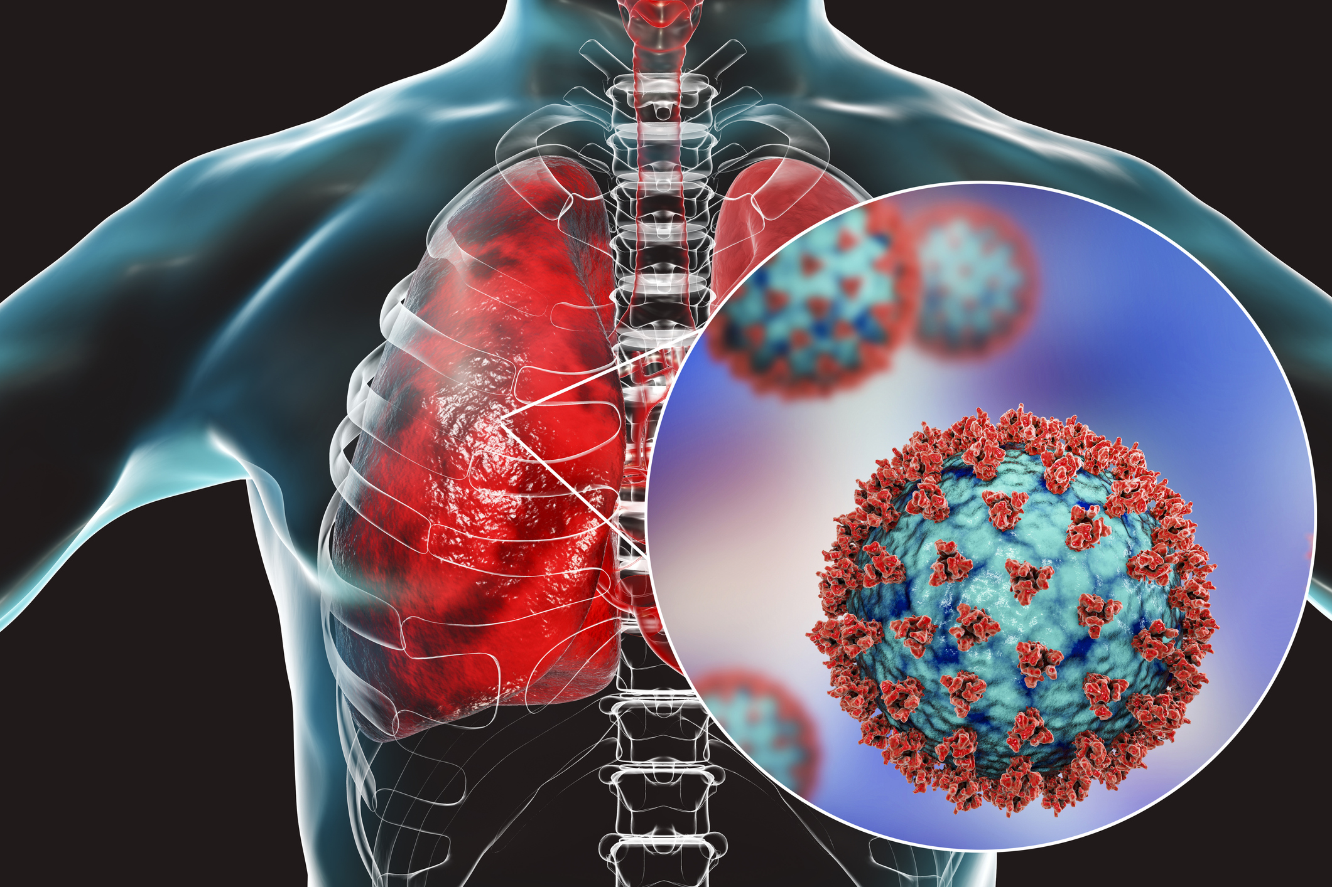
Watch Me!

Slide 19
What is a mutation?

Slide 20
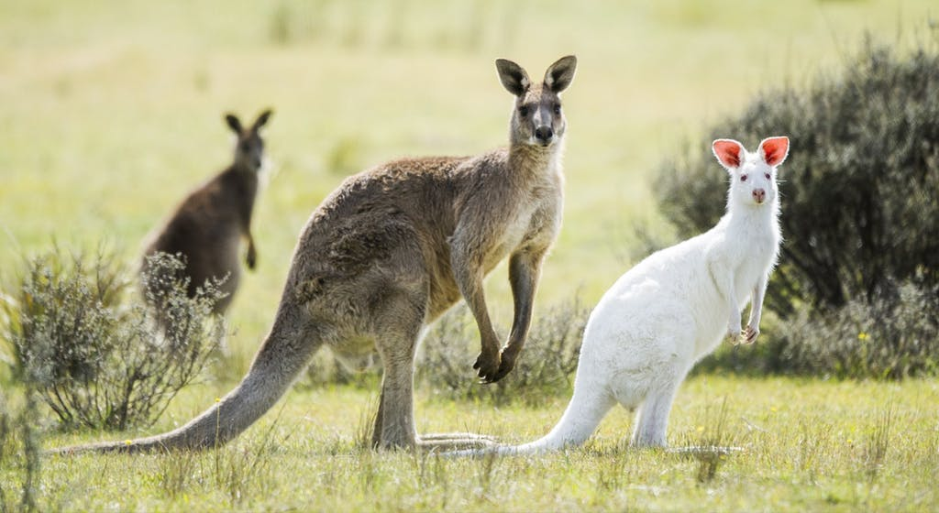
Notes:
A mutation is a change, or mistake, in the genes of an organism. Albinism is a result of a mutation in a gene that codes for pigmentation in the skin.

Slide 21
Viruses make a lot of mistakes, leading to mutations
Notes:
Viruses make a lot of mistakes! They replicate, or multiply, quickly! And this can lead to errors.

Slide 22
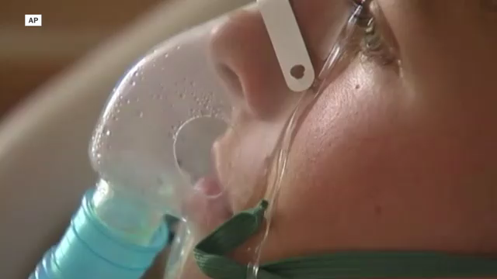

Notes:
Let’s watch how this happens.

Slide 23
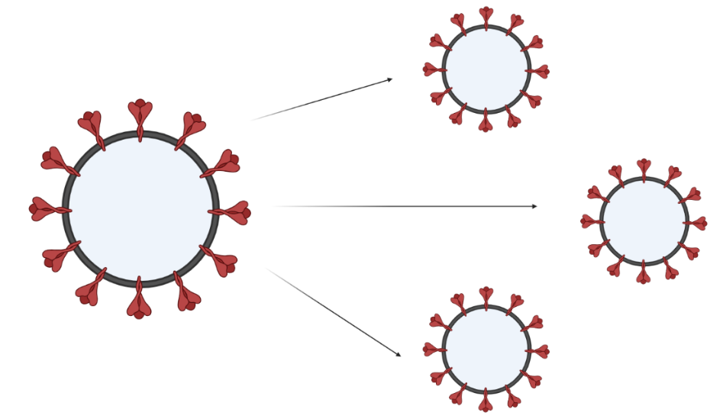
Notes:
So, let’s take a look at your virus model. In a perfect replication, a new virus would emerge that looks exactly the same.

Slide 24
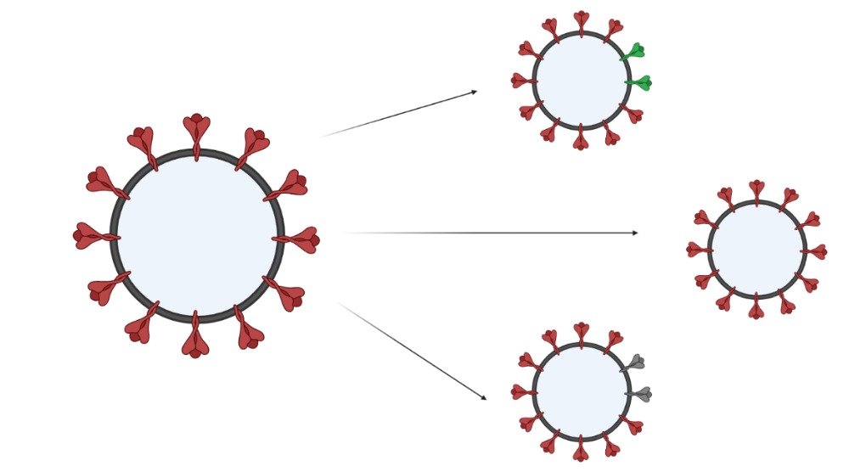
Viruses make mistakes!
Notes:
But, sometimes, viruses make mistakes! And these mistakes lead to mutations. Imagine if we replaced your red gum drops with GREEN, or WHITE, or PURPLE, or ORANGE gumdrops!

Slide 25
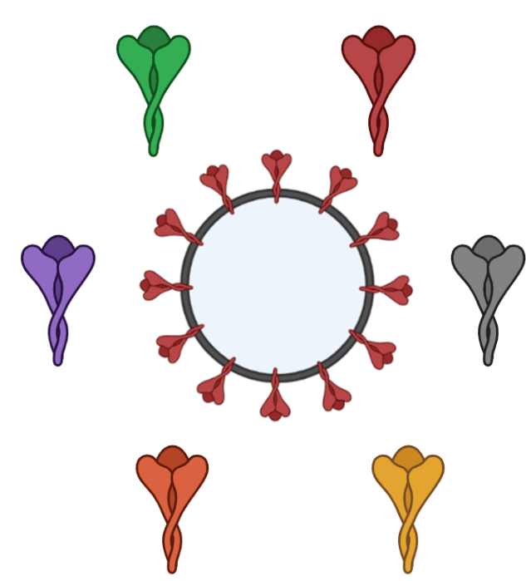
Virus Mutation Game
Notes:
Let’s see

Slide 26
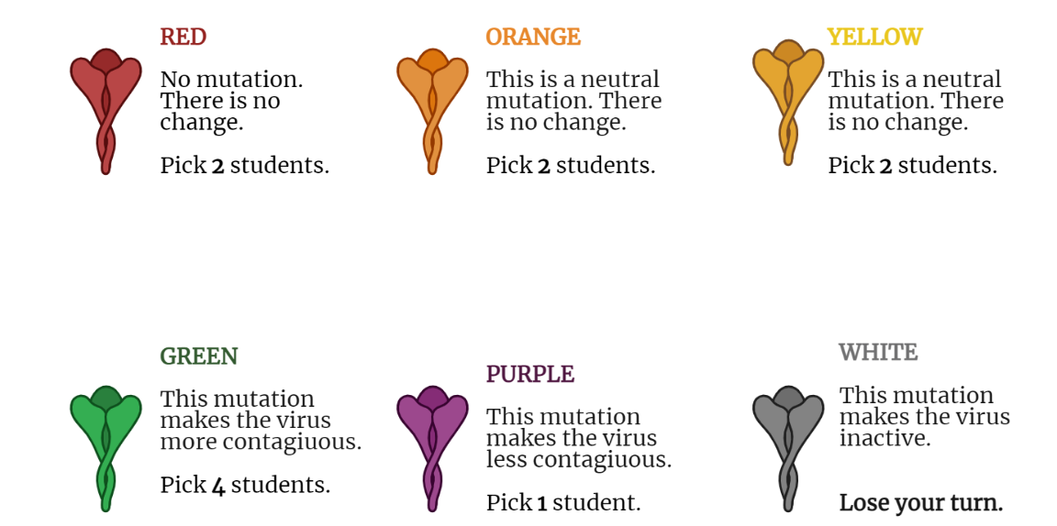

Slide 27
Reflection Questions:
How does your virus compare to others in your class?
What are the most common mutations you saw?
How do different mutations change the way a virus spreads during an outbreak?

Slide 28
Multiplying Mutations

Slide 29
How many new mutations come from an infection of a single cell?
30 Mutations
300 Mutations
3,000 Mutations
3,000,000 Mutations

Slide 30
How many new mutations come from an infection of a single cell?
Calculate the answer using the Multiplying Mutations worksheet!

Slide 31
How many new mutations come from an infection of a single cell?
30,000 bases
1.0 x 10⁻⁵ mutations
10,000 replications
base
3,000 new mutations!

Slide 32
How many new mutations come from an infection of a single cell?
30 Mutations
300 Mutations
3,000 Mutations
3,000,000 Mutations

Slide 33
Reflection Question: Consider the number of new mutations from the infection of a single cell.
Why do you think it is difficult to make vaccines against viruses, like influenza or HIV?
Why do you think you need to get a new flu shot each year?

