Slide 1
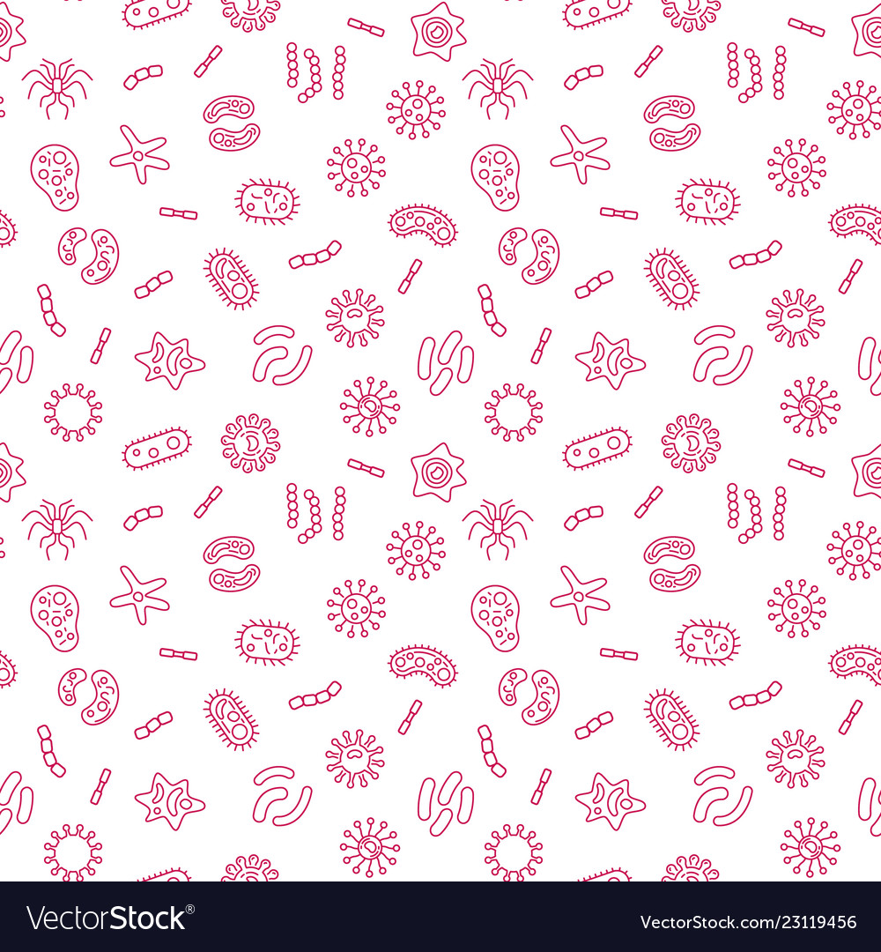
Introduction to Microbiology & Viruses

Slide 2
What are microbes?

Slide 3
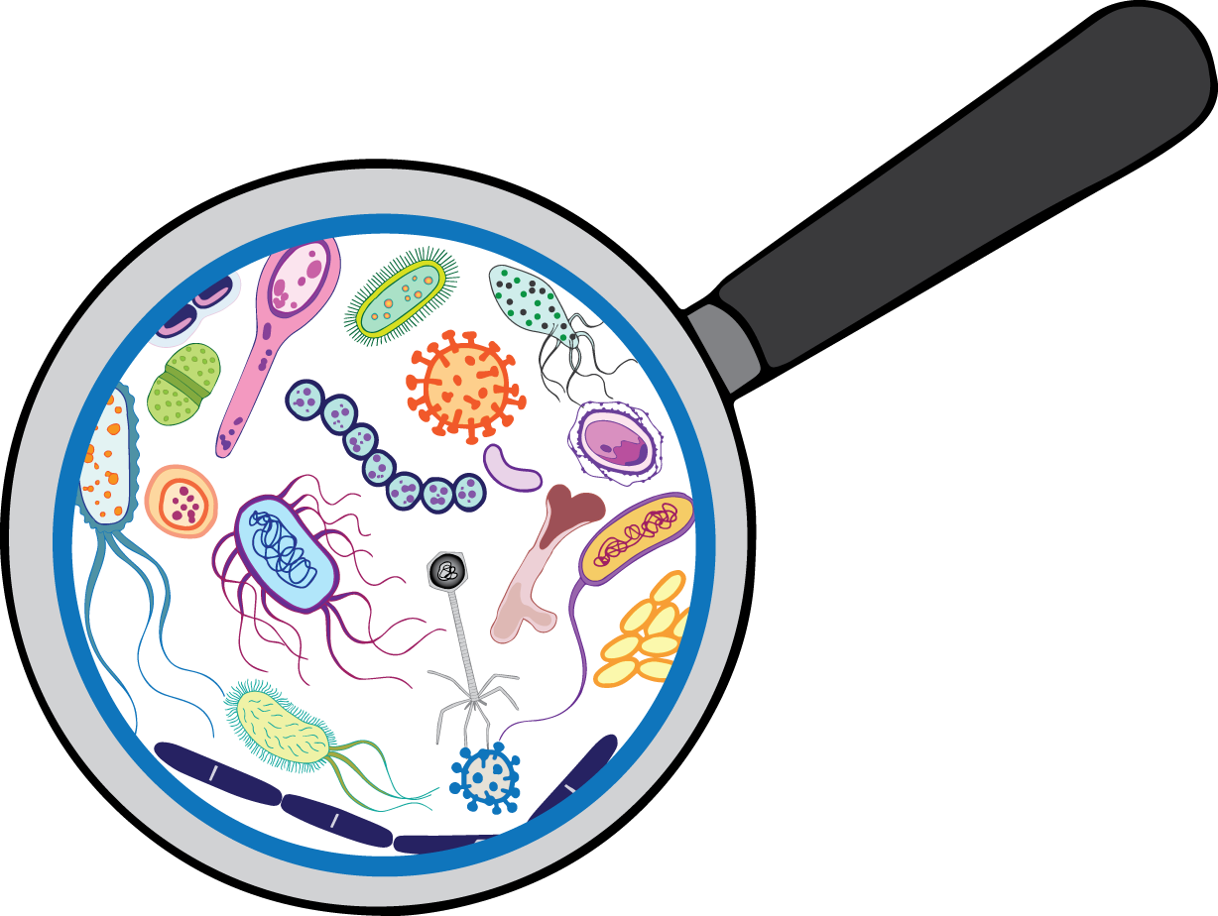
What are microbes?
A microbe is any organism that is too small to be seen by the eyes alone.
This includes helminths, protozoans, fungi, mold, algae, bacteria, and viruses!

Slide 4
What are some microbes that you already know?

Slide 5
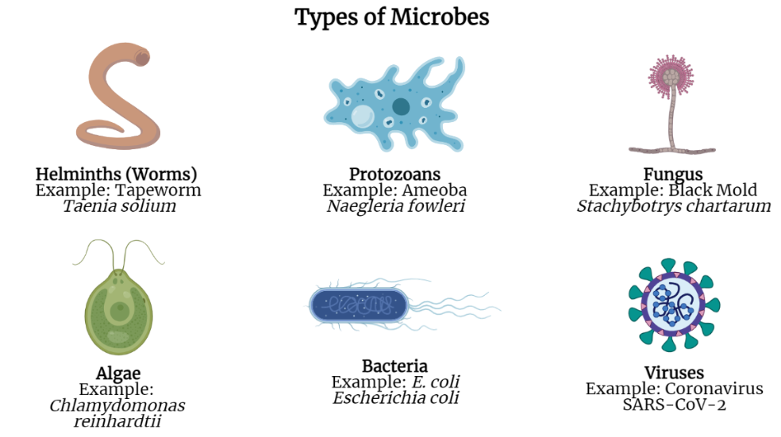

Slide 6
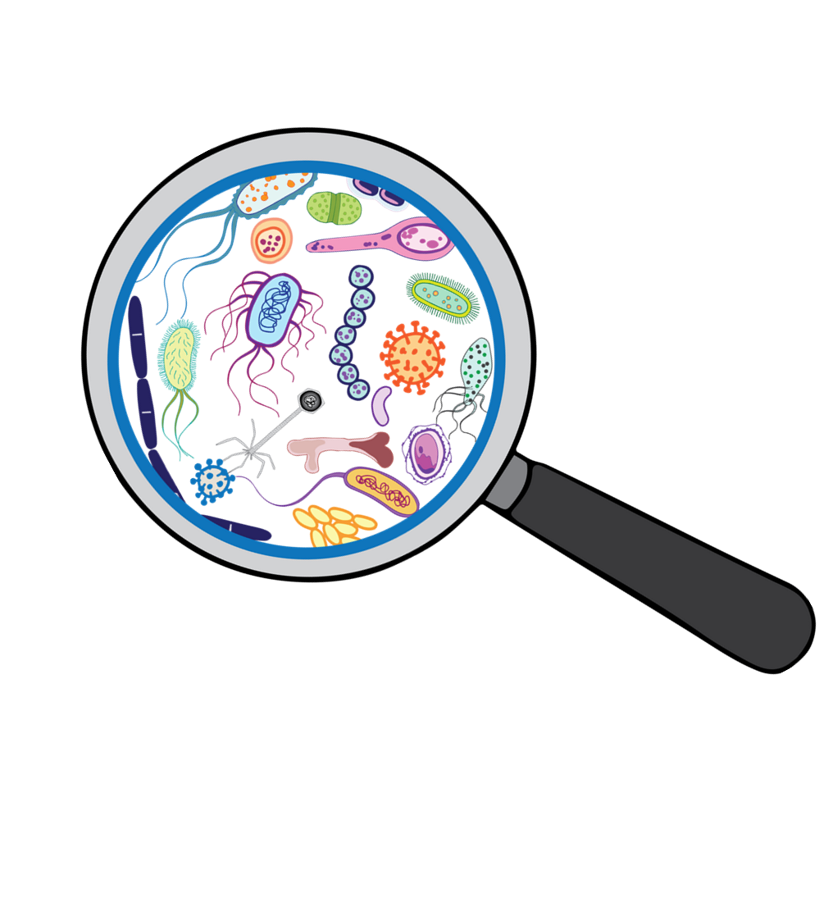
Let’s see how small microbes really are!
Make a prediction. List the following items from largest to smallest:
Coffee Bean
E. coli Bacteria
Skin Cell
Viruses
Grain of Salt

Slide 7
ANSWER
From largest to smallest:
Coffee Bean
Grain of Salt
Skin Cell
E. coli Bacteria
Viruses

Slide 8
Are microbes good or bad?

Slide 9
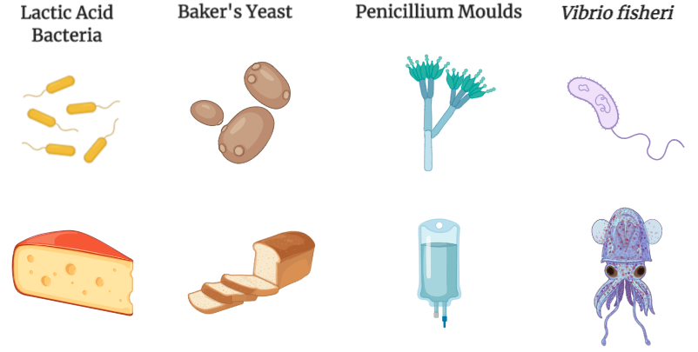


Slide 10
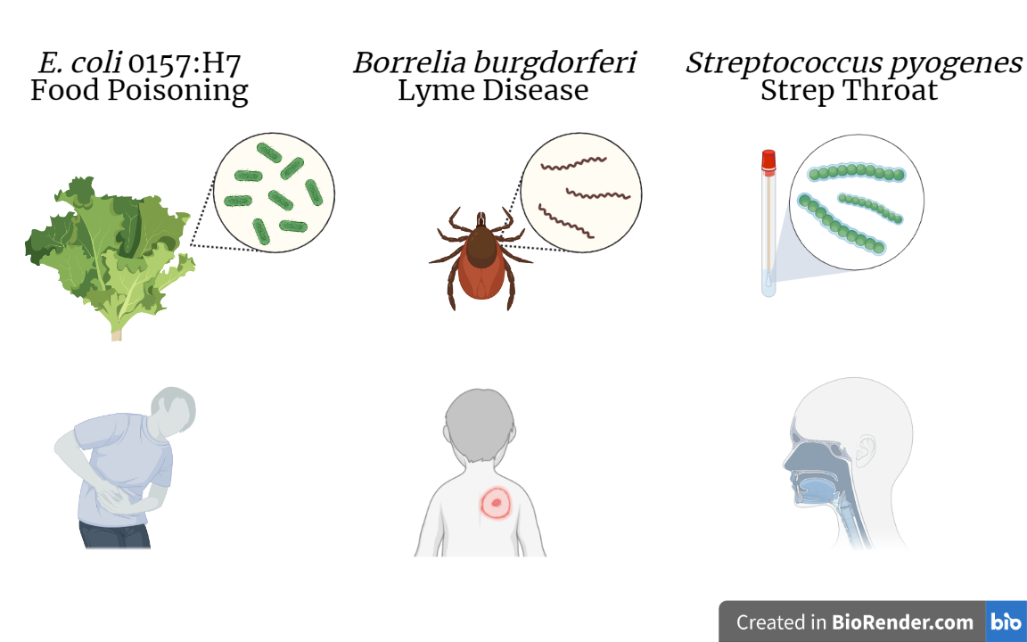

Slide 11
Viruses

Slide 12
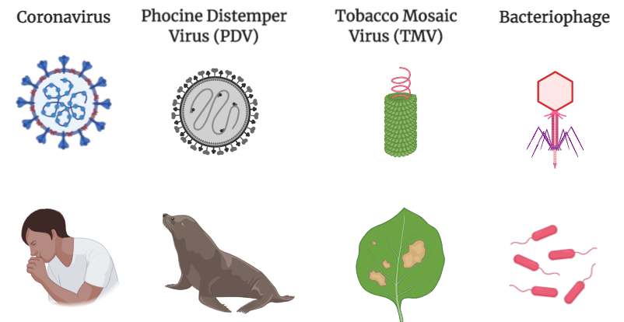
Notes:
Viruses are the smallest microbes and require a host cell to survive. In order to replicate, a virus must infect a host cell. These host cells may be cells from humans, plants, animals, or other microorganisms.
Examples of viruses. (a) The SARS-CoV02 virus infects and replicates inside human and animal cells, (b) Phocine Distemper Virus infects seals and sea lions. (C) The Tobacco Mosaic Virus infects and replicates inside a wide range of plants, especially tobacco, (c) The bacteriophage virus infects and replicates inside bacterial cell hosts.

Slide 13
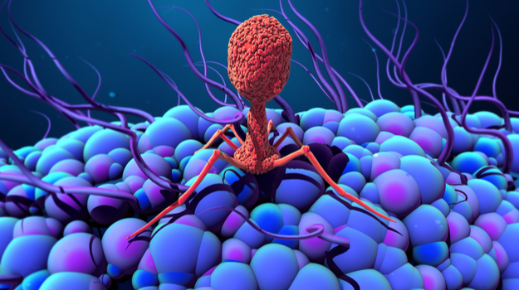
Watch Me!

Slide 14
Let’s Build a Virus!

Slide 15
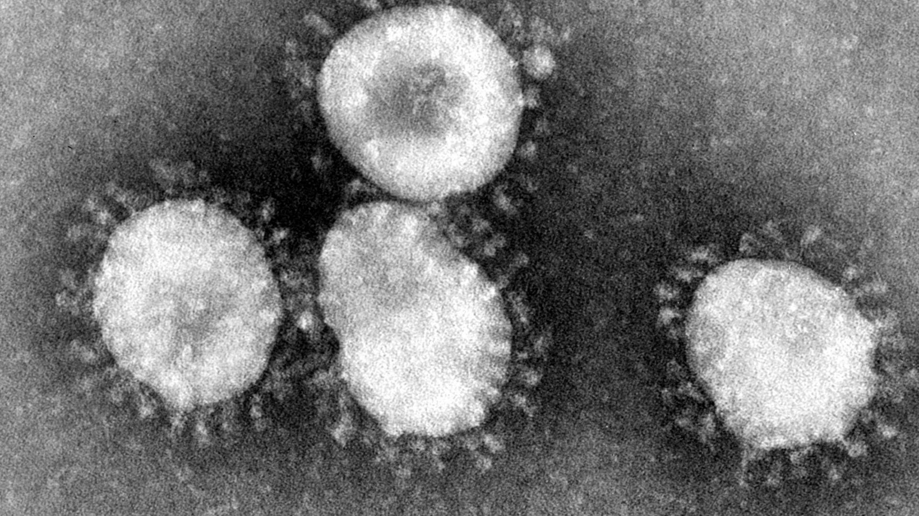

Slide 16
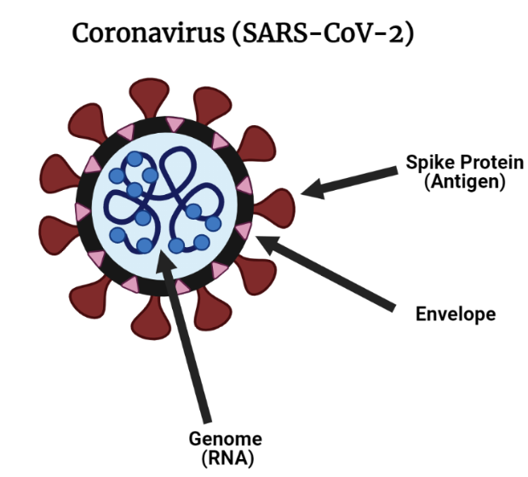

Slide 17
Predict: What happens when the SARS-CoV-2 virus enters the body?

Slide 18
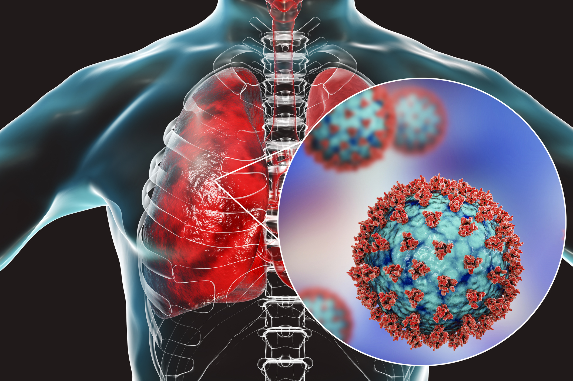
Watch Me!

Slide 19
What is a mutation?

Slide 20
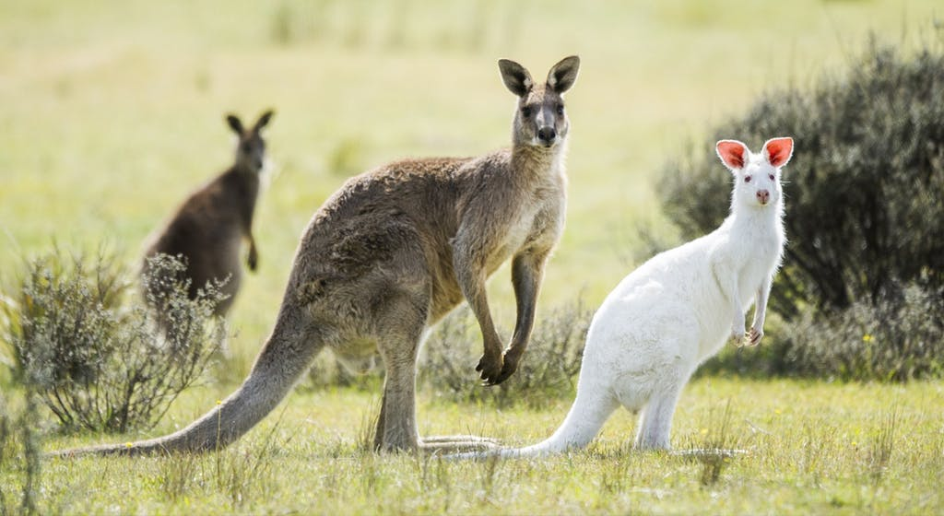

Slide 21
Viruses make a lot of mistakes, leading to mutations

Slide 22
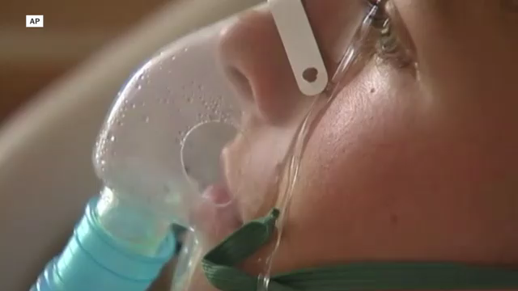


Slide 23
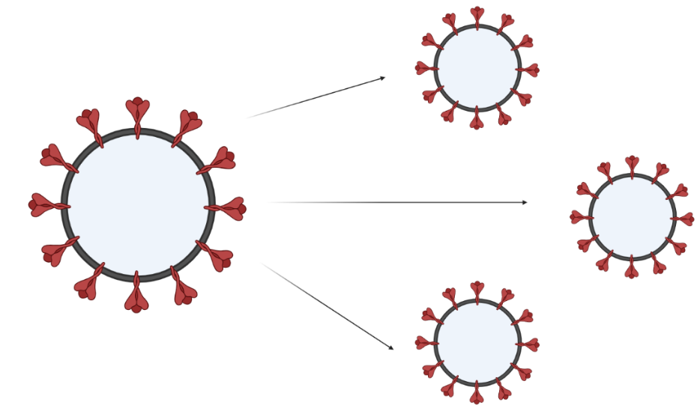

Slide 24
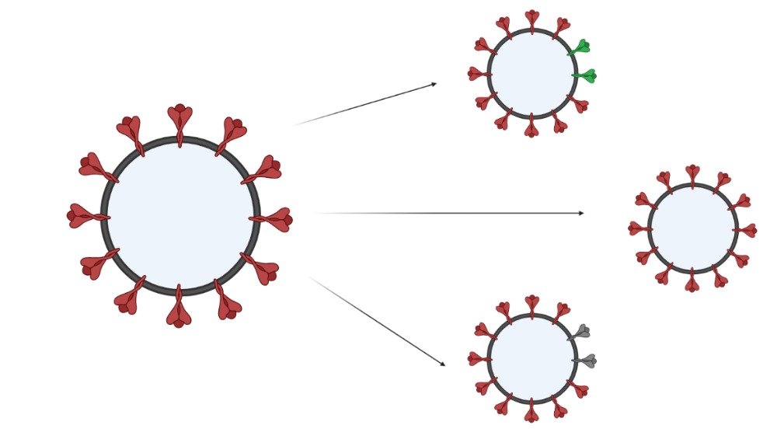
Viruses make mistakes!

Slide 25
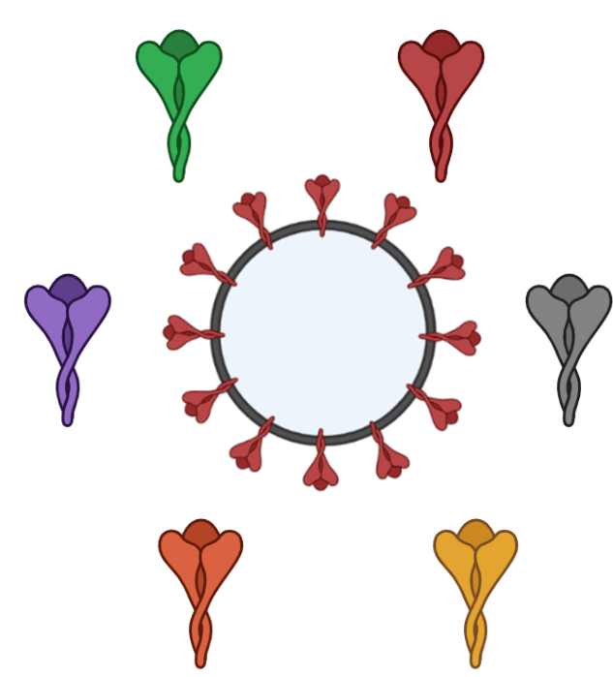
Virus Mutation Game
How do viruses mutate during an outbreak?

Slide 26
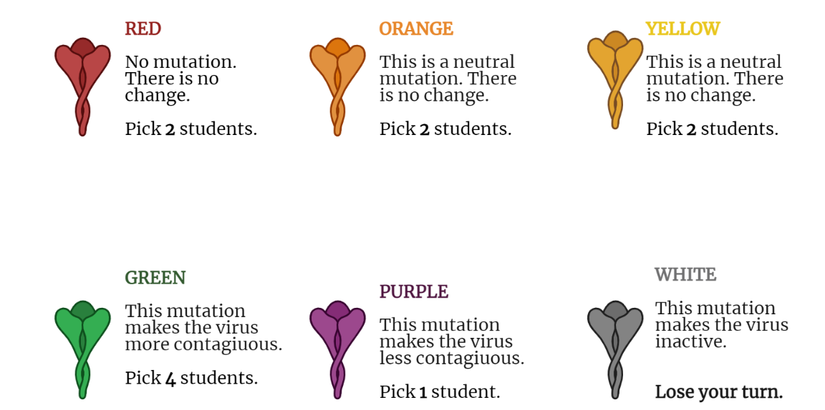

Slide 27
Reflection Questions:
How does your virus compare to others in your class?
What are the most common mutations you saw?
How do different mutations change the way a virus spreads during an outbreak?

