Slide 1
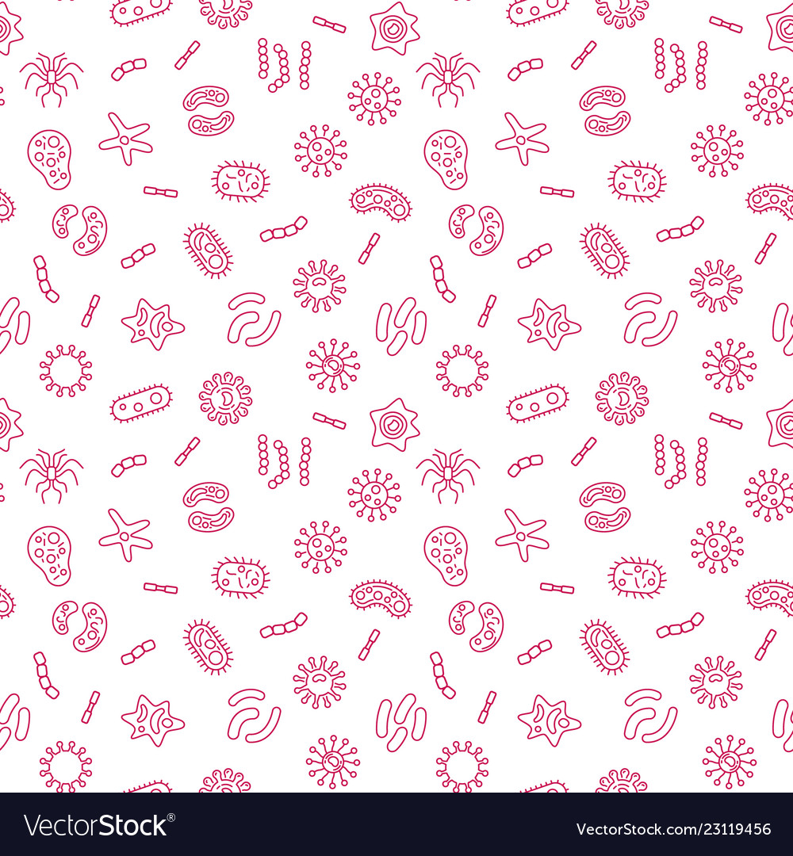
Introduction to Microbiology & Viruses

Slide 2
What are microbes?

Slide 3
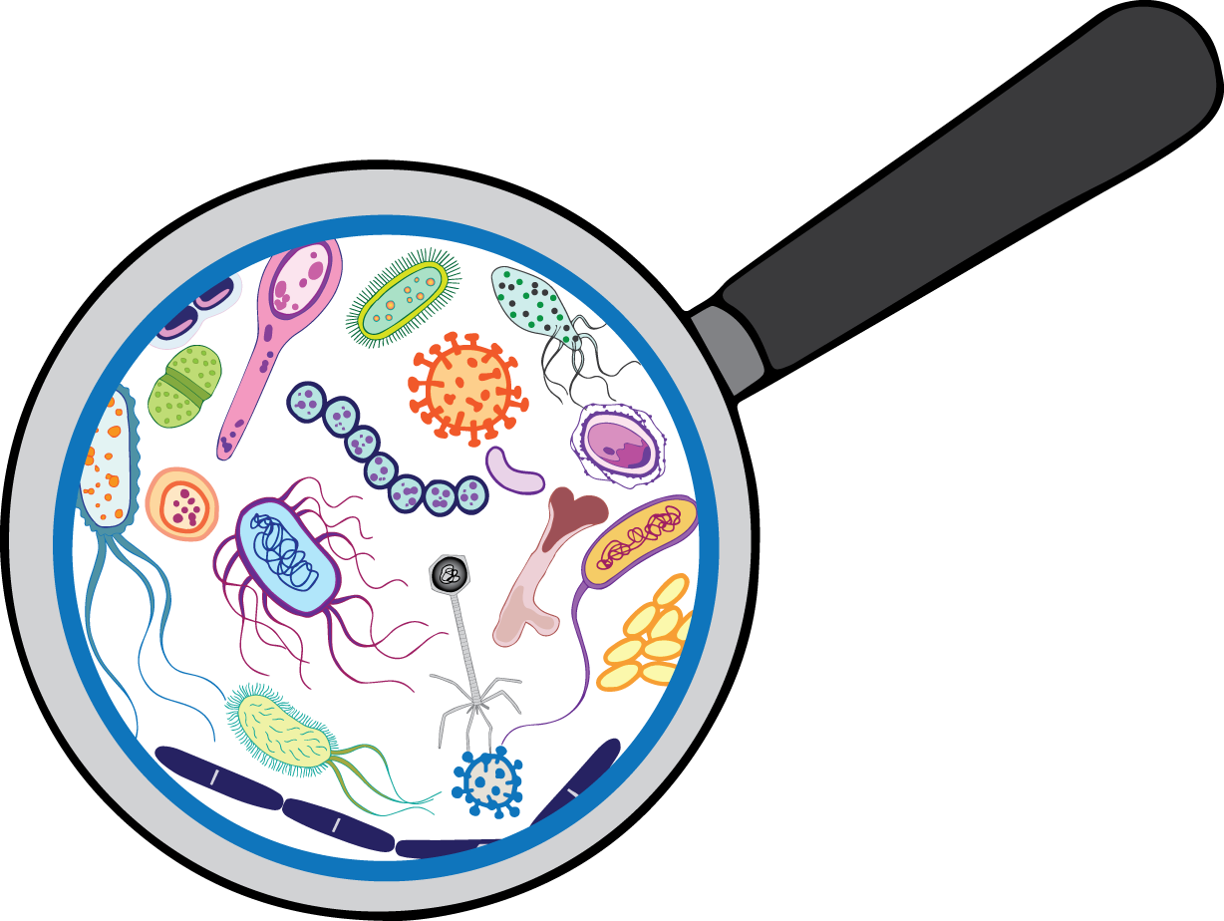
What are microbes?
A microbe is any organism that is too small to be seen by the eyes alone.
This includes helminths, protozoans, fungi, mold, algae, bacteria, and viruses!

Slide 4
What are some microbes that you already know?

Slide 5
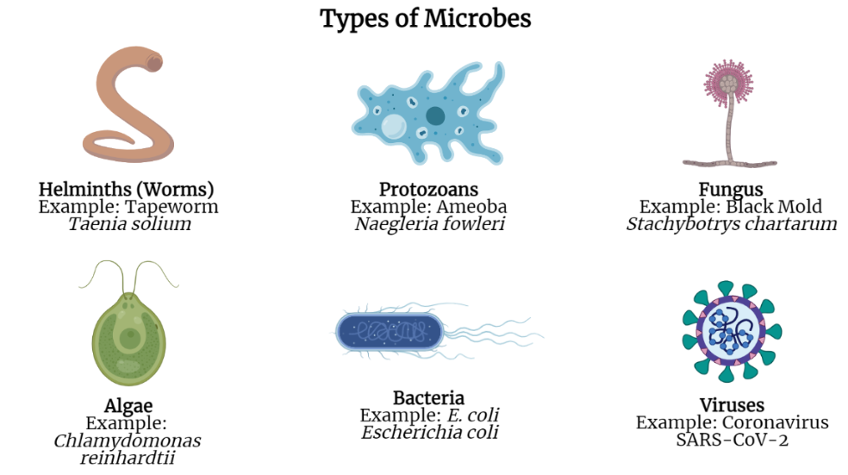

Slide 6
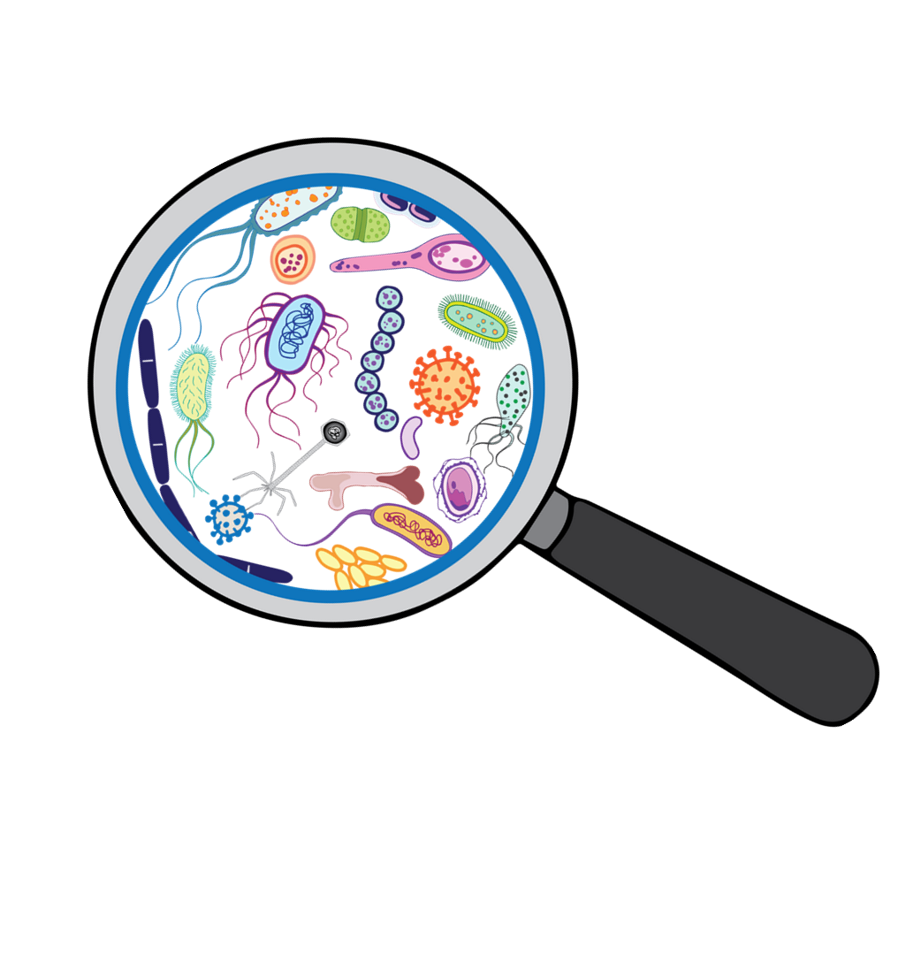
Let’s see how small microbes really are!
Make a prediction. List the following items from largest to smallest:
Coffee Bean
E. coli Bacteria
Skin Cell
Viruses
Grain of Salt

Slide 7
ANSWER
From largest to smallest:
Coffee Bean
Grain of Salt
Skin Cell
E. coli Bacteria
Viruses

Slide 8
Are microbes good or bad?

Slide 9
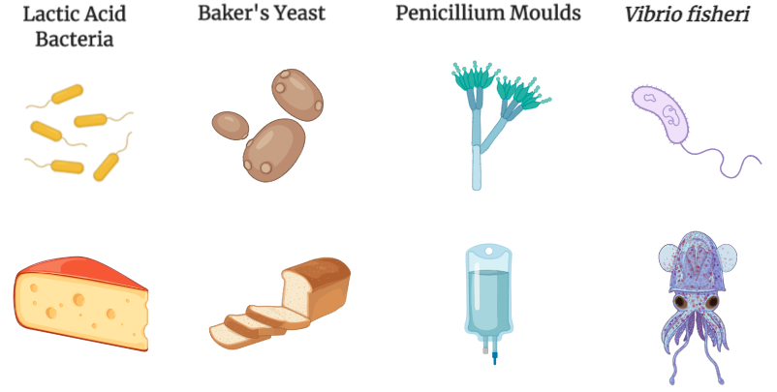


Slide 10
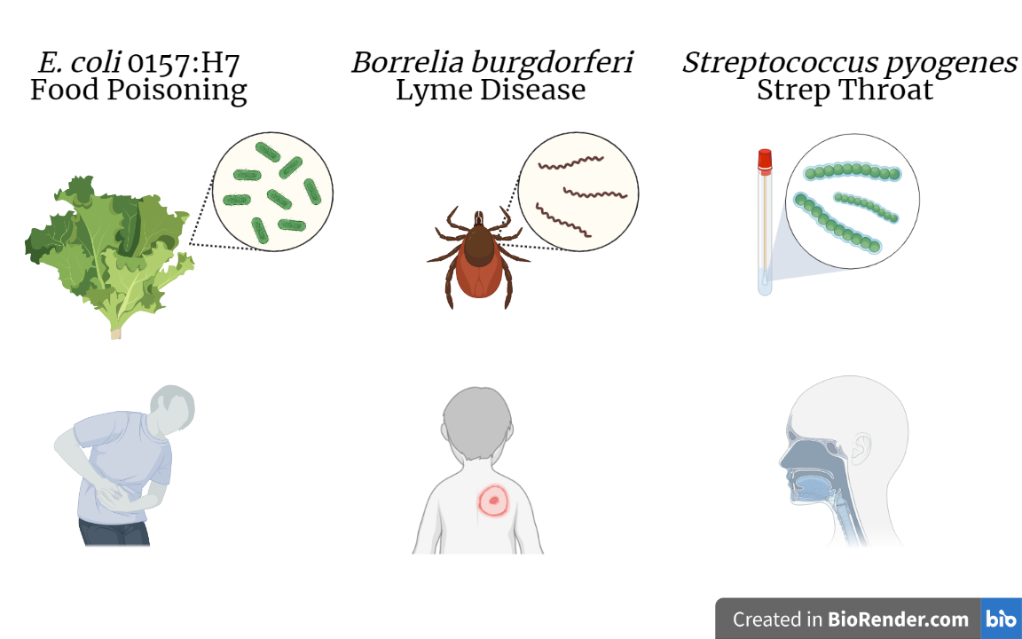

Slide 11
Viruses

Slide 12
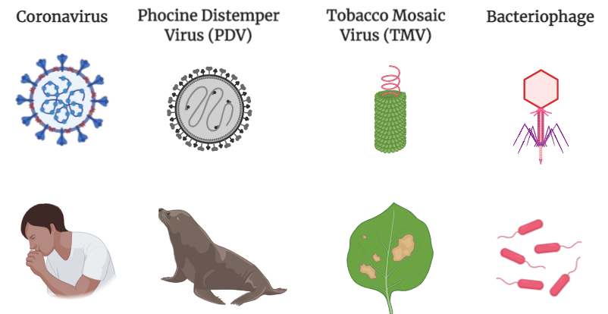
Notes:
Viruses are the smallest microbes and require a host cell to survive. In order to replicate, a virus must infect a host cell. These host cells may be cells from humans, plants, animals, or other microorganisms.
Examples of viruses. (a) The SARS-CoV02 virus infects and replicates inside human and animal cells, (b) Phocine Distemper Virus infects seals and sea lions. (C) The Tobacco Mosaic Virus infects and replicates inside a wide range of plants, especially tobacco, (c) The bacteriophage virus infects and replicates inside bacterial cell hosts.

Slide 13
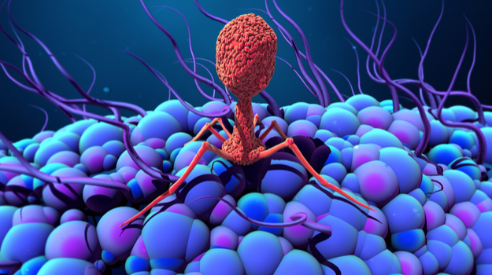
Watch Me!

Slide 14
Let’s Build a Virus!

Slide 15
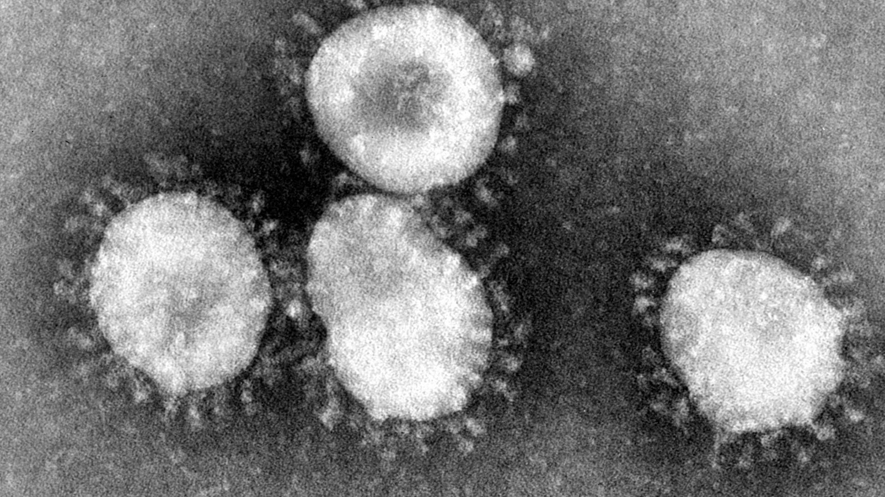

Slide 16
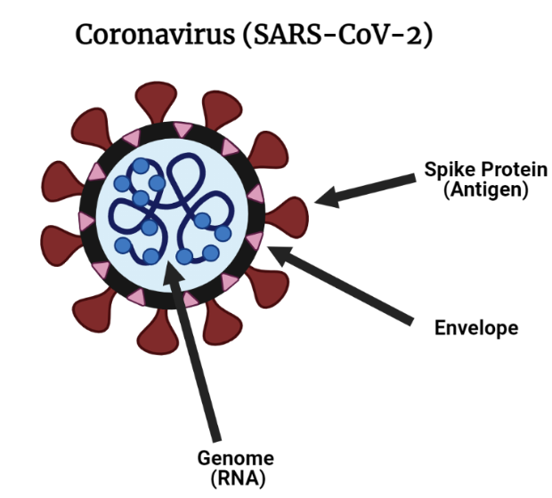

Slide 17
Predict: What happens when the SARS-CoV-2 virus enters the body?

Slide 18
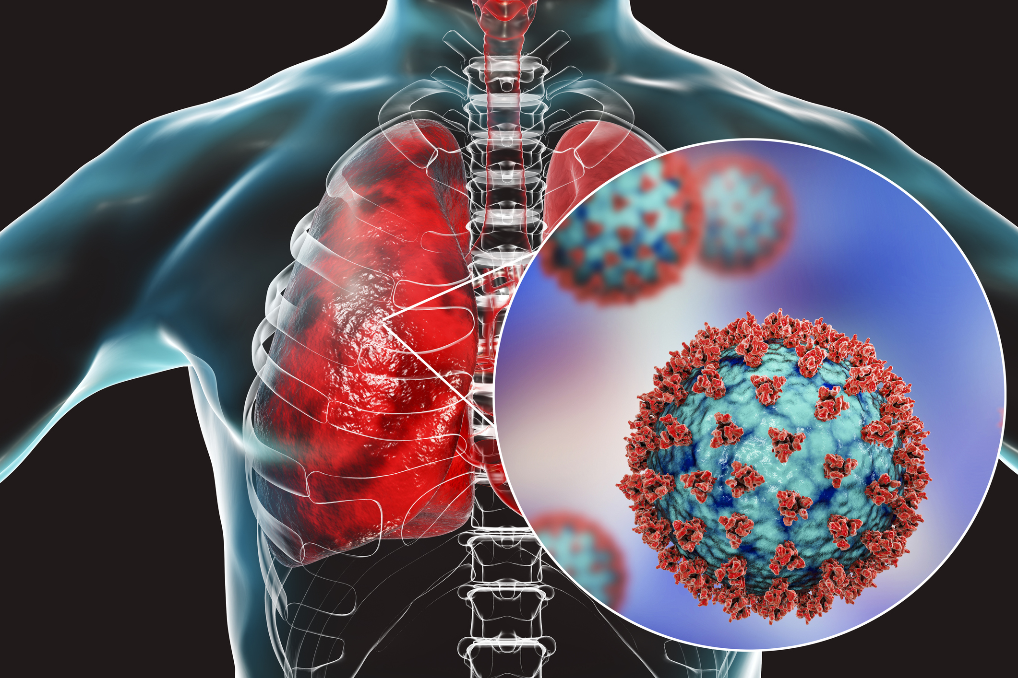
Watch Me!

Slide 19
What is a mutation?

Slide 20
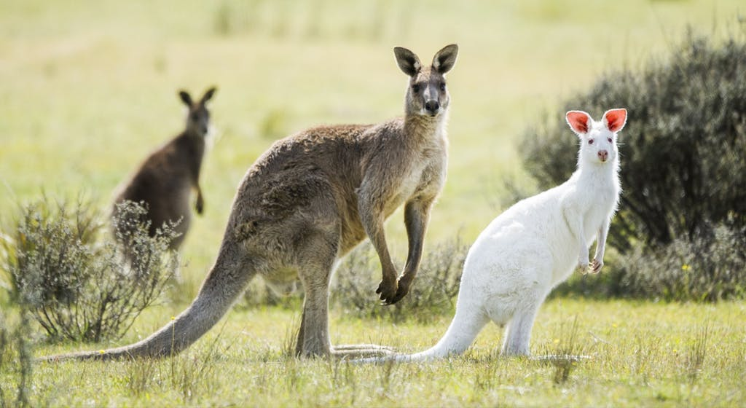

Slide 21
Viruses make a lot of mistakes, leading to mutations

Slide 22
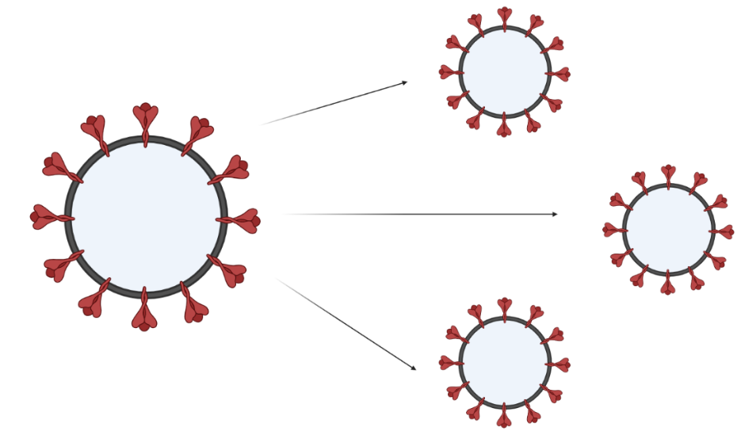

Slide 23
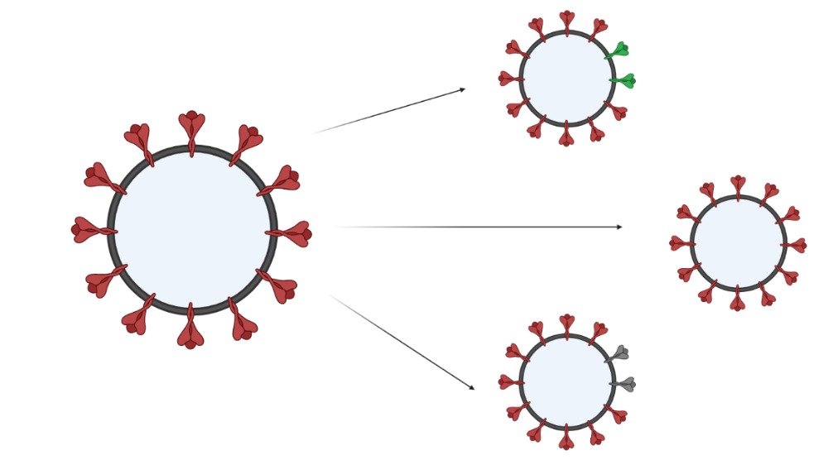
Viruses make mistakes!

Slide 24
