Slide 1
The Retina and Color Vision
Rida Osman

Slide 2
Vision and the World
https://media.npr.org/assets/img/2017/06/30/animal-eyes_custom-20ac4c2a0b6aae2c5da2162678b049e4cae7ef9d-s800-c85.jpg
Notes:
Many organisms rely on vision for various activities. For instance hunting is one. We as humans are very visual creatures and many of us reply heavily on our vision. But have you ever wondering eaxctly how our eyes are able to perceive the world around us?

Slide 3
The Retina
https://www.vmrinstitute.com/what-is-the-retina/
Notes:
Our vision is mainly due to a structure in our eye called the retina. The retina is a tissue that lines the back of the eye. Its function is to convert light into signals that allows organisms to perceive an image.

Slide 4
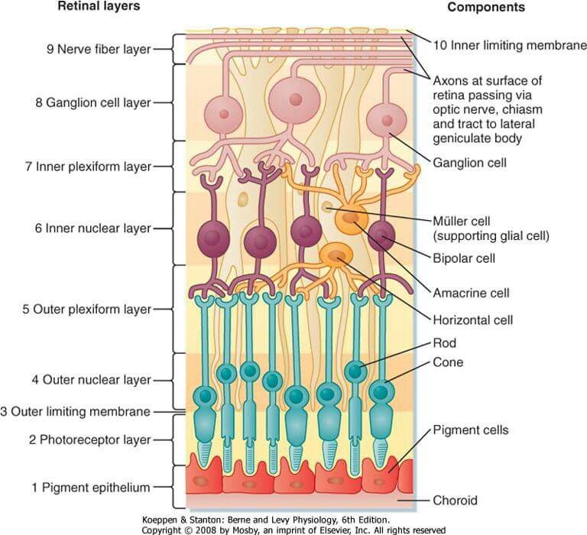
The Layers of the Retina
Notes:
The retina is made up of nine different layers and some layers contain different cell types all responsible for converting light into an image. Light as well as an image will actually first hit the nerve fiber layer but go through all of layers and first begin being processed by coming in contact with the first layer, the RPE

Slide 5
The Pigmented Retinal Epithelium
Notes:
Light hits the RPE first

Slide 6
The Pigmented Retinal Epithelium
https://www.researchgate.net/publication/343341963/figure/fig1/AS:919348847853571@1596201254773/Schematic-drawing-of-the-retinal-pigment-epithelium-and-neighbouring-retinal-layers-The.png
Notes:
The RPE is made up of tightly packed epithelium cells that are pigmented. The RPE maintains the blood eye barrier by only allowing certain cells into the eye. So our eyes like are brain are immune priviledged and where most immune cells cannot go. The RPE also allow nutrients and ions to pass to other cells in the retina. The RPE also will absorb scatter light and help focus it towards the photoreptors in the next layer.

Slide 7
The Photoreceptor Layer
Notes:
The next layer in the retina is the photorecptor layer. Light will bounce of the RPE and come in contact with the cells in this layer. This layer contained the outer segments of the photoreceptor cells.

Slide 8
The Photoreceptor Layer
https://vivadifferences.com/wp-content/uploads/2019/11/Rods-And-Cones.jpg
Notes:
There are two types of photoreceptor cells. Rod cells are responsible for us being able to see in low light conditions. Cone cells allow us to see in bright light, focus in on images, see fine detail of images and also perceive colors. The photoreceptor cells have three parts: The outer segments, the inner segments, and the synaptic region. The outer segments are what are connected to the RPE and absorb light. The inner segment is where the cell body is or where the nucleus of the cell is. The synaptic region is where the photoreceptor cells is connected to other cells in other layers of the retina. Like most cells in the retina, the photoreceptor cells will stretch out over multiple layers.

Slide 9
The Outer Limiting Membrane
Notes:
Outer Limiting Membrane: This is membrane layer between the photoreceptor layer and the outer nuclear layer.

Slide 10
The Outer Nuclear Layer
Notes:
Outer Nuclear Layer: This is the layer that contains the cell bodies of rods and cone cells.

Slide 11
The Outer Plexiform Layer
Notes:
Outer Plexiform Layer: The layer between the outer nuclear layer and the inner nuclear layer. This also contains the synaptic region of the photoreceptor cells.

Slide 12
The Inner Nuclear Layer
Notes:
Inner Nuclear Layer: Contains the cell bodies of horizontal cells and bipolar cells, amacrine cells and our muller glia

Slide 13
Cells of the Inner Nuclear Layer: Muller Glia
https://lh3.googleusercontent.com/proxy/yijNHxBJ6nb6PfApbeHUh8lcS5b2jGN91tlRfZqEoNozz-4ZR8y6FWf2eS2ppI2PHYK3sQ5MhIgWkxr3OsQW_3Dktx32y_uYFkJqoXXT4i_5wMzo8ysOLdh4stidki1FPnb_WouGU3vzWt7ueYRMj48
Notes:
Muller glia are massive cells that actually span most of the retina. The red image is a diagram of a muller glia cell and the left image are muller glia that have been stained with a flourescent dye. Muller glia provide structural support for neurons and other cells types in the retina. The muller glia also help maintain the health of retinal cells by allowing the transfer of nutrients or signaling to immune cells.

Slide 14
Cells of the inner nuclear layer
https://pigeon.psy.tufts.edu/avc/husband/images/Retinax.gif
Notes:
The bipolar cells help pass electrical information from the photoreceptor cells to retinal ganglion cells in the retina. Horizontal cells help sort the multiple signals coming in from multiple photoreceptor cells. Amacrine cells help sort electrical signals from bipolar cells to retinal ganglion cells.

Slide 15
The Inner Plexiform Layer
Notes:
Inner Plexiform Layer: The layer between the ganglion cell layer and the inner nuclear layer. It is also where horizontal cells and bipolar cells synapse to retinal ganglion cells.

Slide 16
The Ganglion Cell Layer
Notes:
Ganglion Cell Layer: Contains the ganglion cells.

Slide 17
Retinal Ganglion cells
https://media.springernature.com/m685/springer-static/image/art%3A10.1038%2Fgt.2011.142/MediaObjects/41434_2012_Article_BFgt2011142_Fig1_HTML.jpg
Notes:
These cells will process all of the electrical information and send these signals to the brain in order to process a visual image. Retinal ganglion cells have axons that will leave through the optic nerve in the eye and go to the brain.

Slide 18
The nerve Fiber layer
Notes:
Nerve Fiber Layer: The axons that lead from the ganglion cells to the optic nerve and then to the brain.

Slide 19
Vision and Photoreceptor cells
https://vivadifferences.com/wp-content/uploads/2019/11/Rods-And-Cones.jpg
Notes:
As we mentioned before, the photorecptors cells are mainly responsible for our vision. In terms of color vision, the cell responsible are cone cells.

Slide 20
Types of cone cells In humans
http://kpmjps.weebly.com/uploads/5/1/4/5/51458257/header_images/1431130633.jpg
Notes:
Humans have three types of cone cells. Short-wave length cones or S-cones allow us to see colors with a short wavelength such as blue colors. Medium wavelength cones or M cones allows us to see medium wavelengths and thus allows us to see greens and yellows. Longwave length cones or L cones allow us to see light with a longer wavelength such as reds. Humans have all three cone types in their retina that allows them to see a wide spectrum of colors. In humans not having a certain cone type can lead to color blindness.

Slide 21
Color Blindness
https://cdn.nanalyze.com/uploads/2019/01/Different-Types-of-Color-Blindness-2.jpg
Notes:
There are three types of color blindness. Deuteranomaly is red/green color blindess. It is caused by defective M cones and makes it hard to differentiate between red and green. Protanomaly is also red/green color blindess but it caused by defective L cones making it hard to see hues of red. Tritanopia is a rare form of colorblindness and is also known as blue green color blindness. This is caused by person not having any S cones this make it hard to tell between blues and greens and yellows look more violet.

Slide 22
Inheritance pattern of color blindness
https://hekint.org/images/All_journal_images/2016_briefs/image011.jpg
Notes:
Color blindess is an X-linked trait. The gene is located often on the X chromosome which means a mom who has color blindness can pass it on to her sons while her daughters would be unaffected. Daughters can only have color blindess if both her mom and dad are affected or mom is a carrier

Slide 23
Color Blindness Test
https://www.aoa.org/healthy-eyes/eye-and-vision-conditions/color-vision-deficiency?sso=y
Notes:
Most optomologists will check for color blindness by using this test to see if their patient can see the number inside.

Slide 24
Color vision in other organisms
https://www.nhm.ac.uk/content/dam/nhmwww/discover/animal-vision/animal-vision-dog-gecko-snail-clam-spider-full-width.jpg
Notes:
. Humans have all three cone types in their retina that allows them to see a wide spectrum of colors. Other organisms maybe only have one or two cone types or have less cone cells total in their retina compared to humans and thus see with less fine detail or not be able to see the full spectrum of colors.

Slide 25
Color vision in cats
https://resources.thrivevet.com/wp-content/uploads/2019/04/Can-Cats-See-Color.jpg
Notes:
Cats also have the same three cone types as humans but cats have less cones total thus they are unable to see the full range of colors like humans. However cats can see better in the dark due to the higher number rod cells in their retina

Slide 26
Color vision in dogs
Notes:
Dogs have only M cone and L comes and thus have trouble distinguishing between yellows and blues. Dogs can also see better in the dark due to the higher number rods cells in their retina

Slide 27
Color vision in hummingbirds
https://earthsky.org/earth/wild-hummingbirds-see-colors-humans-can-only-imagine
Notes:
Hummingbirds have 4 types of cone cells. They have an extra cone cell type that can perceive ultra violet light. This allows them to see colors in even more vivid hues.

Slide 28
Which cells in The Retina Are you most curious about?

Slide 29
Which animal’s vison would you like to possibly research?
How could the animal’s environment affect its vision?

