Slide 1
Investigating mathematics research through a game:
Torus tic-tac-toe

Slide 2
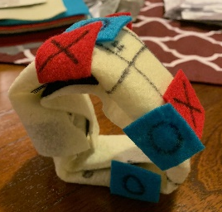

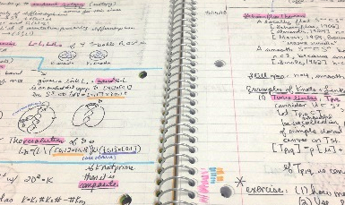
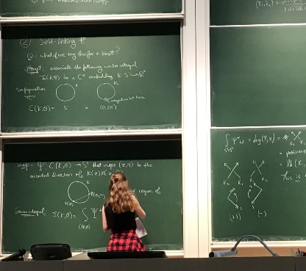
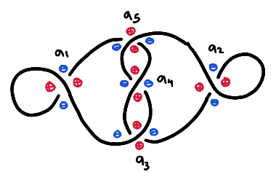
What does mathematics research look like?
Scientists use the scientific method to conduct experiments. What do mathematicians do??
Research in mathematics can involve…
Asking questions
Working out examples
Building models
Making observations
Communicating ideas through writing
Today we will become mathematics researchers by investigating a game called Torus Tic-Tac-Toe!
Notes:
(Introduction to mathematics research- see slide.)

Slide 3
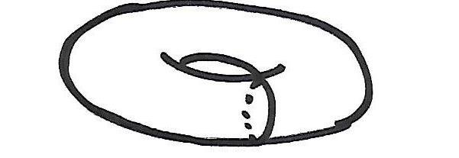
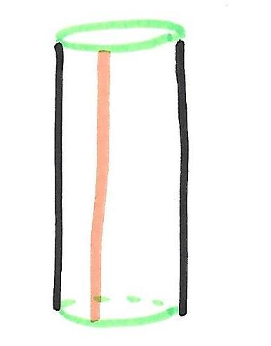
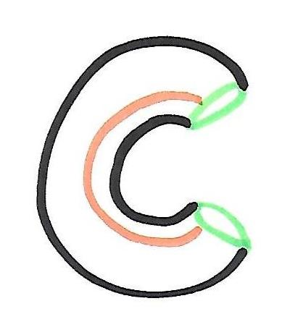
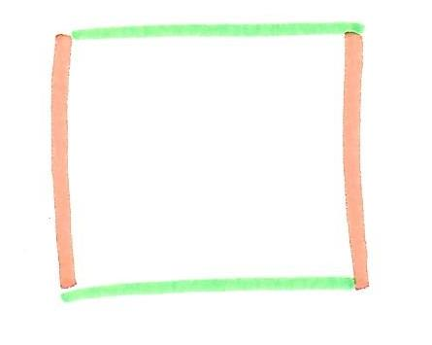
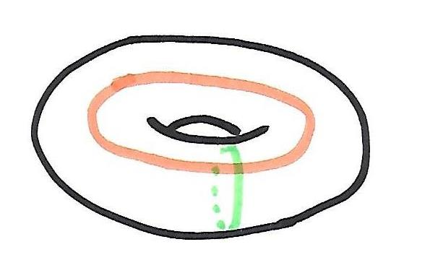
What Is a torus?
Torus = inner tube or surface of a donut (hollow on the inside)
We can build tori (the plural of “torus”) by gluing together opposite sides of a square:
Notes:
The torus is a shape in mathematics that looks like an inner tube or the surface of a donut. In particular, it is hollow on the inside, just like a sphere. We can build tori (which is the plural of torus) by gluing together opposite sides of a square in the following way. First let’s glue the orange sides together. After doing this we get a cylinder. Now let’s glue the green sides together. Voila! We get a torus!
Now we are going to play tic-tac-toe, but instead of playing it on a square, we will play it on a torus…

Slide 4
Torus tic-tac-toe
Notes:
Is everyone familiar with tic-tac-toe? In the usual game, two people take turns placing x’s and o’s in a grid, and the first person to make three in a row wins. Usually, “three in a row” can look like...

Slide 5
Torus tic-tac-toe
 | X
Notes:
Is everyone familiar with tic-tac-toe? In the usual game, two people take turns placing x’s and o’s in a grid, and the first person to make three in a row wins. Usually, “three in a row” can look like...

Slide 6
Torus tic-tac-toe
 | O
 | X
Notes:
Is everyone familiar with tic-tac-toe? In the usual game, two people take turns placing x’s and o’s in a grid, and the first person to make three in a row wins. Usually, “three in a row” can look like...

Slide 7
Torus tic-tac-toe
X | O
 | X
Notes:
Is everyone familiar with tic-tac-toe? In the usual game, two people take turns placing x’s and o’s in a grid, and the first person to make three in a row wins. Usually, “three in a row” can look like...

Slide 8
Torus tic-tac-toe
X | O
 | X
 |  | O
Notes:
Is everyone familiar with tic-tac-toe? In the usual game, two people take turns placing x’s and o’s in a grid, and the first person to make three in a row wins. Usually, “three in a row” can look like...

Slide 9
Torus tic-tac-toe
X | O
X | X
 |  | O
Notes:
Is everyone familiar with tic-tac-toe? In the usual game, two people take turns placing x’s and o’s in a grid, and the first person to make three in a row wins. Usually, “three in a row” can look like...

Slide 10
Torus tic-tac-toe
X | O
X | X | O
 |  | O
Notes:
Is everyone familiar with tic-tac-toe? In the usual game, two people take turns placing x’s and o’s in a grid, and the first person to make three in a row wins. Usually, “three in a row” can look like...

Slide 11
Torus tic-tac-toe
X | O
X | X | O
X |  | O
Notes:
Is everyone familiar with tic-tac-toe? In the usual game, two people take turns placing x’s and o’s in a grid, and the first person to make three in a row wins. Usually, “three in a row” can look like...

Slide 12
Torus tic-tac-toe
X | X | X
Notes:
This (horizontal)...

Slide 13
Torus tic-tac-toe
X
X
X
Notes:
This (vertical)...

Slide 14
Torus tic-tac-toe
X
 | X
 |  | X
Notes:
Or this (diagonal). Now I want to add a new rule.

Slide 15
Torus tic-tac-toe
X
 | X
 |  | X
Notes:
Let’s pretend that we are “gluing” opposite sides of the grid together as we did before. (Show on diagram. The orange sides go together and the green sides go together. That is, the orange sides become the same line, and the green sides become the same line.) What that means is if I go off the right side (point to grid), I come out over on the left side (point again). And if I move up (point to grid), then I come out down below (point again). This is like the arcade game “Asteroids:” when you move off one side of the screen, you appear on the other side. How does this change the game? Everything else is the same, except there are new ways you can win…

Slide 16
Torus tic-tac-toe
 | X
X
 |  | X
Notes:
These X’s now count as being “in a row.” Why? Remember the orange sides are the same. So this X on the bottom...is also over here.

Slide 17
Torus tic-tac-toe
 | X
X
 |  | X
X
Notes:
...is also over here. (Both are on the bottom and to the left of the orange line.)

Slide 18
Torus tic-tac-toe
 | X
X
X
Notes:
Does this make sense?

Slide 19
Torus tic-tac-toe
 | X
X
 |  | X
Notes:
So here is one new way to win. During the activity, we will think about whether there are more new ways to win!

Slide 20

Torus tic-tac-toe
Now let’s do some mathematics research!
Notes:
Now let’s start on the activity!

Slide 21
Do not show this slide to students
 | X
X
 |  | X
X
 |  | X
 | X
 | X
 |  | X
X
 |  | X
X
 | X
Notes:
Note: don’t show this slide to students, but here are all the additional ways to win at torus tic-tac-toe. (This is the answer to discussion question #3.) It is not too hard to see that these are winning positions, but what is harder is seeing why these are the *only* new winning positions.

