Slide 1
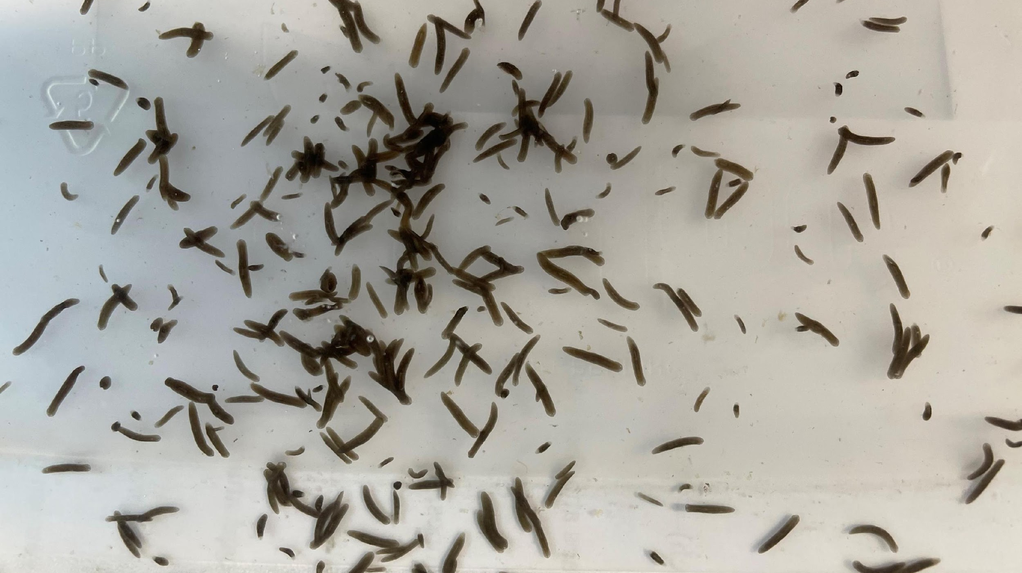
Survival of the Fittest:
Understanding sexual and asexual reproduction in planarians

Slide 2
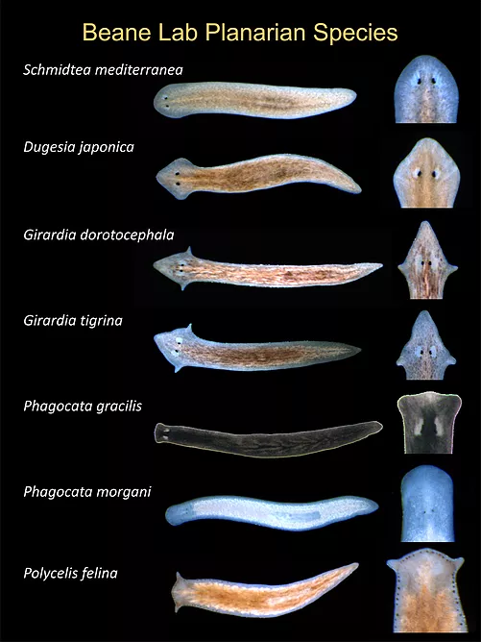
What are Planarians?
Planarians are flatworms that can live in water or on land. There are lots of different species!
Some of them can reproduce sexually and asexually depending on the environment. Other planarians exclusively reproduce one way.
Image from Beanelab.org

Slide 3
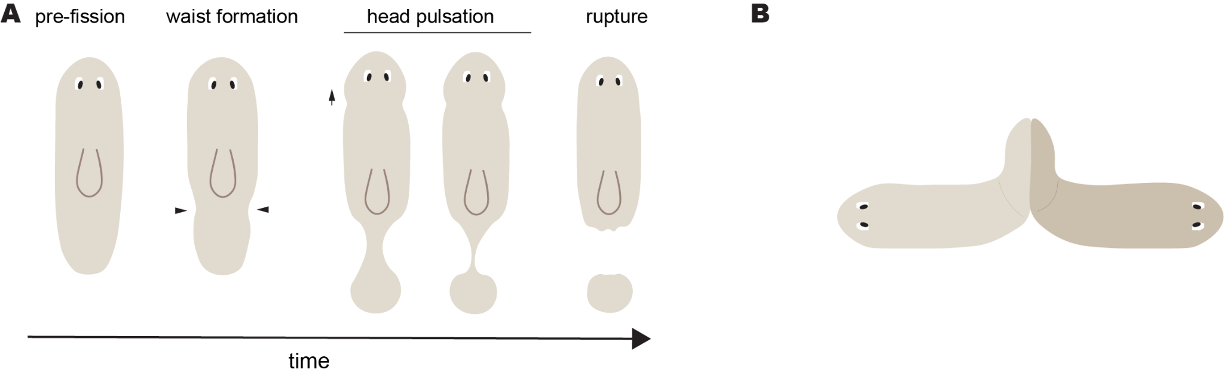
How does reproduction occur?
Asexual
Sexual

Slide 4
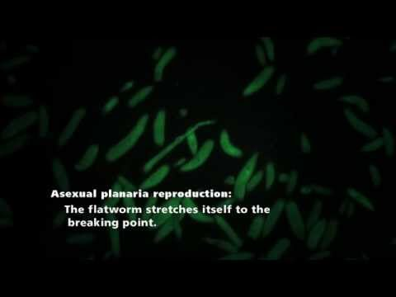
https://www.youtube.com/watch?v=xb0KewzZUUs

Slide 5
Genotype tells you what versions of the gene you have
Genes are pieces of DNA on a chromosome.
Genotype is the combination versions of the gene. The different versions are called alleles.
Genotype can be homozygous (two of the same alleles) or heterozygous (two different alleles).

Slide 6
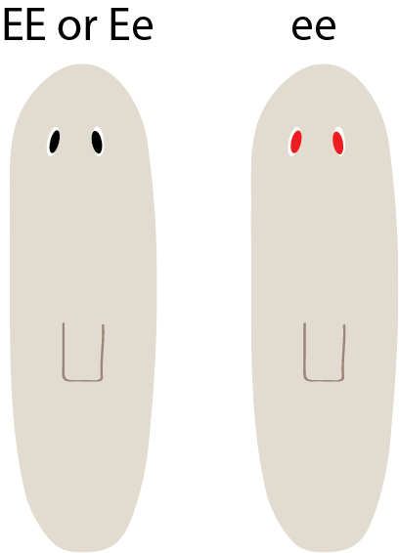
Phenotype is the trait you see
EE or Ee ee
Two different genotypes can have the same phenotype!
Example: The gene for eye color in planarians is represented by E. The dominant form of the gene is E and the recessive form of the gene is e. Planarians with the genotype EE or Ee will have black eyes and planarians with the genotype ee will have red eyes.

Slide 7


Genetic Variation
Parent 1
Parent 2
Asexual: clones of parent (no variation)
Sexual: inherit one chromosome from parent 1 and the other chromosome from parent 2 (since each parent has two chromosomes, there are four different possibilities!)
offspring options

Slide 8
Punnett Squares help calculate the possible genotypes of the offspring
E
e
Each box has a 25% chance of occurring. Parent 1’s genotype goes across the top and Parent 2’s genotype goes down the side.
Example: 2 parents heterozygous for eye color
E
E
E
E
e
e
E
e
e
e

Slide 9




What will offspring of different planarians look like?
COMPLETE THE WORKSHEET ON YOUR OWN
PAIR UP WITH THE PERSON NEXT TO YOU AND DISCUSS
SHARE WITH THE CLASS

Slide 10
Can you think of any pros/cons?
Is it always beneficial to have genetic variation?
Which mode is faster?
Which mode will result in more viable offspring?
Complete the case study!

