Slide 1
The Eyes Have it
How Our Eyes Function
By: Anna Knight

Slide 2
OUR FIVE SENSES
Hearing
Touch
Taste
Smell
Sight
Notes:
What are our five senses? Hearing, Touch, Taste, Smell, and Sight. Our sense of sight is one of the senses that we rely on the most.

Slide 3
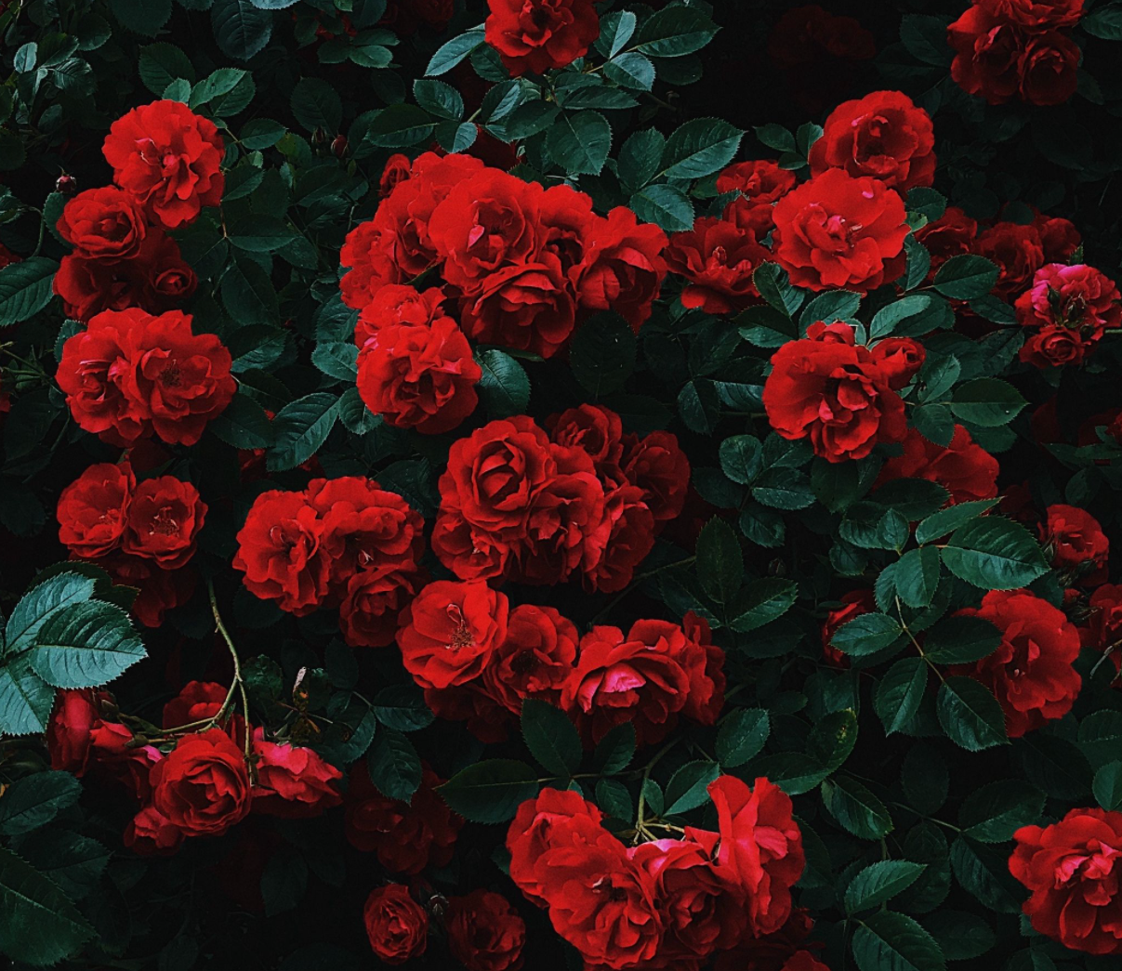
A WALK IN THE PARK
Wallpaperscraft
Notes:
When were taking a walk in the park and see a flower bush, we usually notice what that flower bush looks like before we touch, smell, or taste it (yuck!).

Slide 4
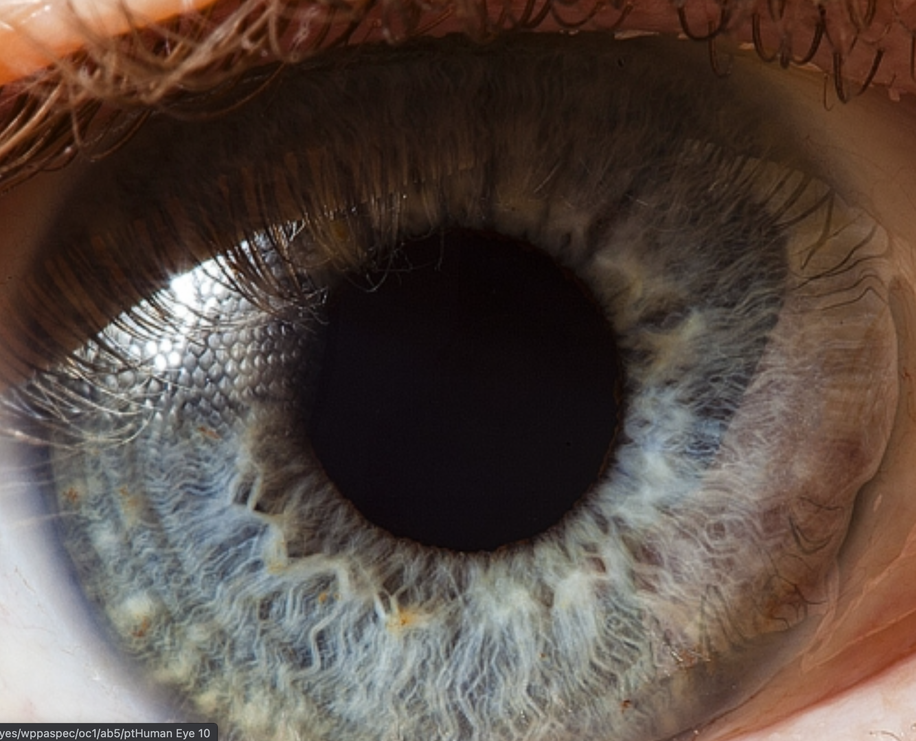
How do our eyes help us see?
Suren Manvelyan
Notes:
Our eyes are the organs that help us see, but the eye does not work alone. Today, were going to learn how the eye functions and how it interacts with another organ, our brain, to help us see a beautiful flower bush in the park!

Slide 5
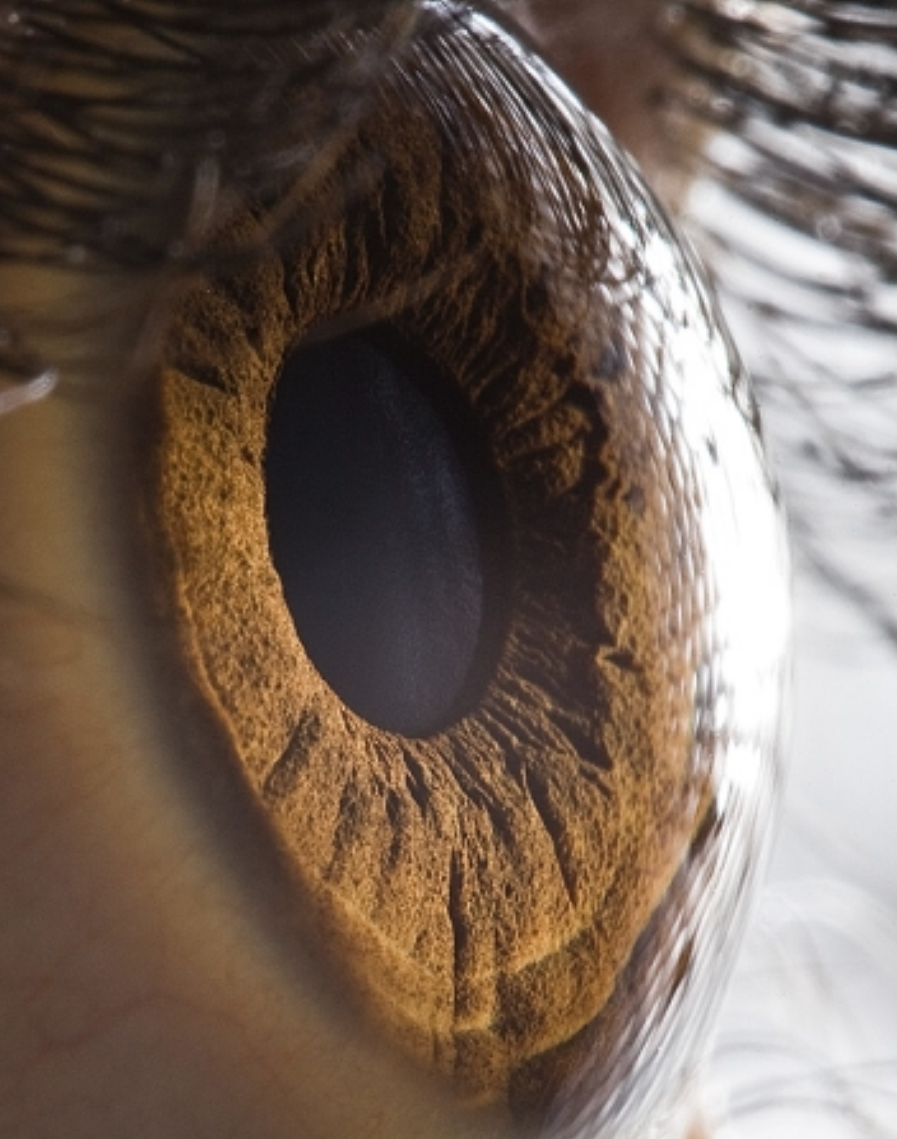
THE CORNEA
A clear, dome-shaped structure on the front portion of the eye
Suren Manvelyan
Notes:
We will start with where the light first enters the eye: the cornea. The cornea is a completely clear (transparent), dome-shaped structure in the front portion of the eye. When you are looking into someone’s eyes, you are looking into their cornea.

Slide 6
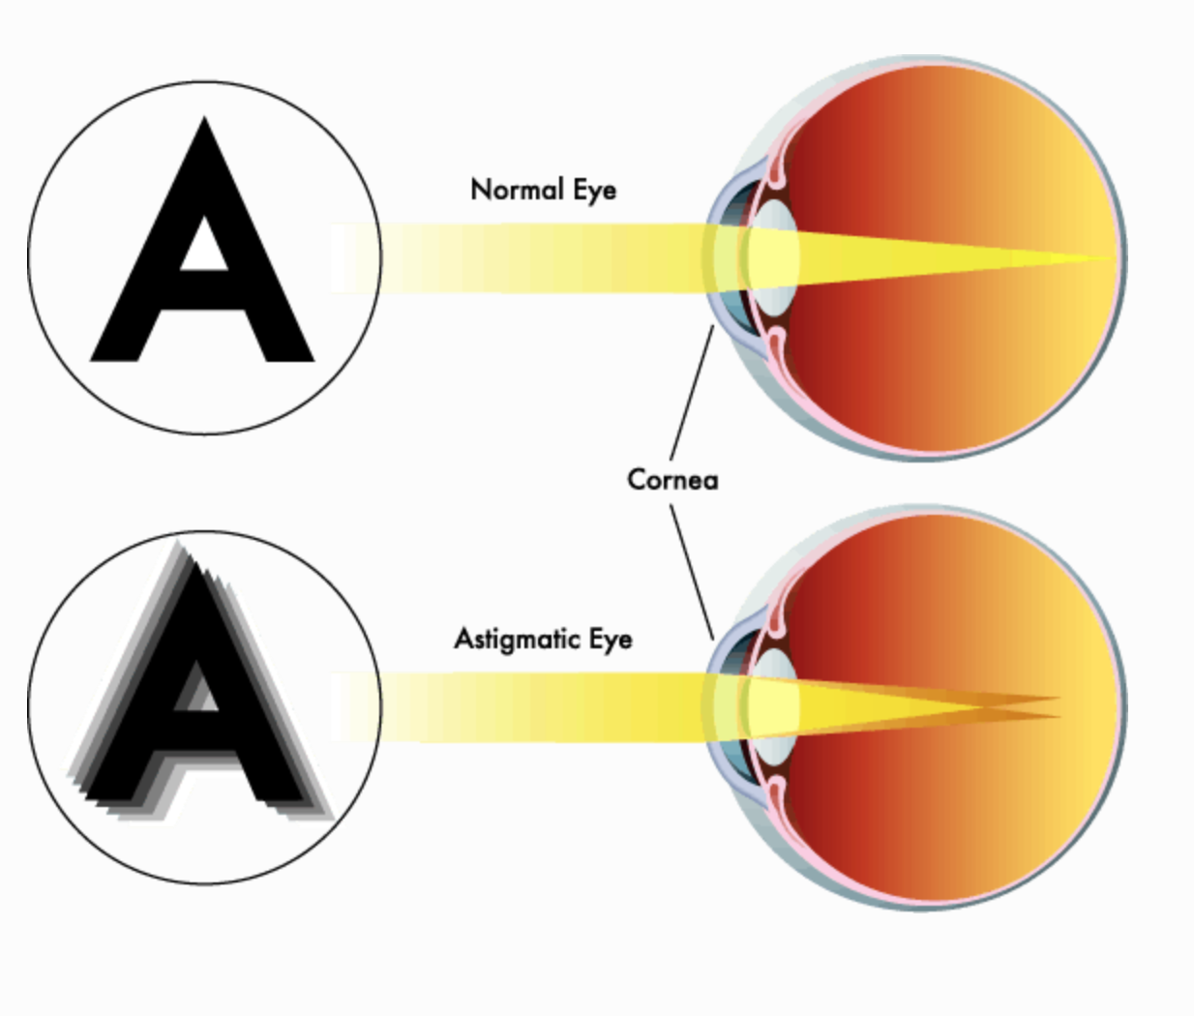
THE CORNEA
Helps protect the inner structures of the eye
Bends, or refracts, light as it enters the eye
Astigmatism
  A common condition where the cornea is an irregular shape (not a perfect dome shape)
  Causes blurry or distorted vision
  Glasses or contact lenses can help correct astigmatism
Seeportoptometry.com
Notes:
What are the cornea’s functions? The cornea helps protect the inside structures in the eye from damage. One of its most important jobs is refracting light. Refracting basically means to bend light. Because the cornea is curved, it refracts light, which helps focus the light onto the back of our eye so that we get crisp, clear vision. The cornea does a majority of the refracting in the eye (about two-thirds).
When the cornea has an irregular shape, this causes a condition called astigmatism. Some of you may have astigmatism or have heard your eye doctor talk about it. Astigmatism can cause blurry or distorted vision, because the irregular shape causes the cornea to not be able to refract light perfectly. This condition is common, and can be corrected with eye glasses or contact lenses in most cases.

Slide 7
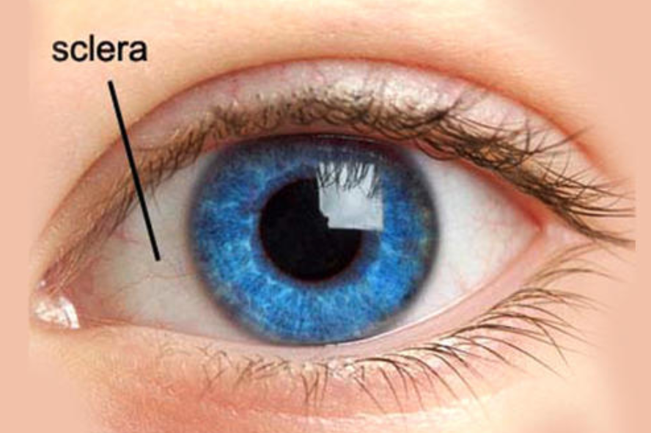
THE SCLERA
The sclera and the cornea make up the outer “wall” of the eye
The sclera is the white, outer portion of the eye
It offers protection to the inside structures of the eye
It also helps give the eye its globe shape
India Mart
Notes:
The sclera is the white, outer portion of the eye. The cornea and the sclera and what make up the outer surface of the eye. The sclera is typically called the “whites” of the eyes, because its an opaque, white tissue. The sclera offers protection to the eye, and also gives the eye its globe shape.

Slide 8
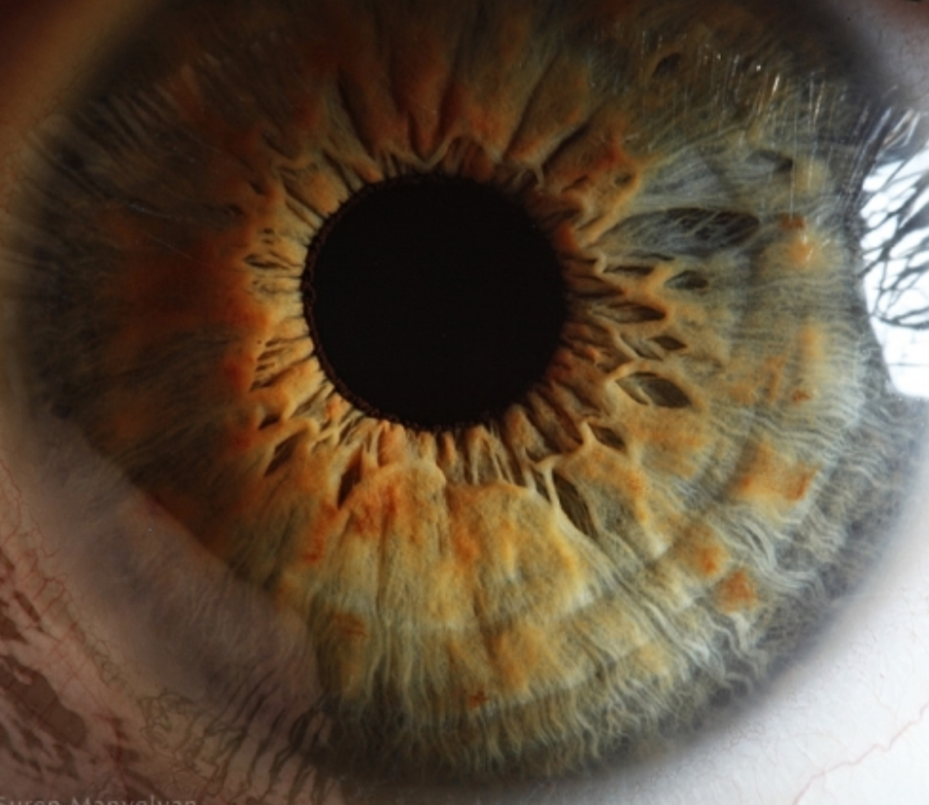
THE IRIS
The iris is the colored part of the eye that lies beneath the cornea
Everyone’s iris is as unique as their fingerprint!
The iris is a muscle that expands or contracts with changes in light
  Bright light: iris constricts (contracts) to limit the amount of light entering the eye
  Dim light: iris dilates (expands) to let more light into the eye
Suren Manvelyan
Notes:
The iris is one of the most recognizable parts of the eye because of its pigment. Everyone has an iris that is unique to them, just like their fingerprint! While the iris is quite beautiful, it also serves an important purpose. The iris is a muscle that helps control how much light is entering the eye. When the light is too bright, the iris constricts, or contracts, to limit how much light is entering. When we are in an area of low light, the iris dilates, or expands, to let in more light to the eye.

Slide 9
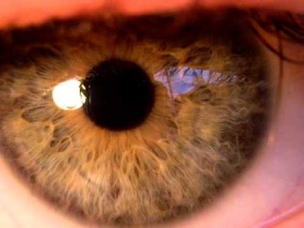
IRIS RESPONDING TO LIGHT
Notes:
https://www.youtube.com/watch?v=vAgGeLJ37iU
Can you identify when the iris is constricting? When is it dilating?

Slide 10
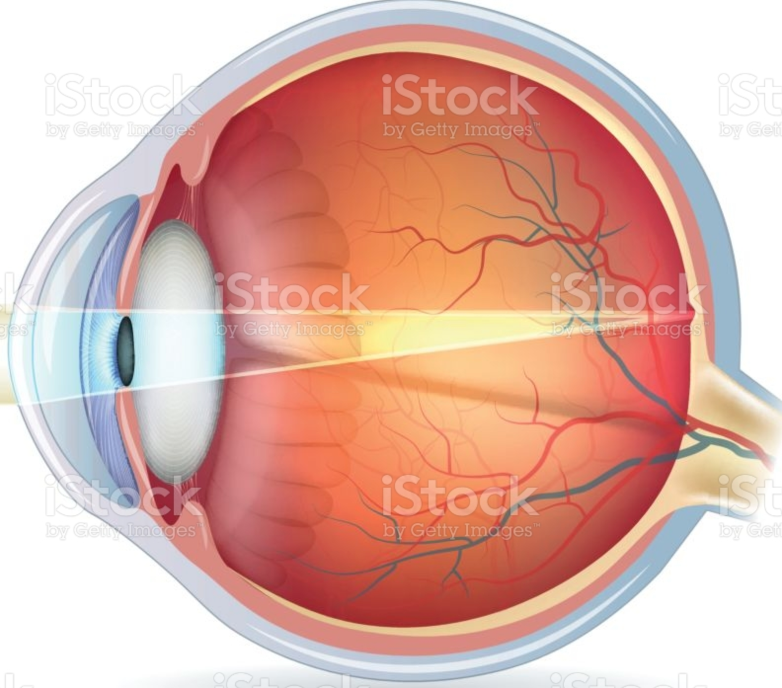
THE PUPIL
The pupil is a hole in the iris
This hole allows light to enter the eye
When the iris constricts, the pupil gets smaller
When the iris dilates, the pupil gets bigger
iStockPhoto
Notes:
The pupil is a hole in the iris that allows light to enter the eye. The pupil and the iris go hand-in-hand: when the iris contracts, the pupil gets smaller. When the iris dilates, the pupil gets bigger.

Slide 11
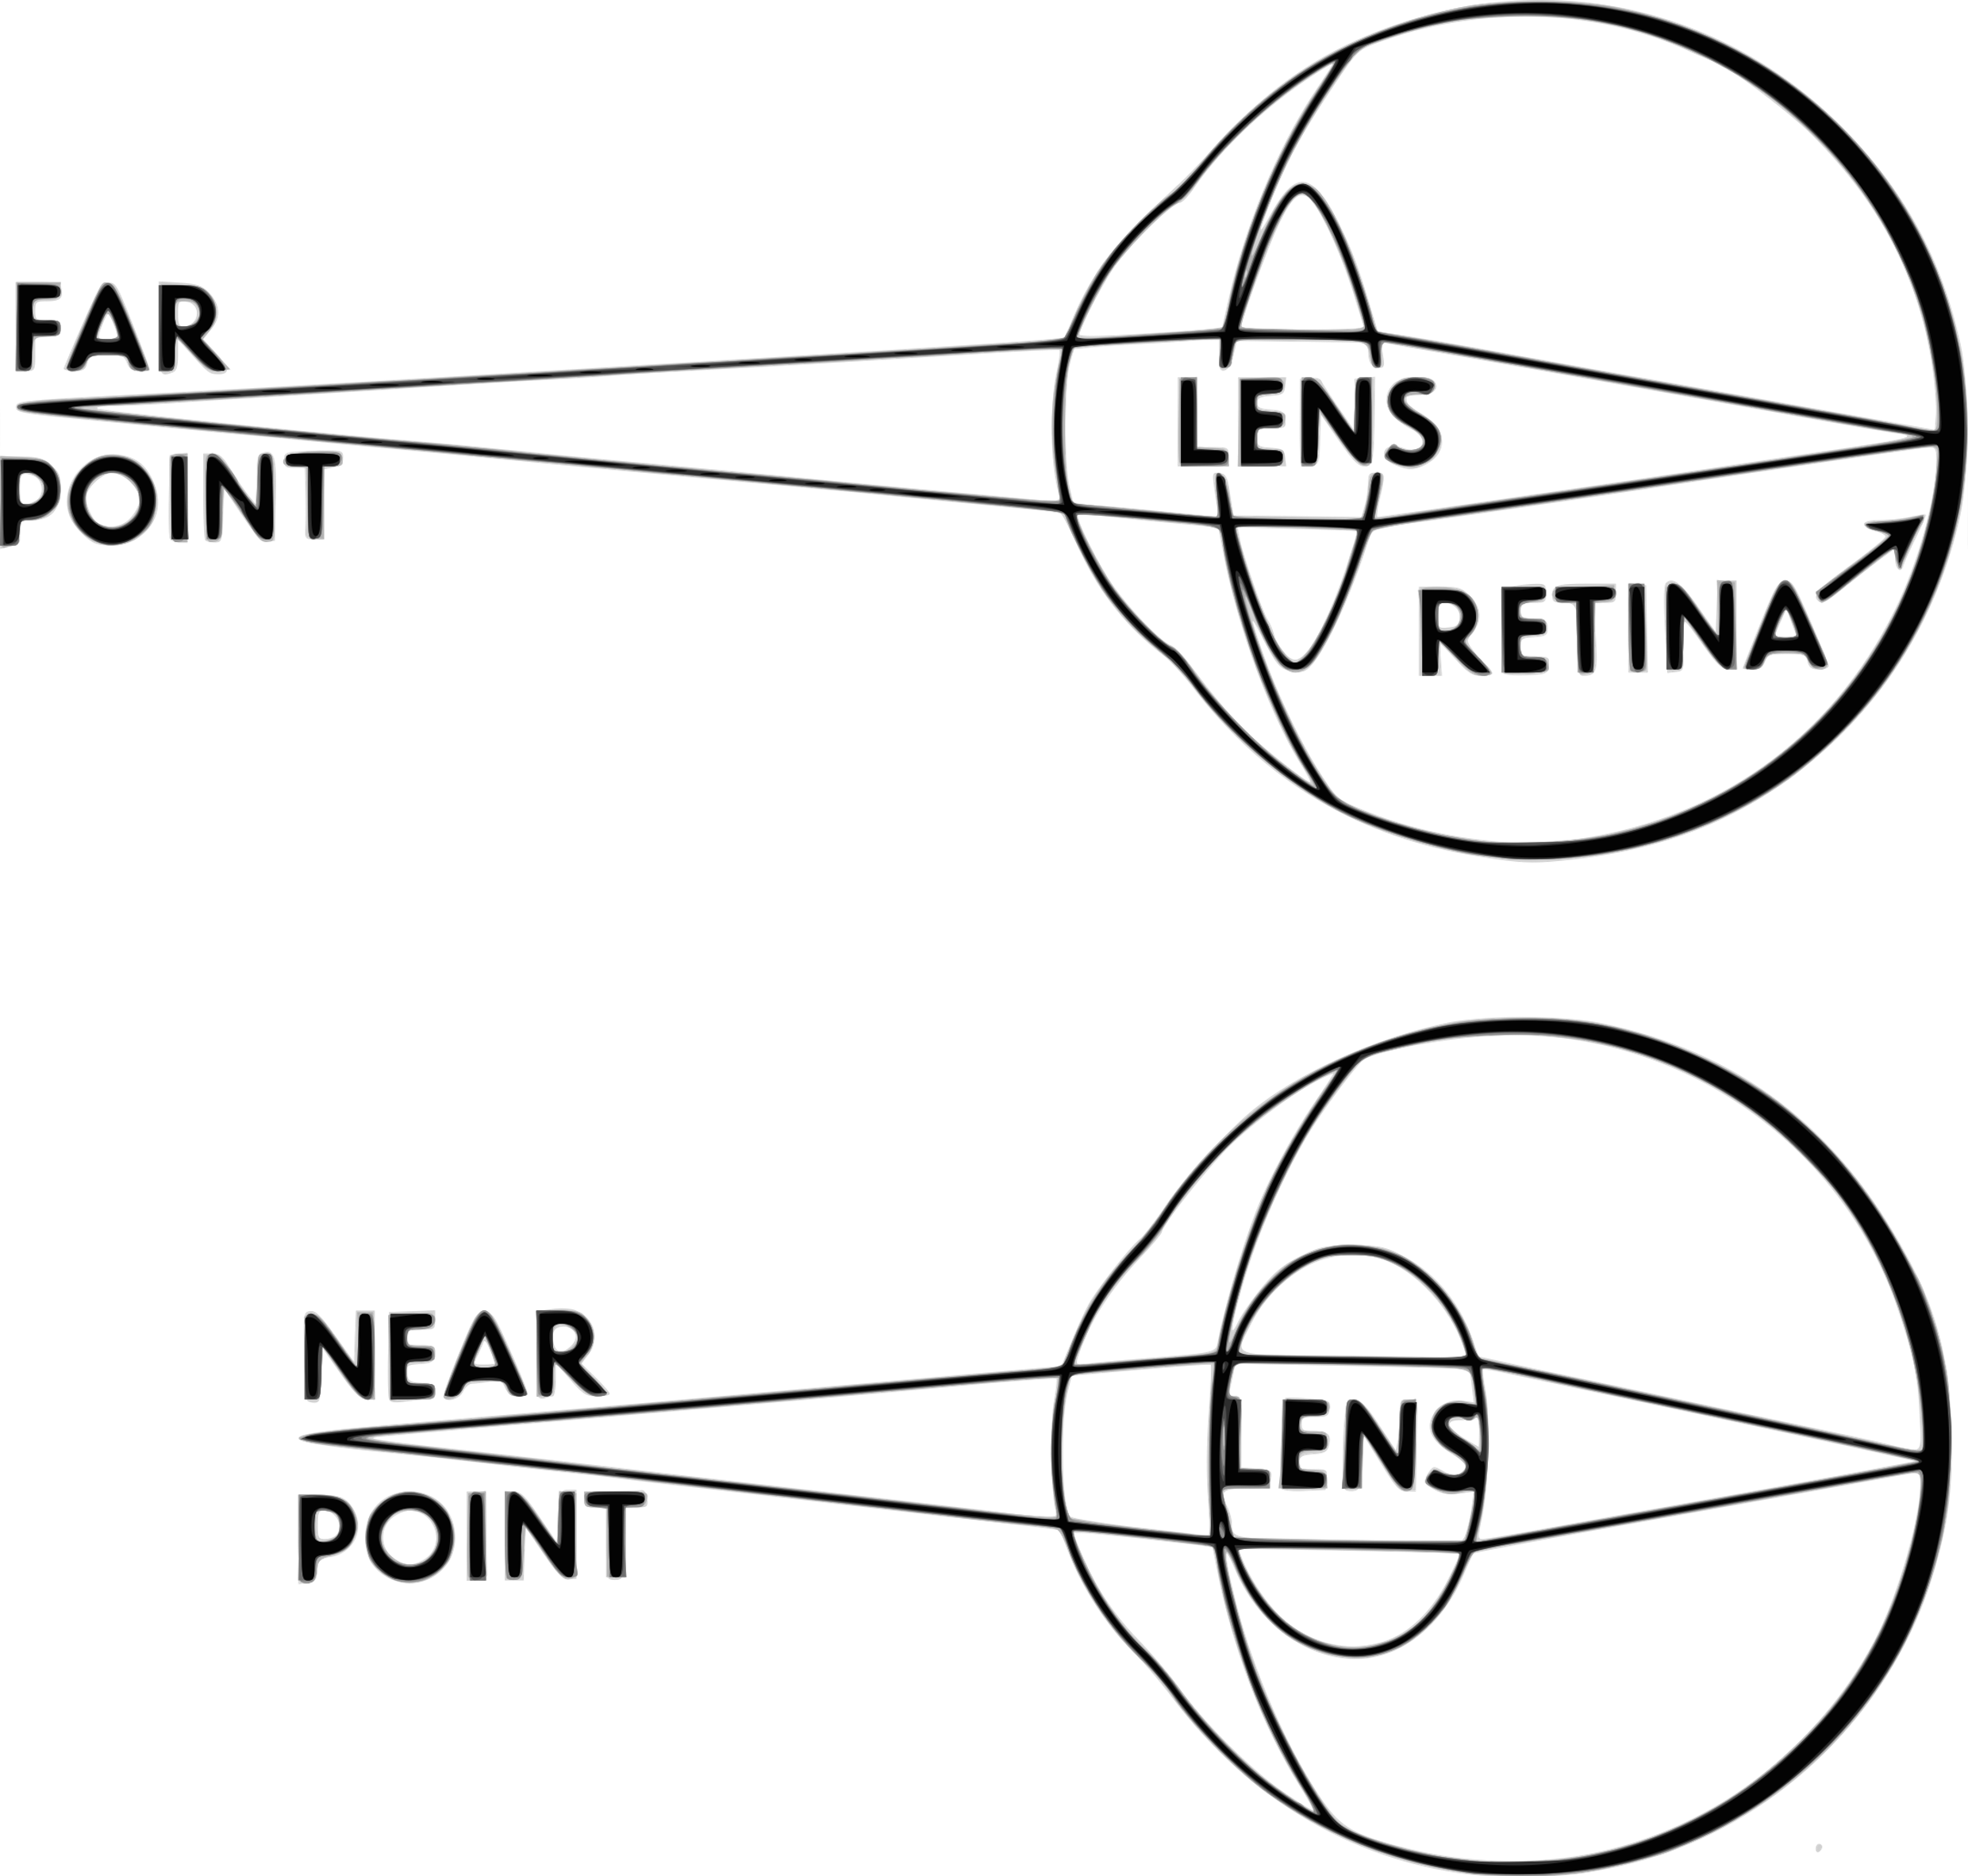
THE LENS
Clear, disc-shaped structure behind the iris
Refracts light
Small adjustments in refraction
  Distance vision-lens flattens
  Near vision-lens thickens
Wikipedia
Notes:
The lens is a clear, disc-shaped structure that lies behind the iris. The lens is another structure in the eye that refracts light. The cornea does most of the refracting, the lens just helps slightly adjust so that the light hits the back of the eye perfectly. When looking at objects that are far away versus objects up close, the light needs to be focused slightly differently. When looking at something far away, the lens flattens. When looking at something up close, the lens thickens. This helps make fine adjustments in your vision.

Slide 12
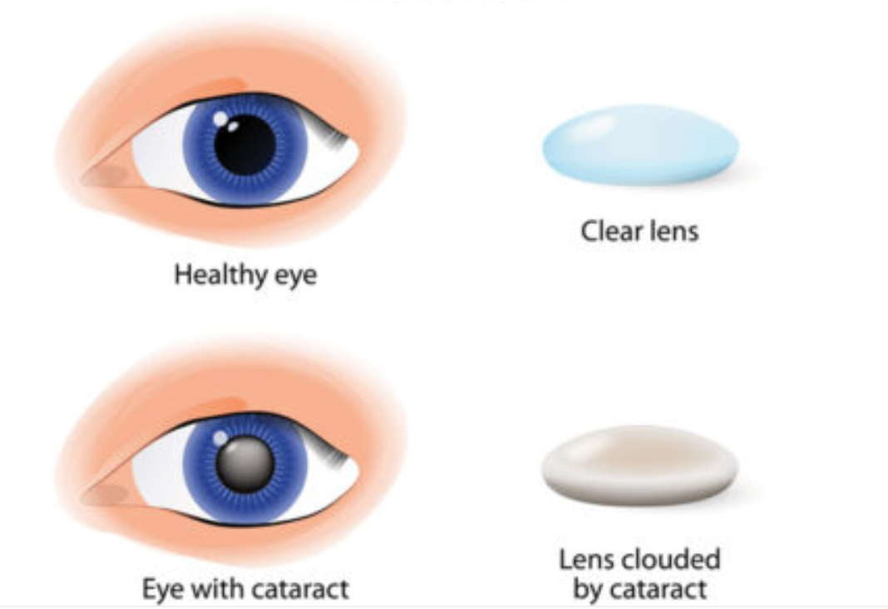
CATARACTS
The natural lens in the eye becomes cloudy, opaque
Causes blurry vision, difficulty seeing at night
Usually caused by old age, can also be caused by injury or disease
Corrected with cataract surgery
Craft Optics
Notes:
A cataract is a clouding of a person’s natural lens. Cataracts can cause blurry vision, especially at night or with bright lights. Cataracts can be caused by damage to the eye, malnutrition, diseases like diabetes, but they are typically due to aging. Cataracts are fixed through surgery. A surgeon removes the old, cloudy lens and replaces it with a brand new, clear lens.

Slide 13
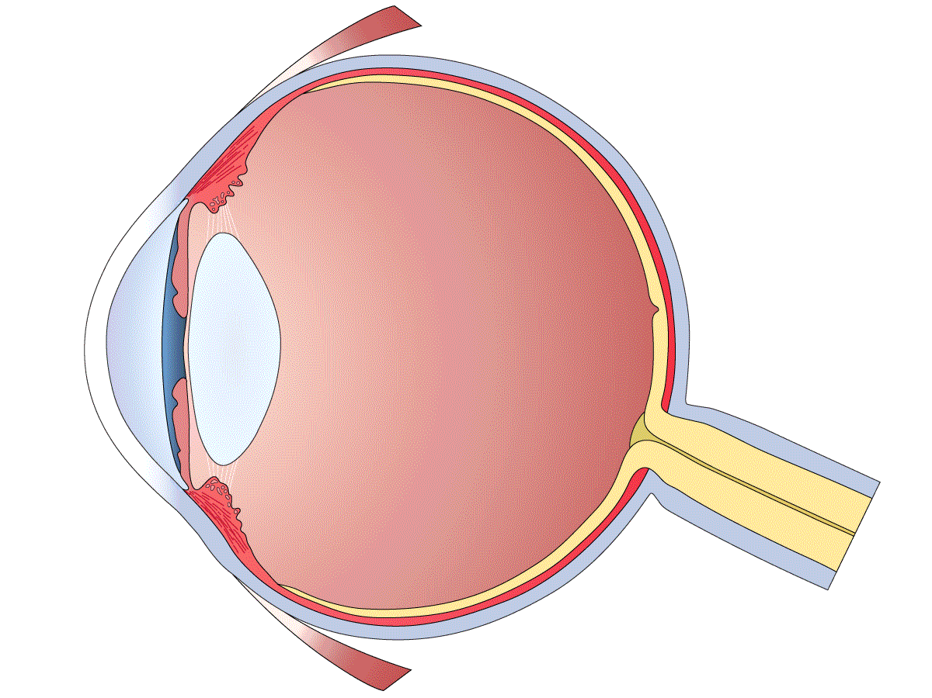
THE RETINA
RETINA (YELLOW)
Layer of specialized cells on the inside of the back of the eye
Retina cells respond to light, turn light into signals
The signals tell a story about your surroundings
These signals will be sent to the brain
PNGEgg
Notes:
The retina is a layer of special cells on the inside of the back of your eye. Up until this point, every structure in the eye has allowed light to be refracted and passed onto your retina so that it can be processed. The retina has specialized cells that turn light into signals. These signals tell a story about what you are seeing: what colors are there, how dark or bright something is, etc. The retina is going to send these signals to the brain to be perceived as vision!

Slide 14
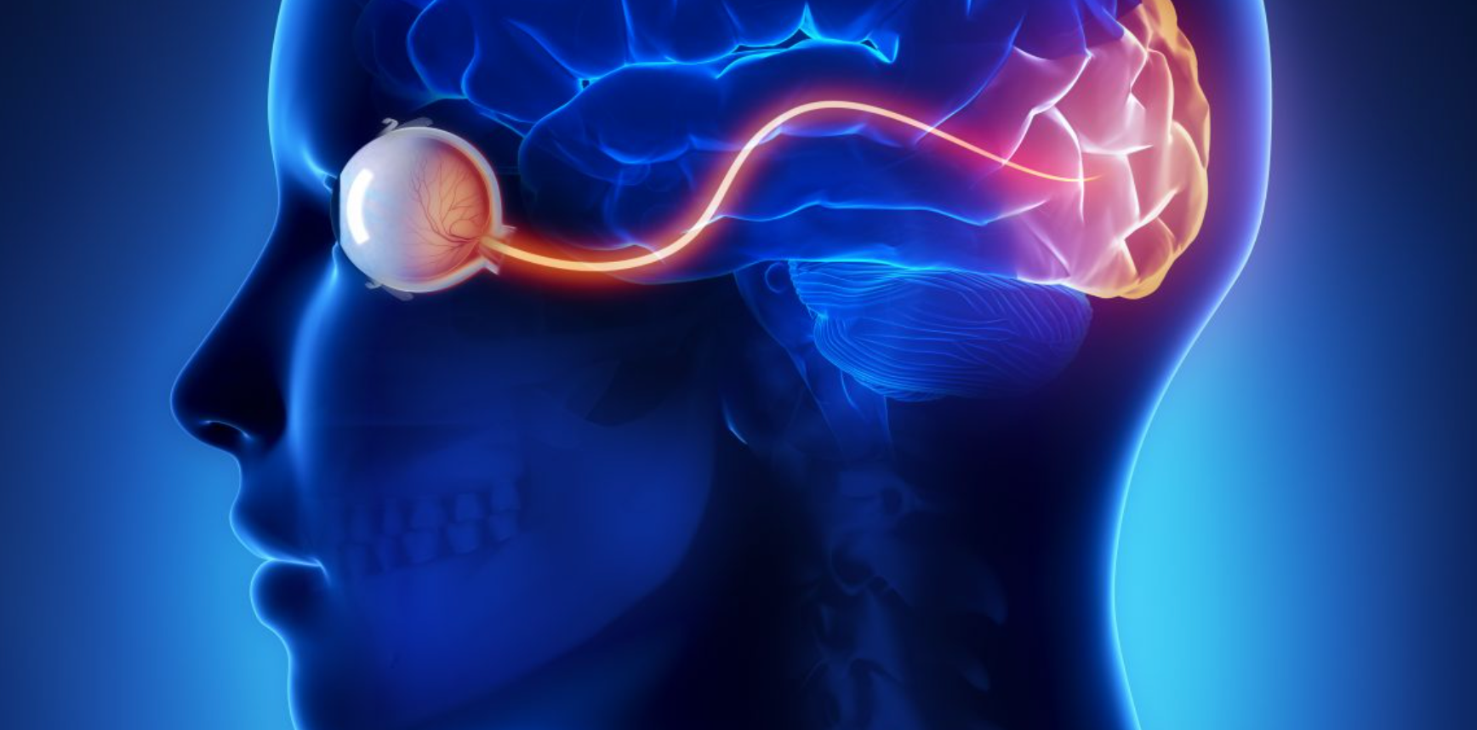
THE OPTIC NERVE
The optic nerve connects the eye to the brain
Like a tiny, smooth piece of rope
Made up of retinal cells
Sends the signals from the retina to the brain
Stanford Medicine
Notes:
How is the retina going to send these signals to the brain? It’s going to use a pathway called the optic nerve. This is where all of your retinal cells meet and form a bundle that looks like a tiny, smooth piece of rope. This optic nerve is going to travel to the brain and give the signals to the brain to be interpreted as vision.

Slide 15
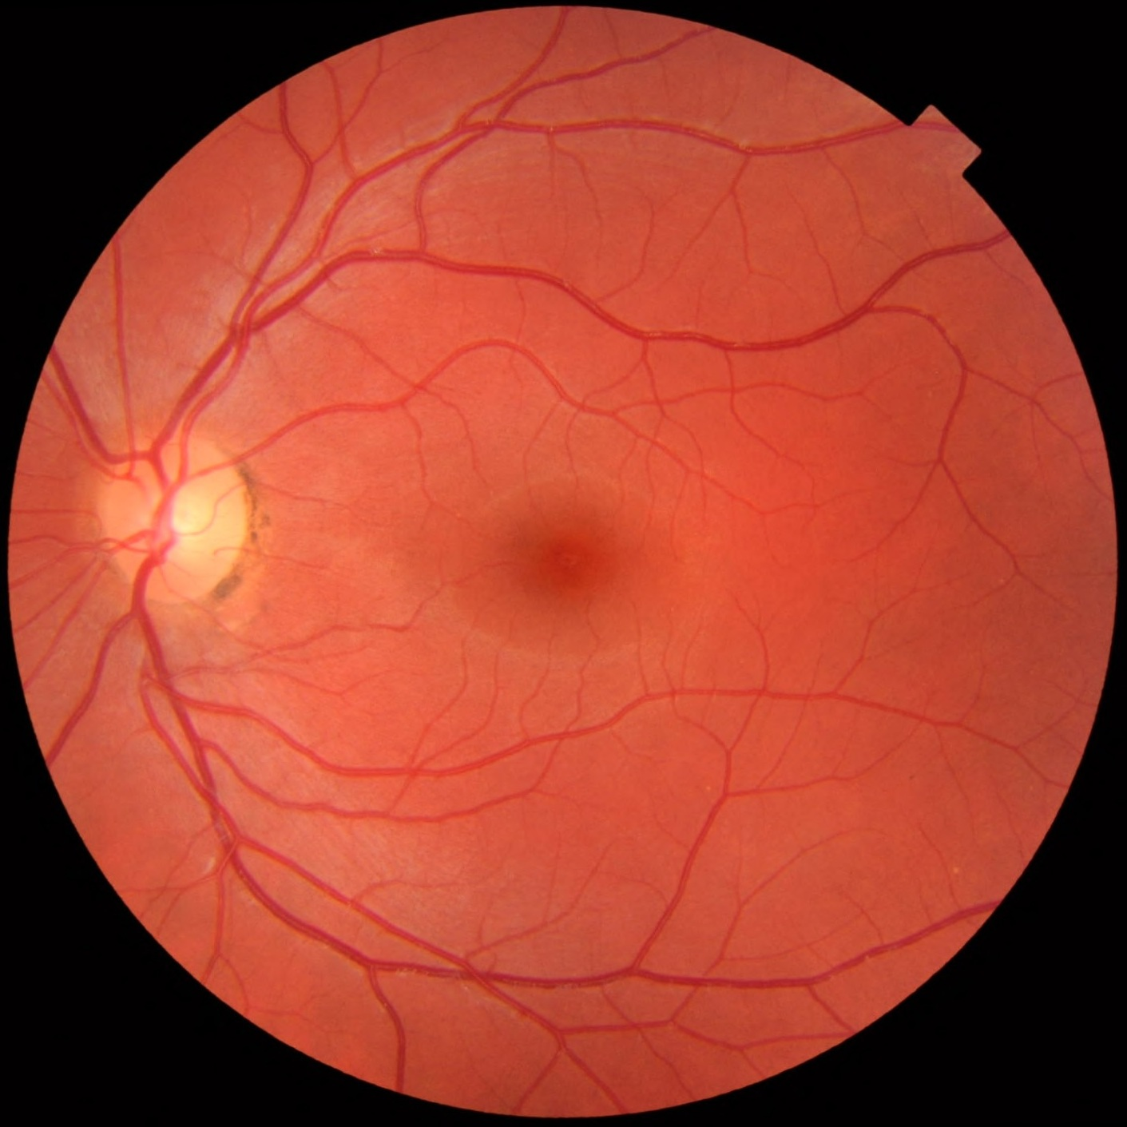
HUMAN RETINA AND OPTIC NERVE
OPTIC NERVE
Wikipedia
Notes:
This is what the eye doctor sees when he looks into the back of your eye! The pink part is the retina, the yellowish circle is the optic nerve. You can also see blood vessels coming out of the optic nerve and going across your retina.
An eye doctor is called an optometrist. The optometrist will sometimes dilate your eyes, to make your pupils bigger so that he can see more of your retina. The optometrist does this to make sure your retina, optic nerve, and blood vessels are healthy!

Slide 16
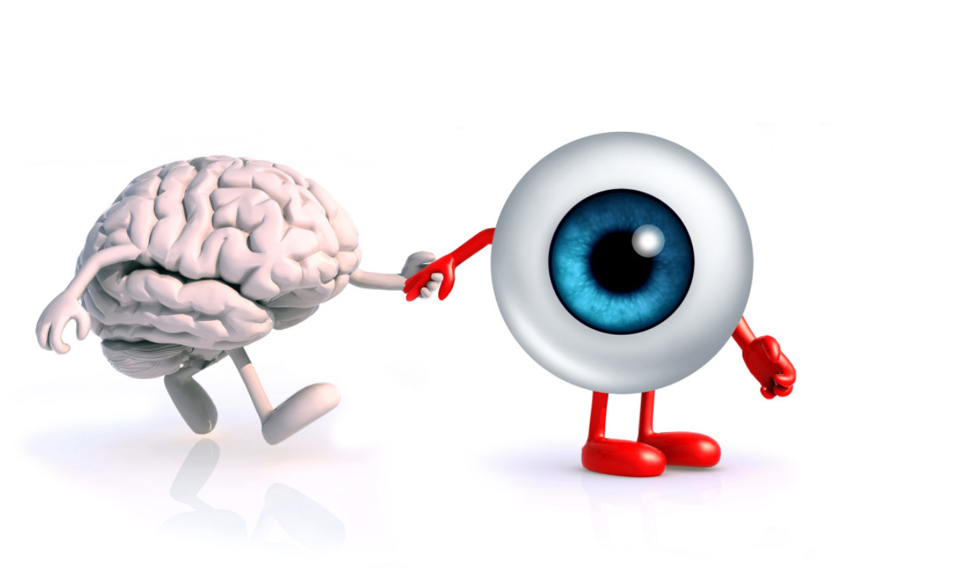
THE EYES AND BRAIN WORK TOGETHER
Minnesota Vision Therapy
Notes:
The eyes and the brain work together to make vision possible. The specialized cells in the retina sense the light coming into the eye, and make signals based on what they are sensing. Then, this information gets sent along the optic nerve to the brain. The brain takes those signals and perceives, or interprets, what the retina signal is saying as what we know as vision. If the optic nerve is damaged, or the visual part of the brain is damaged, vision can be disrupted or completely lost. Even if the eyes are completely healthy and able to receive signals, if this signal cannot be sent to the brain, vision cannot occur. Therefore, this interaction between the eyes and brain are very important in understanding how our vision works.

Slide 17

MAKE YOUR OWN EYEBALL!

Slide 18
PICTURE REFERENCES
https://wallpaperscraft.com/download/roses_bush_bloom_128901/3840x2400
Surenmanvelyan.com
https://www.indiamart.com/proddetail/sclera-treatment-14331431255.html
https://seeportoptometry.com/astigmatism/
https://www.britannica.com/science/iris-eye
https://www.istockphoto.com/vector/human-eye-cross-section-normal-vision-gm648725190-117860905
https://en.wikipedia.org/wiki/Accommodation_(eye)#/media/File:Accommodation_(PSF).svg
https://craftoptics.com/cataracts-and-craftoptics/
https://www.pngegg.com/en/png-ndgrq
https://scopeblog.stanford.edu/2016/07/11/long-distance-eye-brain-connections-partial-vision-restored-for-first-time-ever-in-a-mammal/
https://en.wikipedia.org/wiki/Fundus_photography#/media/File:Fundus_photograph_of_normal_left_eye.jpg
http://www.minnesotavisiontherapy.com/what-is-vision-therapy/eye-brain-holding-hands

