Slide 1
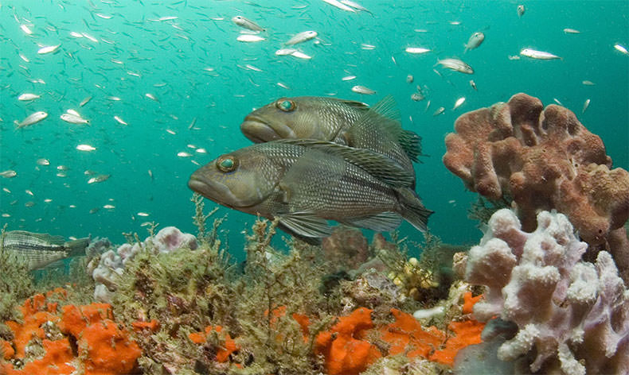
Reading Features of Georgia Fish

Slide 2
You have 1 minute
write down as many body features of fish you can
What do you already know about me?
I may not have legs but I do have…

Slide 3
What did you write down?
Notes:
Students should share with you what you wrote down. Maybe write these features on the board.

Slide 4
You will learn today
how reading fish features can tell you about where they live, what they eat, how they avoid being eaten, and how fast they swim.
My features tell you so much about me!

Slide 5
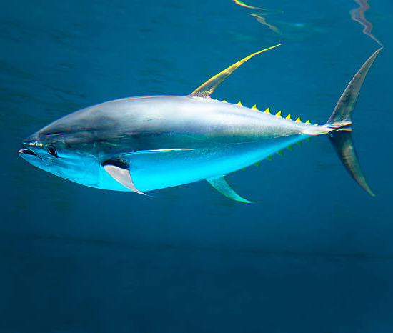
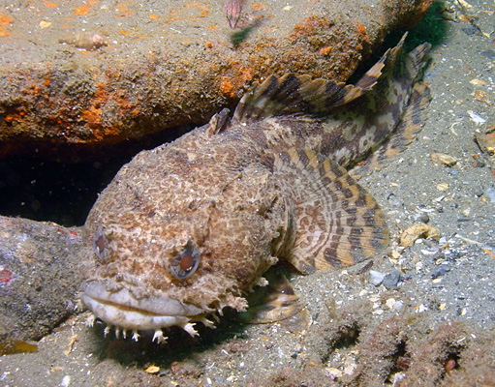
Question: Who swims faster?
Ms. Tuna
OR
Ms. Toadfish

Slide 6
Question: Who swims faster?
I swim faster!
How do you know?
Ms. Tuna
OR
Ms. Toadfish

Slide 7
Question: Who swims faster?
I swim faster!
Why?
My body shape and my tail shape tell you I am a fast swimmer
My body shape and tail shape tell you I am a slowwww swimmer
Ms. Tuna
OR
Ms. Toadfish

Slide 8
Question: Where do you think Ms. Toadfish lives in the ocean?
Ms. Toadfish

Slide 9
Question: Where do you think Ms. Toadfish lives in the ocean?
My color pattern and camouflage tell you I live near rocks
Ms. Toadfish

Slide 10
Fish Habitats
Habitat: is an area where something lives
Fish are adapted to live in different habitats
Fish like Ms. Tuna live in the open water, where they swim all day long
Fish like Ms. Toadfish live under a rocks and oysters, where they hide all day long

Slide 11
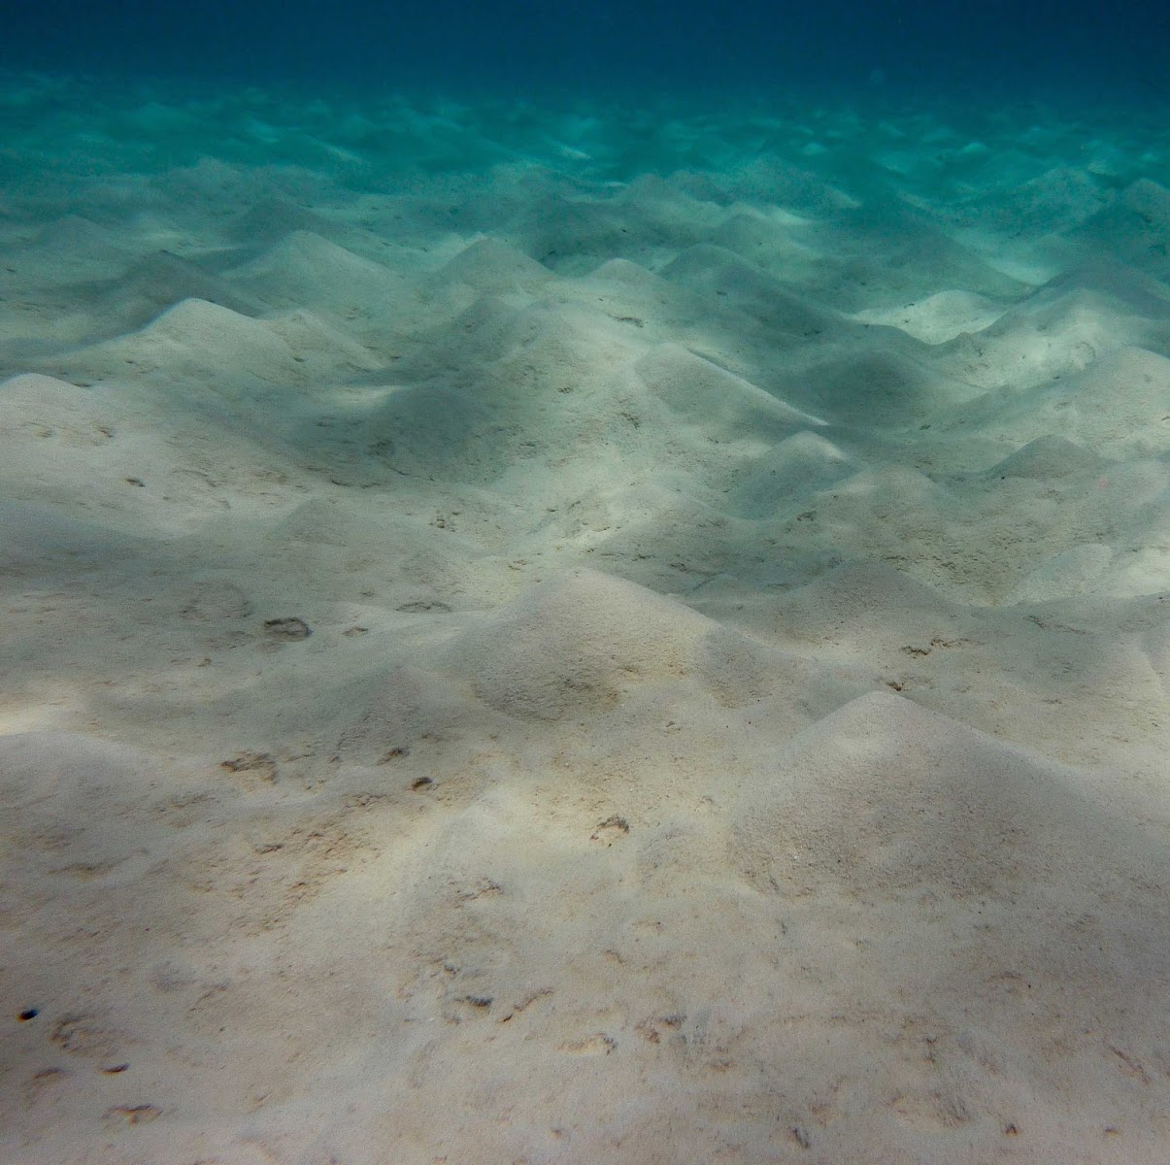
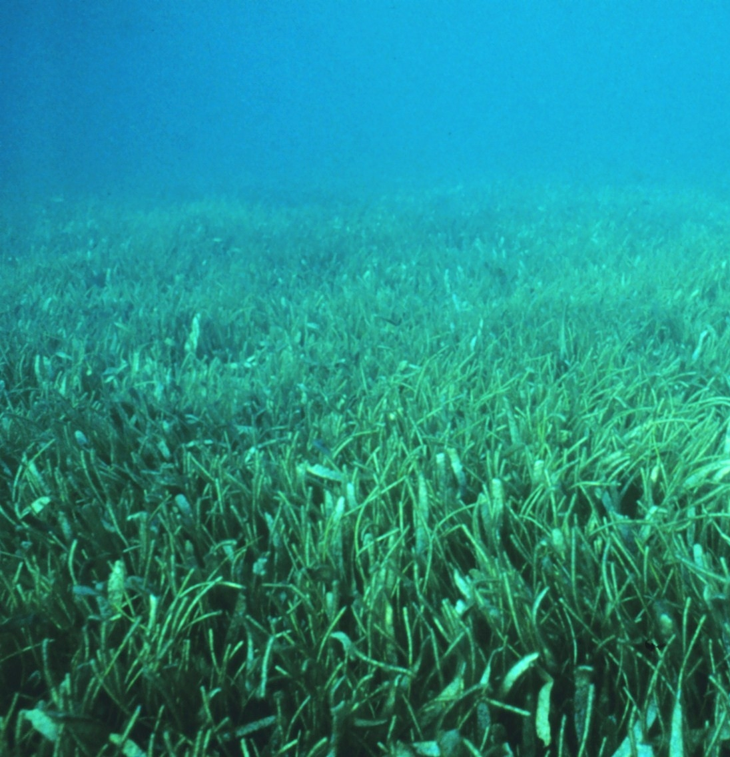
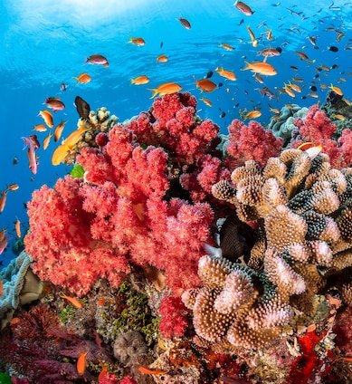

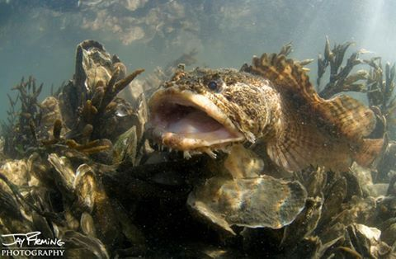
Fish Habitats in Georgia
Let’s explore five different habitats fish in Georgia!

Slide 12
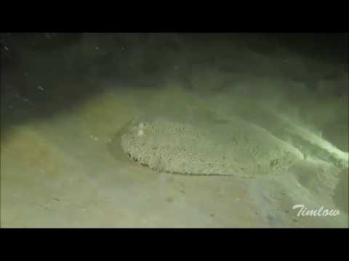
Habitat #1: Sandy Bottom
Some fish live in the sand!
They often bury themselves and wait for food to come by and attack
CLICK HERE
to see Mr. Flounder in his Sandy Bottom habitat

Slide 13
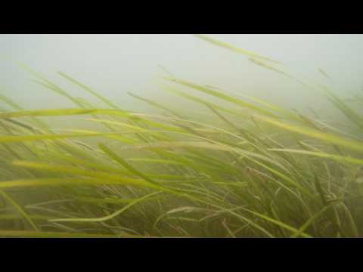
Habitat #2: Seagrass
Some fish live in the seagrass!
They often hide in the seagrass away from predators!
CLICK HERE
to see what it looks like to swim through the seagrass

Slide 14
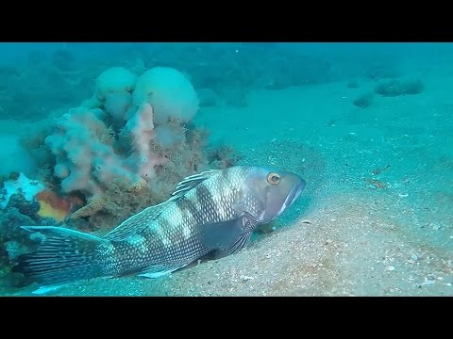
Habitat #3: Coral Reefs
Some fish live in coral reef habitats!
These fish are often colorful!
CLICK HERE
to see what a coral reef looks like in Georgia

Slide 15
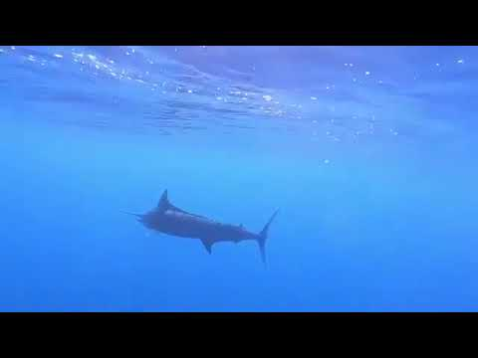
Habitat #4: Open Water
Some fish live in the open water!
This means they swim most of the day and night!
CLICK HERE
to see a Marlin swimming in the open water

Slide 16
Habitat #5: Oyster beds
Some fish live around oyster beds!
There are many oyster beds in Georgia waters!
SEE HERE
Ms. Toadfish on a oyster bed

Slide 17
Now that we explored Georgia habitats…
Let’s learn a little bit about some of the features found on fish
My features tell you so much about me!

Slide 18
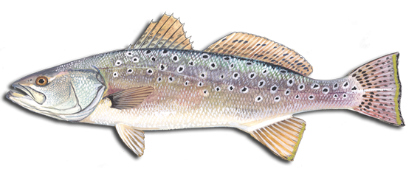
Body features of a fish
Body shape: tells us where it live
Tail shape: tells us how fast it is
Mouth/teeth: tells us what it eats and where its food is
Color pattern: tells us how it protects itself

Slide 19
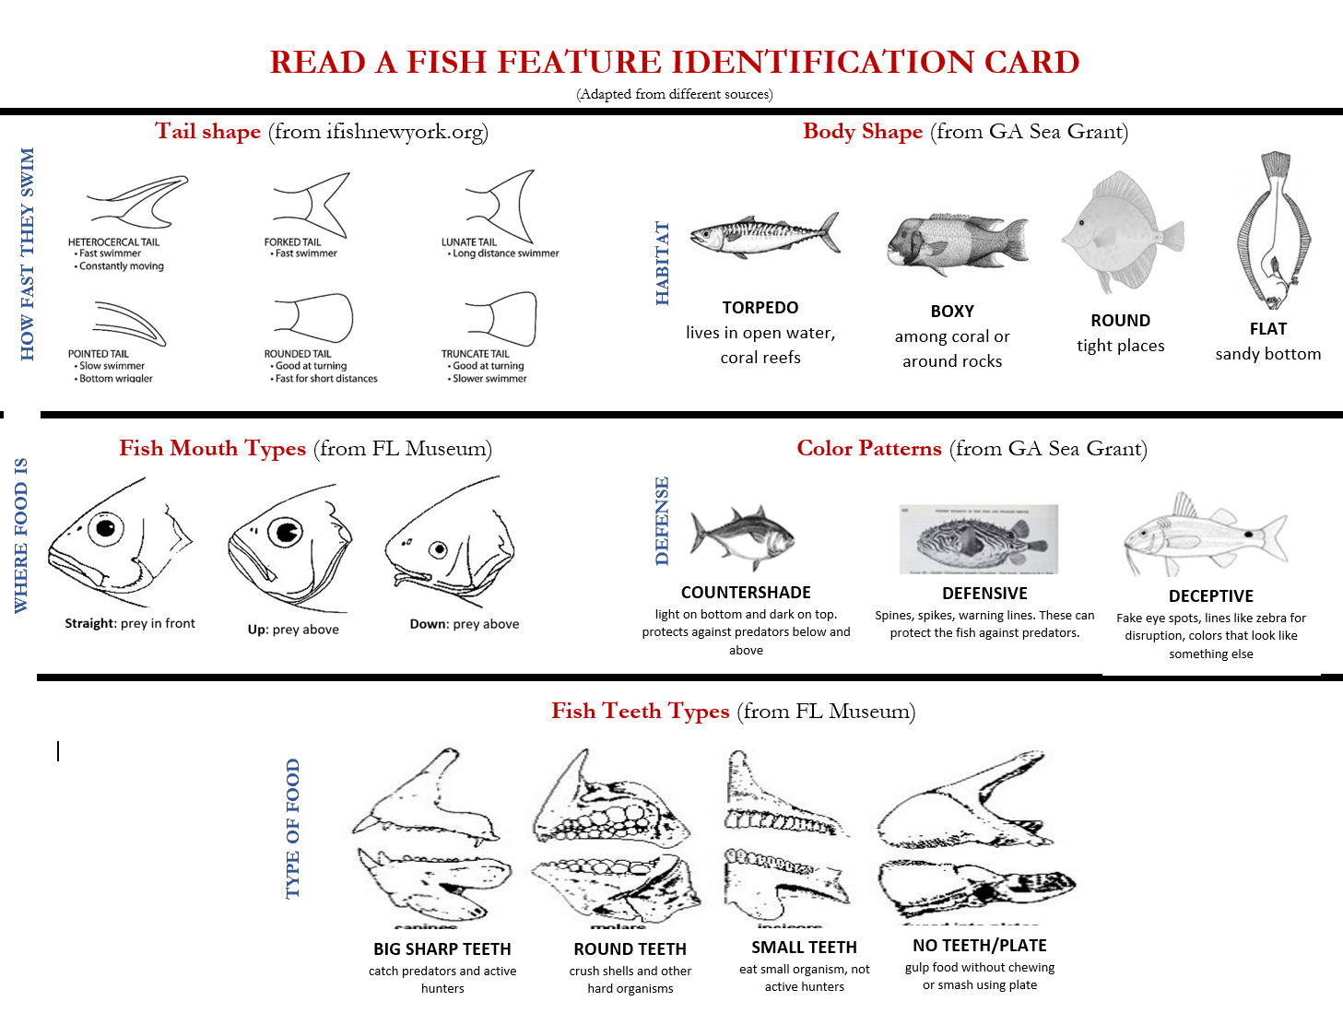
Let’s look at our READ A FISH cards
Notes:
Practice reading this fish

Slide 20
Let’s look at our READ A FISH cards
Body shape: ?
Tail shape: ?
Mouth/teeth: ?
Color pattern: ?
Notes:
Practice reading this fish

Slide 21
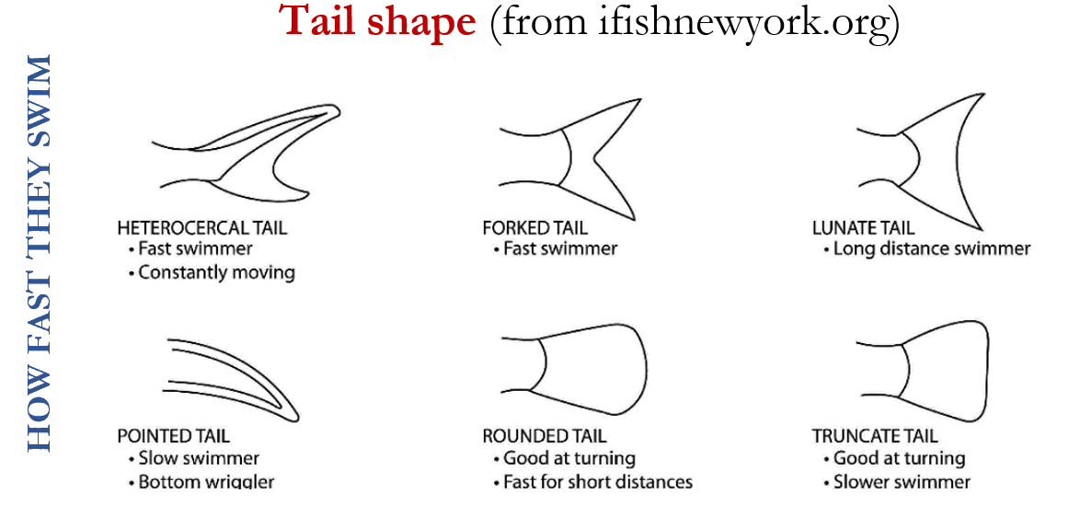
Tail Shape
The shape of a fishes tail tells you have fast they swim!

Slide 22
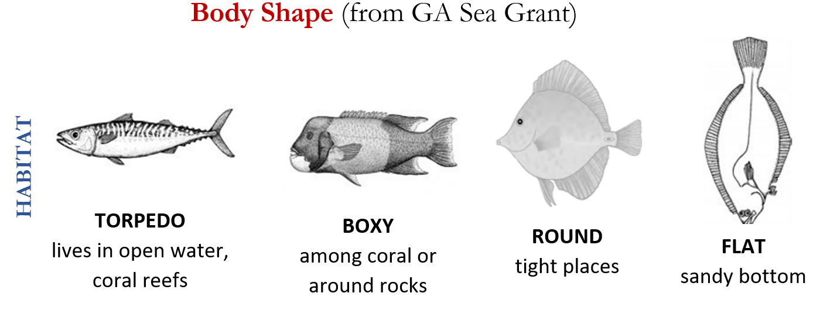
Body Shape
The shape of a fishes BODY tells you where they live!

Slide 23
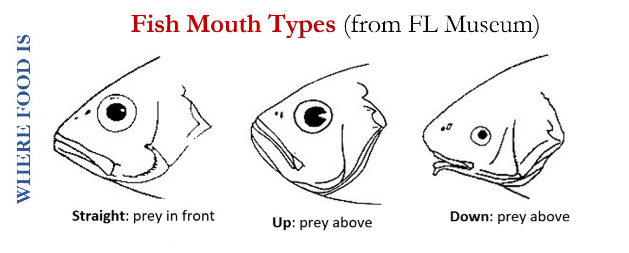
Mouth Types
The MOUTH TYPE tells you where their prey is commonly found!

Slide 24
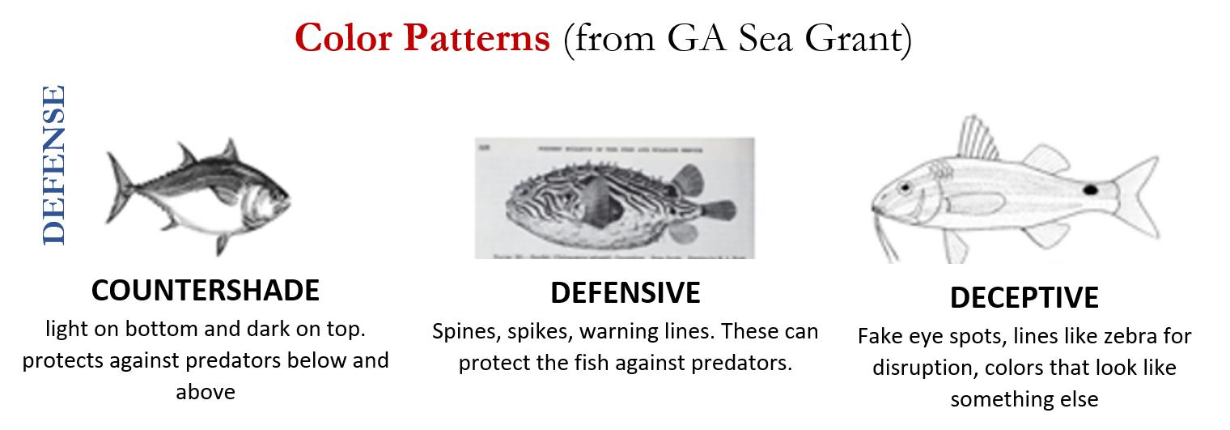
Color Pattern
The COLOR PATTERN tells you defend themselves!

Slide 25
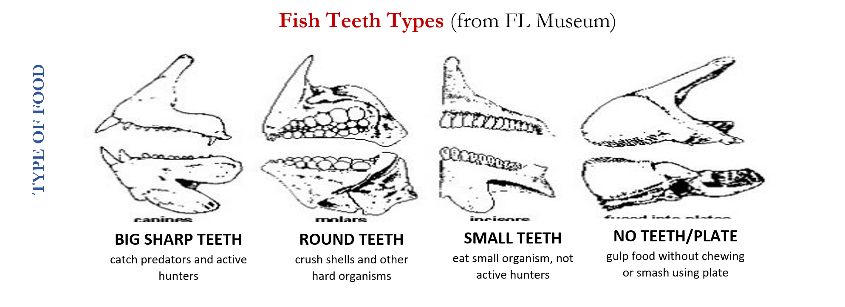
Teeth Type
The TEETH TYPE tells you what they eat!

Slide 26

Let’s practice reading fish!
Kahoot Quiz Time!

Slide 27
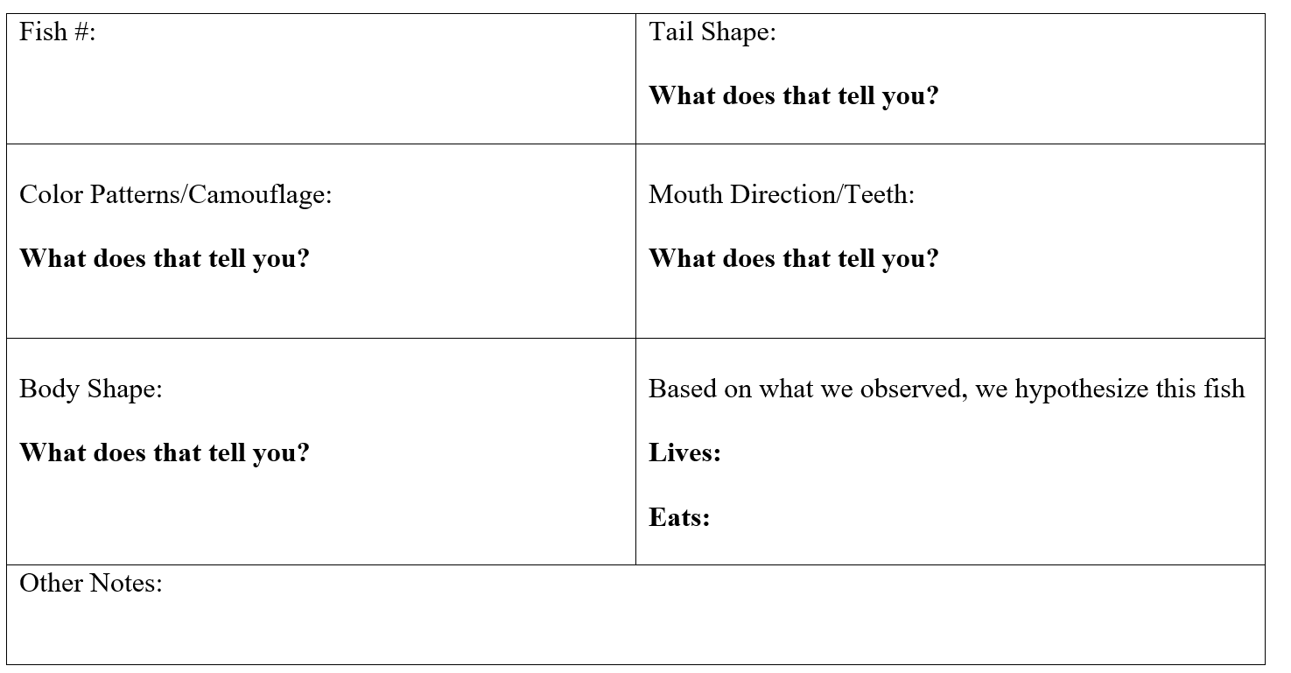
Activity 1: Read fish from Georgia!
Station #2
Station #1
Station #3
Station #6
Station #4
Station #5
Notes:
Explain instructions for Activity 1

Slide 28
Activity 1: Read fish from Georgia!
Notes:
Explain instructions for Activity 1

Slide 29
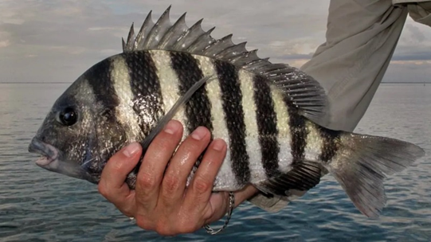
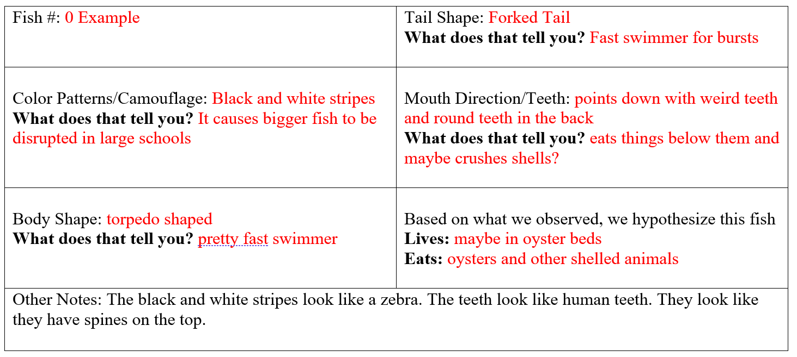
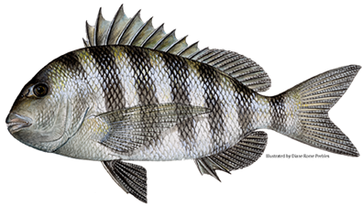
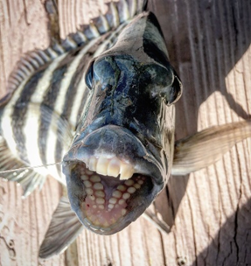
Activity 1: Read fish from Georgia!
Notes:
Explain instructions for Activity 1

Slide 30
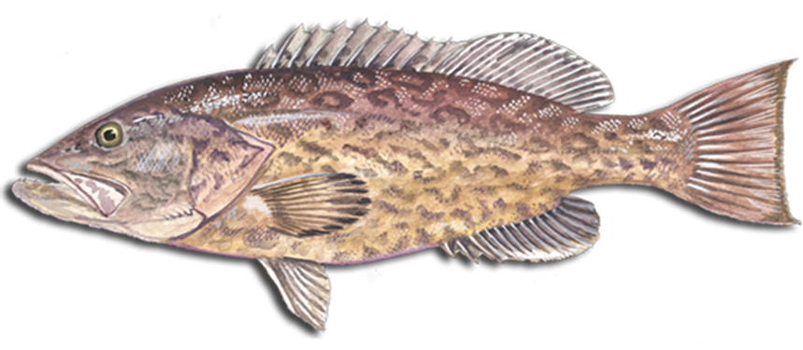
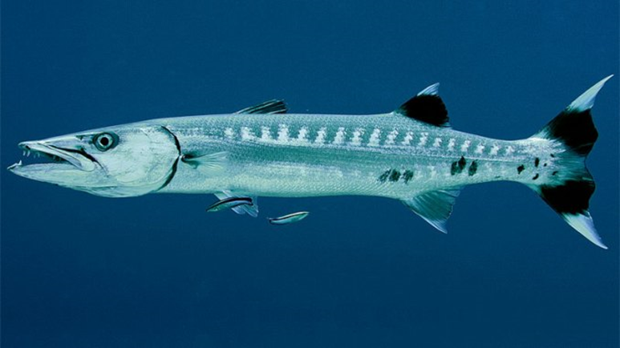
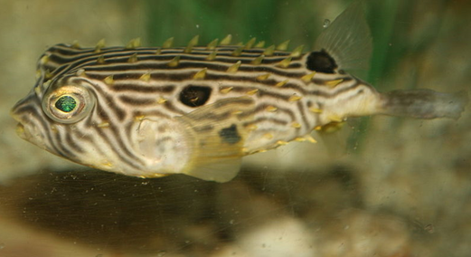
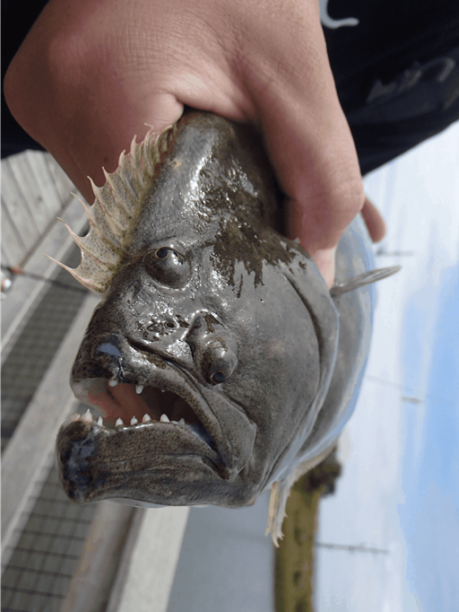
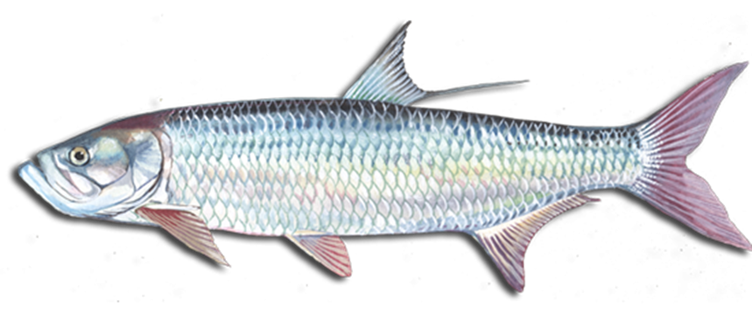
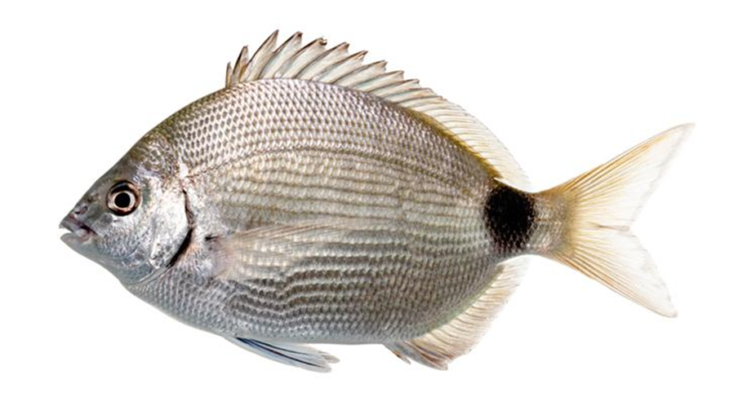
Activity 1: Your turn to Read Fish from Georgia!
Station #2
Station #1
Station #3
Station #4
Station #6
Station #5
Notes:
Explain instructions for Activity 1

Slide 31
Class Discussion
Hi! I am a barracuda!
Tell the class what you learned about me!
Notes:
After all groups have gone to the 6 stations

Slide 32
Class Discussion
Hi! I am a gag grouper!
Tell the class what you learned about me!

Slide 33
Class Discussion
Hi! I am a burrfish!
Tell the class what you learned about me!

Slide 34
Class Discussion
Hi! I am a flounder!
Tell the class what you learned about me!

Slide 35
Class Discussion
Hi! I am a pinfish!
Tell the class what you learned about me!

Slide 36
Class Discussion
Hi! I am a tarpon!
Tell the class what you learned about me!

Slide 37
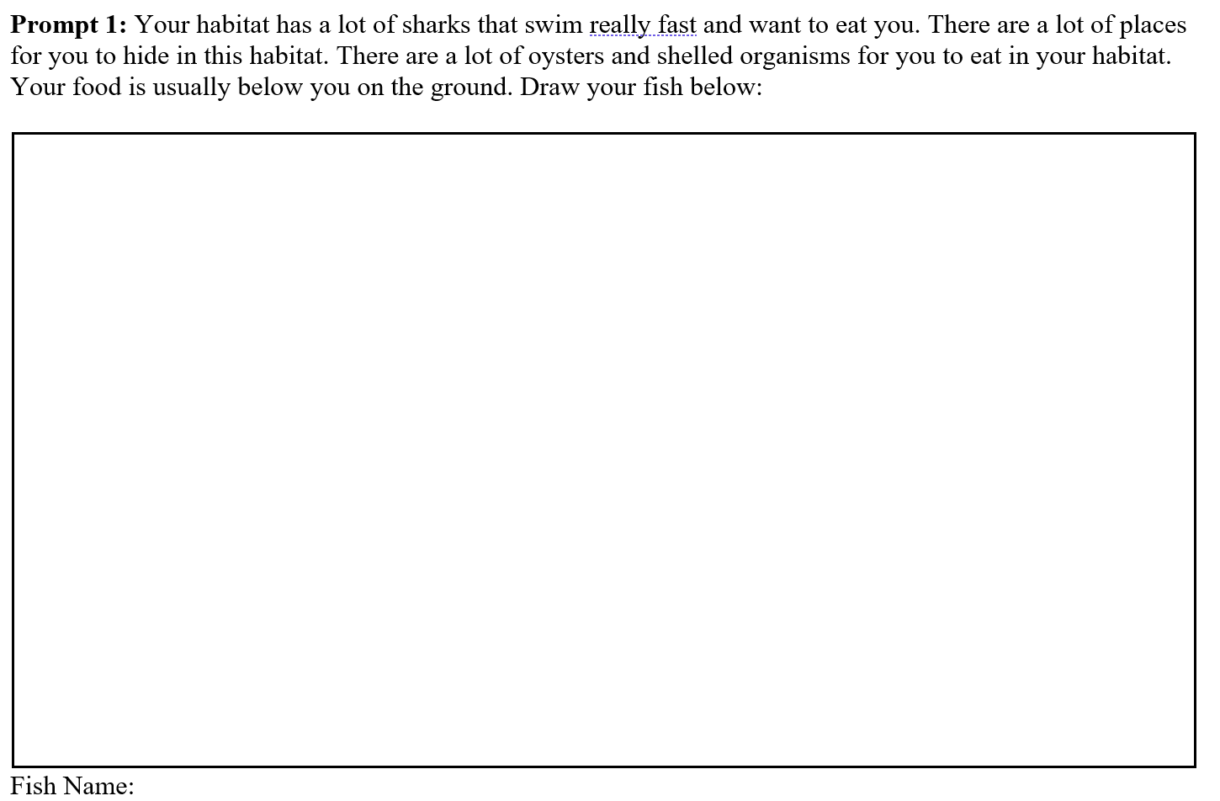
Activity 2: Your turn to design a fish!
Notes:
Explain Activity 2 instructions

Slide 38
Activity 2
I want to hear about the fish you created!

Slide 39
Exit ticket
What was your favorite adaptation you saw today?

