Slide 1
Marine Phytoplankton
McKenzie Powers
January 2021
Email: mckpwrs@uga.edu

Slide 2
What are Phytoplankton?
Microscopic marine organisms that make sugar using sunlight, carbon dioxide, and water

Slide 3
What are Phytoplankton?

Slide 4
Why are they important?
Global distribution
Base of the food chain in the ocean
Produce molecules that support the growth of bacteria in the ocean
Cycle important nutrients in the ocean
Produce the oxygen we breathe!
(Next time you take a breath say thank you to phytoplankton, not only trees!)
Notes:
Green, yellow, red colors = more phytoplankton
All over the world!!!

Slide 5
Why are they important?
Global distribution
Base of the food chain in the ocean
Produce molecules that support the growth of bacteria in the ocean
Cycle important nutrients in the ocean
Produce the oxygen we breathe!
(Next time you take a breath say thank you to phytoplankton, not only trees!)

Slide 6
Why are they important?
Global distribution
Base of the food chain in the ocean
Produce molecules that support the growth of bacteria in the ocean
Cycle important nutrients in the ocean
Produce the oxygen we breathe!
(Next time you take a breath say thank you to phytoplankton, not only trees!)

Slide 7
Phytoplankton Produce organic molecules that support the growth of marine bacteria
I study how climate change (rising temperature) will influence the link between phytoplankton and bacteria in the ocean
The Microbial Loop
Notes:
Watch video

Slide 8
How will rising temperature in the ocean influence the growth and function of Marine phytoplankton?
Help me answer this question by collecting and Analyzing Data!

Slide 9
But First…
1. How would you answer this question???
2. Create your own hypothesis!
(Pair up with your fellow lab mate and discuss)

Slide 10
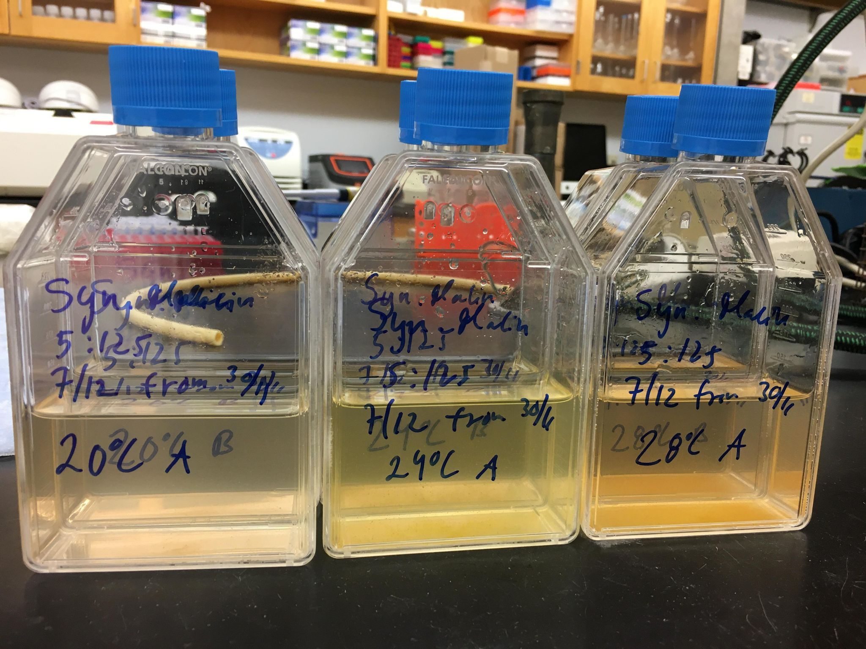
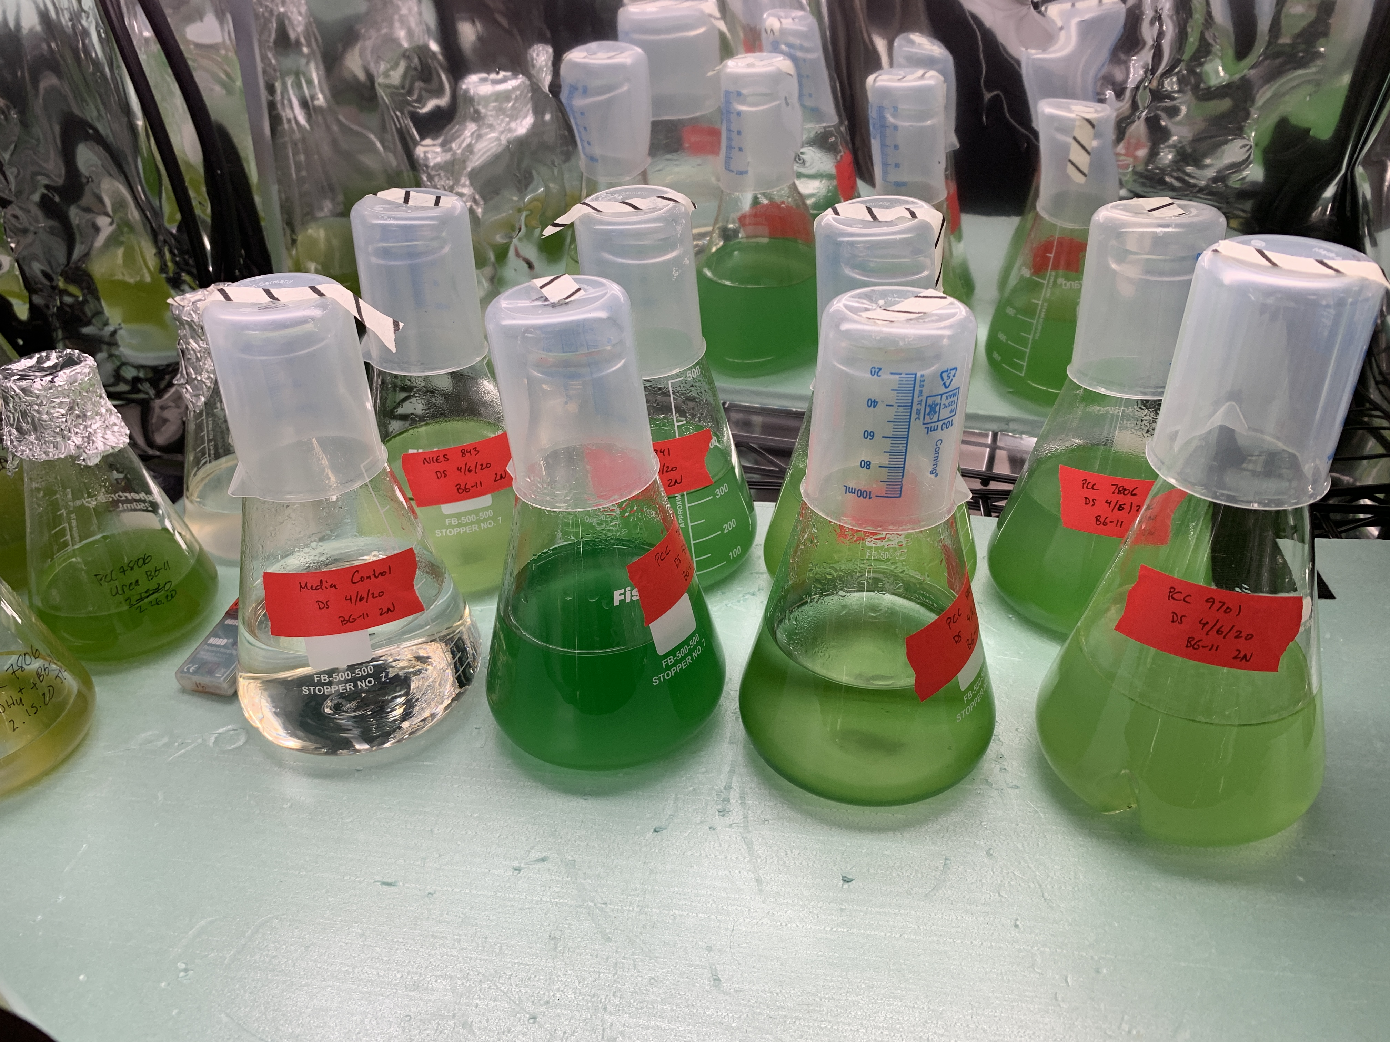
But First…
1. How would you answer this question???
2. Create your own hypothesis!
(Pair up with your fellow lab mate and discuss)
Method: Culture Incubation!
Grow phytoplankton in the laboratory at 3 different temperatures
Track growth by counting cells in the flask
Compare results between each temperature

Slide 11
Mock Experiment
Conduct experiment (work in pairs!)
  Your phytoplankton is growing at three different temperatures and will grow for 8 days
  Count the number of cells present in each flask and record
    TIP: Mark each cell with a black or blue dot to keep track of which cells you’ve already counted. You don’t want to double count or have to start over! (As scientists we like to work smarter not harder!)
Analysis
  Plot data in excel
    X-axis: Time (days), Y-axis: Cell count (cells/mL)
Interpret results and reflect
  How does the phytoplankton’s growth compare between the three temperatures?
  Which temperature results in the highest number of cells? Least number of cells?
  What could the result from this laboratory experiment mean for phytoplankton in the ocean as climate change increases global temperatures?
  Can you describe some potential pros and cons of increased primary production in the oceans due to climate change?
  Do your results support or reject your initial hypothesis?
  What did you find challenging while conducting this experiment? What did you enjoy? Did anything surprise you?
  Would including replicates for this experiment improve your study? Explain.

