Slide 1



NEUROSCIENCE: What is a neuron and what does it do?
Notes:
Teacher throws a paper ball across the room – kids either duck or catch. Then go to next slide!

Slide 2


That almost instant response is an example of how quick your brain can process stimuli coming from the environment and generate an appropriate response.

Slide 3
What do you think a neuron looks like?
Use the materials given to you to construct a neuron. We will come back together in five minutes.
Notes:
Give students the ziplock baggies of materials.

Slide 4

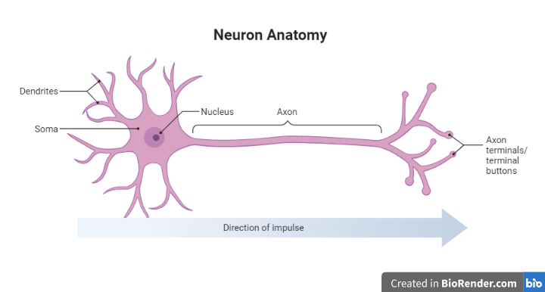
Not all cells look the same! Brains have developed these special cells to carry out important functions in the nervous system.

Slide 5
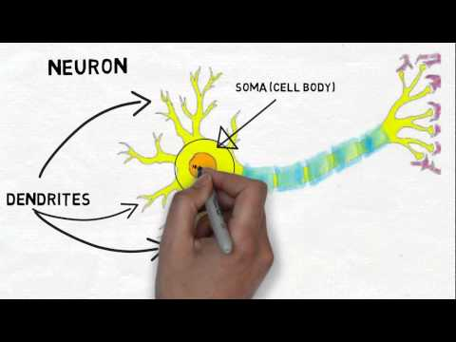
Brains are made of specialized cells called neurons which can transmit electrical and chemical signals to communicate about sensory input and motor output.
Notes:
Myelin might be a little complicated for some students, so you might want to either quickly discuss it or explain it isn’t an essential part of every neuron.

Slide 6
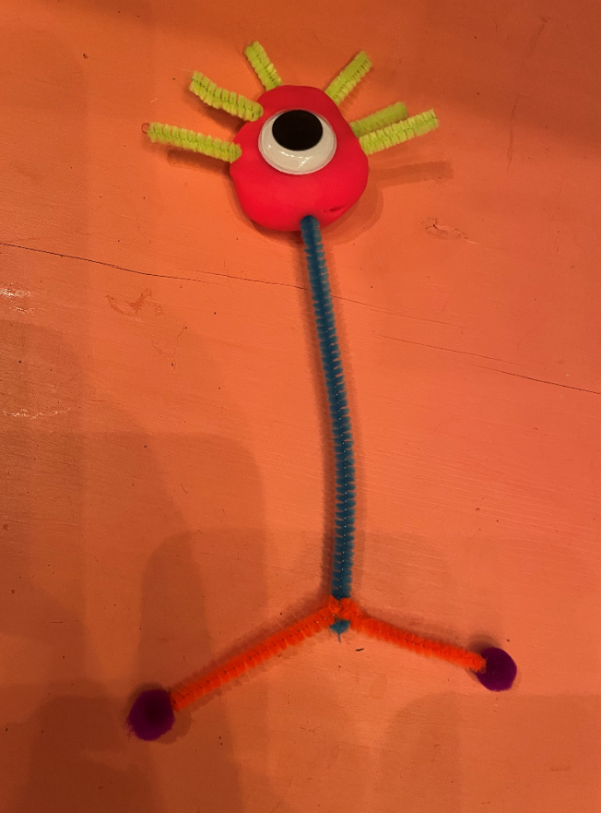
Now make a model of a neuron using the materials from earlier.
Play dough represents the soma.
The googly eye is the nucleus.
Short pipe cleaners represent dendrites.
A long pipe cleaner is the axon.
The medium pieces are axon collaterals, and the pompoms represent terminal buttons.
Notes:
You can glue the pom poms to the pipe cleaner, but honestly it is just as effective without glue if the students make the model on their desk. If possible, you could have the students make a chain of their neurons showing how they transmit information from the terminal buttons to the dendrite of the next neuron.

Slide 7
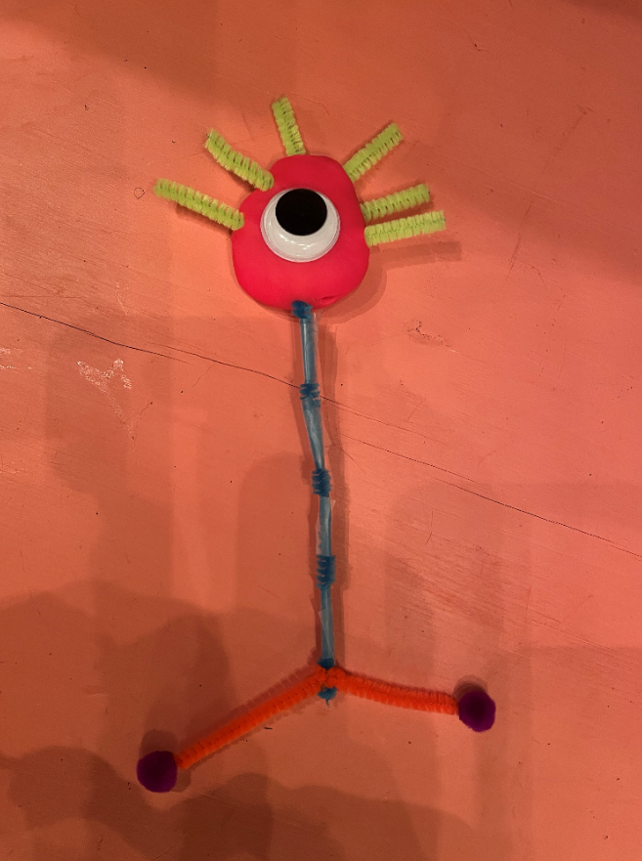
Myelin Sheath - insulates axon to make signal transmission faster
Use pieces of tape to represent the myelin sheath. It folds around the neuron just like tape!
Notes:
optional extension for an honors class: talk about the myelin sheath that helps neurons communicate faster - use tape to represent the myelin sheath pieces along the axon.

Slide 8

Organelles can move down the axon! Shown here are mitochondria moving down the axon to provide energy

Slide 9
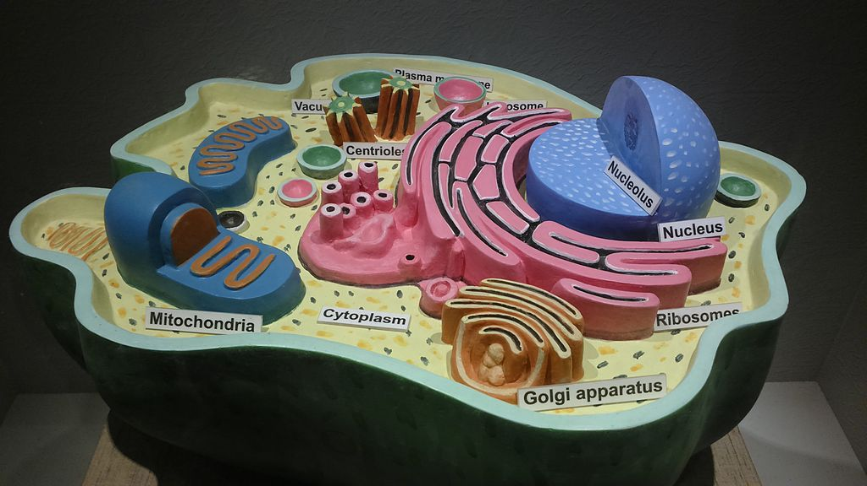
Remember from cellular biology, what does the nucleus of the cell do?
What do you think the other parts of the neuron do?

Slide 10
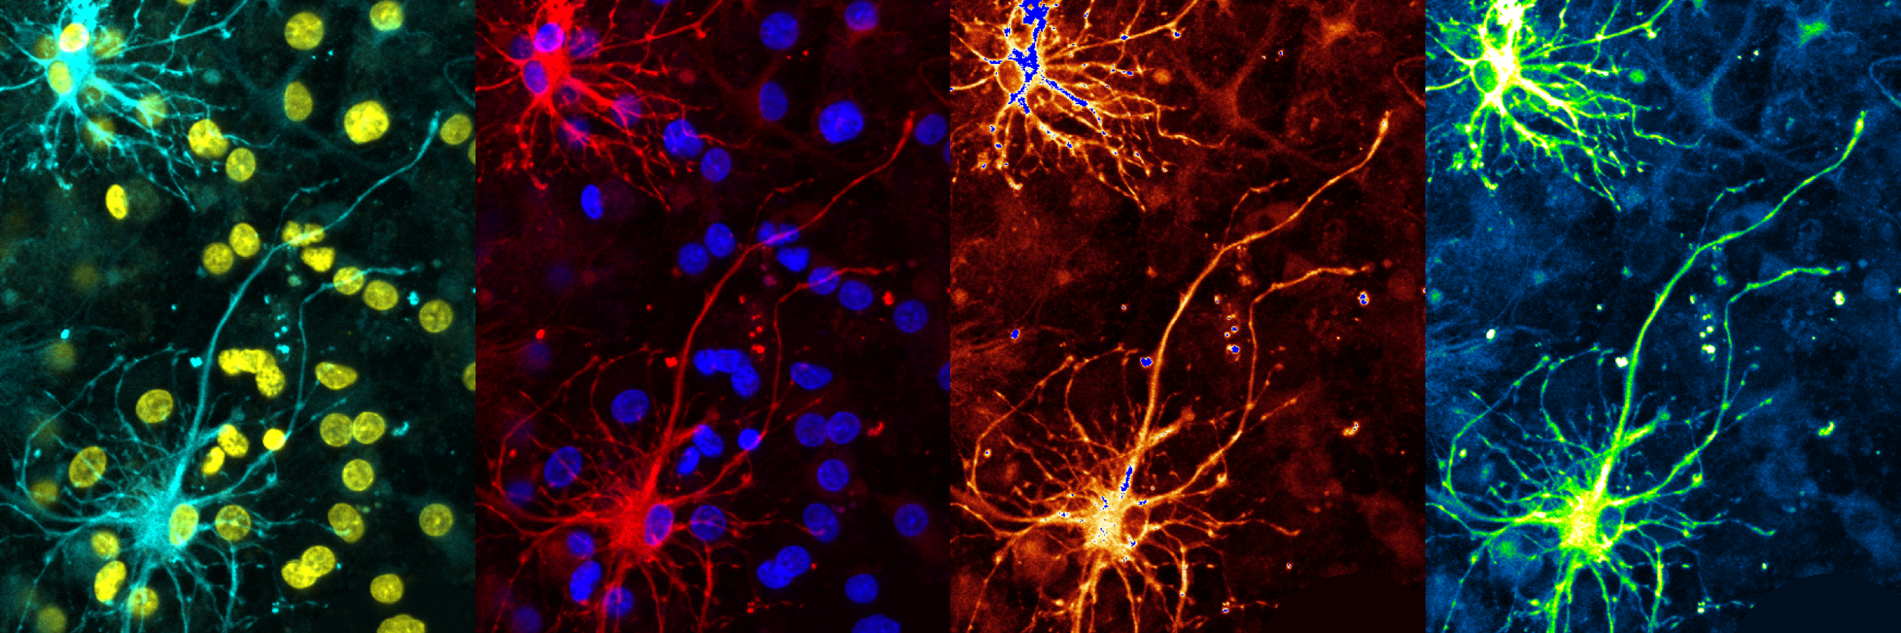
WHAT DO NEURONS DO?
Neurons send electrical and chemical signals to transmit information. The axon sends electrical signals down and the terminal buttons release chemical signals to communicate with the next cell. Dendrites pick up chemical information.

Slide 11

Meet the Scientist: Kendall Clay!
Kendall is a first year Neuroscience PhD student at the University of Georgia. She loves brains and studying how genes work together to control the brain’s many functions. In her free time, she likes to play guitar, embroider, and hang out with her cat!

Slide 12
Exit ticket: 3 things you learned, 2 things you liked, 1 question you still have
Notes:
optional extension: write a short paragraph on the parts of a neuron and what they do. Give an example of what kinds of information neurons send!

