Slide 1
What’s in the water? The connection between wavelength, reflectivity, and ocean color
Mallie Hunt – Mallory.Hunt@uga.edu

Slide 2
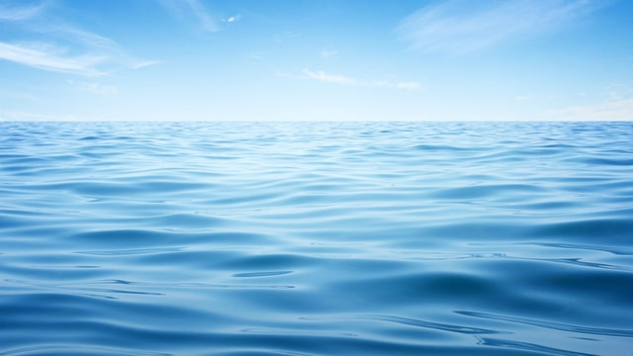
Why is the ocean blue?
Notes:
Discuss this with students, why do they think the ocean is blue?

Slide 3
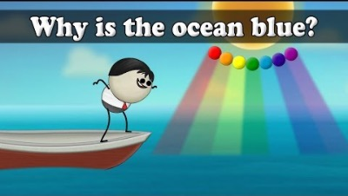
Notes:
https://youtu.be/jUbCoHqB41Y

Slide 4
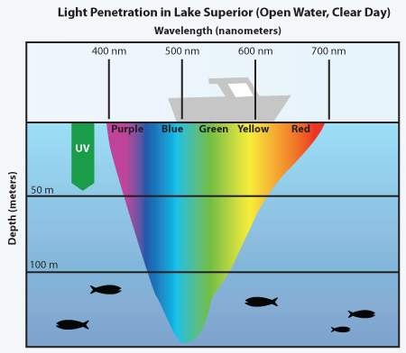
Why is the ocean blue?
Sunlight has seven visible colors (remember ROYGBIV?)
Water molecules absorb and scatter colors from sunlight
Red, orange, yellow, and green are absorbed by water molecules
The remaining colors (blue, indigo, violet) are scattered by the water molecules, making the ocean reflect blue
Notes:
Image from: https://manoa.hawaii.edu/exploringourfluidearth/physical/ocean-depths/light-ocean

Slide 5
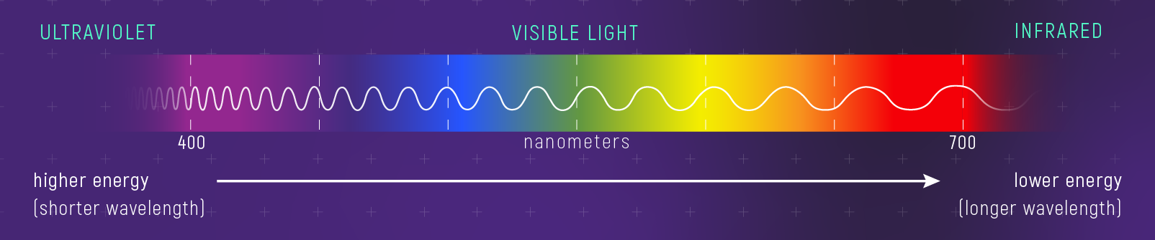
Color, Wavelength, and Energy
Shorter wavelengths such as those in the blue area of the spectrum have higher energy
Longer wavelengths such as those in the red area of the spectrum have lower energy
Notes:
Information from:
Image from: https://stsci-opo.org/STScI-01F9HJW0EDDYZHDMA5H7JKCGR2.png

Slide 6
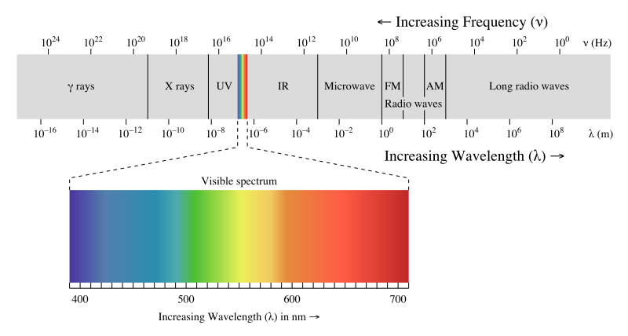

Wavelength, Frequency, and Energy
Frequency can be related to wavelength through the equation:
  $f=\frac{v}{λ}$
  f = frequency
  v = the wave speed
  λ = wavelength
And energy can be related to wavelength through the equation:
  $$E=\frac{hc}{λ}$$
  E is energy in Joules
  h is Planck’s constant (6.626 x 10 ⁻³⁴ J s)
  c is the speed of light (2.998 x 10⁸ m s⁻¹)
Notes:
Information from:
https://www.cuemath.com/frequency-formula/
https://www.e-education.psu.edu/meteo300/node/682
Image from: https://manoa.hawaii.edu/exploringourfluidearth/physical/ocean-depths/light-ocean

Slide 7
Activity: Understanding Absorption
1
Separate into groups.
2
Experiment with the colored lights and colored paper, shine all the colored lights through each colored paper.
3
What do you see? Record your results for each colored light. How are the lights changing or not changing based on the color of the paper?
Notes:
****Note: this can be replaced by a teacher demonstration, requires less materials

Slide 8
Notes for Activity 1:
All light should penetrate through the white paper
  White is a reflector of all colors
All light should be absorbed by the black paper
  Black absorbs all color, no light will penetrate
Only the same colored light should penetrate through that same color of paper (ex. Red light through red paper)
  This is because the other colored lights are all absorbed by the other colors

Slide 9
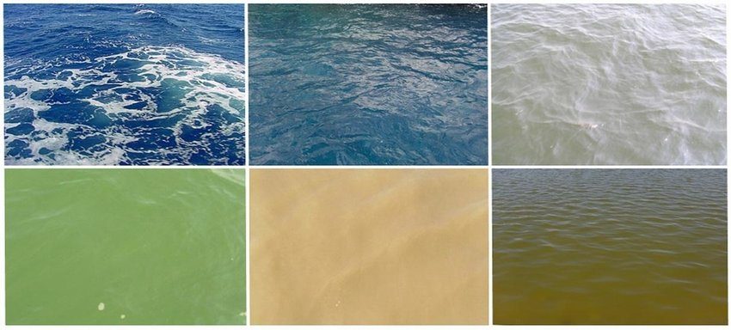
Is the ocean always blue?
Ocean color can change depending on what materials are in the water
Particles suspended in the water can increase the scattering of light or absorb specific wavelengths
Notes:
Information from: https://science.nasa.gov/earth-science/oceanography/living-ocean/ocean-color
Image from: https://www.researchgate.net/figure/An-example-of-six-differently-coloured-sea-areas-with-from-left-to-right-top-Central_fig10_254886155

Slide 10
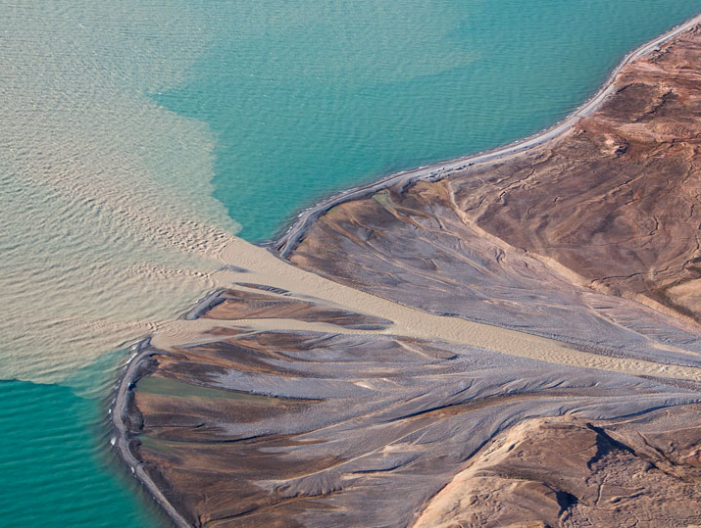
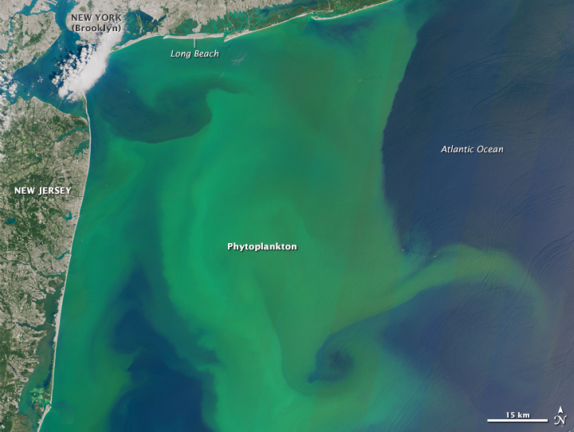
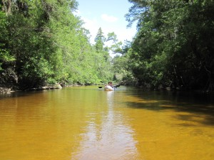
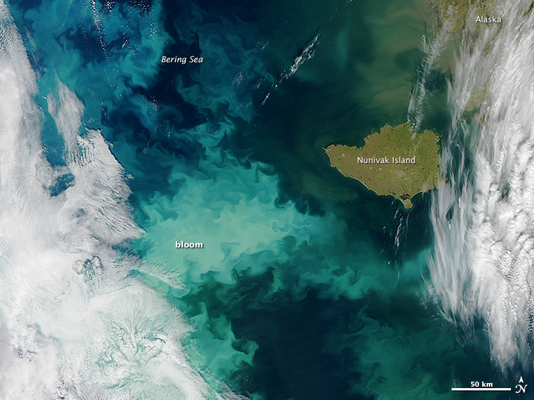
What objects can change ocean color?
Sediment causes coastal waters to turn brown
Runoff from rain and rivers bring sediment into the water
Phytoplankton (also known as algal) blooms that have a green color because of their chlorophyll pigment
Phytoplankton also release energy in the red area of the spectrum in a process called “fluorescence” which is seen in their spectra but not by the human eye
Colored Dissolved Organic Matter (CDOM) are dissolved organic carbon particles in the water that can absorb light
CDOM makes water appear yellow/brown
Coccolithophores are a type of phytoplankton
Coccolithophores have white plates made of calcium carbonate
These white plates reflect light, making the water appear turquoise
Notes:
Information from: https://science.nasa.gov/earth-science/oceanography/living-ocean/ocean-color
Images from:
https://eos.org/articles/sand-from-greenlands-melting-ice-sheet-could-bring-in-business
https://earthobservatory.nasa.gov/images/86377/blooms-off-both-north-american-coasts
https://www.northwestfloridaoutdooradventure.com/2011/03/17/canoeing-on-floridas-blackwater-river/
https://www.ecofoci.noaa.gov/cruiseWeb/Dyson_Sept2014/

Slide 11
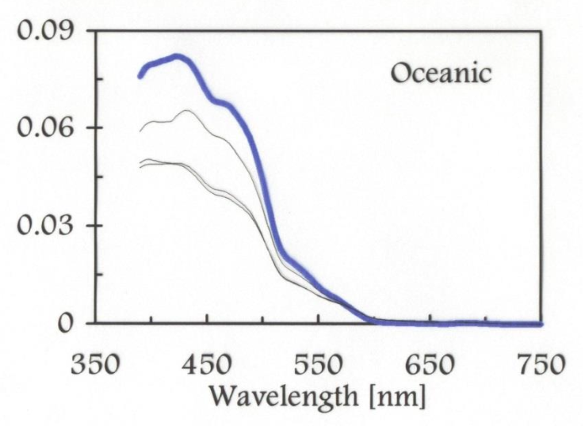
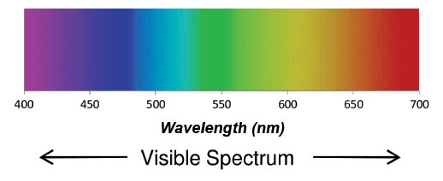
Reflectance Spectra
Spectra shows high reflectance in the blue region of the spectrum, which is what we see
Spectra shows low reflectance from the green-red region of the spectrum due to water molecules absorbing this light
Colors in the ocean can be recorded as reflectance spectra
This spectra can change based on the particles in the water
Notes:
Ocean reflectance spectra from Roesler and Perry, 1995 (https://doi.org/10.1029/95JC00455)
Visible spectrum image from: https://www.orcagrowfilm.com/Articles.asp?ID=145

Slide 12
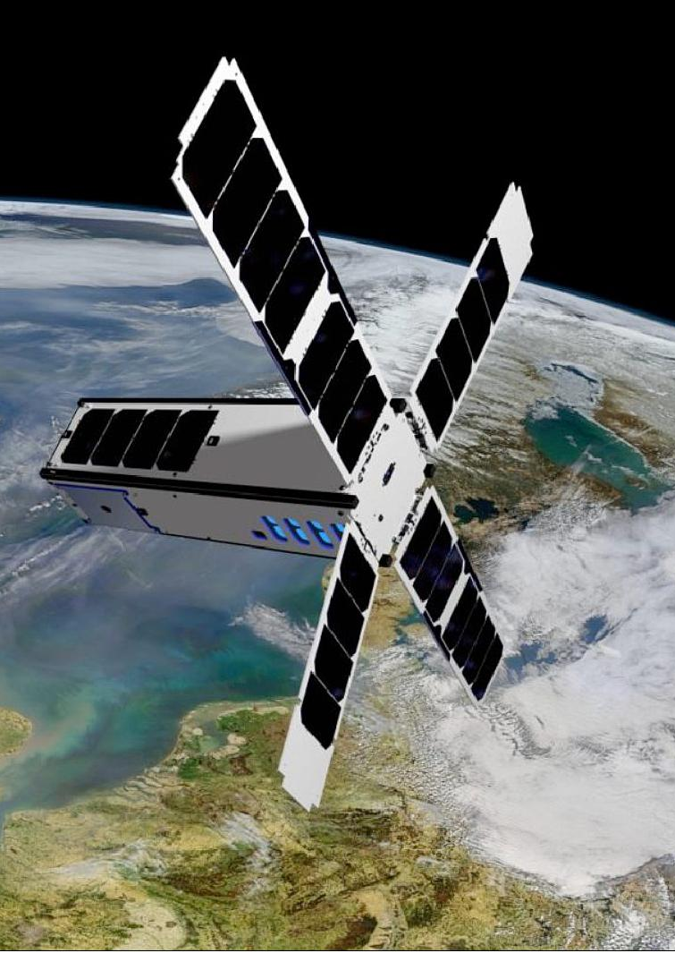
How is the color of the ocean measured?
There are many different types of satellites (including ones that orbit other planets!)
Satellites provide a global perspective
Ocean-observing satellites can observe how the ocean changes anywhere on Earth
Ocean-observing satellites can measure many parameters including sea surface temperature, chlorophyll concentration, and sea level height
Ocean color satellites such as Seahawk and MODIS measure colors of the ocean by recording reflectance spectra of the water
Notes:
NASA’s ocean color missions can be found on this website: https://oceancolor.gsfc.nasa.gov/about/
More about ocean satellite applications: https://earth.esa.int/eogateway/news/satellite-data-central-to-ocean-monitoring
Image of SeaHawk satellite: https://www.eoportal.org/satellite-missions/seahawk-1#seahawk-1-cubesat-ocean-color-mission

Slide 13
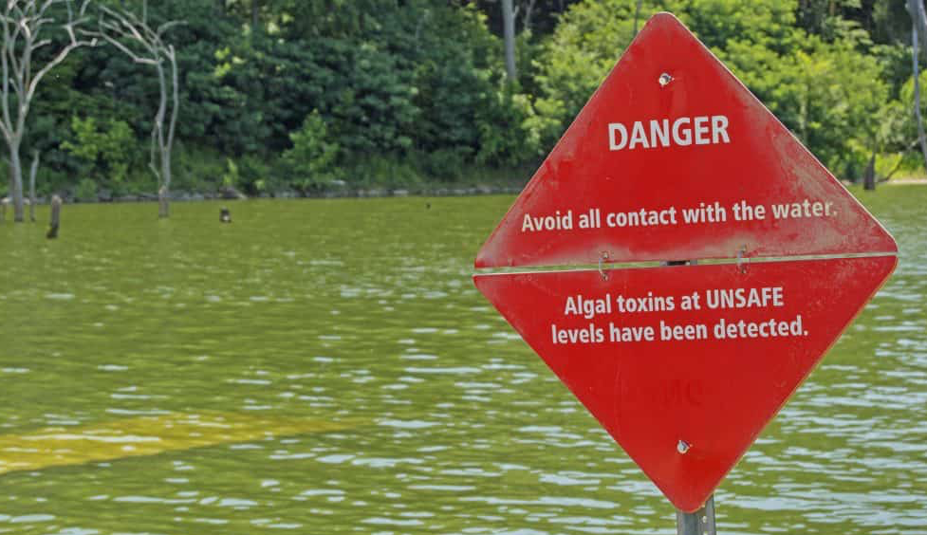
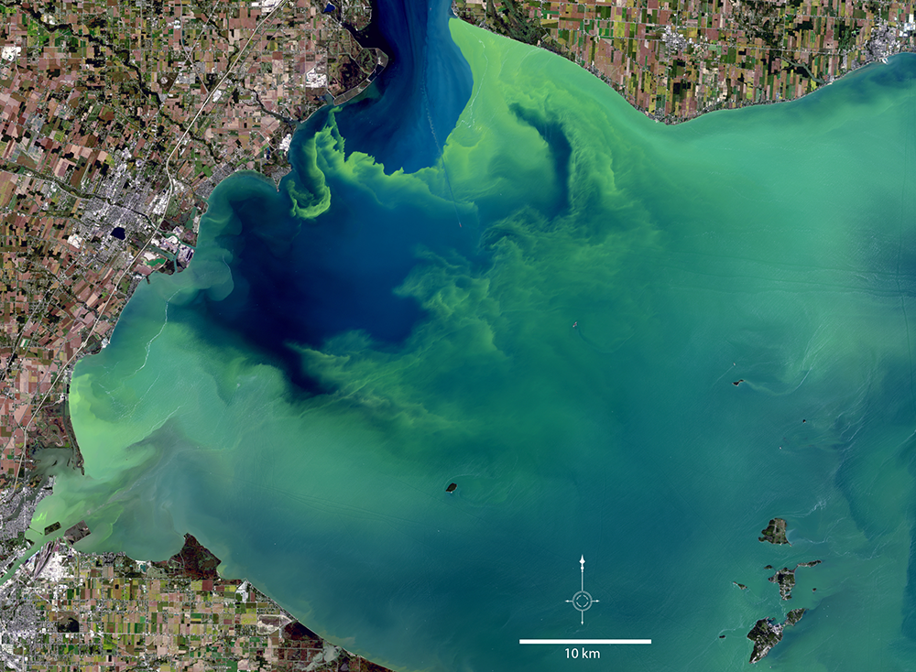
What can ocean color tell us about?
The carbon cycle
Climate change
Natural disasters (ex. Hurricanes)
The marine food web
Harmful algal blooms
And more!
Notes:
Information from:
https://www.npl.co.uk/resources/q-a/why-do-we-measure-ocean-colour
https://www.smithsonianmag.com/science-nature/hurricanes-and-the-color-of-the-oceans-33332726/
https://ioccg.org/group/habs/
Images from:
https://landsat.gsfc.nasa.gov/article/satellites-on-toxic-algae-patrol/

Slide 14
Activity: Understanding Reflectance
1
Separate into groups.
2
Examine the colored jars, what light are they absorbing and what light are they reflecting? What ocean particles would cause the ocean to be this color?
3
Match one spectra and one oceanic component to each colored jar.
Notes:
****Note: this can be replaced by a discussion using the following slides if materials can not be acquired

Slide 15
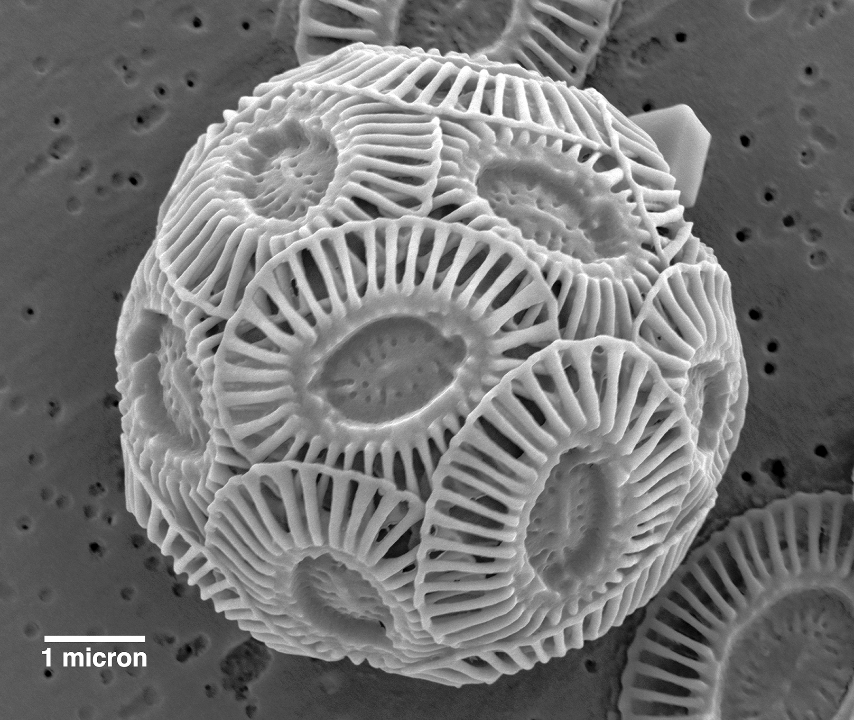





A
C
Coccolithophores: a type of phytoplankton with white plates made of calcium carbonate.
Colored Dissolved Organic Matter (CDOM): Dissolved organic carbon particles in the water that can absorb light
B
D
Suspended sediments: sediments that flow into the water from river runoff, or are resuspended by tides and storms
Phytoplankton: microscopic photosynthetic algae that fluoresces (releases energy) in the red wavelengths.
Notes:
Which organism is behind the ocean color?
Answer: A, Coccolithophores spheres are white, reflect light making the water look turquoise
Answer: C, CDOM absorbs light in the blue and green, making the water appear a yellowish brown
Images from:
A: https://web.colby.edu/offmayflowerhill/2019/01/02/plankton-portrait-coccolithophores/
B: https://www.istockphoto.com/vector/shovel-and-soil-gm871605944-145662417
C: https://www.flaticon.com/free-icon/particles_3055589
D: https://vecta.io/symbols/tag/phytoplankton

Slide 16


A
C
Coccolithophores: a type of phytoplankton with white plates made of calcium carbonate.
Colored Dissolved Organic Matter (CDOM): Dissolved organic carbon particles in the water that can absorb light
B
D
Suspended sediments: sediments that flow into the water from river runoff, or are resuspended by tides and storms
Phytoplankton: microscopic photosynthetic algae that fluoresces (releases energy) in the red wavelengths.
Notes:
Which organism is behind the ocean color?
Answer: D, phytoplankton absorb light in the blue and red, making the water look green
Answer: B, Suspended sediments, brown sediments enter the water at the coastline and turn the water brown
Images from:
A: https://web.colby.edu/offmayflowerhill/2019/01/02/plankton-portrait-coccolithophores/
B: https://www.istockphoto.com/vector/shovel-and-soil-gm871605944-145662417
C: https://www.flaticon.com/free-icon/particles_3055589
D: https://vecta.io/symbols/tag/phytoplankton

Slide 17
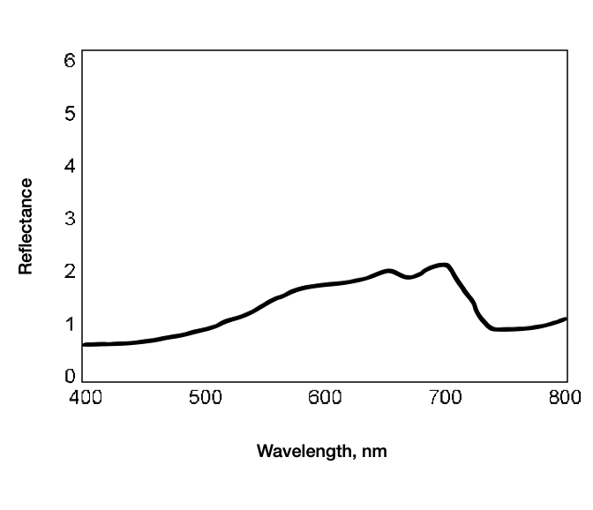
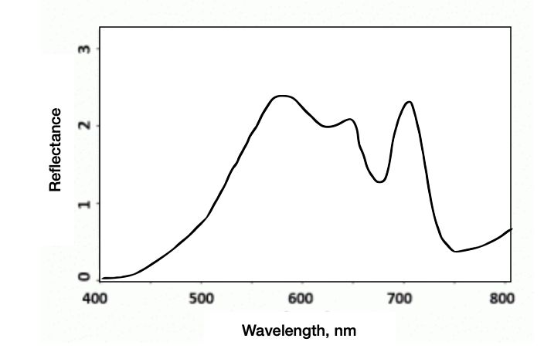
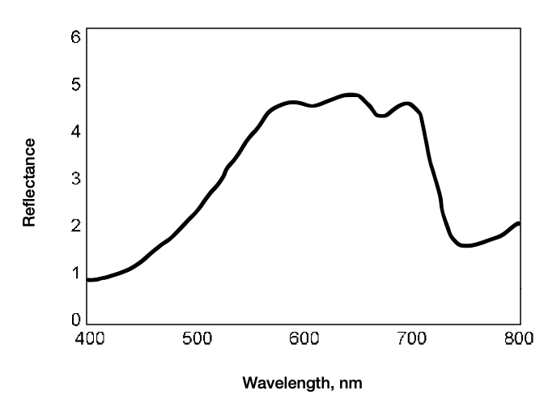
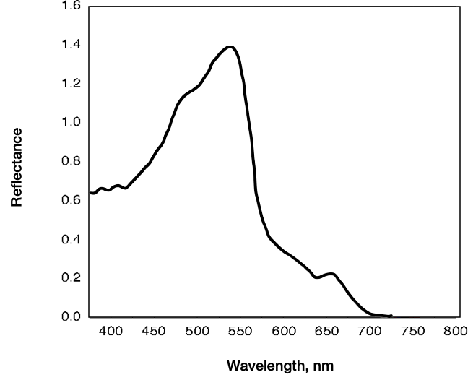
A
C
B
D
Notes:
Which spectra matches this ocean color?
Answer: D , notice the reflectance is highest in the turquoise area
Answer: B , notice the reflectance is highest in green, yellow and red, making it appear brown
Images from:
A: https://water.rs.umn.edu/lwc
B and C: https://www.researchgate.net/figure/The-general-spectral-features-for-coastal-water-that-are-dominated-by-high-concentrations_fig1_276495599
D: https://www.semanticscholar.org/paper/Final-Report-%28-Year-2-%29-to-the-North-Pacific-Marine-Stabeno-Cokelet/78009c5cee85c88310e1a2861deb8566dea3364c/figure/10

Slide 18
A
C
B
D
Notes:
Which spectra matches this ocean color?
Answer: C, this is similar to the one before, but more focused in the orange area of the spectrum
Answer: A, this is focused in the green, the red is fluorescence
Images from:
A: https://web.colby.edu/offmayflowerhill/2019/01/02/plankton-portrait-coccolithophores/
B: https://www.istockphoto.com/vector/shovel-and-soil-gm871605944-145662417
C: https://www.flaticon.com/free-icon/particles_3055589
D: https://vecta.io/symbols/tag/phytoplankton

