Slide 1
SciRen Lesson Plan on Aerosols and the Environment Day 1
Omar El Hajj, Kruthika Kumar, Charles Perrie

Slide 2
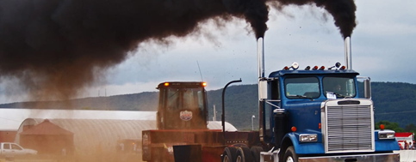

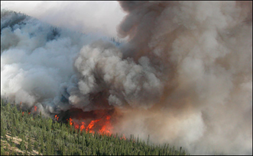
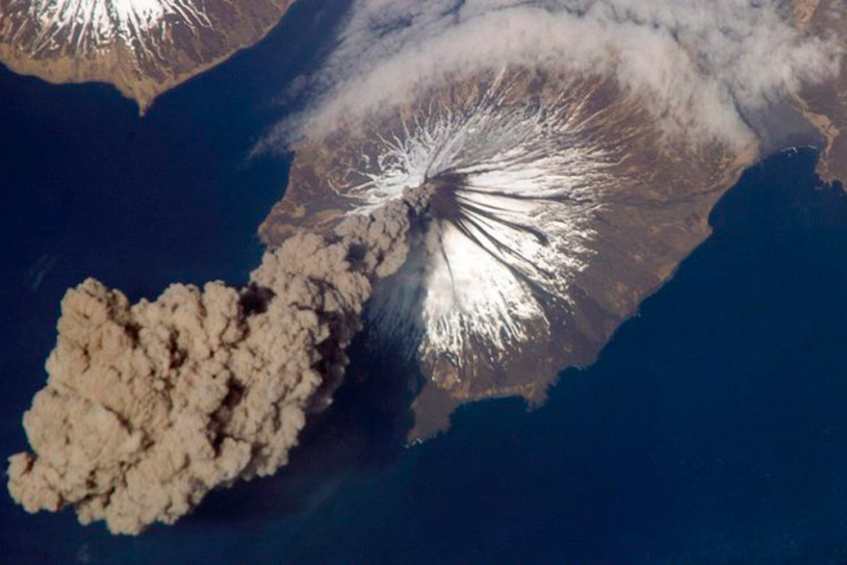
Aerosols
Notes:
Aerosols: they are solid or liquid particles suspended in air or gas and sometimes referred to as Particulate matter (PM).

Slide 3
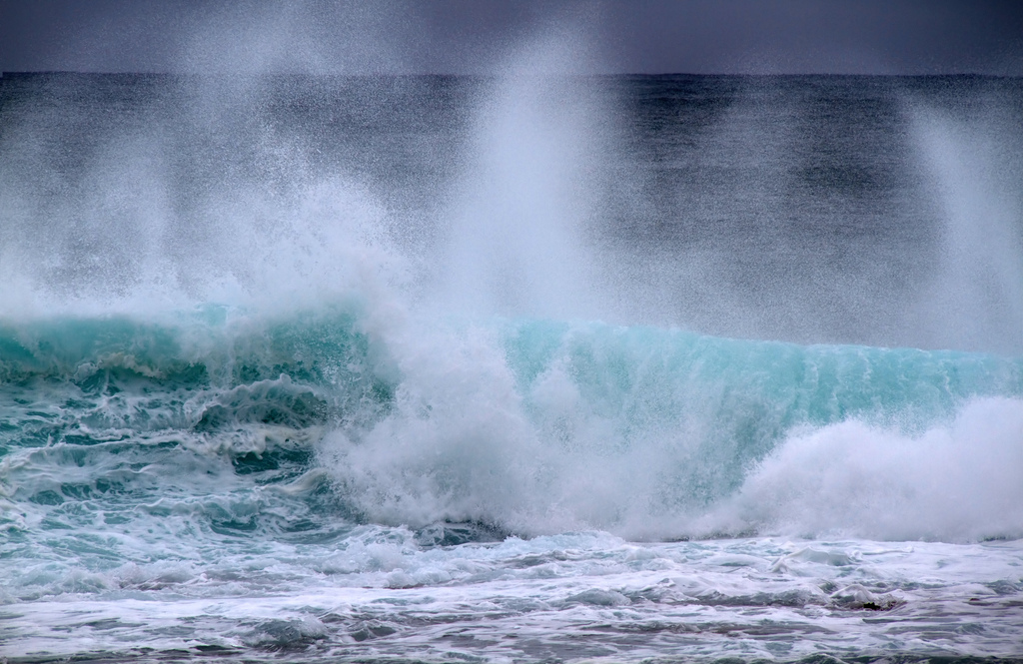
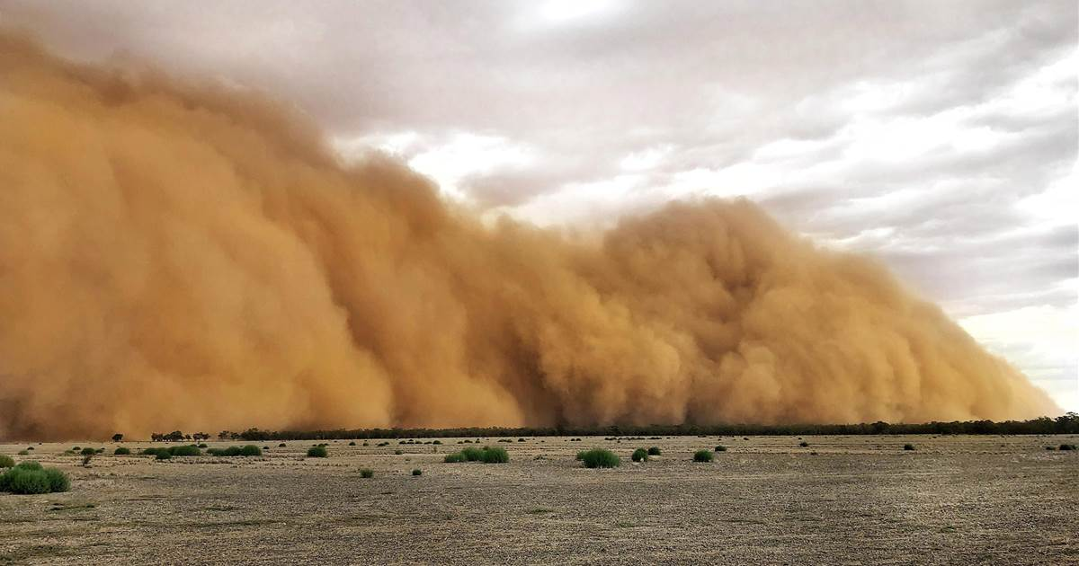
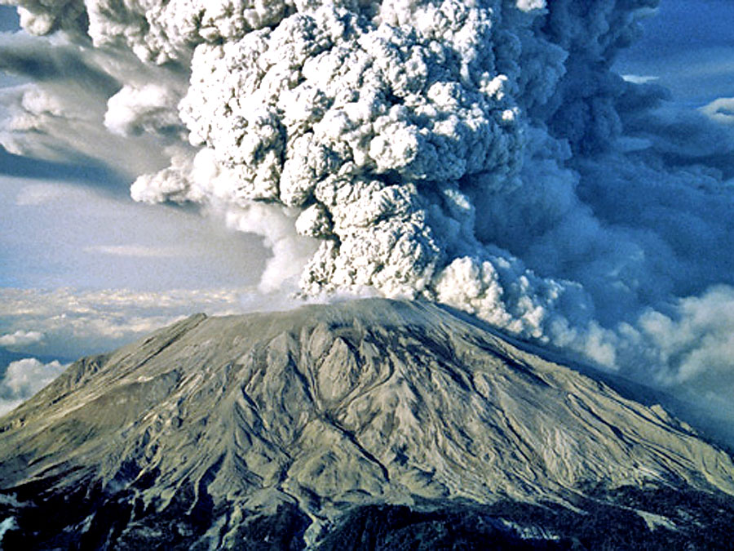
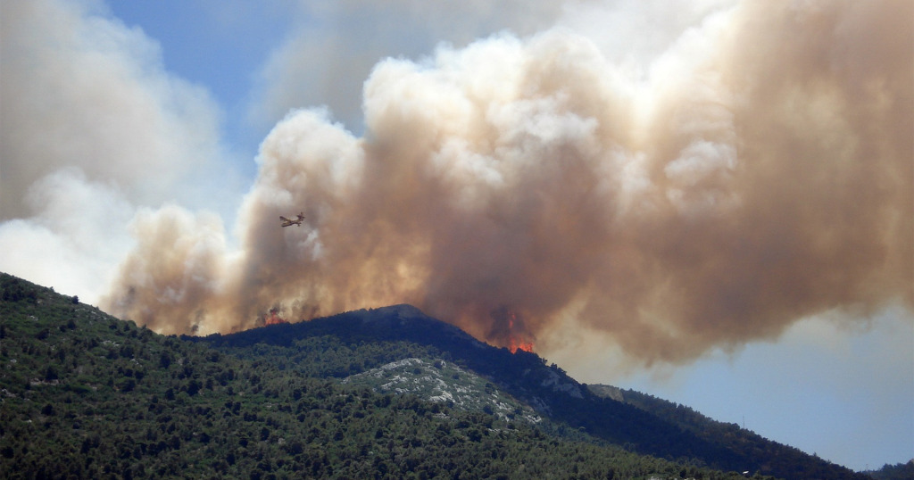
Where do Aerosols Come From?
Natural Sources
Notes:
There are two sources of aerosols: Natural sources and Anthropogenic sources..
Natural sources are dust, volcanoes (produce ash and sulphate), forest fires, and sea spray (sea salt and sulphate aerosols).

Slide 4
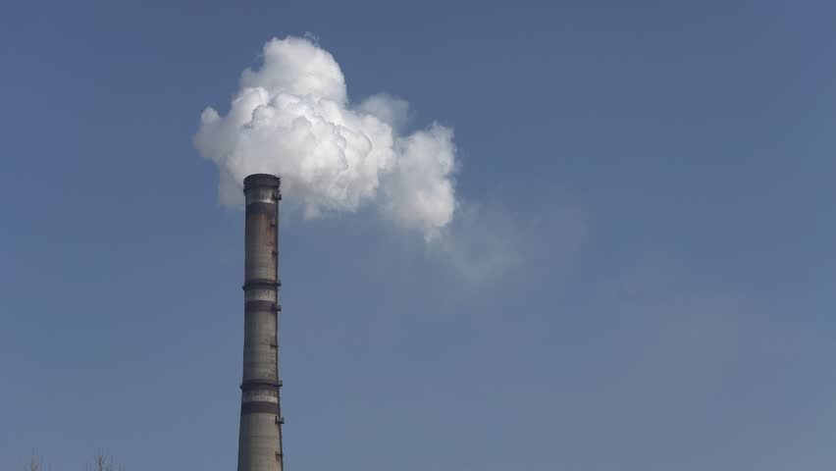
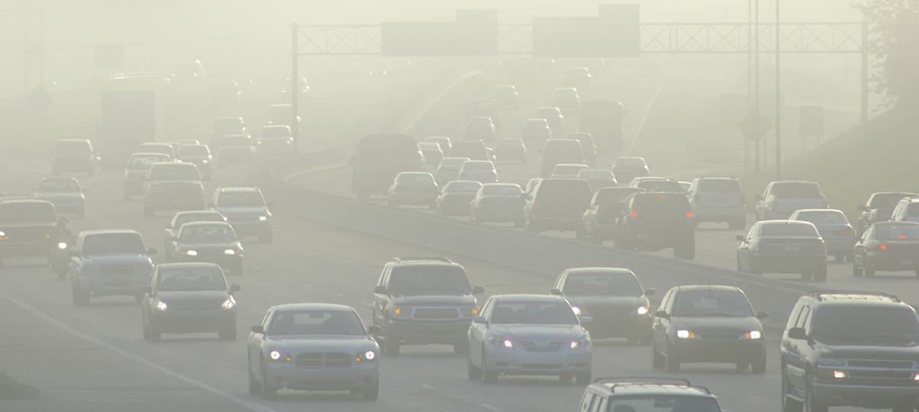
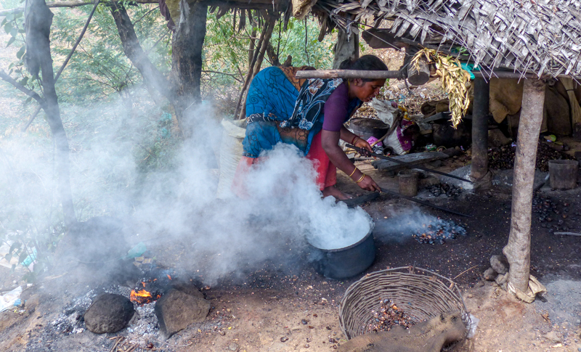
Where do Aerosols Come From?
Anthropogenic Sources
Notes:
Most Anthropogenic sources of aerosols are from fossil fuel and biomass burning.

Slide 5
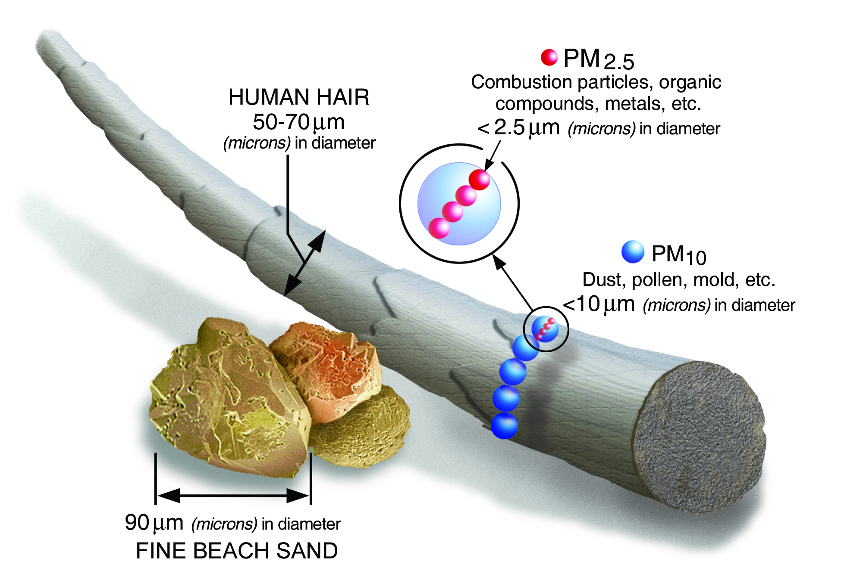
Aerosols Compared To a Human Hair
Notes:
This picture compare the size of aerosols from natural and anthropogenic sources to a human hair.
PM2.5 stands from particulate matter having a size < 2.5 micron (micrometer) and PM10 are particles having sizes < 10 microns.
Most anthropogenic sources are PM2.5 while most natural sources are PM10.
The majority of the particulate mass from natural sources are likely to be large particles that fall out near the source. While anthropogenic sources produce fine particles that remain suspended for many days, long enough to travel global distances.

Slide 6
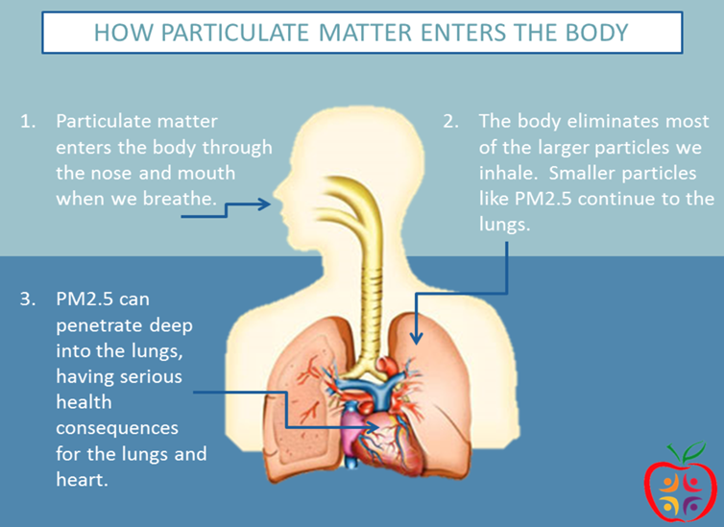

Why Do We Care About Aerosols ?
They Affect Our Health
Utah Department of Health
Notes:
Why do we care about aerosols?
-Because they affect our health, PM2.5 can penetrate our lungs and get into our blood stream. Health effects depends on the exposure time. Low exposure can mean that it can cause coughing to shortness of breath and eyes irritation. However, long-term exposure can lead to lung, heart disease and cancer and even premature death.

Slide 7
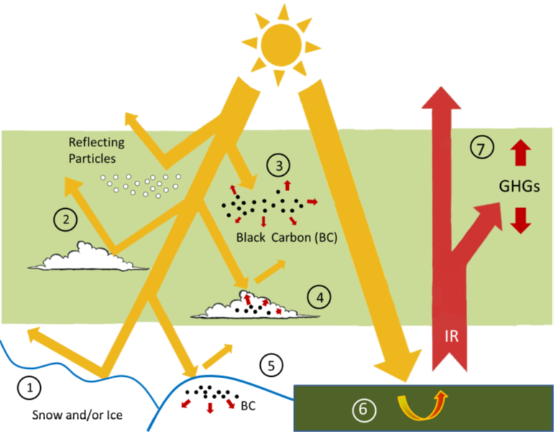
Why Do We Care About Aerosols ?
They Affect Our Climate
Notes:
As we know, Greenhouse gases (GHG) (step 7 on the figure) only absorb IR(infrared) coming from earth surface and heat the atmosphere, however aerosols interact in a different way in the atmosphere.
Aerosol particles have direct and indirect effect in the atmosphere depending on their optical properties.
They affect the atmosphere directly by absorbing solar radiation and heating the atmosphere (like Black Carbon particles such as soot) (3) or reflecting radiation back to space (like salt particles) (2), and indirectly by depositing on clouds and snow increasing the snow melting rate (4 and 5).
Snow is white and reflects light. If the Black Carbon particles like soot deposit on the snow, in the long-term, the color of the snow starts to change and the reflection of light is hindered slowly. Then, the snow starts to melt faster.

Slide 8
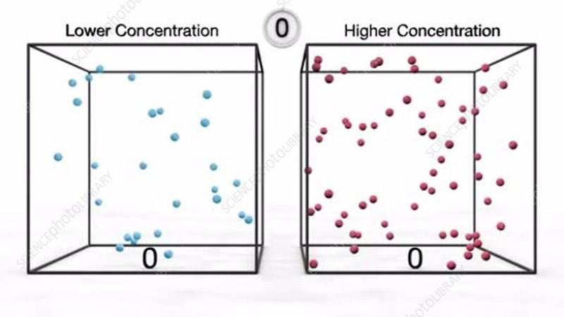
Concentrations
The amounts of aerosols present in an area is important to know
  Human health and wildlife can be affected by the amount of aerosols present at a time
  Need a conceptual way of presenting the amount present
    Saying “there are 100 kg of carbon dioxide today” sounds like a lot, but are we talking about 100kg present in one city block/neighborhood, across the whole city? The whole state? It is important to accurately define how much is present in an area. This is done by calculating the concentration of the aerosols.
The amount of aerosols present in an area is presented by using its concentration in that area
  The concentration of the aerosol is defined as mass of aerosol per unit volume of air in the region
  Examples are gram per cubic meter (g/m^3), kilogram per cubic meter (kg/m^3)
Notes:
The amounts of aerosols present in an area is important to know
Human health and wildlife can be affected by the amount of aerosols present at a time
Need a conceptual way of presenting the amount present
Saying “there are 100 kg of carbon dioxide today” sounds like a lot, but are we talking about 100kg present in one city block/neighborhood, across the whole city? The whole state? It is important to accurately define how much is present in an area. This is done by calculating the concentration of the aerosols.
The amount of aerosols present in an area is presented by using its concentration in that area
The concentration of the aerosol is defined as mass of aerosol per unit volume of air in the region
Examples are gram per cubic meter (g/m^3), kilogram per cubic meter (kg/m^3)

Slide 9
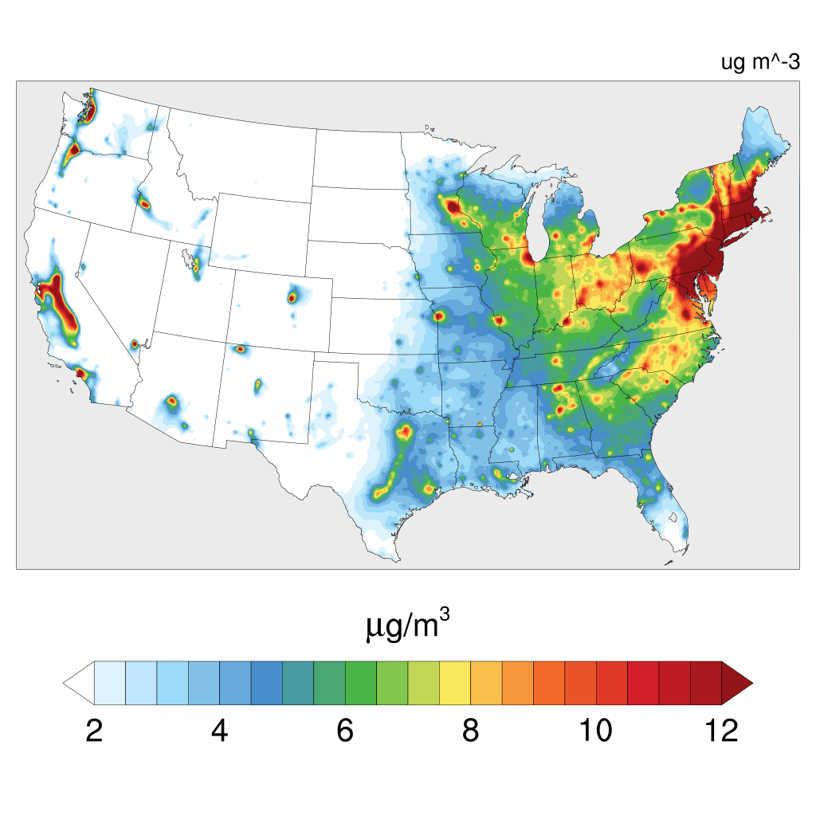
Concentration variation
Concentration is not uniform across every city at any part of the day
  Concentration of aerosols can vary based on several factors
  Exercise: Which of these factors can lead to a higher concentration of aerosols?
    Rush hour traffic versus traffic at 2 A.M.
    Windy day versus Still day
Notes:
Key factors that affect aerosol concentration:
Weather (sunny versus rainy, cold versus warm, windy versus still)
Certain weather patterns can cause aerosols to disperse, lowering concentration, while others will cause them to sit around, causing an increase in concentration
For wind: imagine you’re at a campfire. If the air is still, the smoke will rise and sit around you. If it is windy, the smoke will blow away quicker and disperse more, leading to lower concentrations.
Number of cars on the road/power plant operations
More cars, more aerosols emitted. Think weekend versus weekday, rush hour versus 3 P.M.
Power plants can be a key contributor. If there is a higher energy demand and plants are having to run at a higher rate, it will cause an increase in aerosol output

Slide 10
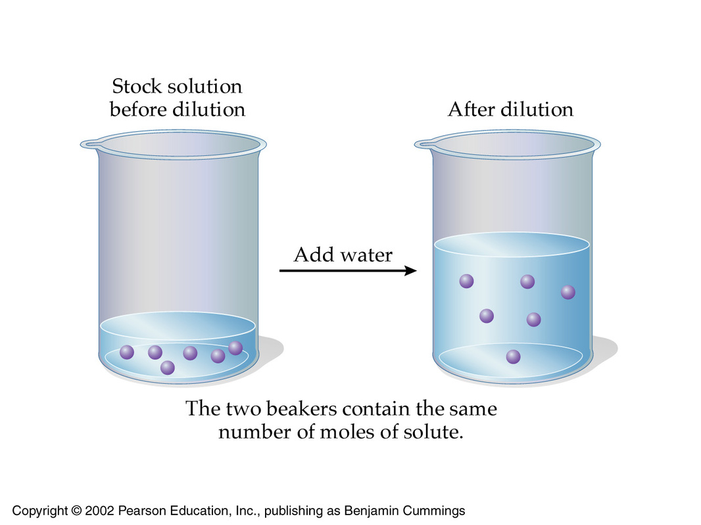
Concentration Variation
Dilution
  Dilution is a process where the concentration of a substance is reduced
  Exercise:
    You have a 1 gram of salt in a 10 liters of water. We want to decrease the concentration of salt to .05 grams per liter. How much water do we need to add? What would we need to do to increase the concentration of salt to 3 grams per liter?
Notes:
The total amount does not change, but the amount per volume does
Think of making sweet tea. You pour a glass of Y ounces unsweet tea and add sugar. There is now X number of grams of sugar in the tea. If it is too sweet, you add Z more ounces of tea. The amount of sugar has not changed, however the amount of sugar relative to the rest of the drink has. This is dilution. In the first glass, you have X grams per Y ounces. That is your concentration. In the second glass, you have X grams per (Y+Z) ounces. The total concentration decreased, but the amount of sugar is the same.
DON’T FORGET TO WRITE UP THE ANSWERS

Slide 11
PM_{2.5} Concentrations
Atlanta GA
Notes:
This map displays the January 2011 monthly average PM_{2.5} surface concentration.
Notice that each of these high concentration areas are cities.
The anthropogenic sources like fossil fuel burning are common and critical in the cities.
This is where pollution produced by us. As there are many cars and human activity in the cities.
Hence, the cities and high populated areas have more PM_{2.5} surface concentration.
We are now going to do Guess the cities and notice how the concentrations are drastically higher in those regions.
The first one is Atlanta, Georgia

Slide 12
PM_{2.5} Concentrations
Washington D.C.
Atlanta GA
Notes:
Washington D.C.

Slide 13
PM_{2.5} Concentrations
New York City NY
Washington D.C.
Atlanta GA
Notes:
New York City, New York

Slide 14
PM_{2.5} Concentrations
Seattle WA
New York City NY
Washington D.C.
Atlanta GA
Notes:
Seattle, Washington

Slide 15
PM_{2.5} Concentrations
Seattle WA
New York City NY
Sacramento CA
Washington D.C.
Atlanta GA
Notes:
Sacramento, California
Overall, Notice that in the northeast region where there are a lot cities that intersect and create megacities have more concentrations than everywhere else

Slide 16
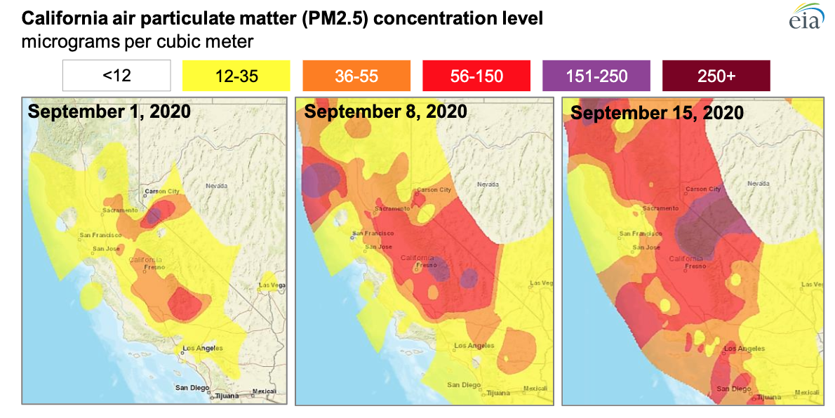
PM_{2.5} Concentrations with Forest Fires
Notes:
This map displays the PM_{2.5} surface concentration around the time that the forest fires occured in California in September 2020.
These concentrations include the anthropogenic sources of cars and human activity. However, these maps clearly display the impact of forest fires(which is one of the natural sources) on the PM_{2.5} concentrations. As the concentrations have drastically increased in a couple weeks due to the forest fires impact.
Image: https://www.eia.gov/todayinenergy/detail.php?id=45336

Slide 17

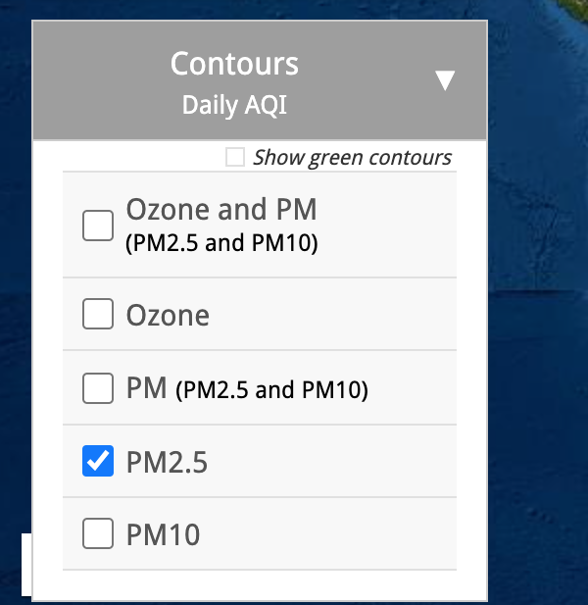
See the Changes: Activity
Steps
Go to https://gispub.epa.gov/airnow/
Click on the Archive Tab on the top
Uncheck the (Ozone and PM) box under the Contours
tab on the left side of the screen
Click on the PM2.5 tab (the fourth one in the box)
Notes:
Activity: https://gispub.epa.gov/airnow/
Steps
Go to https://gispub.epa.gov/airnow/
Click on the Archive Tab on the top
Uncheck the (Ozone and PM) box under the Contours tab on the left side of the screen
Click on the PM2.5 tab (the fourth one in the box)
Click on the Legend tab on the right side of the screen
Click on the calendar icon on the bottom of the page on the right side of the screen
Use the left and right arrows to go to September and pick a date
Make sure that the year on the bottom is on 2020
Repeat steps 7 and 8 with various dates to see the impacts of forest fires on Air quality
Suggested dates: August 17th,2020 to October 14th, 2020. You can see the changes in other years and days as well.

Slide 18
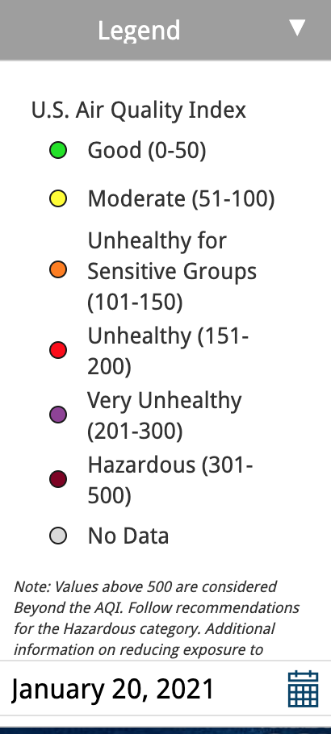
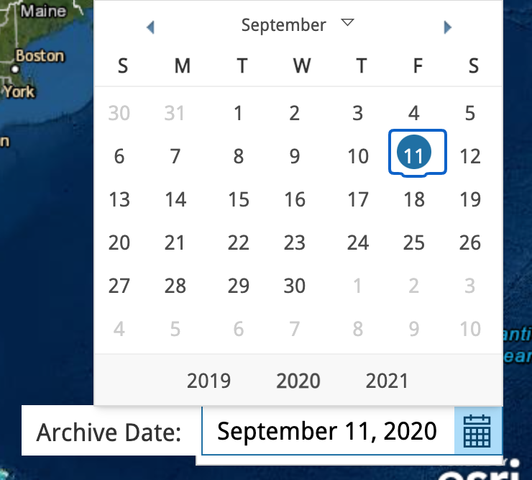
See the Changes
Steps- Continued
5. Click on the Legend tab on the right side of the screen
6. Click on the calendar icon on the bottom of the page on the right
side of the screen
7. Use the left and right arrows to pick a date (9/11/2020)
8. Make sure that the year on the bottom is on 2020
9. Repeat steps 7 and 8 with various dates to see the impacts of
forest fires on Air quality
Suggested dates: August 17, 2020 - October 14, 2020
Notes:
Activity: https://gispub.epa.gov/airnow/
Steps
Go to https://gispub.epa.gov/airnow/
Click on the Archive Tab on the top
Uncheck the (Ozone and PM) box under the Contours tab on the left side of the screen
Click on the PM2.5 tab (the fourth one in the box)
Click on the Legend tab on the right side of the screen
Click on the calendar icon on the bottom of the page on the right side of the screen
Use the left and right arrows to go to September and pick a date
Make sure that the year on the bottom is on 2020
Repeat steps 7 and 8 with various dates to see the impacts of forest fires on Air quality
Suggested dates: August 17th,2020 to October 14th, 2020. You can see the changes in other years and days as well.

Slide 19
Take-Home Assignment
You are tasked with coming up with a public-awareness campaign to increase education on aerosols. The campaign will be a television ad played during the Super Bowl. In groups of 3, make a brief video (30 seconds or less) describing what aerosols are, where they come from, and why we should care about them. Include the transcript in your video. Video should appeal to a wide audience and make the list for top 10 SB54 ads.
Video can be a TikTok, Youtube, or something you’d see on C-Span, if you want to be dull. How you make it is up to you.
Notes:
Should be graded on effort, information presented, and time limit

Slide 20
SciRen Lesson Plan on Aerosols and the Environment Day 2
Omar El Hajj, Kruthika Kumar, Charles Perrie

Slide 21
Take-Home Assignment
Presentation Time!

Slide 22
Health effects of aerosols
If the concentration of aerosols present in an area is too high, there are detrimental effects to human health
Harvard Six Cities Study (1993)
  Took place in six cities from 1974-1991, aimed to study the effects of air pollution on life-expectancy
  Watertown, MA.
  Harriman, TN.
  St. Louis, MO
  Stubenville, OH
  Portage, WI
  Topeka, KS
Notes:
The Harvard Six City Study was conducted between 1974 and 1991, looking at individuals in six cities across the United States to determine the effect air pollution had on life expectancy. Researchers measured air pollution within the six cities over time, and at the same time were following up with specific citizens within each city and monitoring their health. Researchers would check in with the volunteers every six months roughly while keeping tabs on levels of pollution, specifically PM2.5 in the city.
Volunteers and their daily habits were accounted for as well to levelize every person in the study that way no individuals were at an automatic disadvantage due to their habits. The health was “normalized” in the study.

Slide 23
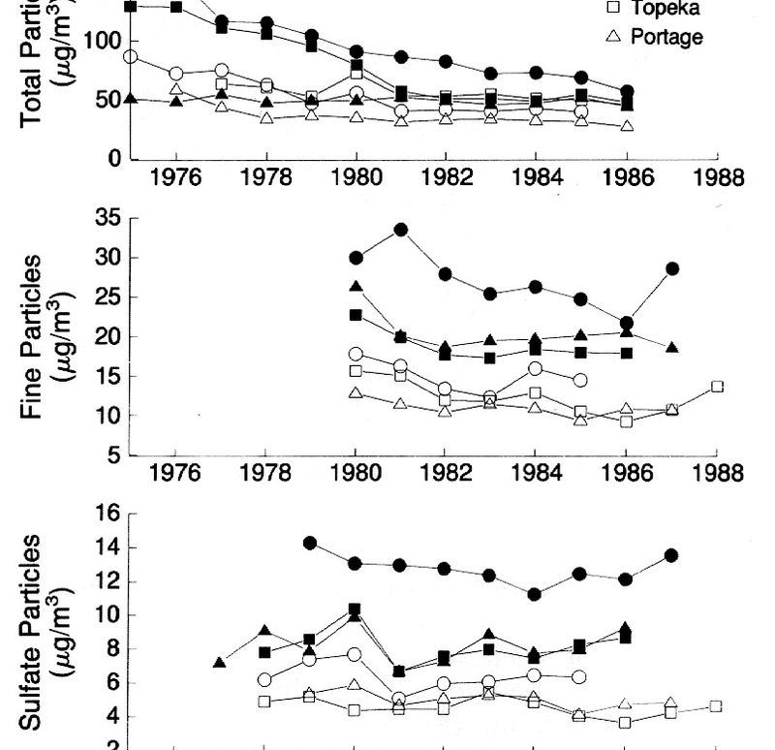
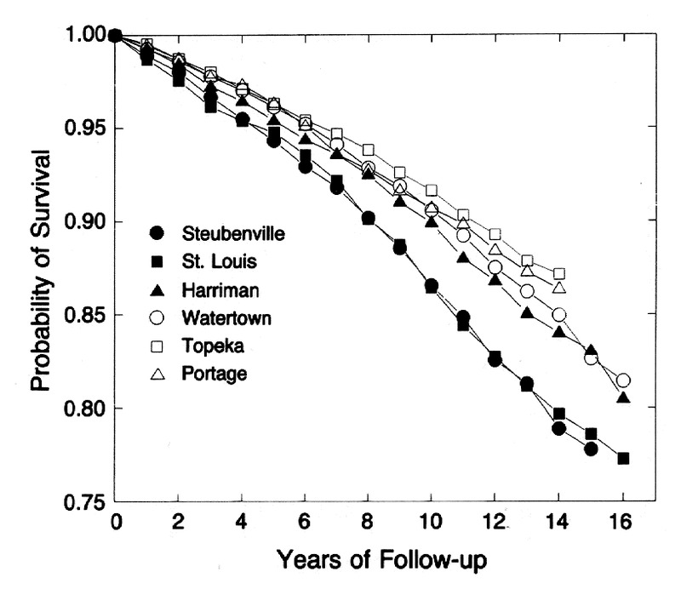
Results of Six Cities Study
Figure 1: Particle concentrations by city over the years
Figure 2: Probabilities of Survival
Figure 1
Figure 2
Dockery, Douglas W., et al. “An Association between Air Pollution and Mortality in Six U.S. Cities.” New England Journal of Medicine, vol. 329, no. 24, 1993, pp. 1753–1759., doi:10.1056/nejm199312093292401.
Notes:
Over time what was found was that the life expectancy, or the “probability of survival” of these individuals varied based on the city they lived in. (refer to notes on specifics of the study)
The biggest takeaway is how air pollution has a direct and measurable effect on human wellbeing.

Slide 24
Health effects of aerosols
The Six Cities Study is widely cited as to show how aerosols can affect health
All over the world, there are examples of the detrimental effects of aerosols that go beyond the study
  Beijing, China - Daily concentrations of PM 2.5 regularly go over 140 micrograms per cubic meter. The LIMIT for PM 2.5 in the US is 35 micrograms per cubic meter. Beijing averages 42.1 micrograms per cubic meter.
  New Delhi, India - New Delhi is the most polluted city in the world, with concentrations of PM 2.5 averaging 98.3 micrograms per cubic meter.
Notes:
Beijing: The air pollution in Beijing causes lower birth rates and higher adult mortality from respiratory related diseases. Lung cancer rates have risen over 60% in the past decade, although the smoking rate has not increased. -
https://ohiostate.pressbooks.pub/sciencebites/chapter/causes-and-consequences-of-air-pollution-in-beijing-china/
New Delhi: high rates of cardiovascular diseases caused by PM2.5. Air also contains unsafe levels of sulfur dioxide, nitrous oxide, and carbon monoxide, resulting in higher rates of strokes, heart attacks, and respiratory illnesses than anywhere else in the world

Slide 25
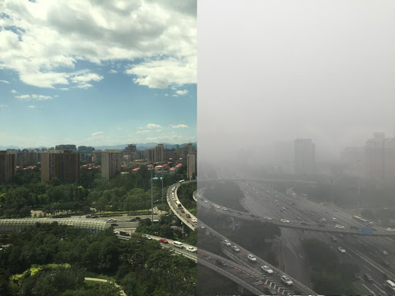
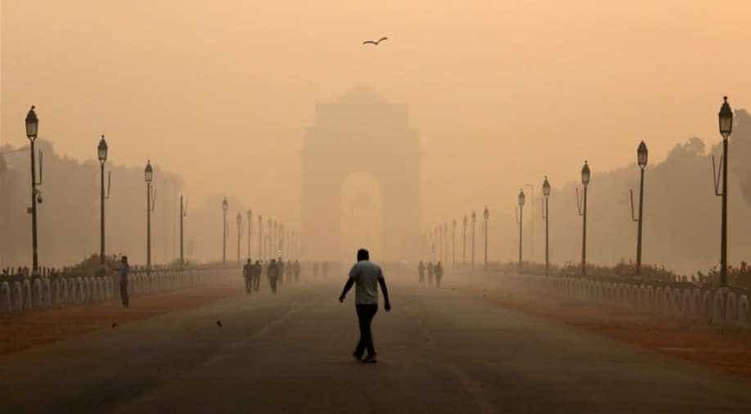
Health effects of aerosols
Beijing (Boston Globe)
New Delhi (Image Source)
Notes:
Photos above show the air pollution in Beijing (clear versus normal day) and New Delhi. Images are typical of the dense smog that can hang over cities for weeks at a time.
Imagine not being able to go play sports because of the condition of the air
You can only step outside for minutes at a time without running risk of major health effects
What are ways to combat this level of pollution?

Slide 26
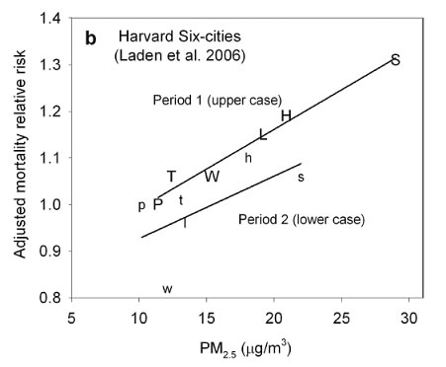
Social Costs
Notes:
Each letter corresponds to a city where the experiment was done.
P = Portage, Wisconsin; T = Topeka, Kansas; W = Watertown, Massachusetts; L = St. Louis, Missouri; H = Harriman, Tennessee; S = Steubenville, Ohio. Period 1 = 1974–1989; Period 2 = 1990–1998.
The graph shows that increased PM concentrations in the atmosphere are associated with an increased mortality.

Slide 27
Social Costs Quantified
M_{PM2.5} = AF x M_{total}
M_{PM2.5} : Mortality rate due to PM_{2.5} [μg/m³]
AF: Attributable Fraction = (Mortality rate due to PM_{2.5}) / (Total Premature mortality rate) [unitless]
M_{total} : Total Mortality rate in a given time [μg/m³]
AF= 1-e^{(-β x ΔC)}
β: Concentration-response factor; β = 0.0052 m³/(μg) from epidemiology studies
ΔC: Change in concentration of PM_{2.5} [μg/m³]
Notes:
M_{PM2.5} equals AF times M_{total}
M_{PM2.5} : Mortality rate due to PM_{2.5}
AF: Attributable Fraction = (Mortality rate due to PM_{2.5}) divided by the (Total Premature mortality rate), this can also be calculated by the equation below
M_{total} : Total Mortality rate in a given time
AF equals 1 minus e to the power of (-β times C)
AF= 1-e^{(-β x C)}
β (Beta) is the concentration-response factor. Using the relationship between the concentration of PM_{2.5} and mortality rate, the slope is used to calculate the concentration-response factor. Hence, β = 0.0052 m³/(micrograms) from epidemiology studies. EPA uses this value for their calculations.
ΔC: Change in concentration of PM_{2.5}
These equations were determined through many experiments to depict the relationship between the concentration and mortality rate.

Slide 28
Social Costs Example Problems
M_{PM2.5} = AF x M_{total}
AF= 1-e^{(-β x ΔC)}
β = 0.0052 m³/(μg) for epidemiology studies
For instance, if the United States total mortality rate was 2.5 million people per year and the change in concentration of PM_{2.5} was 12 μg/m³,
  What is the mortality rate due to PM_{2.5} per year?
  What percentage of people died prematurely due to PM_{2.5} per year?
If Georgia’s mortality rate was 135,000 people per year(assuming COVID is not a factor), what is the mortality rate due to PM_{2.5} per year? Hint: Find the PM_{2.5}. Let us assume the PM_{2.5} per year = PM_{2.5} per hour at the location of your choice for all of Georgia
Steps:
Go to Airnow
Type in the location of your choice in Georgia and press enter
Click on “Monitors near me” tab under the location name
Click on the monitor number to find the PM_{2.5}
Calculate the M_{PM2.5}
Notes:
When addressing social costs, the EPA has set the standards for PM_{2.5} concentrations to be less than or equal to 12 μg/m³. The first problem determines the social cost by applying the 12 μg/m³.
AF = 1-e(-0.0052 (m^3/μg) x 12 (μg/m^3)) => AF = 0.0605
M_{PM2.5} = AF x M_{total} = 0.0605 x 2,500,000 deaths/year => M_{PM2.5} = 151,250 deaths/year
% PM_{2.5} = (M_{PM2.5} / M_{total} ) x 100 = (151,250 deaths/year)/(2,500,000 deaths/year) x 100 = 6.05% PM_{2.5}
Notice that the percentage of people who die due to PM_{2.5} is equal to Attributable Fraction as a percentage (AF times 100).
Follow the same method as above for part a
Sample: if PM_{2.5} has 12 (μg/m^3) -> AF = 0.0605 and M_{total} = 135,000 deaths/year -> M_{PM2.5} = 494 deaths/year in Georgia due to PM_{2.5}

Slide 29
Take-Home Assignment 2
Determine how the social costs changes region to region:
  Compare a rural place in Georgia to Atlanta, Georgia
  Compare Washington D.C. to New York City, NY
  Compare Beijing to New Delhi
  Compare Mexico to the USA
Write a small paragraph addressing the aforementioned topics
Bonus: Provide calculations to support your claims

Slide 30
ELementary- Middle school
Exercise 1
Group of Exercises

