Slide 1
Can you think of any ocean creatures that have hard parts or shells?

Slide 2
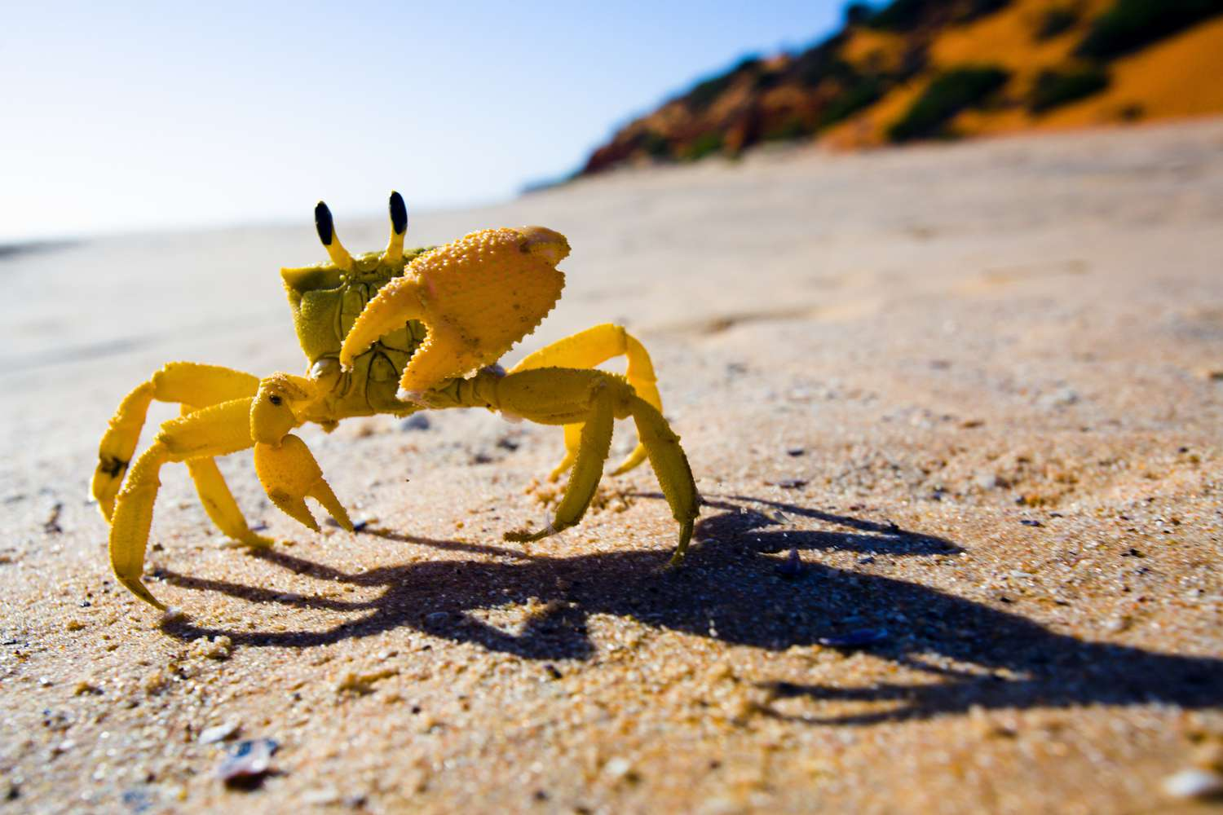
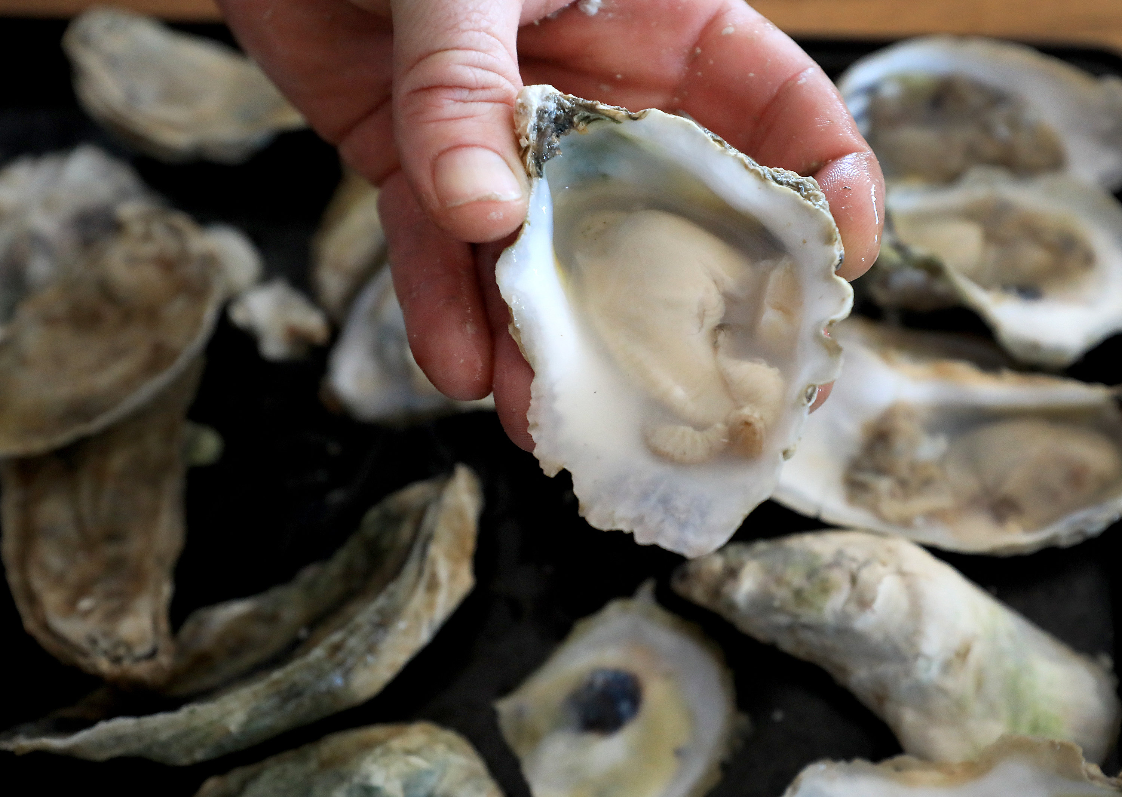
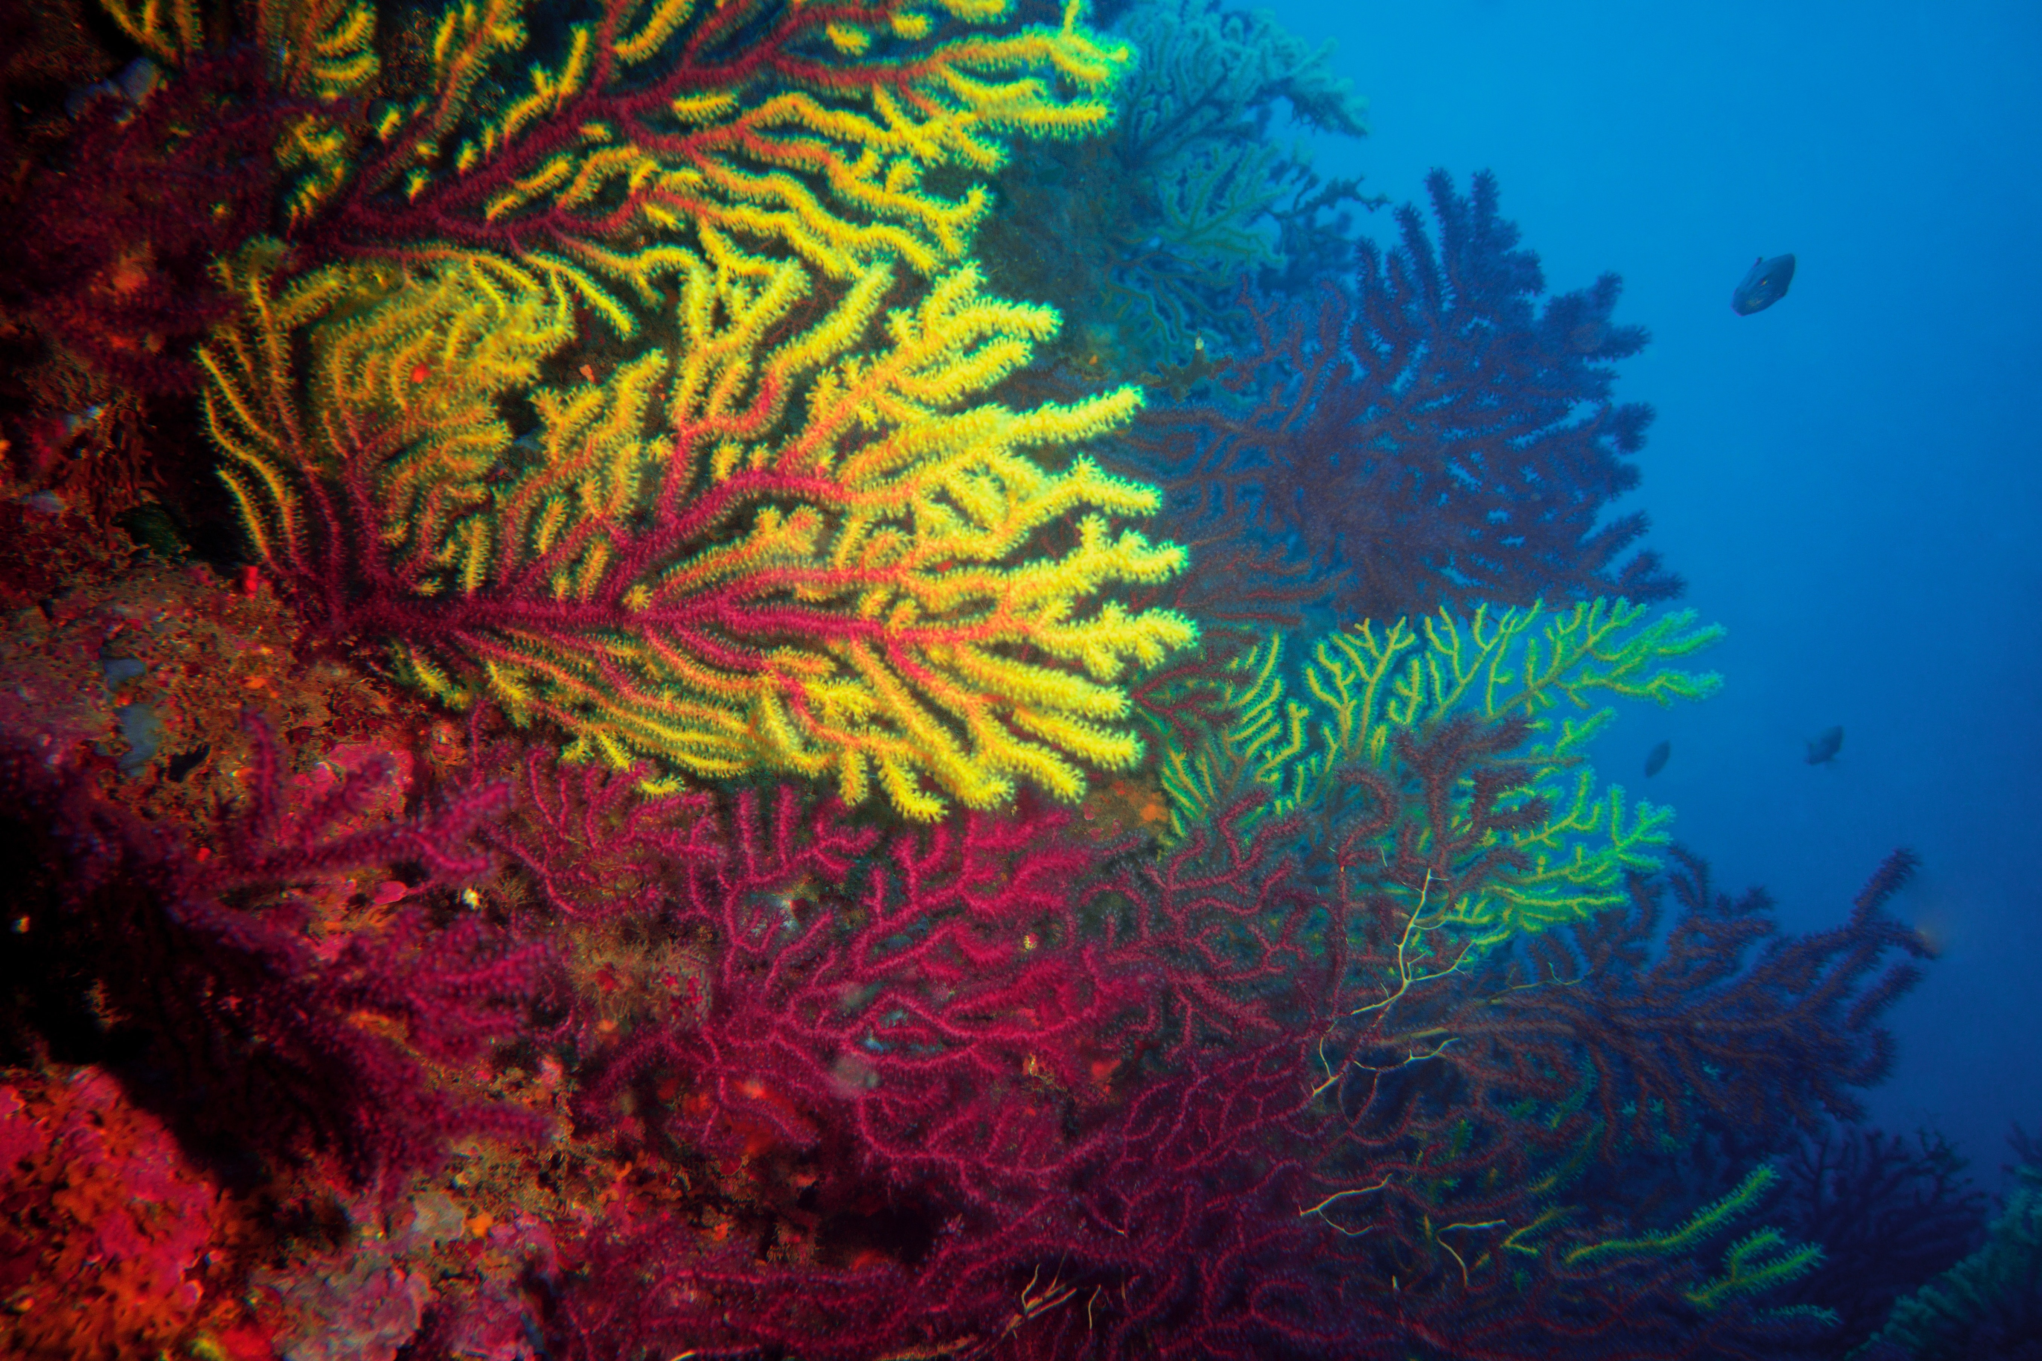
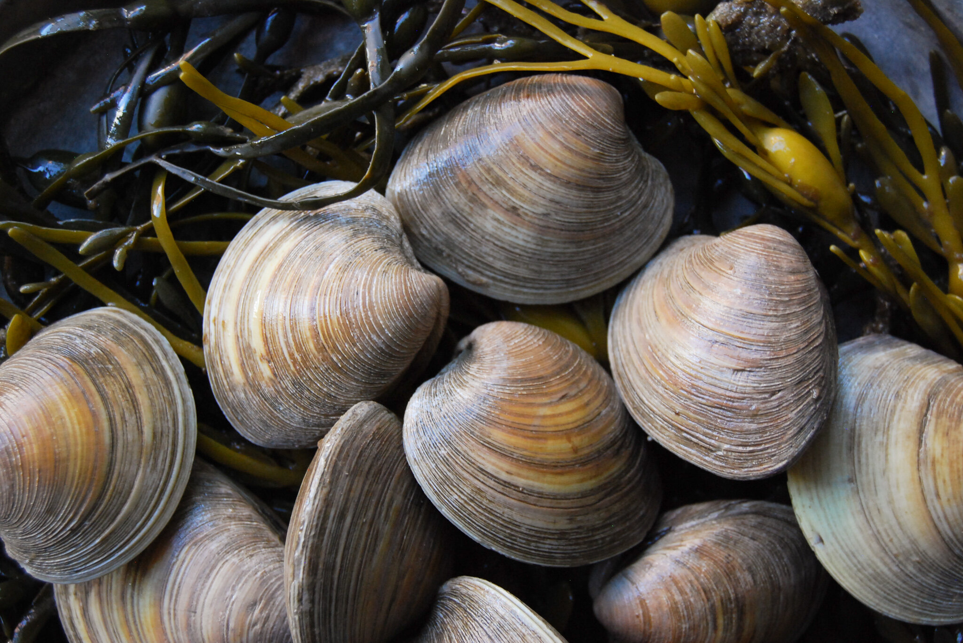
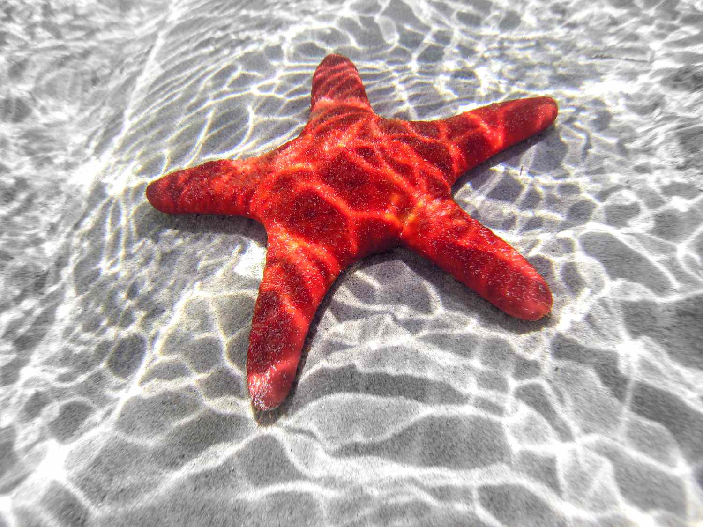

Slide 3
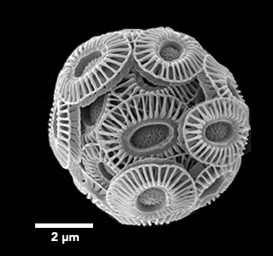
0.002 mm = about 100 times smaller than a grain of sand!

Slide 4
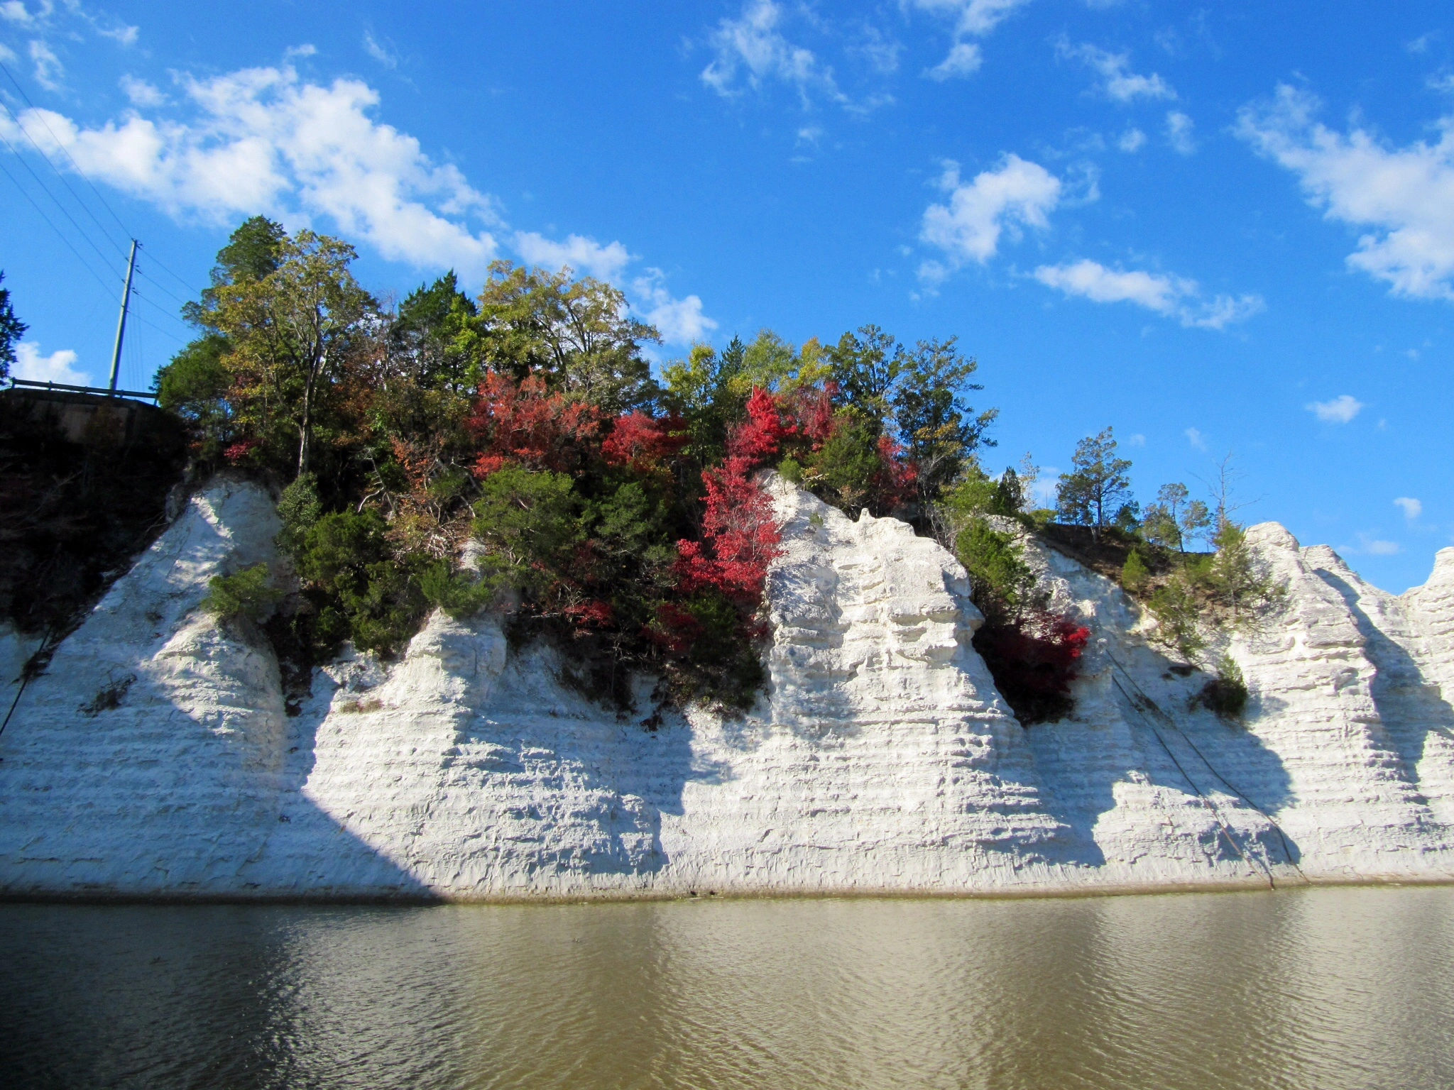
Fun Fact!
Demopolis, AL
Chalk cliffs made from fossil shells.
Under the sea during the time of the dinosaurs

Slide 5
How do you build a shell?
+
=
Calcium
(Ca)
Carbonate
(CO3)
Calcium Carbonate
(CaCO3)

Slide 6
How do you build a shell?
How much there is of this one changes with “acidity”
+
=
Calcium
(Ca)
Carbonate
(CO3)
Calcium Carbonate
(CaCO3)

Slide 7
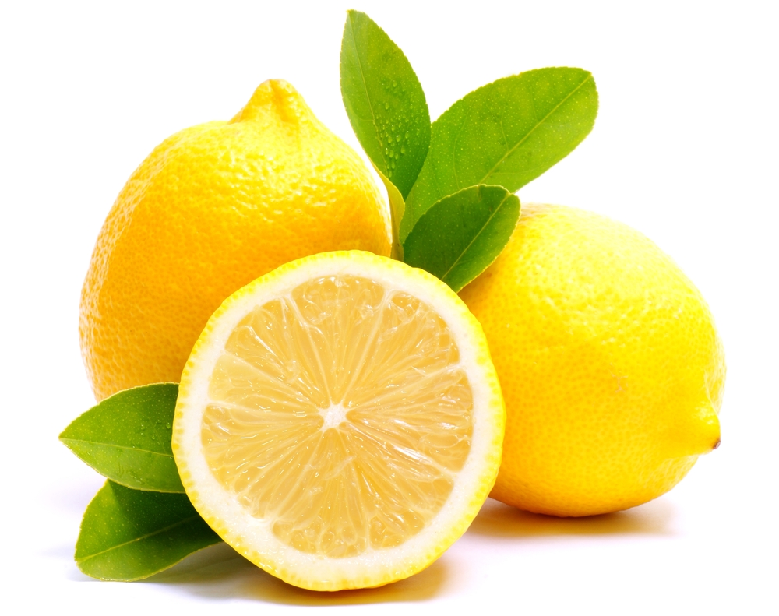
Have you ever taken a bite of a lemon??

Slide 8
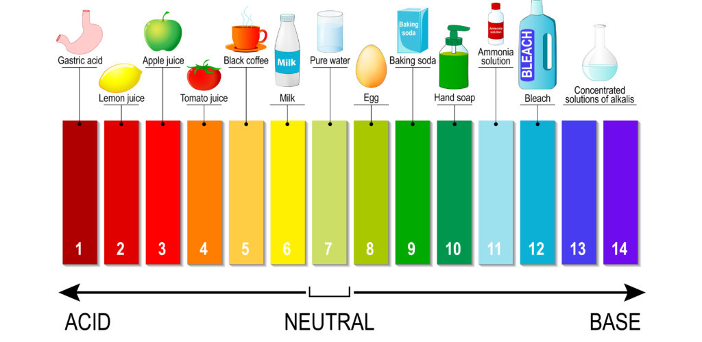
We measure acidity using the pH scale
Range from 0 to 14; Low numbers mean acidic.
Can you think of another example of an acid?
[HINT: often something sour]
0
http://onlineresize.club/2021-club.html

Slide 9

Acids have a low pH
0
http://onlineresize.club/2021-club.html

Slide 10
Opposite of an acid is called a base
Can you think of an example of a base?
[HINT: often used for cleaning]
0
http://onlineresize.club/2021-club.html

Slide 11
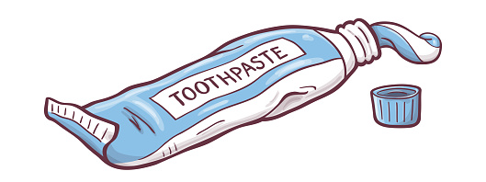
Bases have a high pH
Can you think of an example of a base?
[HINT: often used for cleaning]
0
http://onlineresize.club/2021-club.html

Slide 12
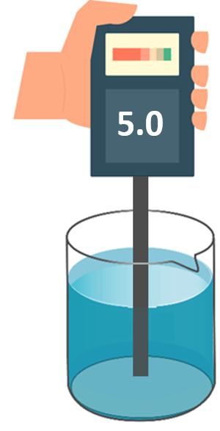
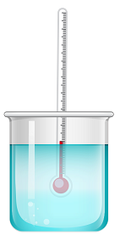
We can measure pH with a pH meter
Just like how we use a thermometer to measure temperature

Slide 13
What about water?
0
http://onlineresize.club/2021-club.html

Slide 14
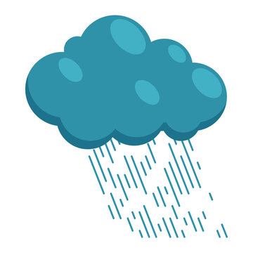
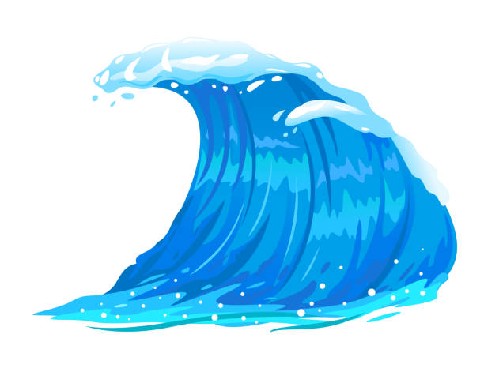
What about water?
0
http://onlineresize.club/2021-club.html

Slide 15
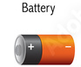
The pH scale
0
http://onlineresize.club/2021-club.html

Slide 16
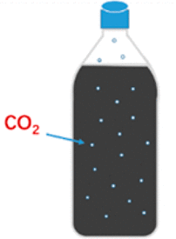
We can change the acidity of water
How? By adding carbon dioxide (CO2)
-- like in club soda!
(tastes sour… acid or base?)
Where does carbon dioxide come from?

Slide 17
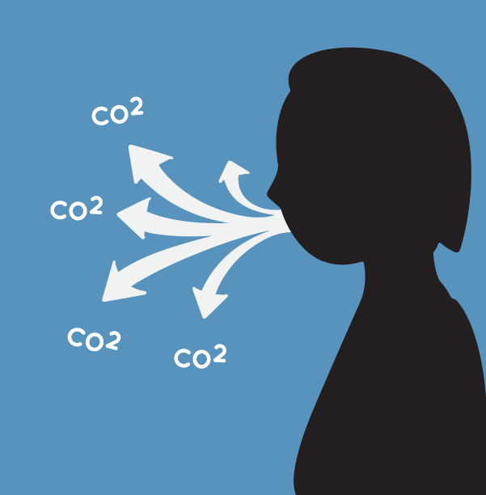
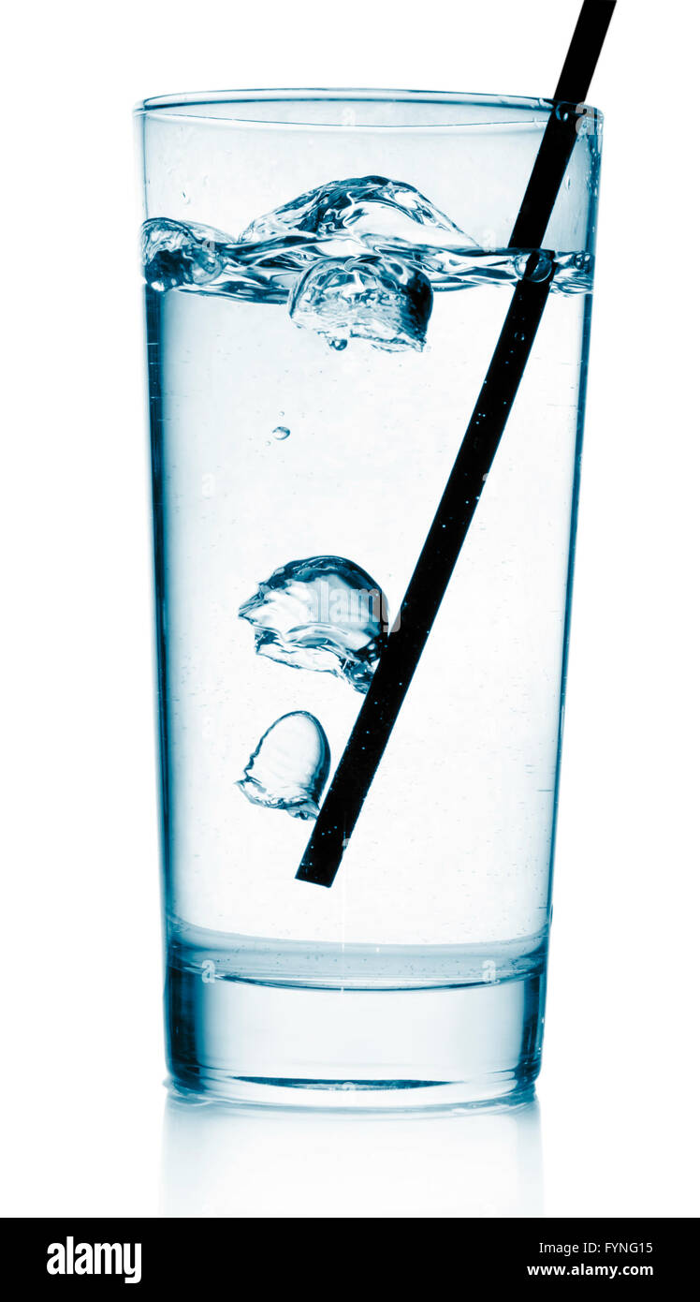
We breathe out carbon dioxide
Credit: NASA/JPL-Caltech.

Slide 18
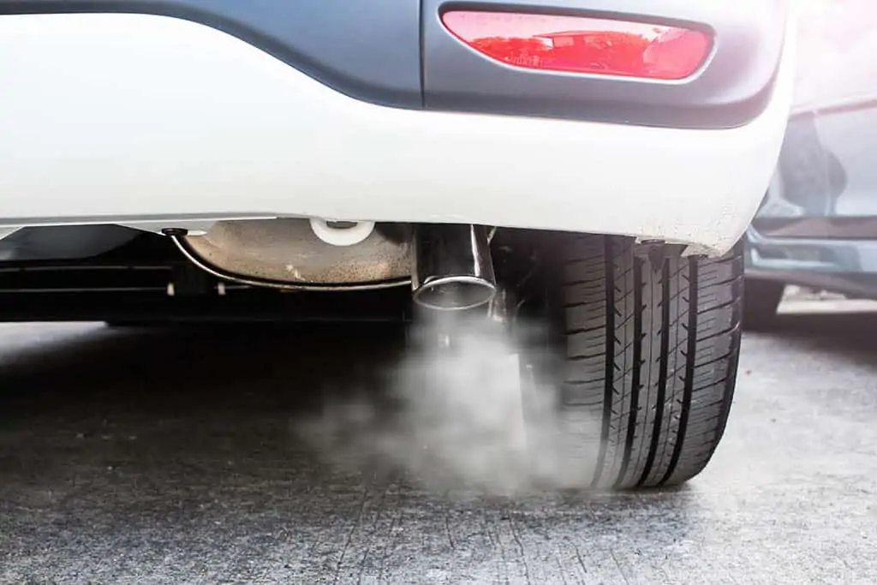
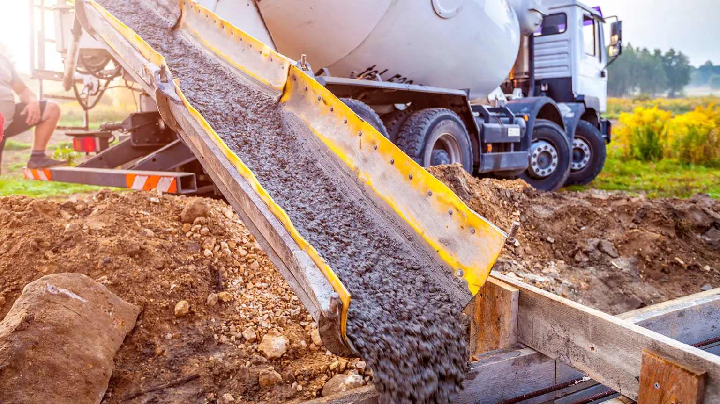
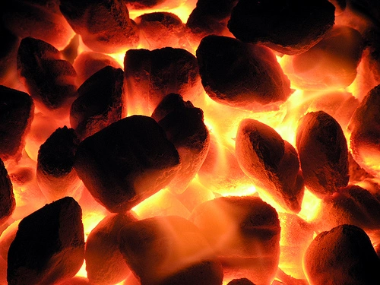
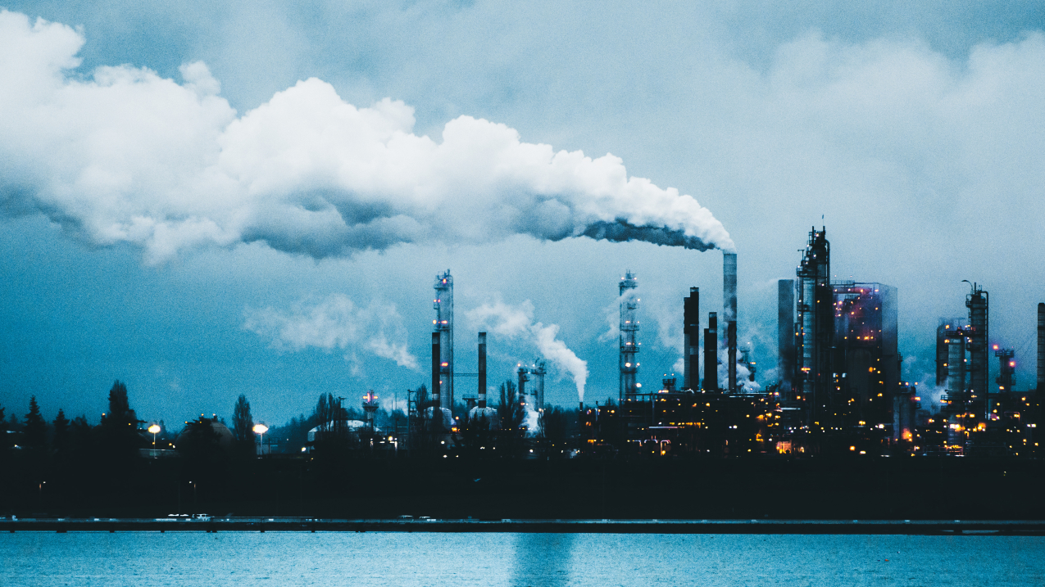
carbon dioxide comes from...
Credit: NASA/JPL-Caltech.
Credit: Getty Images

Slide 19
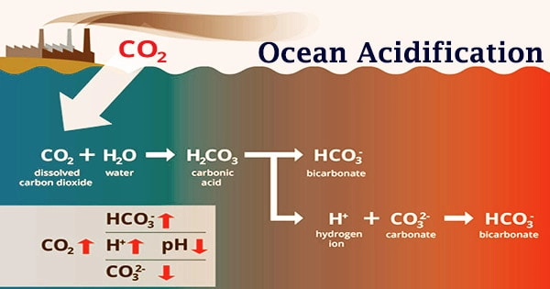
Much of this carbon dioxide goes into the ocean...
Will that make the ocean more acidic or more basic?
Let’s find out what this means for shell-builders!

Slide 20
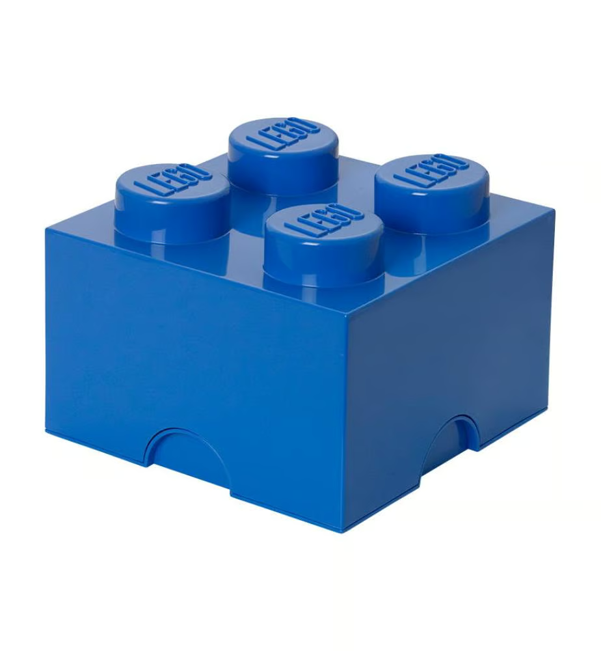
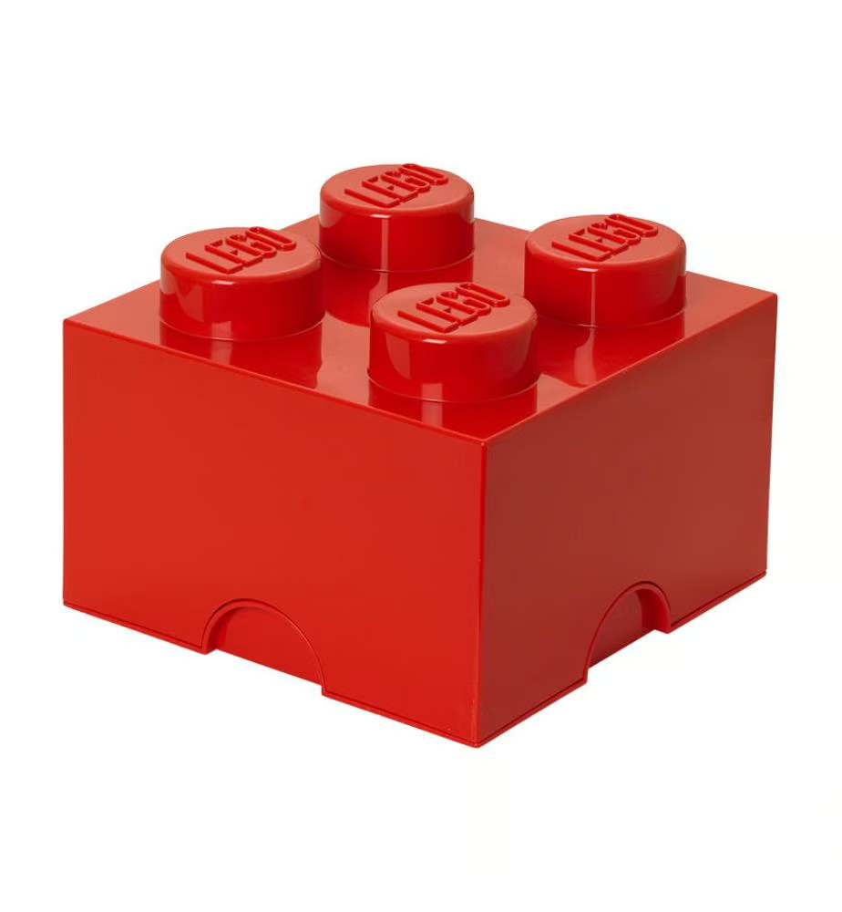
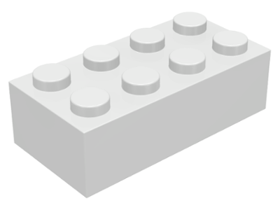
Ocean Acidification Game
Calcium
(Ca)
Carbonate
(CO3)
Carbon Dioxide
(CO2)

Slide 21
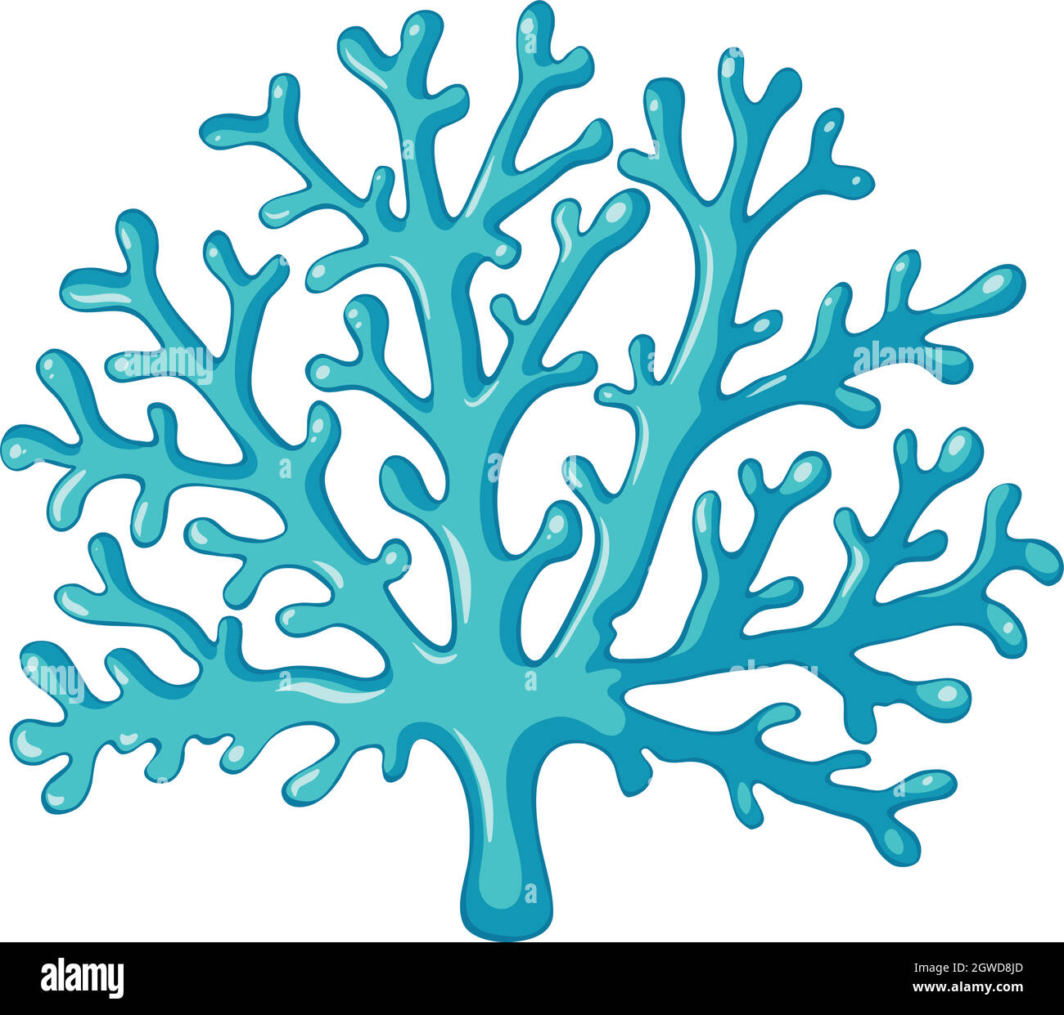
Ocean Acidification Game
+
=
1 Calcium
(Ca)
1 Carbonate
(CO3)
1 “coral unit”
(CaCO3)
Team with the most coral units wins!

Slide 22
Score Board
 | Team 1850 | Team 1900 | Team 1970 | Team 2024
Number of “coral units”
Number of carbon dioxides
Do you notice any “trends” (patterns with time)

Slide 23
Just like in the real ocean!
Past ocean (e.g., 1850):
less CO2 but more carbonate = more coral
Today’s ocean:
more CO2 but less carbonate = less coral
The game was rigged!

Slide 24
More acidic mean less carbonate and fewer building blocks for shell-builders
+
=
Calcium
(Ca)
Carbonate
(CO3)
Calcium Carbonate
(CaCO3)

Slide 25
Time to plot your results!
What patterns (“trends”) do you notice?
What do you predict will happen in the year 2050? Why?

Slide 26
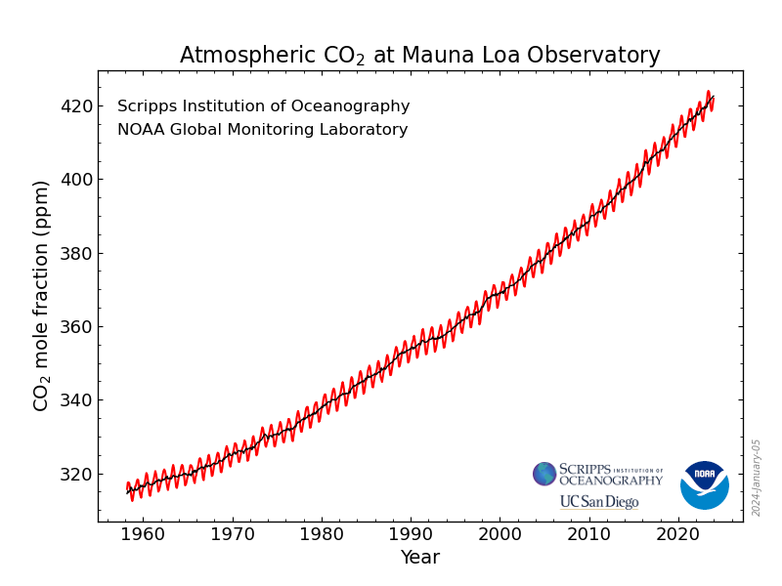

Slide 27
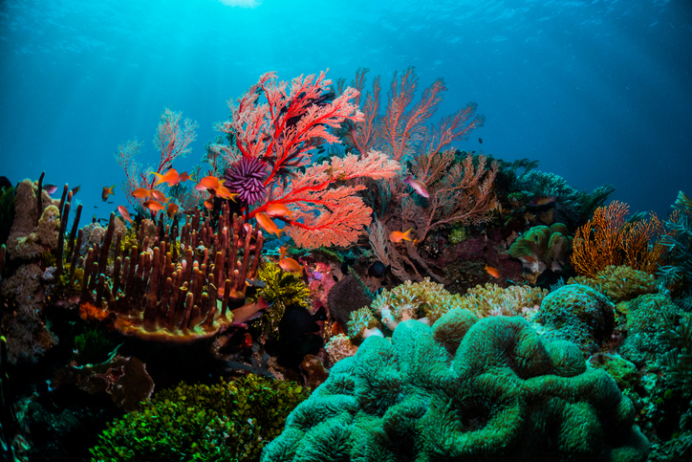
Why should we care?

Slide 28
What can we do about it?

Slide 29
What can we do about it?
Plant more trees?
New technologies...

Slide 30
What can we do about it?
Plant more trees?
New technologies...
Even better: put less carbon dioxide into the air in the first place!

Slide 31

How can you help save energy?

Slide 32
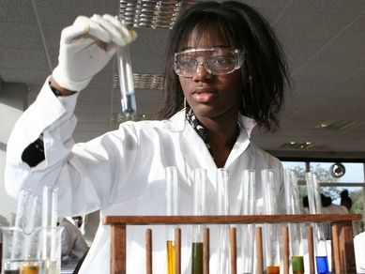
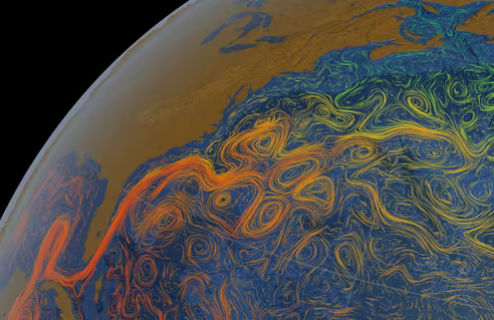

The ocean needs you!
Bright young minds with fresh ideas for climate solutions
Biologists, engineers, oceanographers, climate scientists, chemists etc.
Take math, science, technology, computers/coding, geography in high school

