Slide 1
Overview of Drinking Water Treatment
SciREN 2022
Notes:
Ask why students where they think our drinking water comes from and why treating it might be important

Slide 2
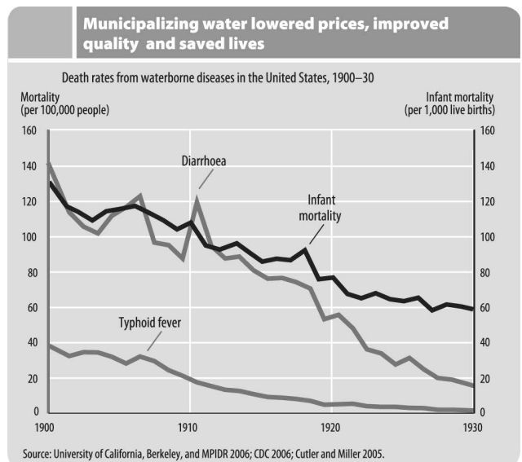
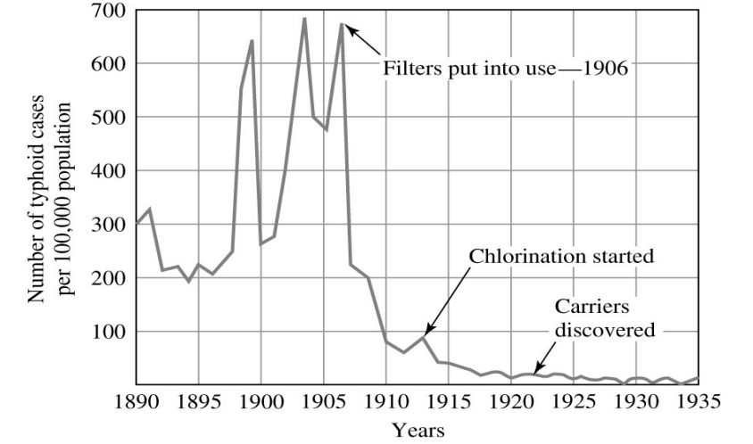
Treating drinking water was a major advancement for public health
Source: Introduction to Environmental Engineering, Davis and Cornwell, 2013
Notes:
With drinking water treatment, illness and deaths due to waterborne diseases vastly decreased
Drinking water treatment (filtration, chlorination) considered one of the biggest public health advancements in recent history

Slide 3
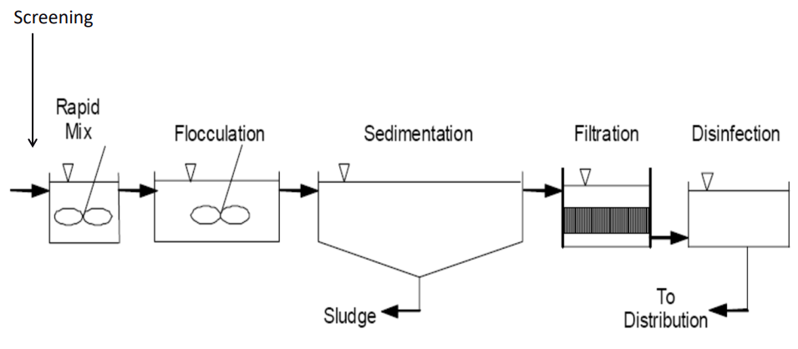
Overview of drinking water treatment
Notes:
Today, we will cover an overview of traditional water treatment and why it is necessary

Slide 4
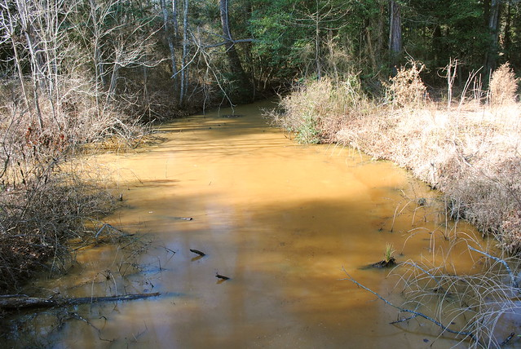
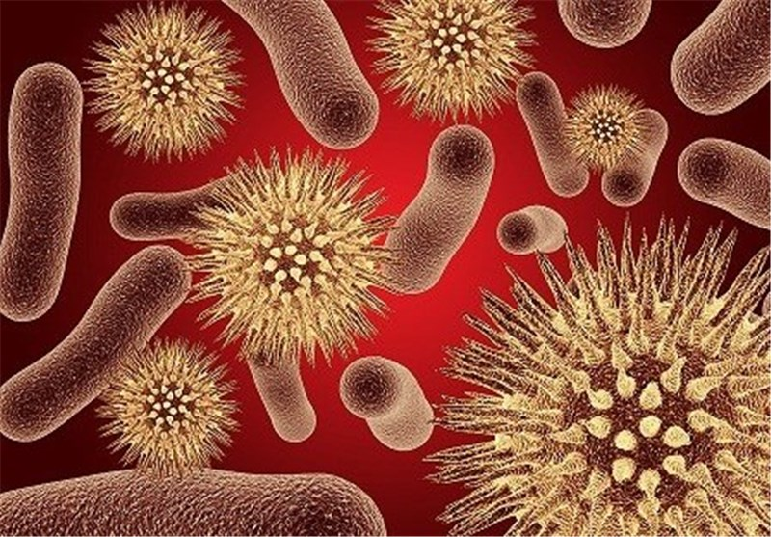
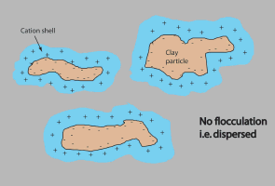
The main goal
Notes:
Murky water carries dirt particles, collectively referred to as turbidity
Bacteria, viruses, and other disease-causing microorganisms rarely float freely in water. They are usually attached to dirt particles.
Therefore, removing turbidity removes the majority of disease-causing microorganisms.

Slide 5
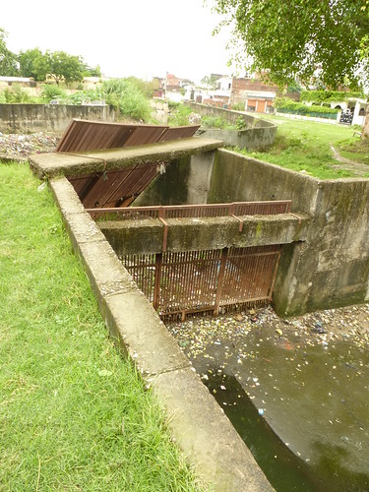
Screening
Notes:
Most treatment plants have some sort of bar screen if they use surface water
This prevents logs, fish, etc. from getting into the plant

Slide 6
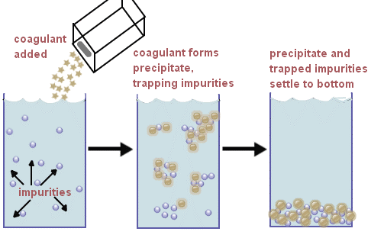
Coagulation + rapid mix
This Photo by Unknown Author is licensed under CC BY-NC-ND
Notes:
Clay particles do not like to stick together and will not settle to the bottom of a tank on their own
To make them stick together, we add chemicals called coagulants to encourage them to stick together (by destabilizing their negative charge)
The rapid mix tank allows the coagulant to be thoroughly mixed into the water

Slide 7
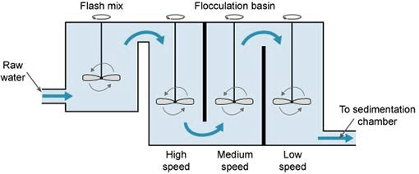
flocculation
This Photo by Unknown Author is licensed under CC BY-SA-NC
Notes:
The flocculation basin involves paddles that stir the water more slowly than the rapid mix basin
This slow stirring allows the particles to start sticking together, forming “flocs”
These flocs become big enough to start settling to the bottom of the basin

Slide 8
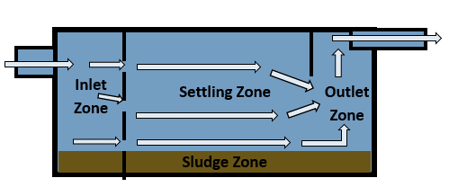
sedimentation
This Photo by Unknown Author is licensed under CC BY-SA-NC
Notes:
Water flows through this basin with the sole purpose of giving flocs time to settle to the bottom before moving to the next step of treatment

Slide 9
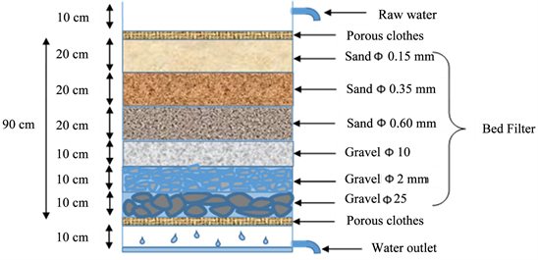
filtration
This Photo by Unknown Author is licensed under CC BY
Notes:
Filters remove smaller particles that do not settle out
Filters can consist of various media: sand, anthracite, activated carbon, or a combination

Slide 10
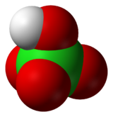
chlorination
This Photo by Unknown Author is licensed under CC BY-SA
Notes:
Chlorination kills any remaining microorganisms that can cause illness
We add enough to leave a chlorine residual throughout the distribution system so that more bacteria do not grow in pipes
This is an important step because it keeps people from getting sick

Slide 11
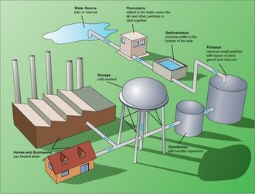
distribution
This Photo by Unknown Author is licensed under CC BY-SA
Notes:
After water treatment, the water is dispersed via underground pipes to homes, businesses, etc. in the surrounding community

Slide 12
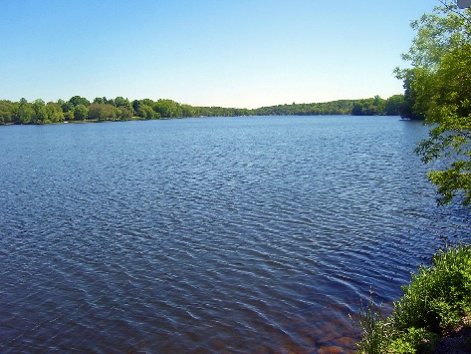


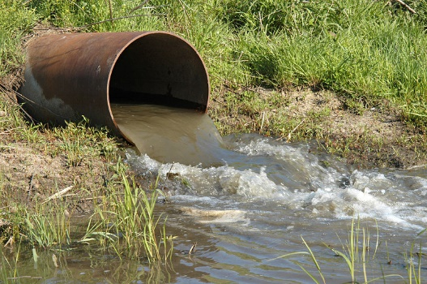



Organic matter in the water can mix with chlorine to make disinfection byproducts
Notes:
Organic matter (decayed leaves, microbial products, etc) is in all water
When organic matter meets chlorine, a chemical reaction occurs that forms compounds called disinfection byproducts (or DBPs)
DBPs are unwanted compounds that form in our distribution system and sometimes cause health problems

Slide 13
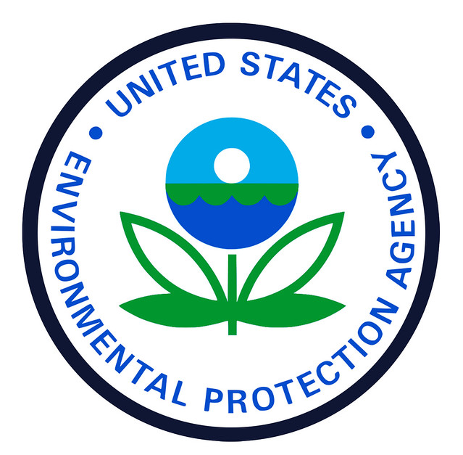
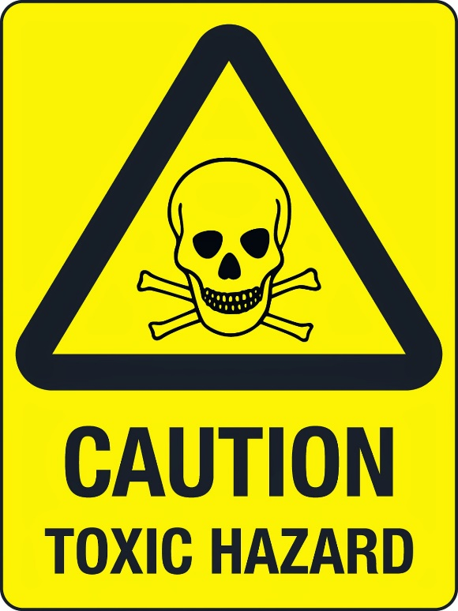


Some dbps are regulated by the epa because they cause health problems
This Photo by Unknown Author is licensed under CC BY
Notes:
Because some types of disinfection byproducts (DBPs) can cause health problems in humans, the Environmental Protection Agency (EPA) requires cities to measure and report the DBPs in their systems
Trihalomethanes (THMs) and Haloacetic Acids (HAAs) are the two regulated types of DBPs that the EPA tracks

Slide 14
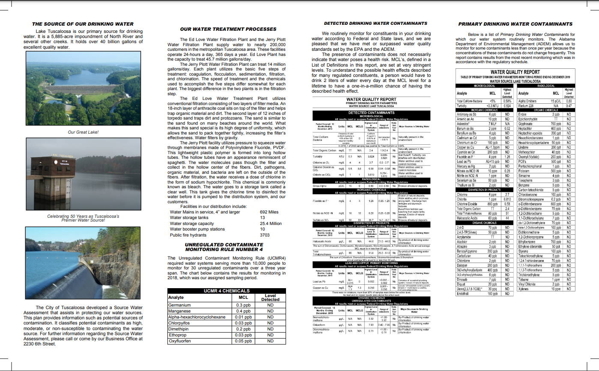
Notes:
The City of Tuscaloosa issues a water quality report every year, so we can see what is in our water
We will now complete an activity where we look at how these values change over time

