Slide 1
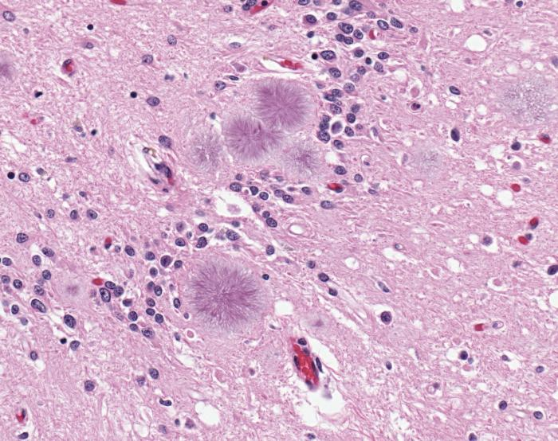
Transmissible spongiform encephalopathies (TSEs)
Rare, incurable neurodegenerative diseases characterized by spongiform vacuolization and amyloid plaques
Can be hereditary, sporadic, or acquired
Plaques
Vacuoles (spongy holes)
Credit: CDC (Sherif Zaki; MD; PhD; Wun-Ju Shieh; MD; PhD; MPH)
Notes:
Red = red blood cells
blue-purple = cell nucleus
Pink = Extracellular matrix and cytoplasm

Slide 2
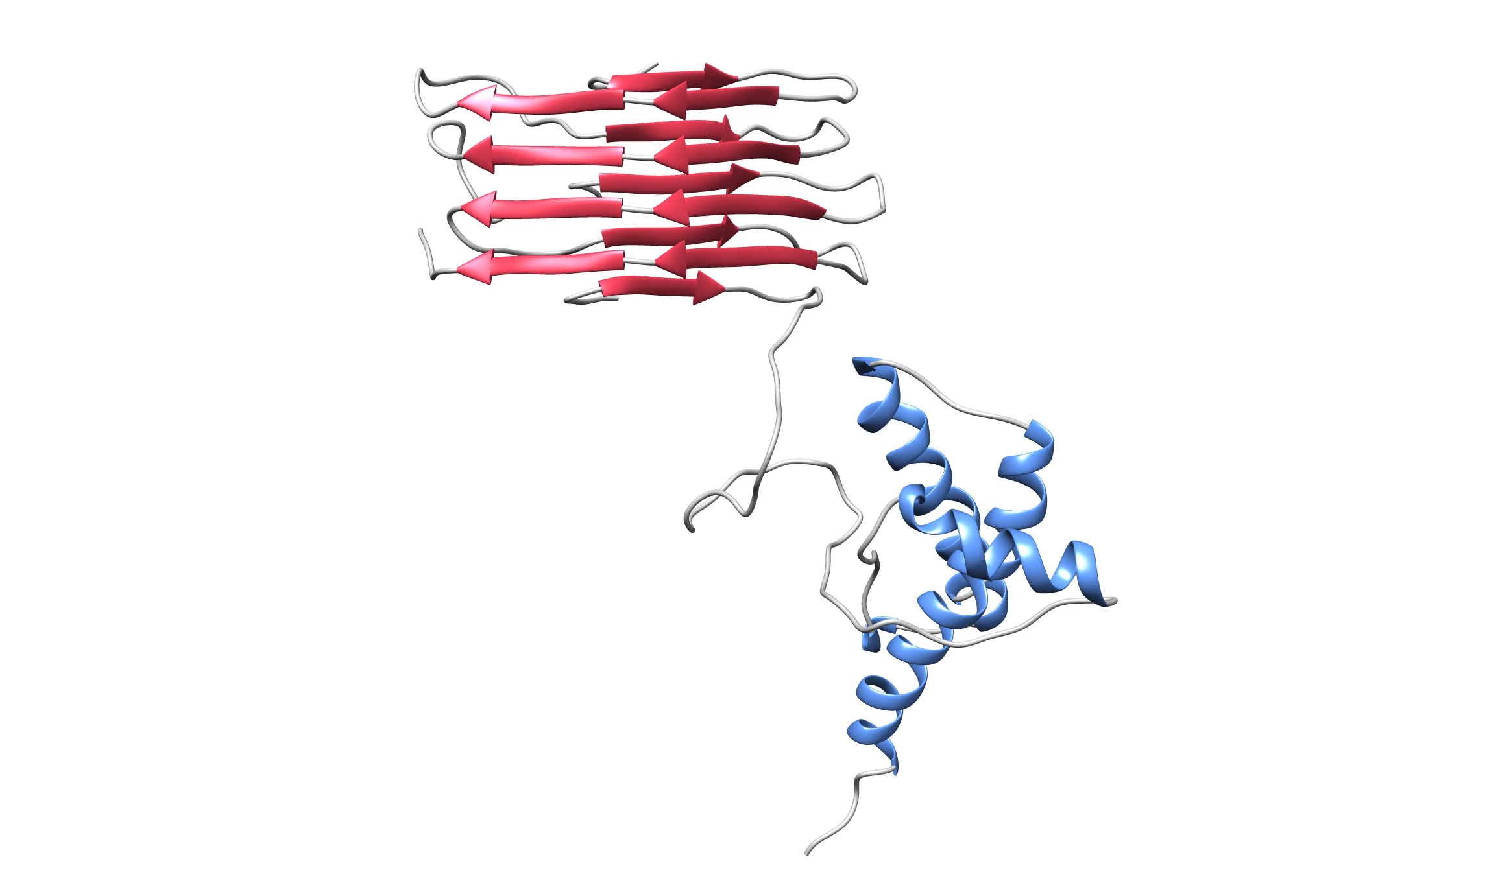
Prion templating starts chain reaction
Misfolded prion
Healthy prion
Credit: Simulation by Spagnolli and colleagues, 2019
Notes:
https://journals.plos.org/plospathogens/article?id=10.1371/journal.ppat.1007864

Slide 3
Prion templating starts chain reaction

Slide 4
Prion templating starts chain reaction

Slide 5
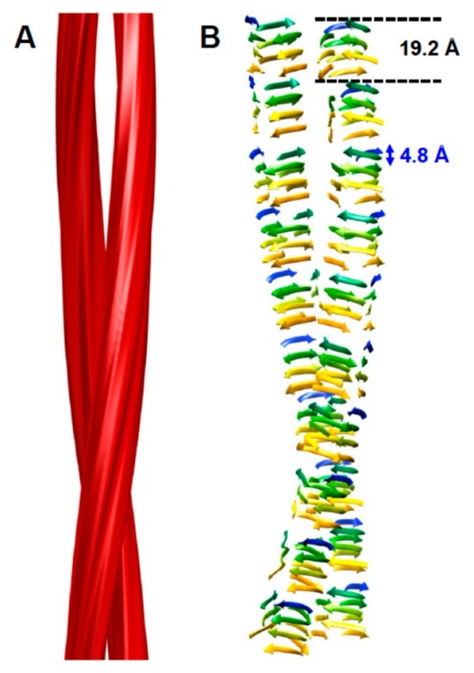
Prion templating starts chain reaction
Credit: Wille and colleagues, 2018

Slide 6
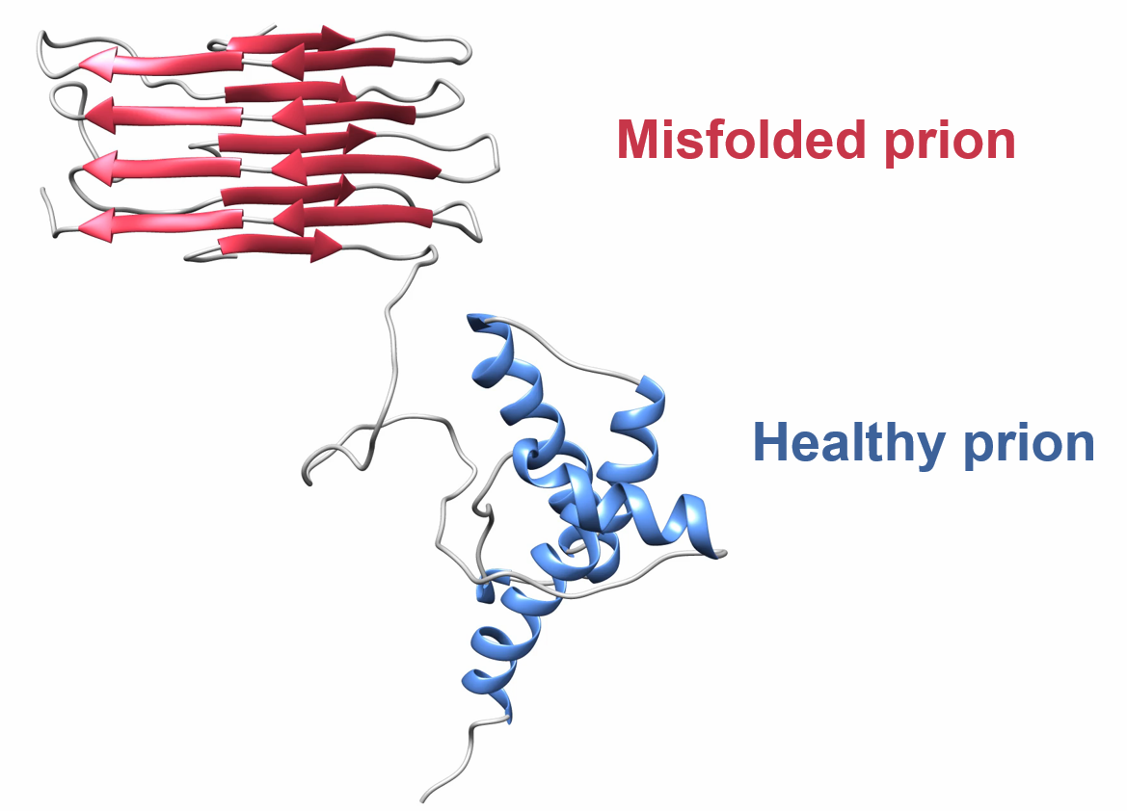
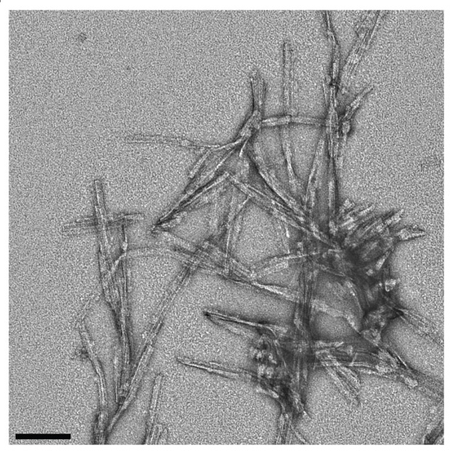
Steps
Stacking
+
Prion amyloid fibers
Prion amyloid plaques
Neurodegeneration
Credit: Pines lab

