Slide 1

Why Did Lizards Lose Their Legs?
Carter Coleman
PhD Student
University of Georgia Department of Environmental Health Science

Slide 2
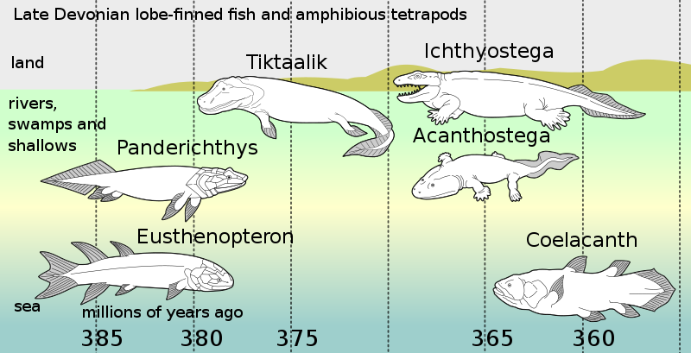
Fish, Birds, Mammals, and Reptiles all Start With Tetrapods
Tertrapods = four limbs
So, the earliest ancestors of all reptiles had limbs.

Slide 3
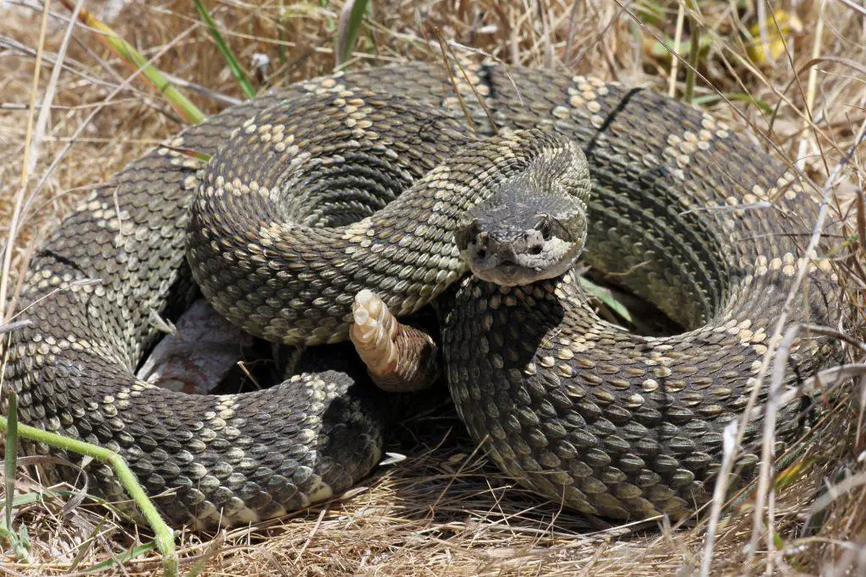
But Somewhere Along the Way Those Limbs Vanish…

Slide 4
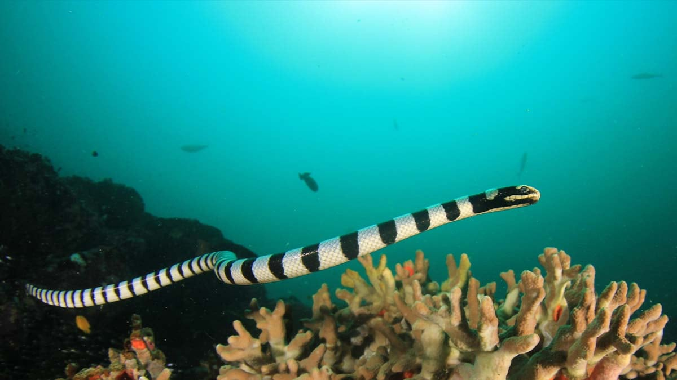
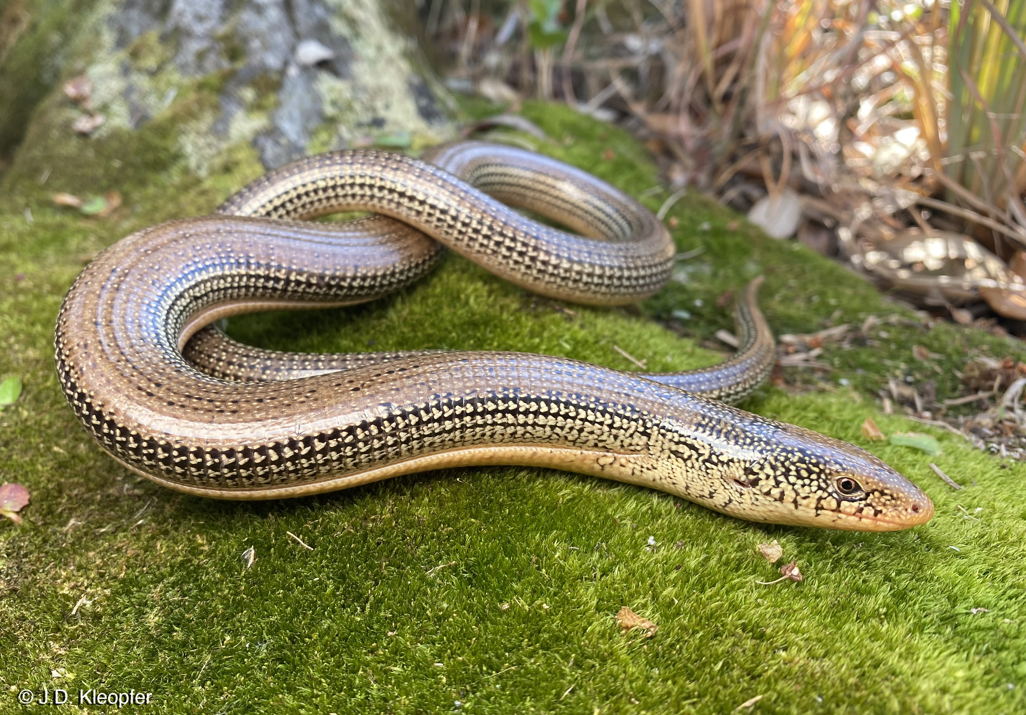
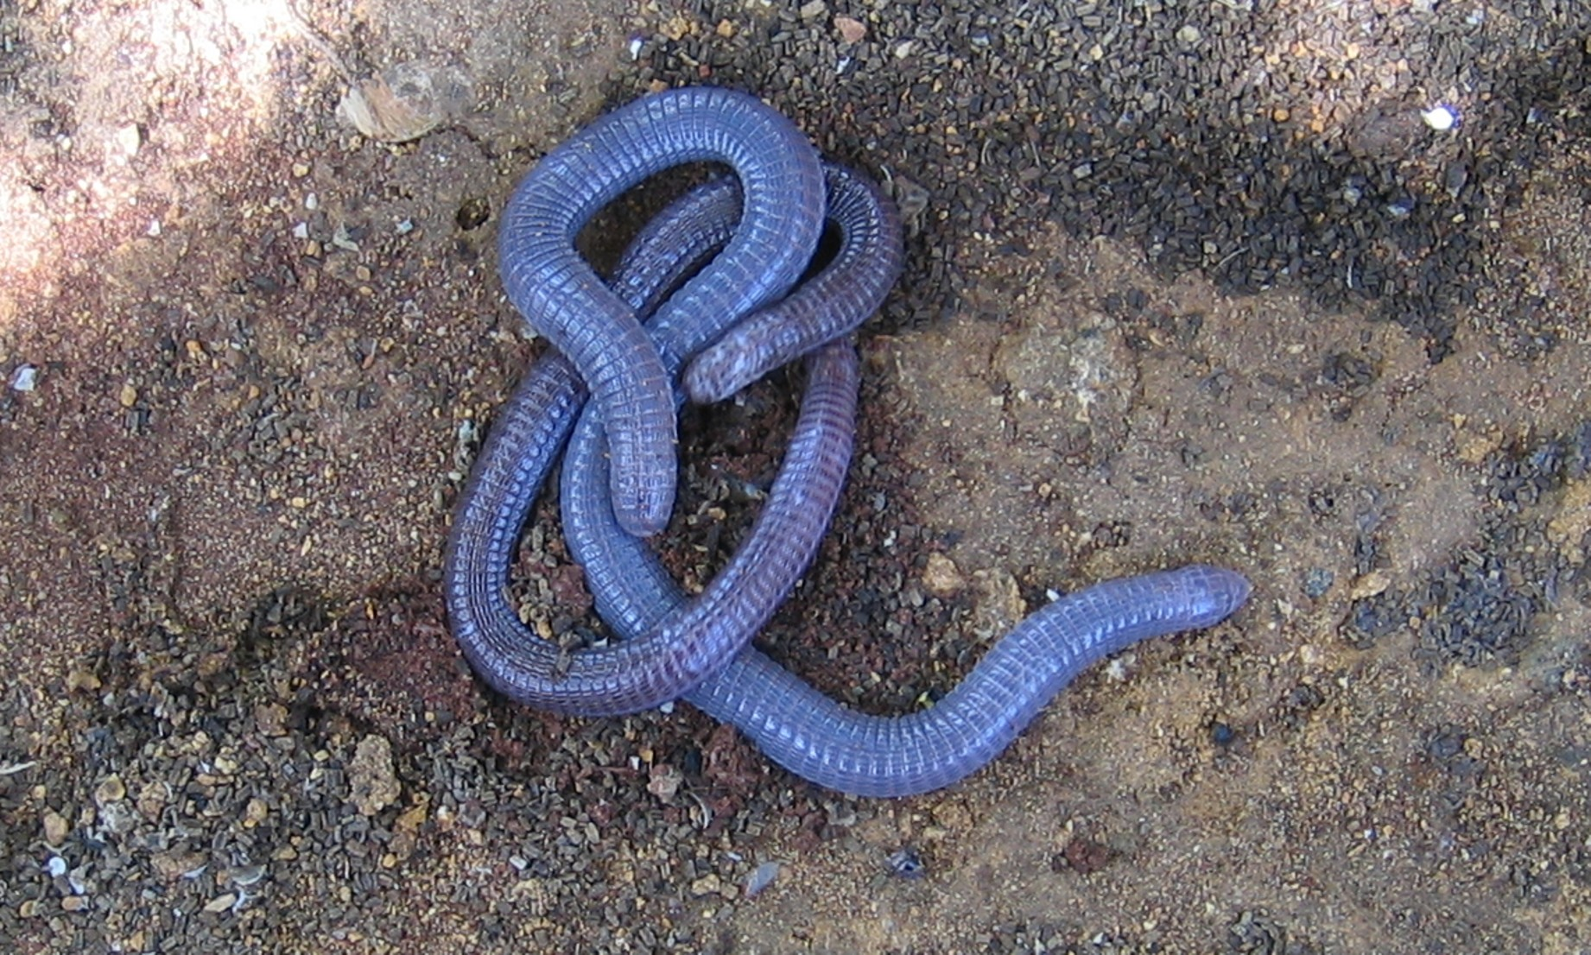
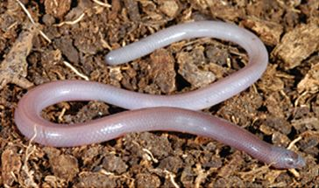
Snakes Are Not the Only Reptiles Without Legs…
Sea Snakes
Glass Lizards
Worm Lizards
Blind Lizards

Slide 5
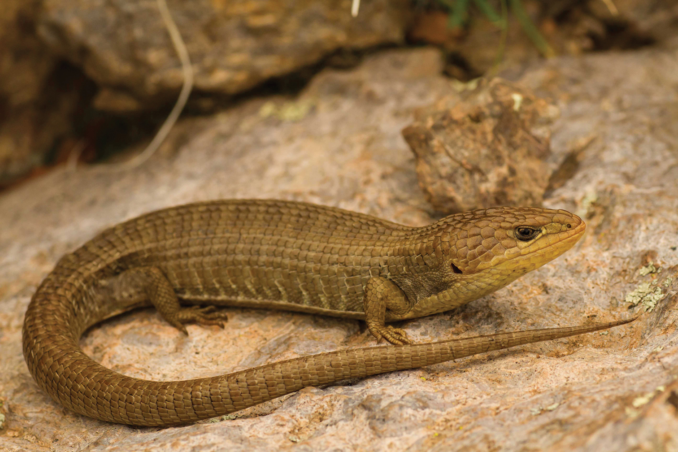
How did this happen?

Slide 6

Break Out 1: Evolution by Natural Selection
Form groups of ~4
Each group should have:
  Plain copy paper
  Pencil/color pencils
  Playdough (optional)

Slide 7
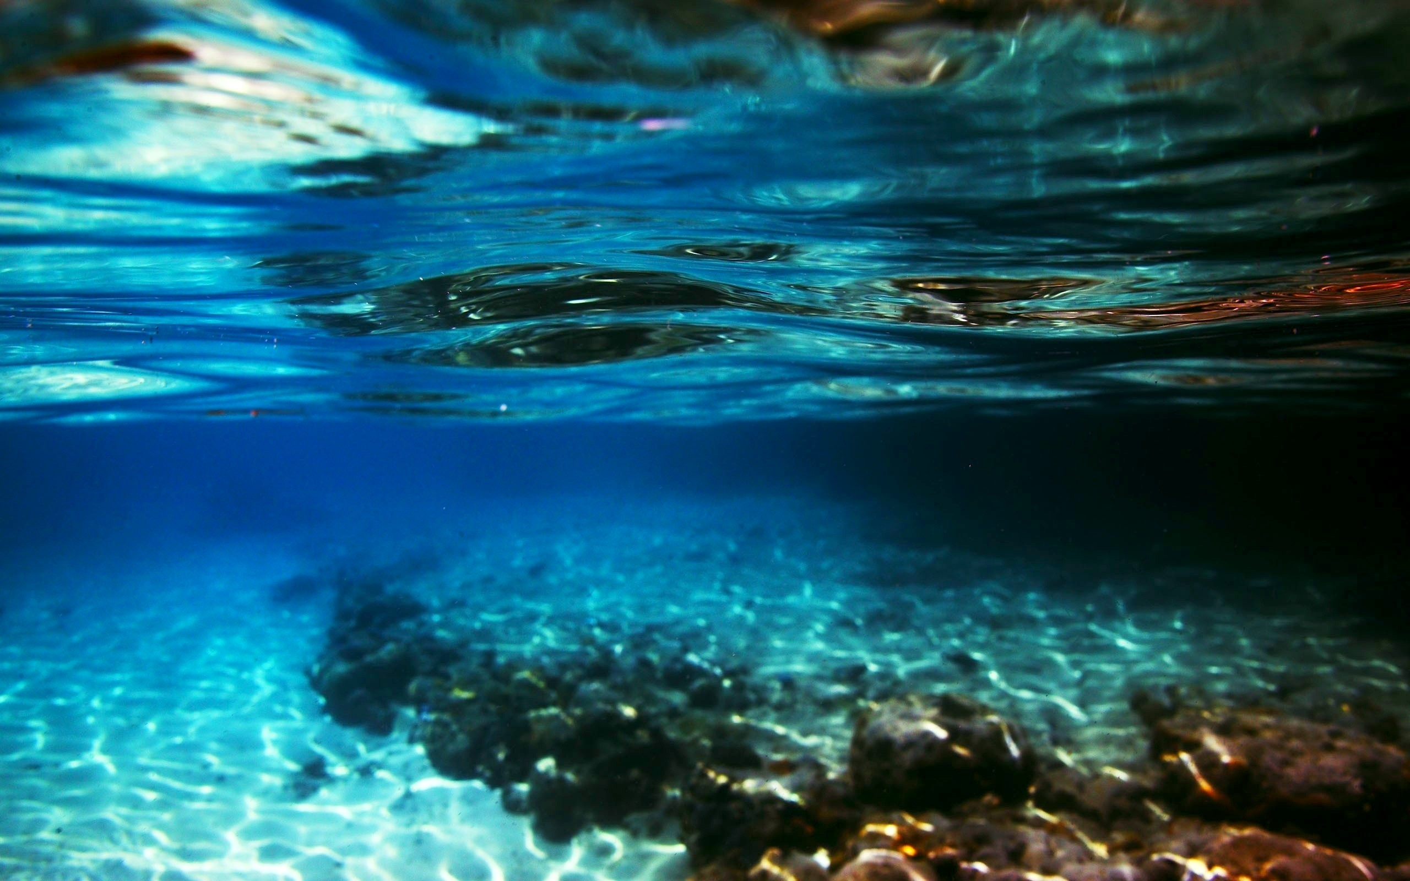
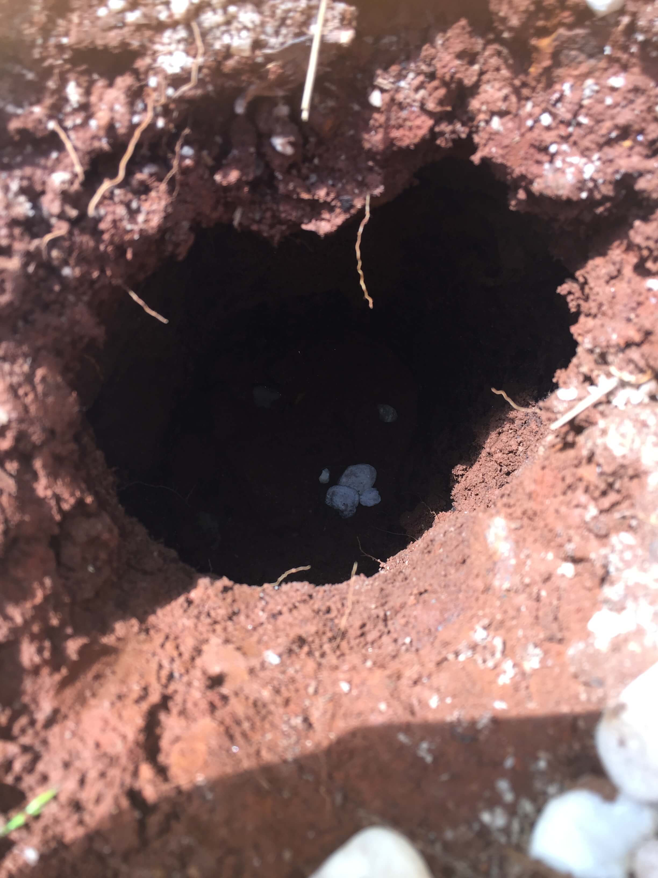
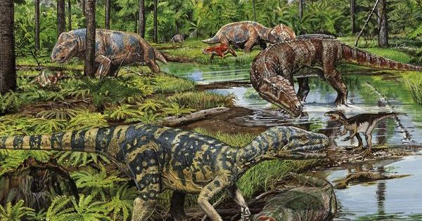
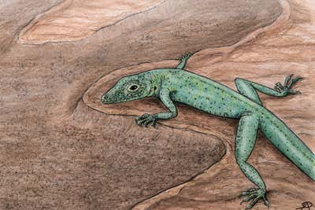
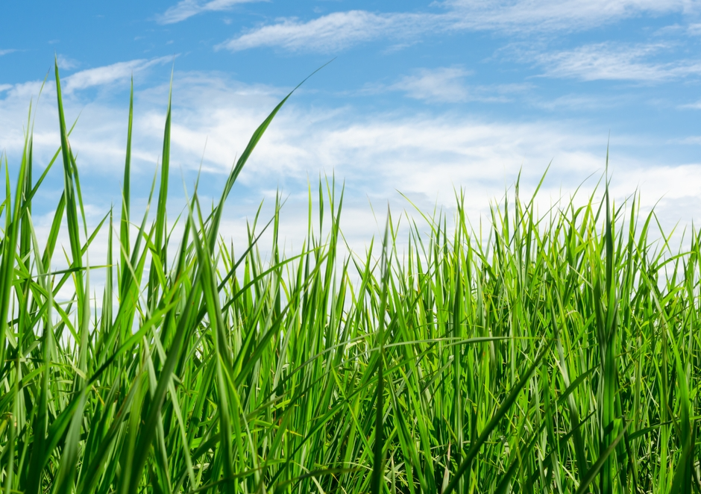
Break Out 1:
You are a prehistoric (Triassic), ground-dwelling, lizard. Suddenly, a bunch of predators find you and they look hungry!!!!!
You and your team need to figure out which area you want to hide:
  Grass
  Burrow underground
  Shallow tidal pool
Once your group has picked a survival strategy, design and draw a new lizard body to help you escape predators and move around in your new habitat.

Slide 8
Break Out One: Hints
When designing a new Morphology, think about some obstacles each habitat type has for movement
  If burrowing, what body shape would help you tunnel? Think about tools you use to dig holes, like a shovel or a drill…
  If in the water, how will you make your self go forward (think boat rutter). Additionally, if it is shallow, do you want fins flapping around or not?
  If in the grass, how could you move without rustling the grass? Might want to be slender in order to squeeze through rather than just push yourself through.

Slide 9
Break Out 1: Discussion
Tell everyone what you came up with!
What body features did you include and why?

Slide 10
Evolution by Natural Selection Explained
Everything you guys came up with for your new lizard bodies are called ”phenotypes”.
  Phenotypes are the observed result of ”genes” that come from your DNA.
  Phenotypes are created by random genetic changes.
  If a phenotype makes it easier to live in a habitat, the habitat selects for that phenotype.
  This process is called Evolution by Natural Selection!!!!!!

Slide 11
So What Actually Happened?
Legs were selected against in ground-dwelling lizards!!!!!!

Slide 12
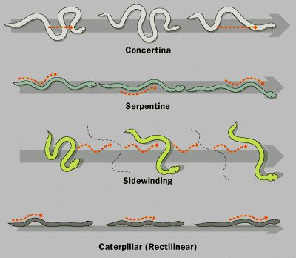
Why Did They Lose Legs?
Legs (shoulders) make it hard to fit into tight spaces, like burros in the ground, much easier if you have a muscular, streamlined body shape.
Slender bodies without appendages allow these lizards to “swim” through blades of tall grass and water very efficiently!

Slide 13
Break Out 2: Convergent Evolution
Scientists have found that limb loss has evolved many times throughout lizard evolutionary history.
In your groups, review the simplified phylogenetic tree (shows how species are related and changed through time) and find 2-3 lizards that got rid of their legs.
  Can you tell whether the loss of limbs in the separate species happened because a common ancestor lost limbs?
  Or did they lose limbs separately from each other?
But first………..

Slide 14
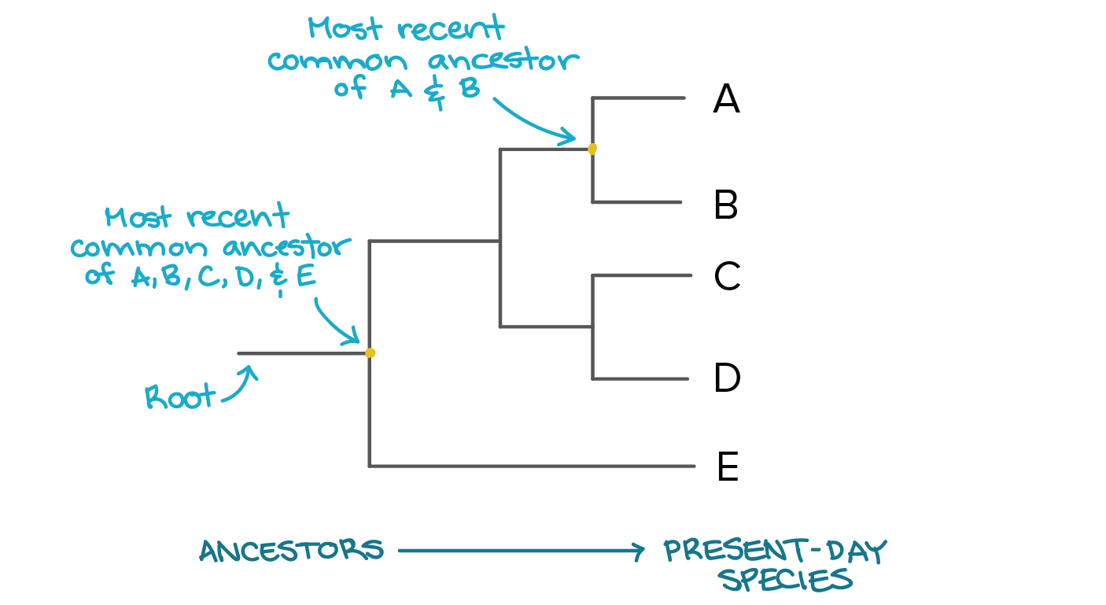
Quick Lesson on Phylogenetic Trees!

Slide 15
Breakout 2: Discussion

Slide 16
Conclusions
Evolution by Natural Selection: “process that results in the Sustained adaptation of an organism to its environment by means of selectively reproducing changes in its genotype, or genetic constitution”.
– Encyclopedia Britannica
Convergent Evolution: “the independent development of similar traits or features (as of body structure or behavior) in unrelated or distantly related species or lineages that typically occupy similar environments or ecological niches”.
Merriam Webster Dictionary
Hypotheses for Loss of Legs: Adapted for life burrowing, being on the ground, or in shallow water.
  Researchers still debate whether swimming or burrowing selected for limb loss first.
What we go know is that loss of limbs evolved convergently in over 20 existing lizard taxa, with snakes being the largest!

