Slide 1
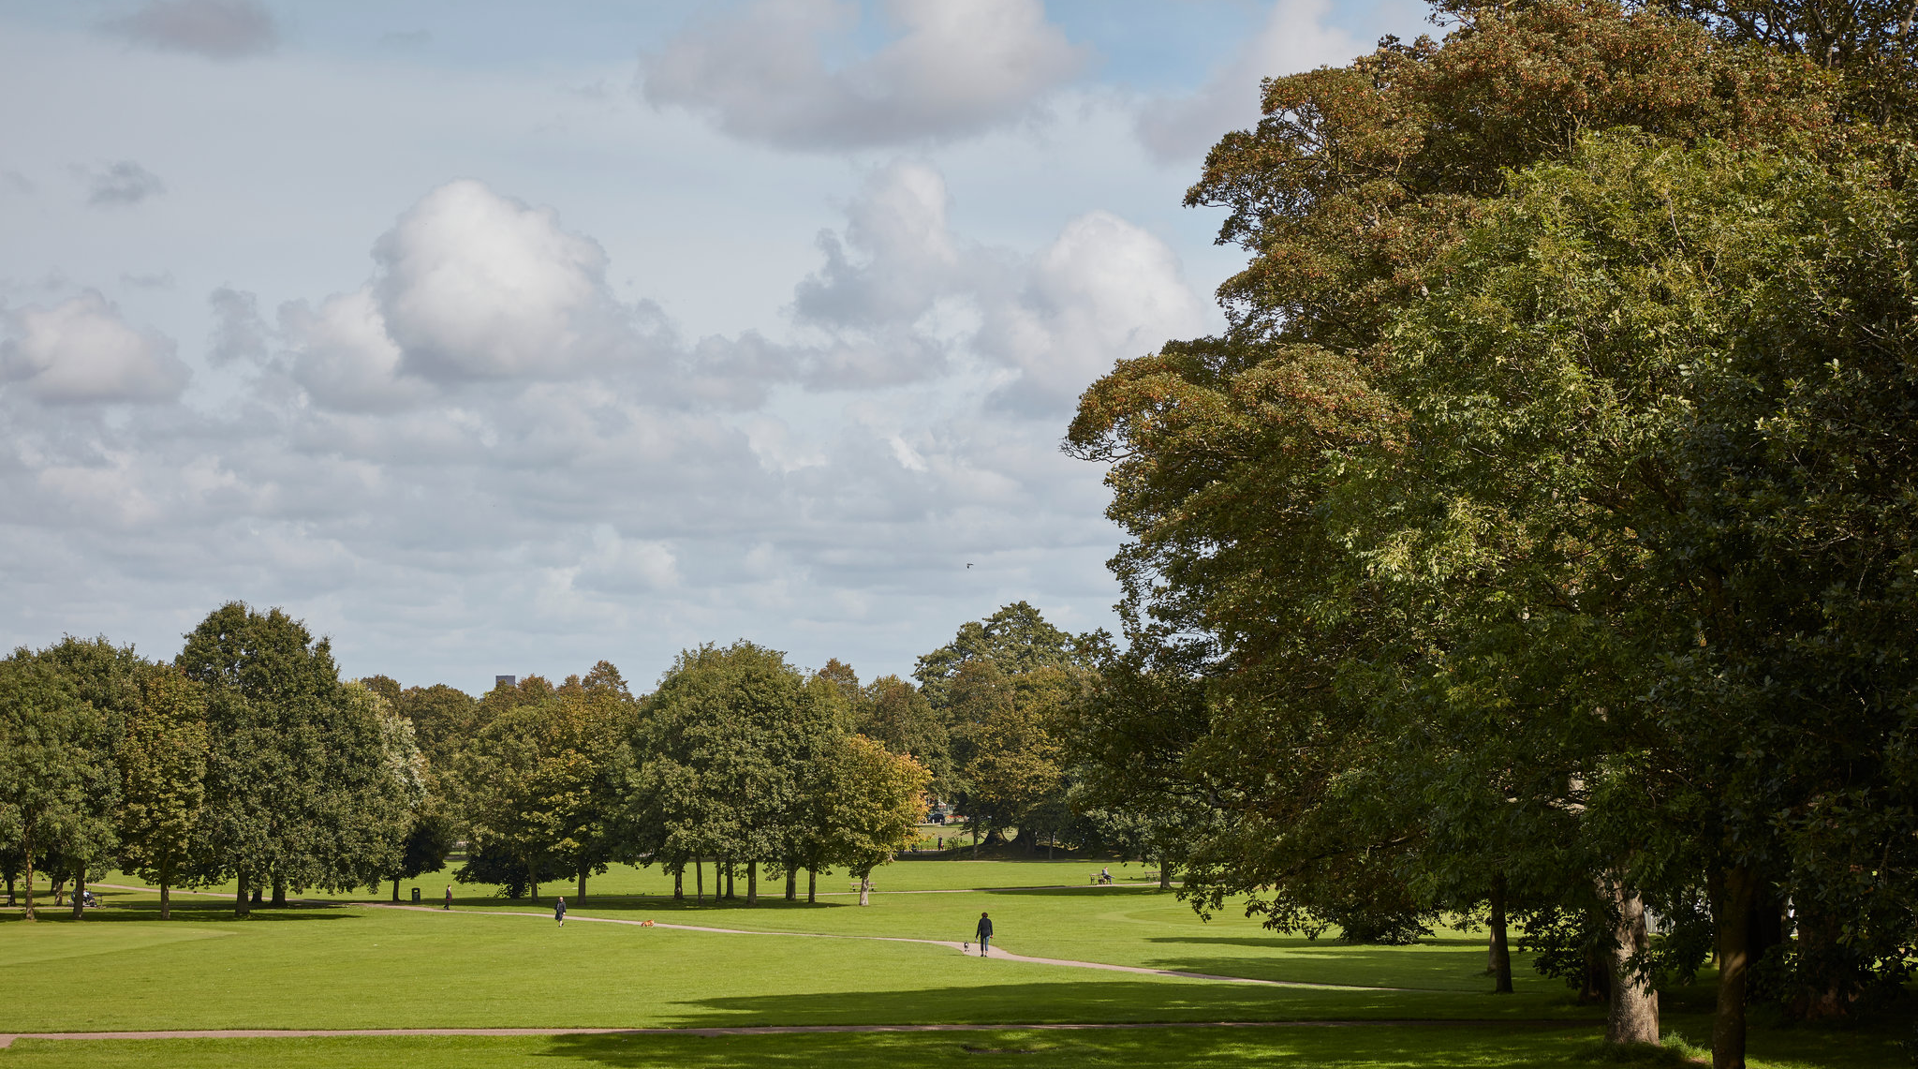
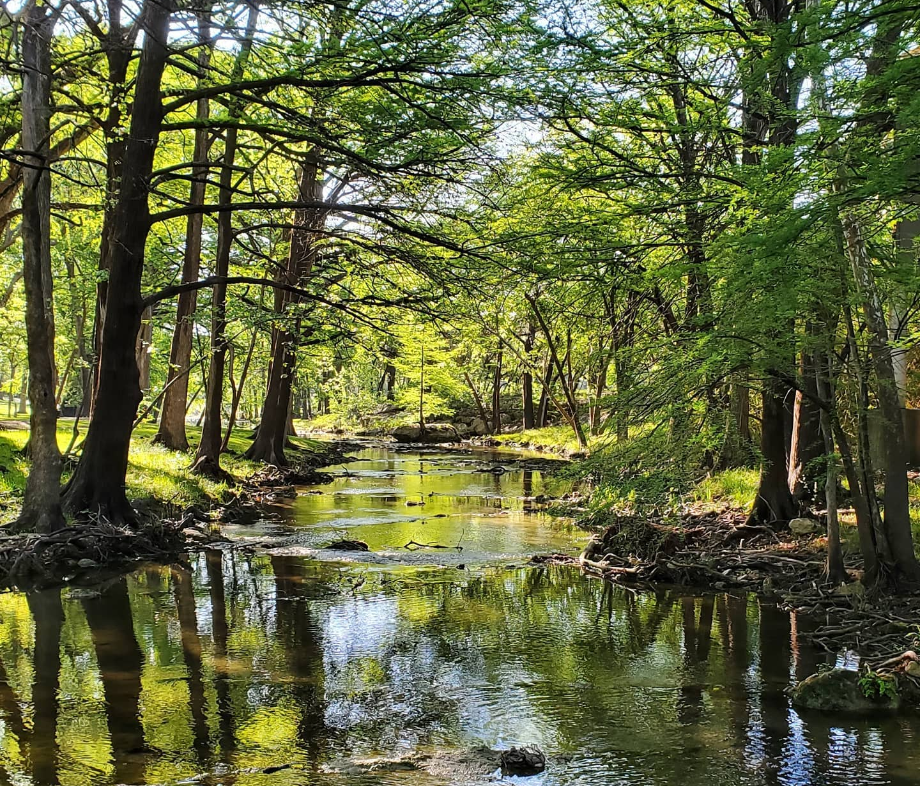
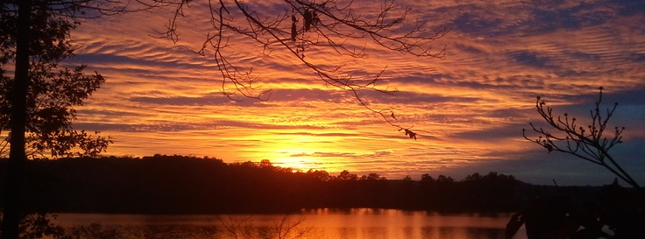
Do you love playing outside?
What are your favorite things to do outside?
Notes:
Hopefully the answer is yes

Slide 2
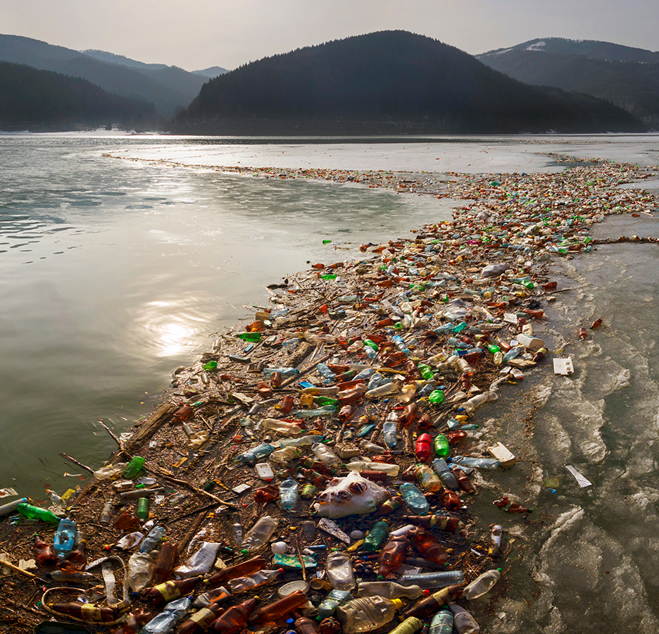
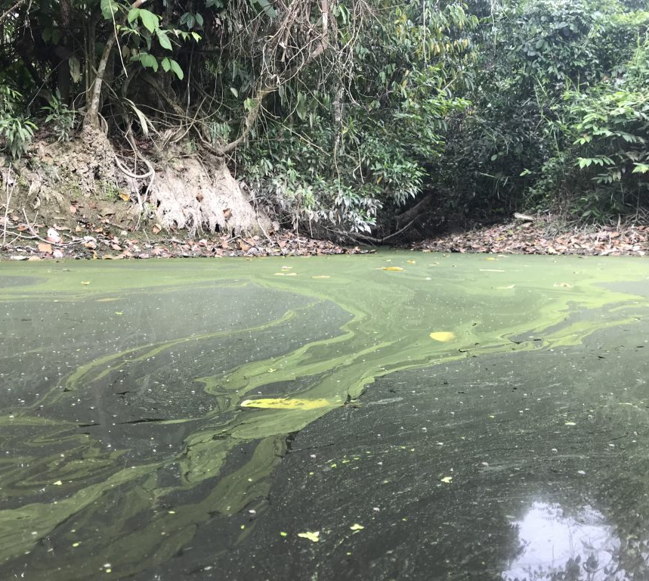
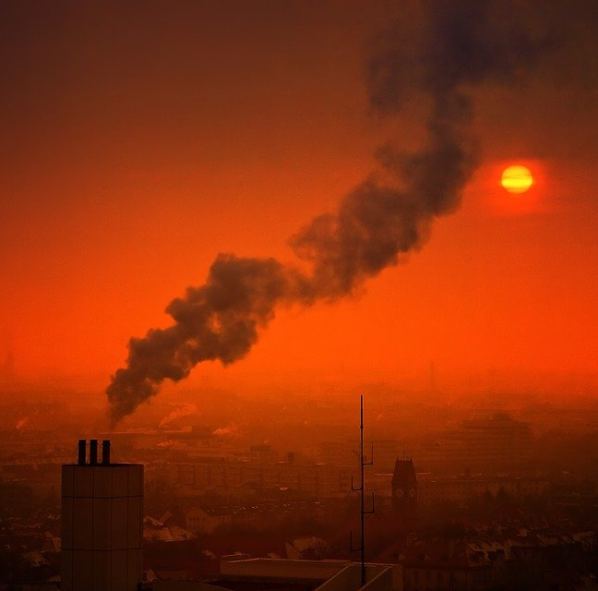
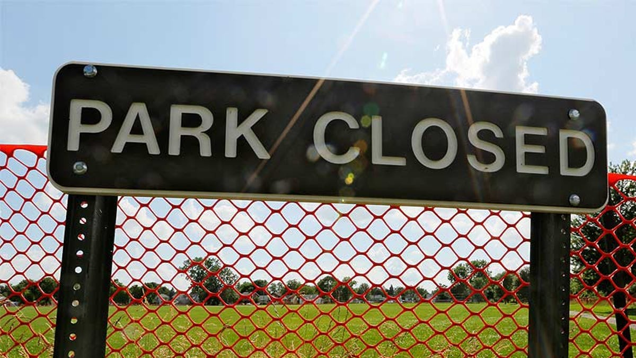
What if playing outside looked like this?
Notes:
Hopefully here they do not want to play outside

Slide 3


What is Environmental Engineering?
Dr. Leigh Terry, Jonathan Clayton, and Corinne Baroni
Train the Trainers / SciRen
Notes:
Environmental engineering is the application of engineering principles and skills to reduce the impact of human activity on the environment and public health.

Slide 4

What do plants and animals need to survive?
Think for a minute about this.
Do you have any pets at home? Do you have a garden or any plants around your house? If so, what do you do to take care of them?
Pair with a friend and share for a minute each.
Class discussion – share your answers!

Slide 5
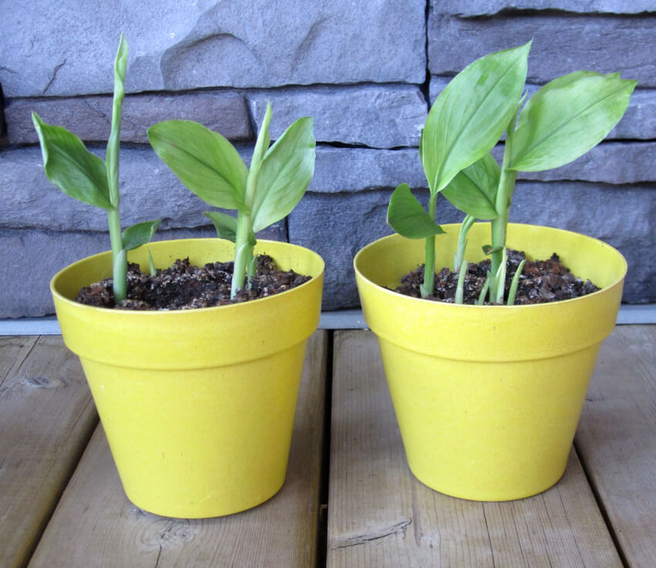

What do living things need to survive?
All animals need food, water, and air in order to survive.
  Animals obtain their food from plants and other animals.
Plants need water, light and air to survive.
Environmental engineers help keep air, water, soil, and all of our natural resources safe so that living things can stay healthy.

Slide 6

Environmental engineers help protect people, animals, and the environment from the harmful effects of pollution.
A pollutant is any substance that hurts the ecosystem or human health.
Pollutants can be from both human sources… can you name some?
Notes:
Examples has animation to come in.

Slide 7
Environmental engineers help protect people, animals, and the environment from the harmful effects of pollution.
A pollutant is any substance that hurts the ecosystem or human health.
Examples: cars, buildings, sewer systems, etc. and natural sources such as dust storms, erosion, volcanoes, animal wastes, and wildfires.
Notes:
Examples has animation to come in.

Slide 8
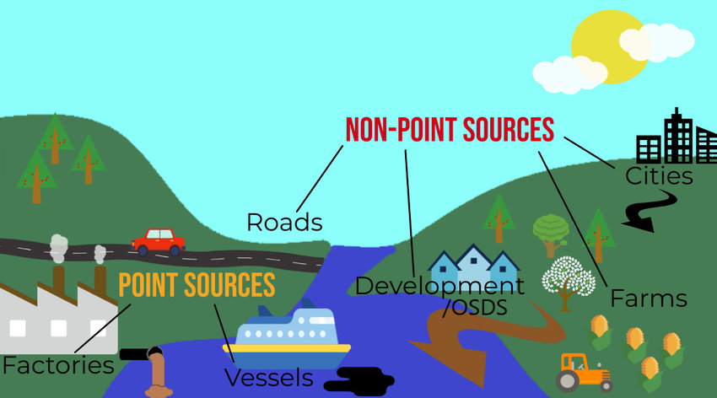
Point vs. Non-Point Sources
Point sources: where pollutants are released into the surrounding environment from one source.
Non-point source pollution: where pollutants are released by many small sources that are spread out.
Do you think urban (cities) or rural areas (farmland) experience more point source solution?
  Why?

Slide 9

Water Quality
All living things need clean water to survive: your family, your friends, your pets – every single plant, animal , and person on Earth must have clean water to live!

Slide 10
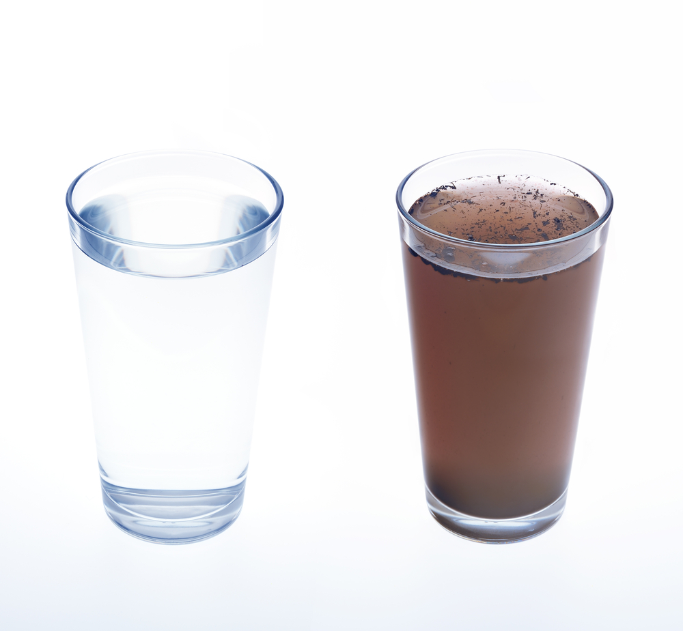
Environmental Engineers help keep water clean. They design systems to treat drinking water and wastewater.
Sometimes waterways can get polluted.
Have you ever seen litter on the side of the road? When it rains, this gets into our streams and rivers.
Remember point and non-point sources. Point sources can come from an industry producing waste. Non-point sources can come from too much loose soil on a large construction site getting into the water.
We have to remove waste, particles, and harmful pathogens from water for it to be safe to drink.

Slide 11
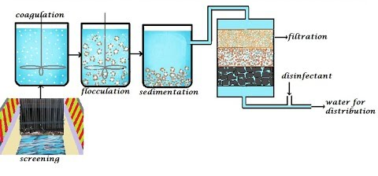
How is drinking water treated?
Dirty water is taken into the plant.
Screens remove large items, like the litter you see on the side of the road.
Smaller particles are settled out by gravity, like soil particles.
The water is filtered and disinfected to get rid of any remaining particles and kill any pathogens that make people and animals sick.
The clean water gets distributed to you!

Slide 12

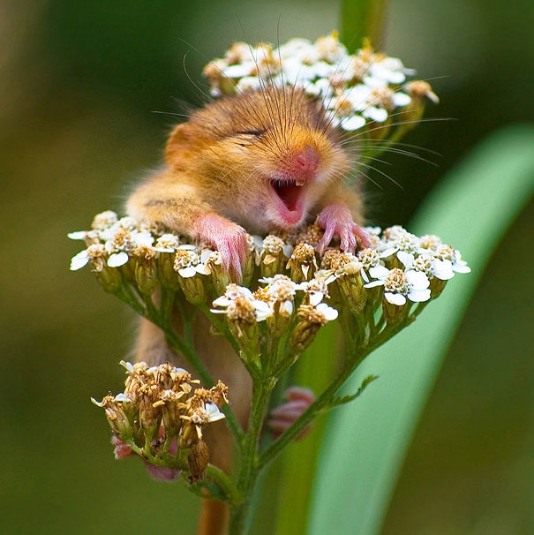
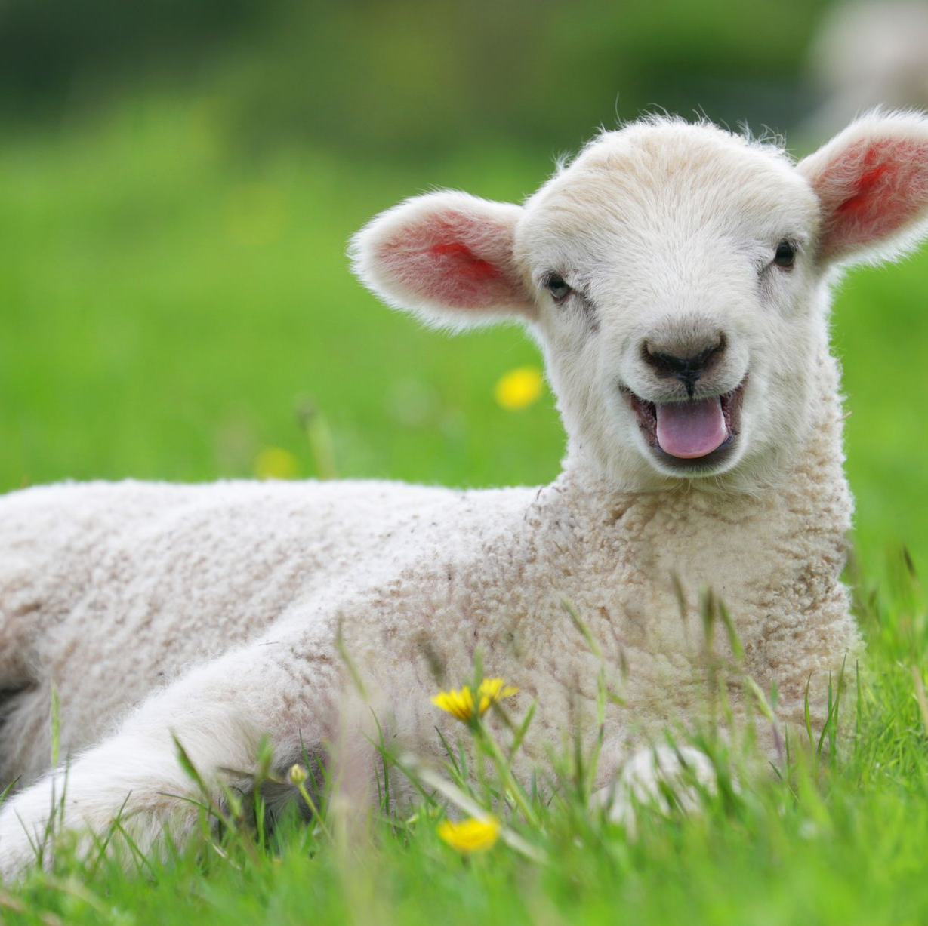
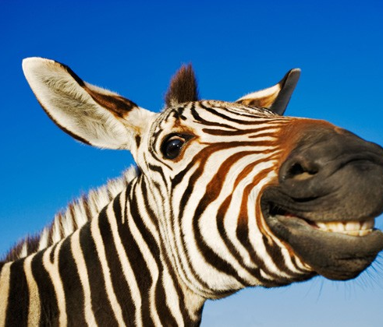
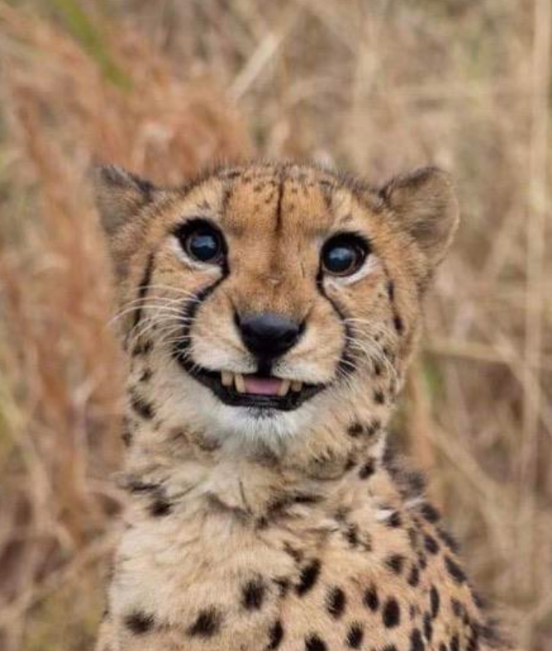

Clean water keeps us all of us safe!
That’s something to smile about!

Slide 13
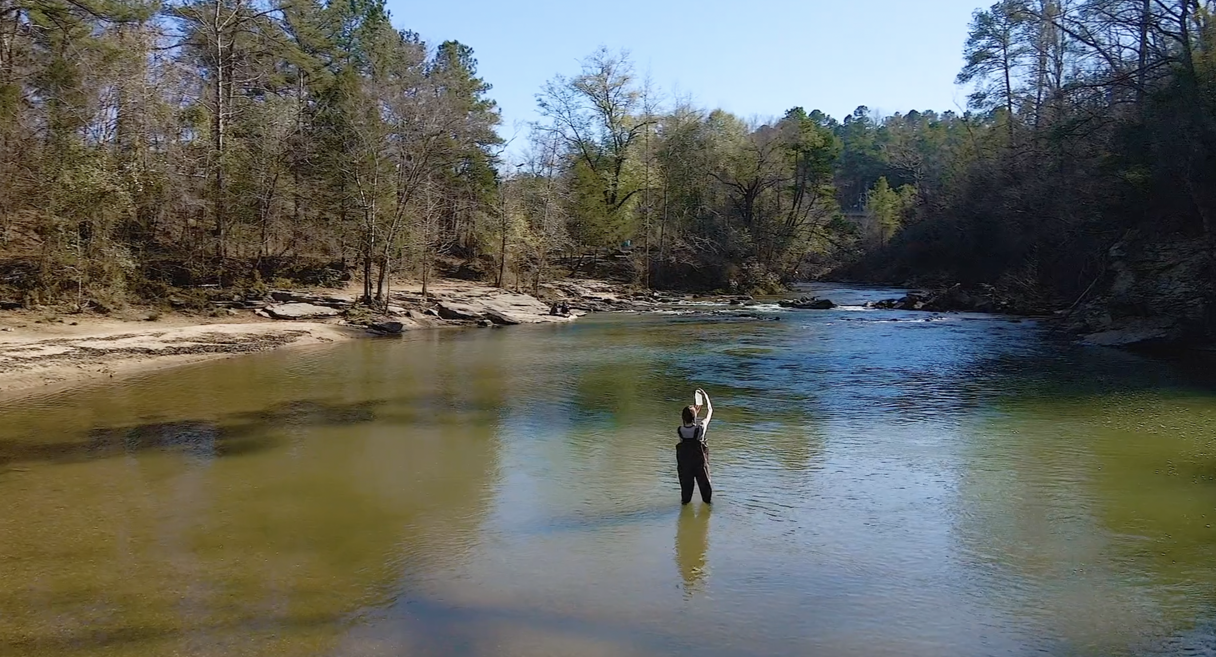
Where Can Environmental Engineering Take You?
As the climate crisis becomes increasingly pressing, people are valuing and investing in Environmental Engineering students.
Corinne Baroni & The John F. Ramsey Award: https://vimeo.com/674587412/e4413df7ea
The University is paying for her to travel to Europe this summer to study water quality abroad…
This can be YOU!!!!
Notes:
https://vimeo.com/674587412/e4413df7ea

Slide 14
Let’s Recap! Today we learned…
All animals need food, water, and air in order to survive.
Plants need water, light and air to survive.
Environmental engineers help keep air, water, soil, and all of our natural resources safe so that living things can stay healthy.
Pollutants harm health and can come from point or non-point sources.
How water is treated

Slide 15

What did you learn today? Any questions?

