Slide 1
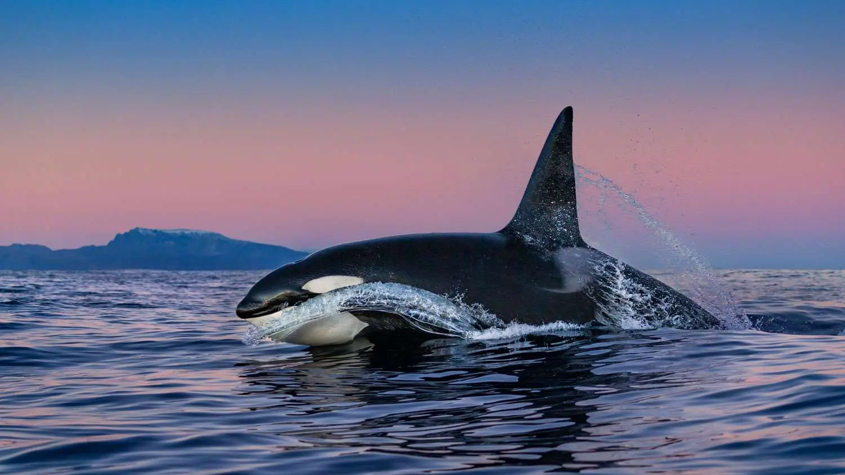
Do you speak whale?
Regina Guazzo, PhD
Oceanographer
U.S. Navy

Slide 2
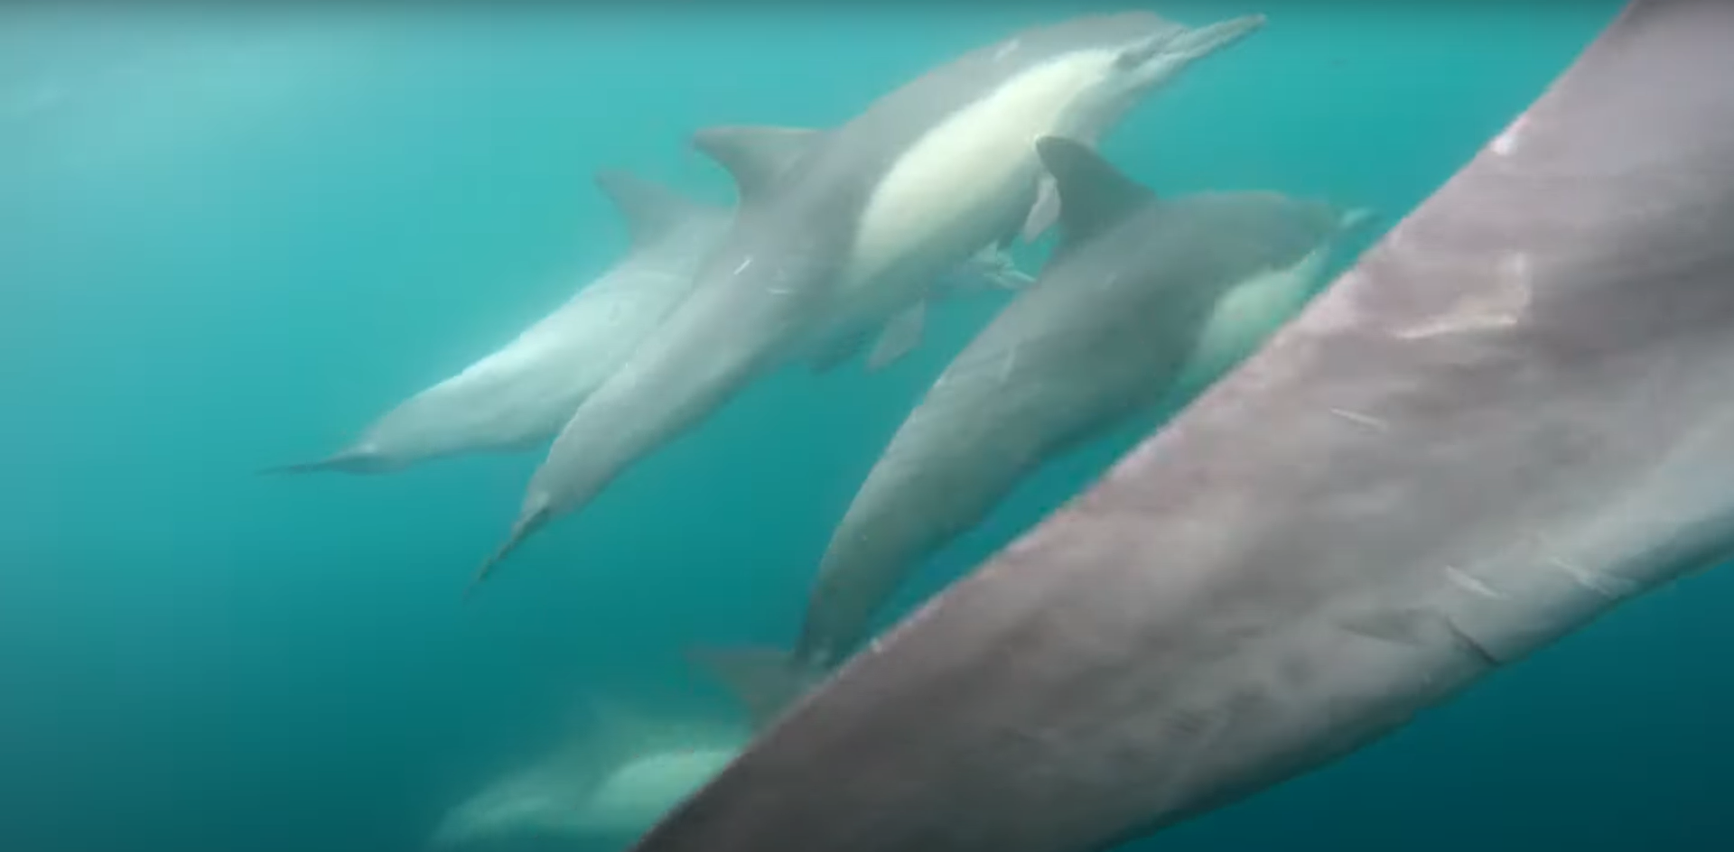
Notes:
What is happening in this picture? What do you think this picture sounds like? How do you know?

Slide 3
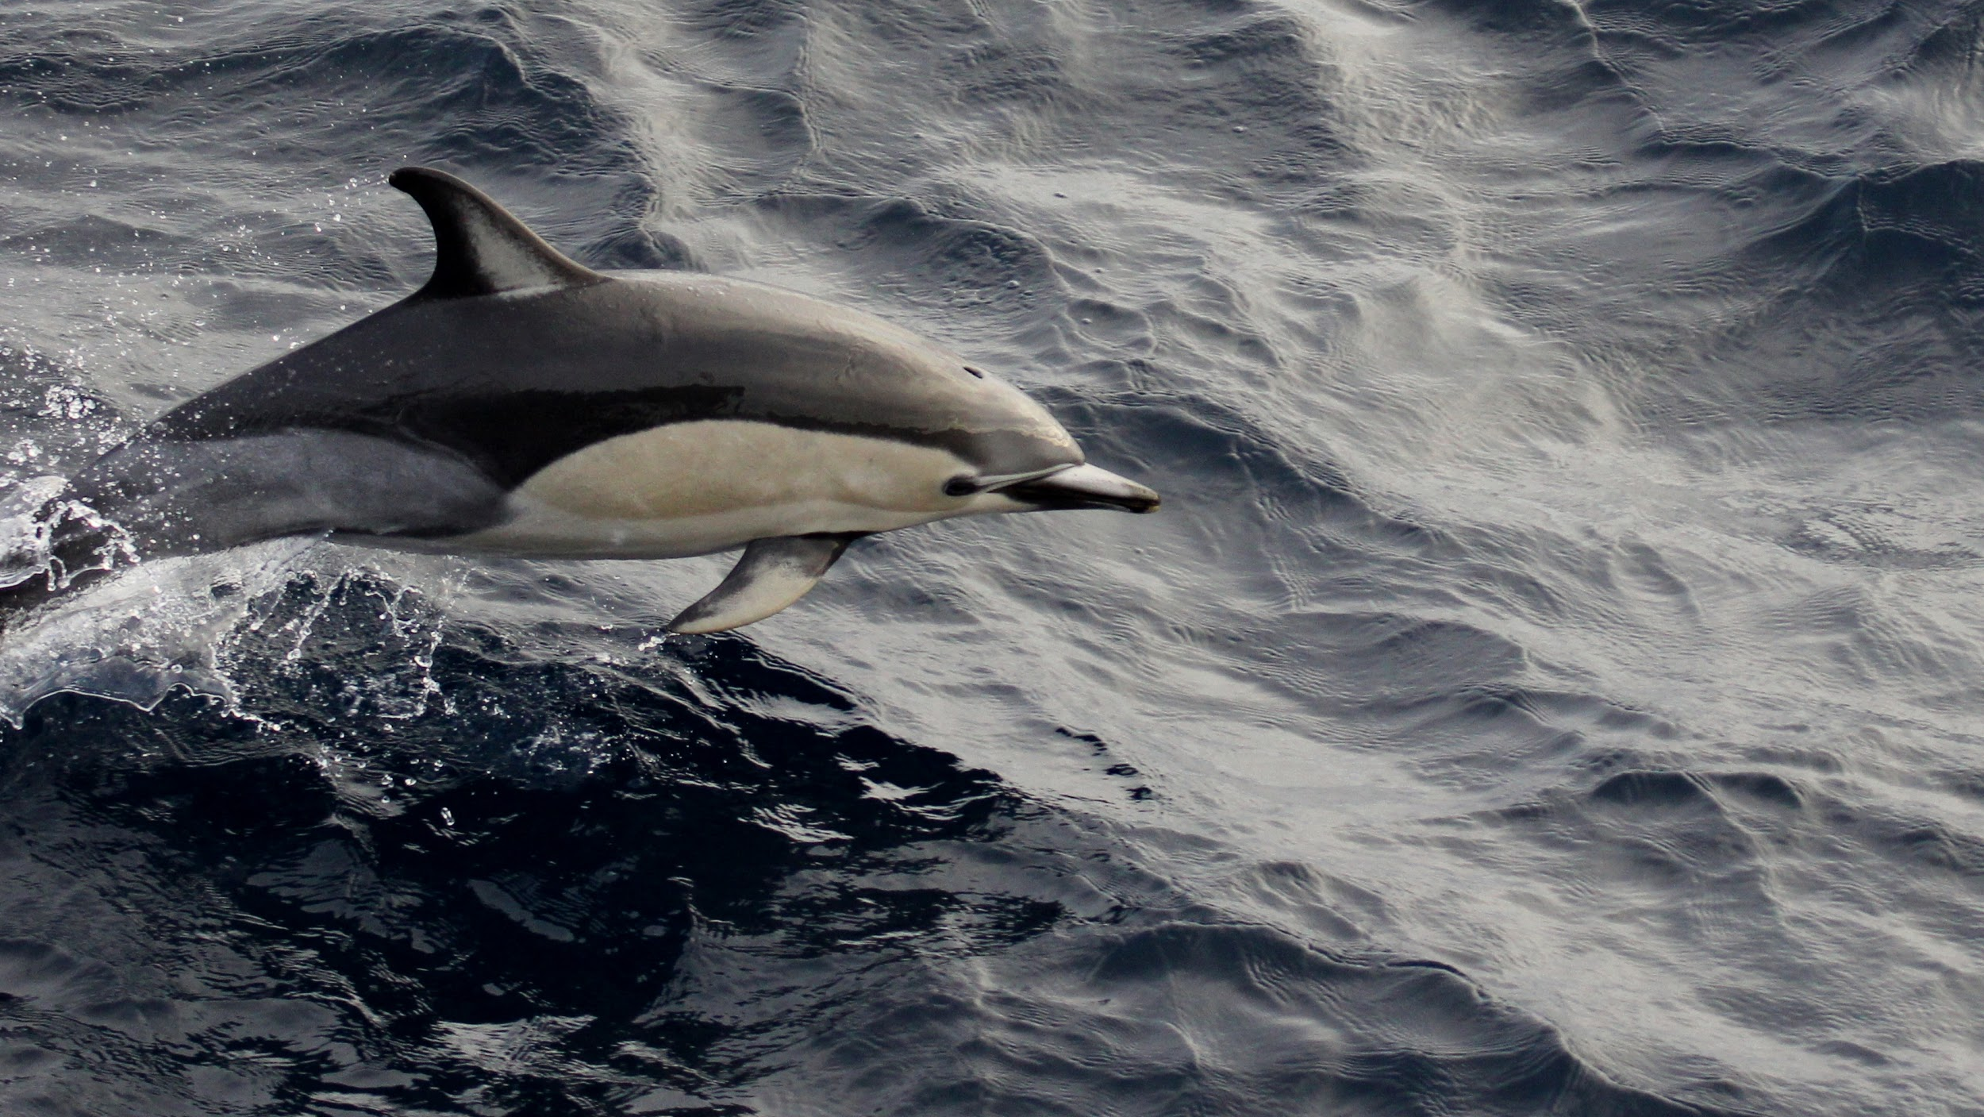
Game Time!
Notes:
Ask students to hold questions until the end of this section

Slide 4

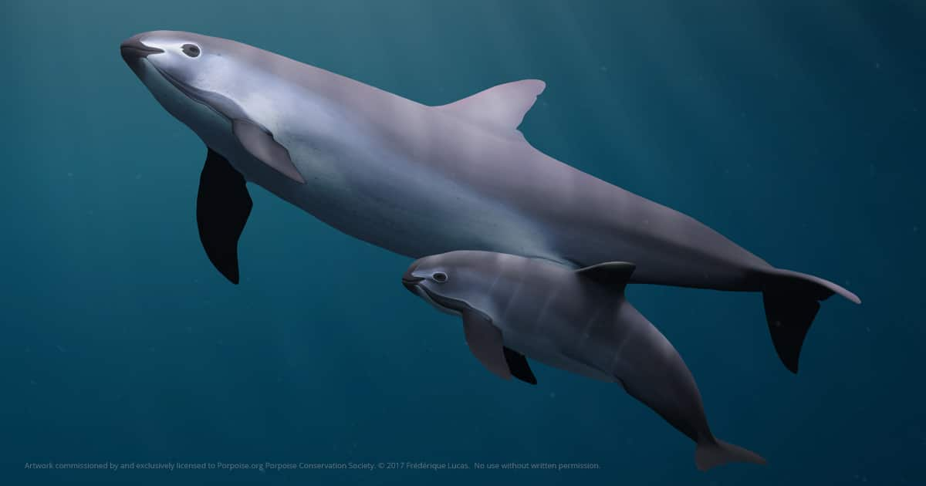
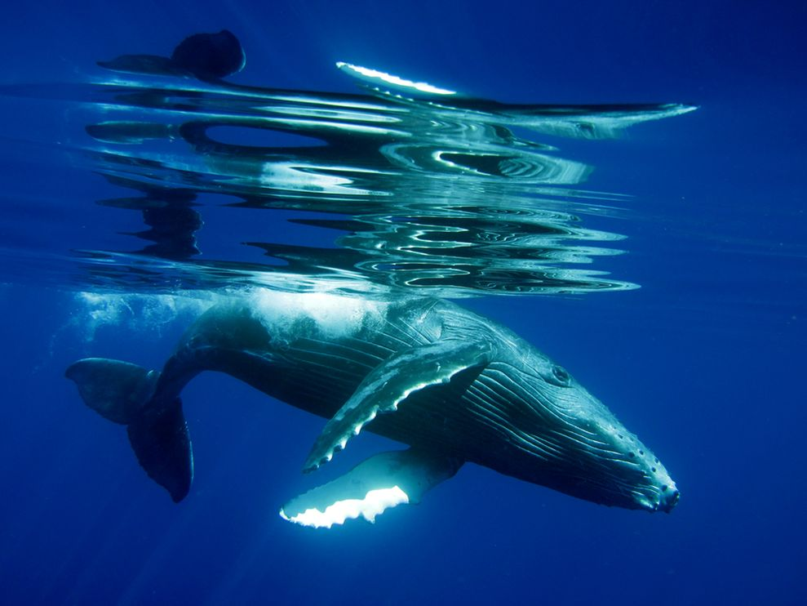
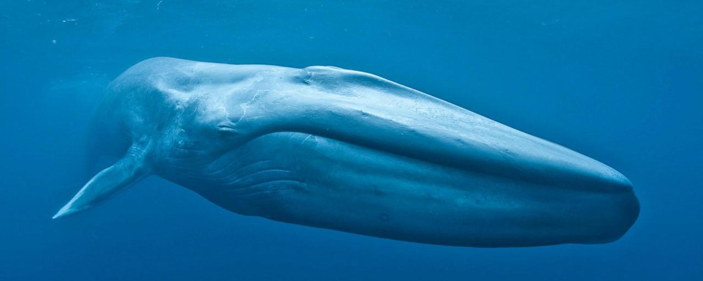

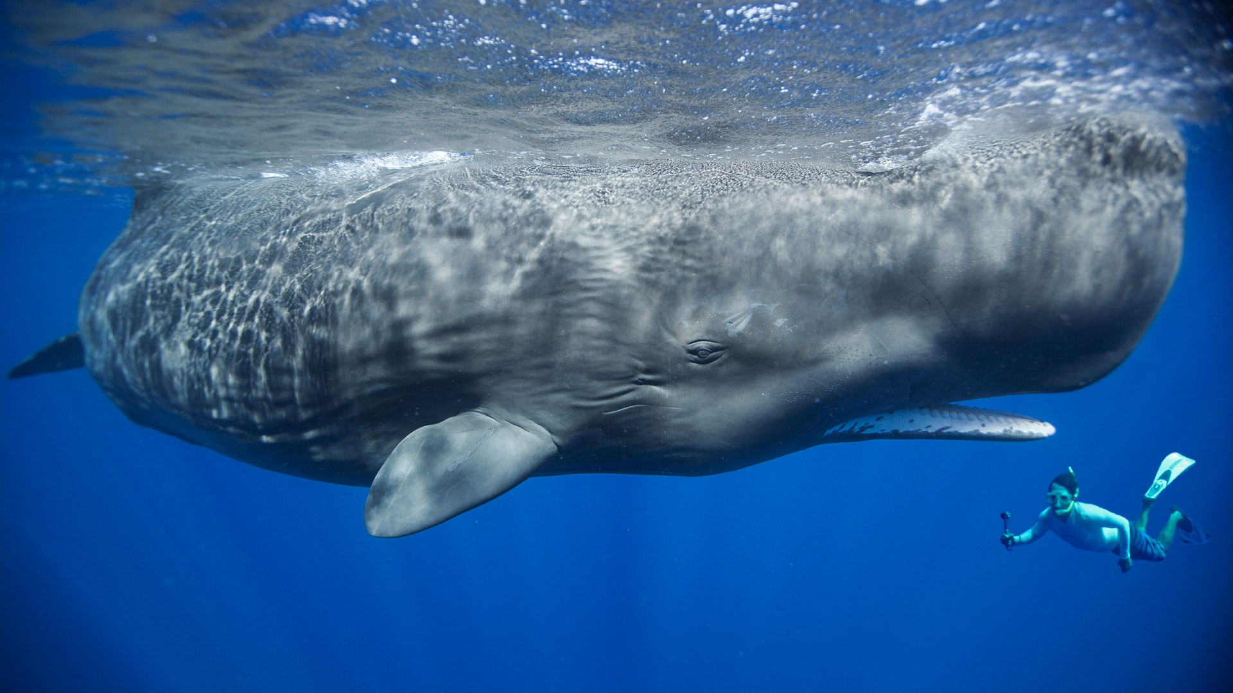
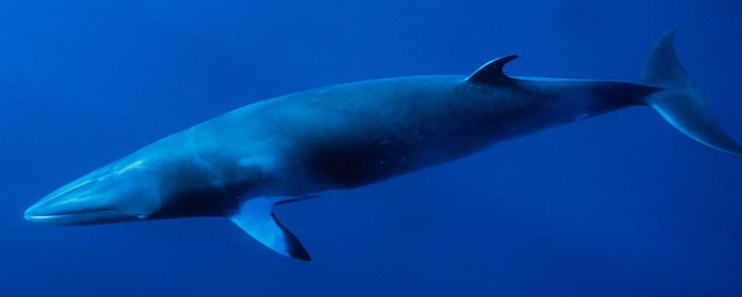
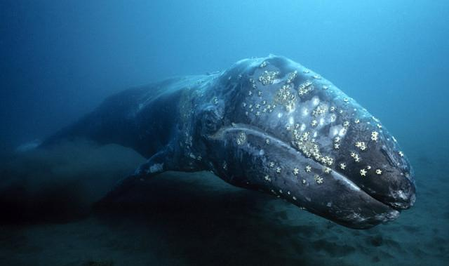
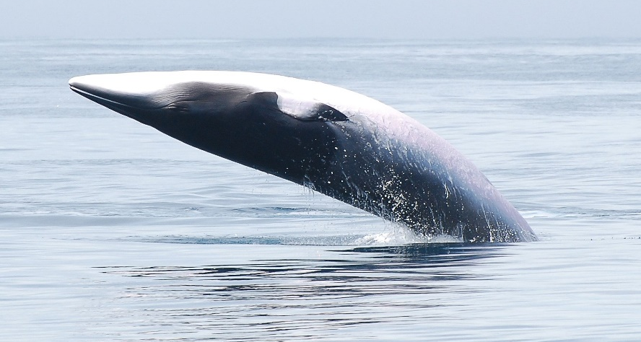
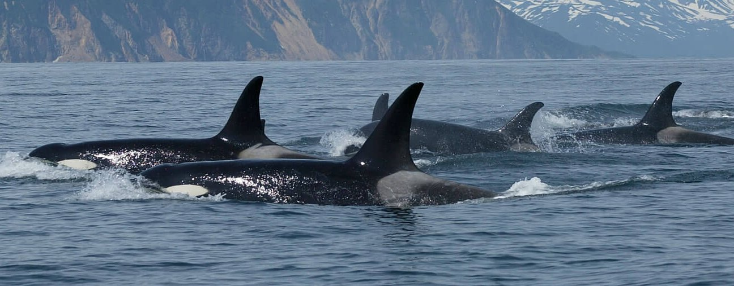
Guess Who!
HUMPBACK WHALE
BLUE WHALE
VAQUITA PORPOISE
COMMON DOLPHIN
SPERM WHALE
COMMON DOLPHIN
FIN WHALE
GRAY WHALE
KILLER WHALE
MINKE WHALE
Notes:
Humpback whale males sing long, complex songs that can last for an hour or more!
We think they sing these songs to attract a mate.
Every male in the population sings the same song each winter and the song changes slightly from year to year.
More information: https://www.fisheries.noaa.gov/species/humpback-whale

Slide 5
Guess Who!
BLUE WHALE
VAQUITA PORPOISE
COMMON DOLPHIN
SPERM WHALE
COMMON DOLPHIN
FIN WHALE
GRAY WHALE
KILLER WHALE
MINKE WHALE
Notes:
Common dolphins are very common to see!
They live in large groups that can sometimes include thousands of other dolphins. These large groups are called a “super pod”
They are constantly making clicks to echolocate (use sound to “see” underwater) and whistling to communicate with each other
If you go out on a boat, you will often see them surfing the waves of the boat and leaping out of the water
More information: https://www.fisheries.noaa.gov/species/short-beaked-common-dolphin

Slide 6
Guess Who!
BLUE WHALE
VAQUITA PORPOISE
SPERM WHALE
FIN WHALE
GRAY WHALE
KILLER WHALE
MINKE WHALE
Notes:
This sound is a fin whale male song. It is sped up so that you can hear it because it is produced at such low frequencies, we would need fancy speakers to be able to hear it! Fin whale males produce their low-frequency pulses in precise patterns of rhythms and frequencies. These sounds are also extremely loud (high amplitude) and can be heard by other whales many miles away.
More information: https://www.fisheries.noaa.gov/species/fin-whale

Slide 7
Guess Who!
BLUE WHALE
VAQUITA PORPOISE
SPERM WHALE
GRAY WHALE
KILLER WHALE
MINKE WHALE
Notes:
Vaquita porpoises produce these clicks. Vaquitas are the smallest whale species and grow to lengths of 4-5 ft! They are also the most endangered species with less than 30 individuals left. They only live in the northern part of the Gulf of California. They are so endangered because they become entangled in nets that people are using for fishing.
More Information: https://www.fisheries.noaa.gov/species/vaquita

Slide 8
Guess Who!
BLUE WHALE
SPERM WHALE
GRAY WHALE
KILLER WHALE
MINKE WHALE
Notes:
Minke (pronounced mink-ee) whales produce this bizarre “boing call”. The sound is so strange that it took scientists almost 40 years from when they first heard the sound to figure out that the minke whale was making it! Scientists towed a hydrophone (underwater microphone) behind a boat and kept driving in the direction that the sound was coming from. Eventually they found the minke whale! A lot is still unknown about these elusive whales!
More information: https://www.fisheries.noaa.gov/species/minke-whale

Slide 9
Guess Who!
BLUE WHALE
SPERM WHALE
GRAY WHALE
KILLER WHALE
Notes:
Sperm whales are the largest species of toothed whales (odontocetes) and use clicks to communicate with each other and to echolocate. They dive deep in the ocean in search of their squid prey. They make these intense clicks which bounce off whatever is in front of them. When the whale hears the echo from their click, it is able to tell what is in front of them and how far away it is from them. As they get closer to their prey, they click faster and faster until their clicks sound like a creak, which is when they are grabbing the squid. Although we have never seen a sperm whale eating a squid, sperm whales often have scars on their body from squid suckers, so we think they are probably battling each other in the dark.
More information: https://www.fisheries.noaa.gov/species/sperm-whale

Slide 10
Guess Who!
BLUE WHALE
GRAY WHALE
KILLER WHALE
Notes:
Killer whales are one of the top marine predators. Different groups of killer whales specialize in different prey. Some killer whales only eat fish. Those killer whales whistle to communicate while they are hunting their prey and use clicks to echolocate and find their prey. Other killer whales only eat other marine mammals. Those killer whales hunt silently since their prey have such good hearing. Killer whale grandmothers often lead the pods and teach the younger whales their group’s hunting technique.
More information: https://www.fisheries.noaa.gov/species/killer-whale

Slide 11
Guess Who!
BLUE WHALE
GRAY WHALE
Notes:
Blue whales are the largest animal to ever live and can reach lengths of over 100 ft (almost the length of 3 school buses) and weights of up to 330,000 lbs (about the weight of 25 male African bush elephants)! Blue whales can be seen feeding on krill off the coast of San Diego in the summer. The calls you are hearing are known as D calls and are associated with feeding.
More information: https://www.fisheries.noaa.gov/species/blue-whale
**we will come back to the gray whale**

Slide 12
What sound characteristics can help you distinguish between species?
BLUE WHALE
VAQUITA PORPOISE
HUMPBACK WHALE
COMMON DOLPHIN
SPERM WHALE
COMMON DOLPHIN
FIN WHALE
GRAY WHALE
KILLER WHALE
MINKE WHALE
Notes:
Example Responses:
Frequency - some whales make higher pitched sounds (shorter wavelength), other whales make lower pitched sounds (longer wavelength)
Type of sound - some whales click, others whistle, some make groaning sounds

Slide 13
Why do you think some of the characteristics you observed are different in different species?
BLUE WHALE
VAQUITA PORPOISE
HUMPBACK WHALE
COMMON DOLPHIN
SPERM WHALE
COMMON DOLPHIN
FIN WHALE
GRAY WHALE
KILLER WHALE
MINKE WHALE
Notes:
Frequency: larger whales tend to make lower frequency sounds, smaller whales tend to make higher frequency sounds
Types of sound: Whales with teeth (Vaquita, dolphins, sperm whale, killer whale) echolocate to find their prey and whistle to communicate. These whales make a larger variety of sounds.
Whales with baleen (humpback, blue, fin, gray, minke) make group calls (a few call types for the entire group) and some species have males that sing songs.
Low frequency sounds can travel over longer distances than high frequency sounds. Baleen whales are often spread apart from other members of their species and can use their calls to communicate many miles!
Toothed whales do not need to communicate as far since they form tighter groups and are instead communicating and coordinating between whales that are nearby

Slide 14
What do you think the gray whale sounds like?
BLUE WHALE
VAQUITA PORPOISE
HUMPBACK WHALE
COMMON DOLPHIN
SPERM WHALE
COMMON DOLPHIN
FIN WHALE
GRAY WHALE
KILLER WHALE
MINKE WHALE
Notes:
Hints: gray whales have baleen and are about 45 ft long (sped up 1.5x to make it audible)
Gray whales are famous for their long migrations between Alaska and Baja California every year. These calls were recorded while they were migrating. Gray whales are a conservation success story. They were once hunted to only a few thousand individuals, but now approximately 30,000 gray whales travel through California waters every year!
More information: https://www.fisheries.noaa.gov/species/gray-whale

Slide 15
Notes:
Revisit the photo from the beginning if there is time. Can watch the video at: https://www.youtube.com/watch?v=n9baocz2qvY&ab_channel=brianorca

