Slide 1

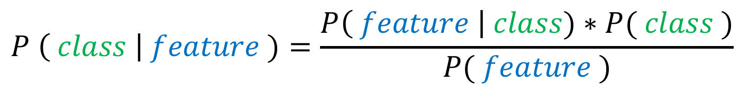
Bayes' Rule
The equation:
$$P \left( class \right| feature )=\frac{P\left( feature \right| class)∗P( class )}{P( feature )}$$
Let’s take our cat example. Our classes are then “is a cat” or “is not a cat”. Let’s pick the feature “has hair”
In words:
The probability that the image is a cat given that it contains hair is the probability that cat images have hair times the probability of there being a cat image divided by the probability of there being hair in an image.
This should seem intuitive to you. We do this calculation subconsciously in our heads all the time!!!

Slide 2

The Decision Rule
The equation:
$${Class}^{∗}={ArgMax}_{class} \left( P \left( class \right| feature \right))$$
In words:
The most likely class is the class with the maximum probability given the feature
An example:
Think of a medical doctor giving a diagnosis to a patient based on their symptoms. In this case the disease is the class and the symptoms are the features
A simplified case:
P( cough | fever )*P( fever ) = 0.3
P(cough | cold )*P( cold) = 0.7
P( cough | flu )*P( flu ) = 0.5
Doctor picks cold!

Slide 3
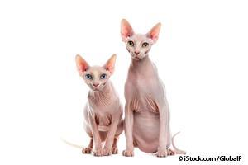
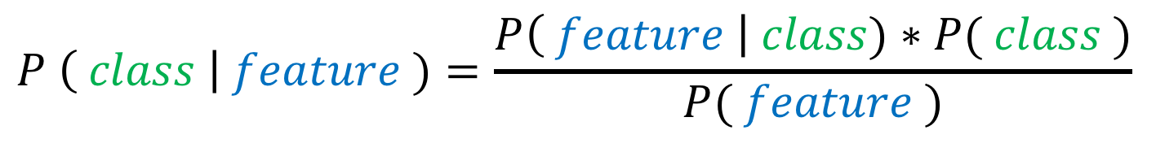
$$P \left( class \right| feature )=\frac{P\left( feature \right| class)∗P( class )}{P( feature )}$$
Thinking back on the exercise where did the algorithm succeed? Where did it fail?
What were some of the features in cases that failed?
The Hairless Sphinx Cat!!!
P ( no hair | cat ) is very low!!!! Therefore the algorithm often misclassifies!

Slide 4



Machine learning and Data
So how do we find these probabilities?
From data! We collect lots of data and it to estimate the probabilities. The process of estimating the probabilities based on data is known as “training” or “learning”. The more data the better the estimate. You also want to make sure your data is truly representative of the real-life problem you are trying to solve.
This is why many tech companies (Google, FB, Amazon, TikTok) collect data on their users. The more data they have, the better their algorithms will perform.
How do we pick features?
We can either manually pick the features we want to use for classification, or we can use sophisticated models (such as neural networks) that learn the best features during their training. Features are represented as mathematical functions of the pixel values in the image. The details can be quite advanced and requires more math that you will be exposed to in college.

